Slide 1
Final Project
Hamza Ali
Rania Jamal
Riham Khan
Ali Chahbandar

Slide 2
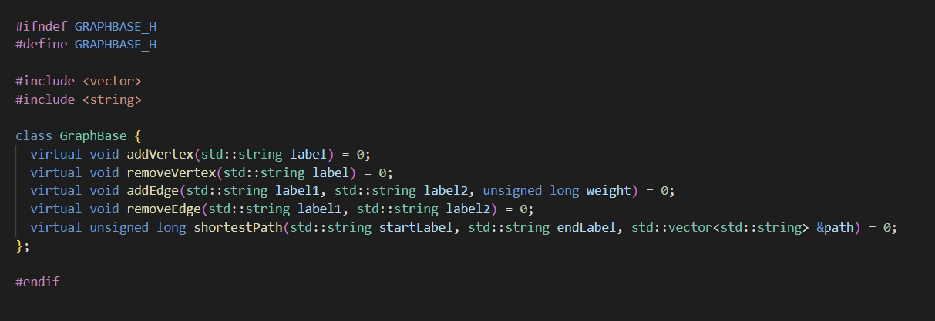
GraphBase.hpp (Given Header file)

Slide 3
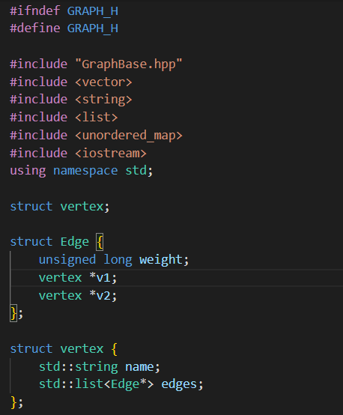
Header (Part 1)
The first header file of this project, Graph.hpp, includes the essential boilerplate for constructing and manipulating a graph data structure in C++.
By embracing vertices, edges, and their relationships, this framework promotes versatility in addressing various graph-related tasks across many applications.
This portion of code includes a series of libraries that will be used for defining the fundamental components of a graph data structure, such as vertices, edges, and their relationships.
Beneath the libraries are some of the structures: vertex and edge. Each Edge contains data members, weight which clearly holds the weight of the edge, while v1 and v2 are the vertices that the edge is incident on.

Slide 4
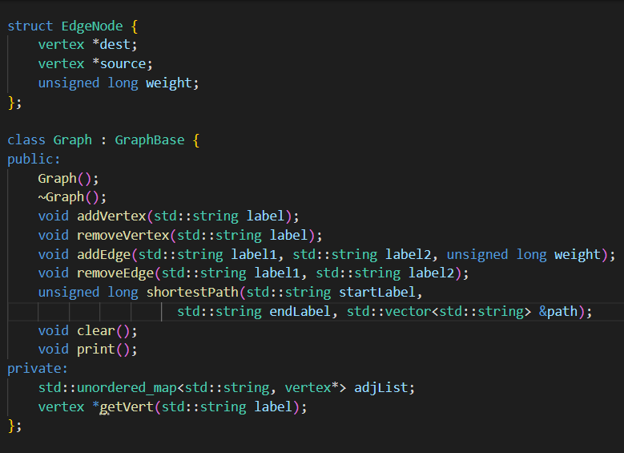
Header (Part 2)
In essence, Graph.hpp serves as the cornerstone for graph-based solutions, offering a strong toolkit for navigating complex networks and relationships within software applications.
With a comprehensive set of functions for adding and removing vertices, establishing and deleting edges, and computing the shortest path via Dijkstra's algorithm, this header file lays the groundwork for efficient graph operations.

Slide 5
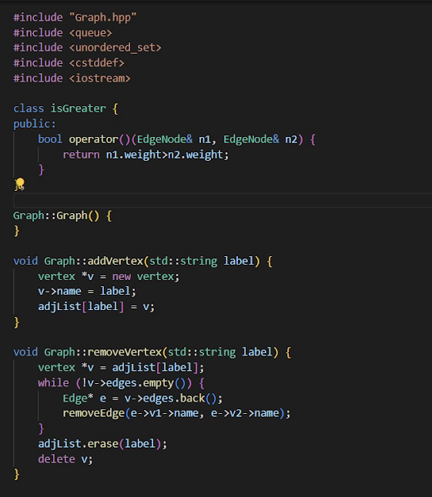
Graph.cpp (Part 1)
The file Graph.cpp is comprised of all the function definitions that were declared in both header files, providing fundamental operations for vertex and edge manipulation within the graph data structure.
The IsGreater class defines an operator that is used for comparing different EdgeNode objects based on their weights, enabling the sorting arrangement within a priority queue.
The addVertex() function is a void function that takes a string for the name and allocates memory for a new vertex and adds it to the adjacency list.
The removeVertex() function, also a void function, locates the vertex to be removed from the adjacency list, then it proceeds to delete all edges connected to the vertex and removes the vertex itself from the list, releasing the memory that was allocated.

Slide 6
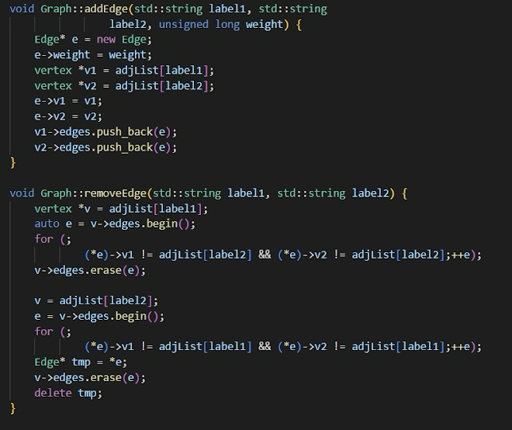
Graph.cpp (Part 2)
The addEdge() function, another void function, establishes a connection between two vertices identified by their labels, assigning a weight to the edge. This connection is reflected by adding the edge to the lists of adjacent edges for both vertices involved.
Similarly, the removeEdge() function, also void, searches for the edge connecting two specified vertices and removes it from their respective lists of adjacent edges. This action effectively severs the connection between the two vertices.

Slide 7
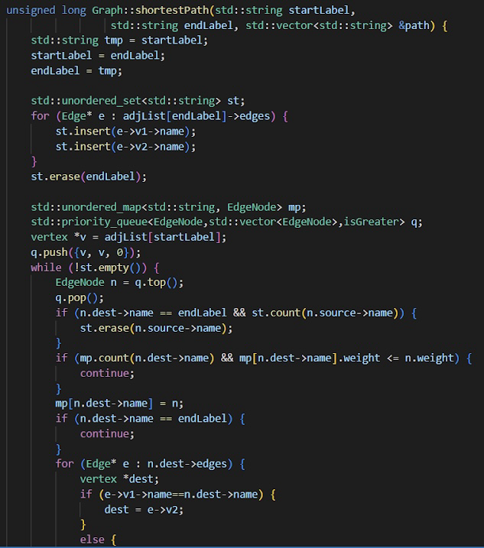
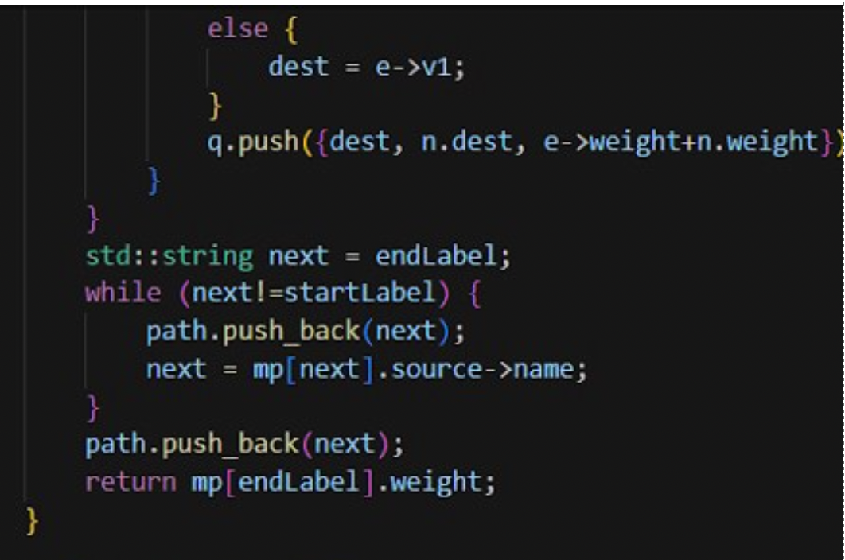
Graph.cpp (Part 3)
The shortestPath() function calculates the shortest path between two specified vertices within the graph. Using Dijkstra's algorithm, it determines the most efficient route based on the weights of the edges connecting the vertices. The function returns the shortest path as a vector of vertex labels traversed from the starting vertex to the destination vertex, and it also provides the length of the shortest path.
Within the shortestPath() function, the logic follows the Dijkstra's algorithm to efficiently find the shortest path. Initially, the function sets up a priority queue to store candidate paths, prioritized by their weights. It then iteratively explores neighboring vertices, updating the shortest path to each vertex as it progresses. This iterative process continues until the we reach the destination vertex, ensuring that the shortest path from the starting vertex to every other vertex is calculated. By employing a combination of data structures like unordered sets and maps, along with the priority queue, the function efficiently explores the graph, ultimately delivering the shortest path with optimal time complexity.

Slide 8
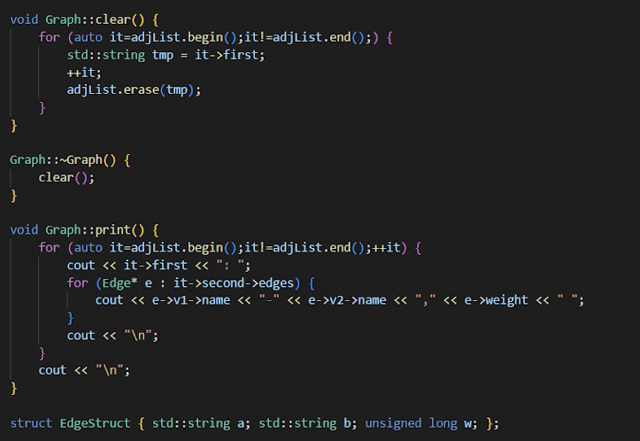
Graph.cpp (Part 5)
The clear() function removes all vertices and edges from the graph, efficiently resetting it to an empty state.
The ~Graph() deconstructor is called when we're done using a Graph object, it simply just runs the clear function. This helps avoid memory leaks.
The print() function iterates through the adjacency list and displays the vertices along with their adjacent edges and respective weights, providing a visual representation of the graph's structure.
The EdgeStruct{} defines a simple structure encapsulating data about an edge, including the labels of the vertices it connects (a and b) and the weight of the edge (w).

Slide 9
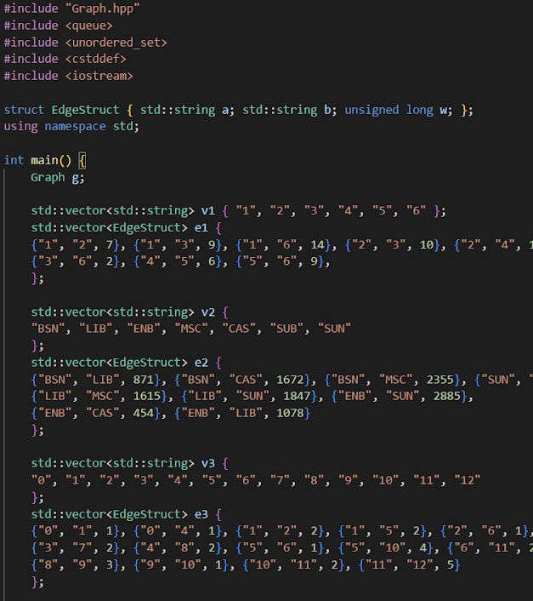
Main.cpp (Part 1)
Finally, let's execute our files and put our code to the test!
But first, in order to do so, we have to represent our vertices and edges by using v as a vector the represents vertices, and e as a vector from EdgeStruct that represents edges.
These are setting up three different graphs, from the simplest to more complexed concepts.

Slide 10
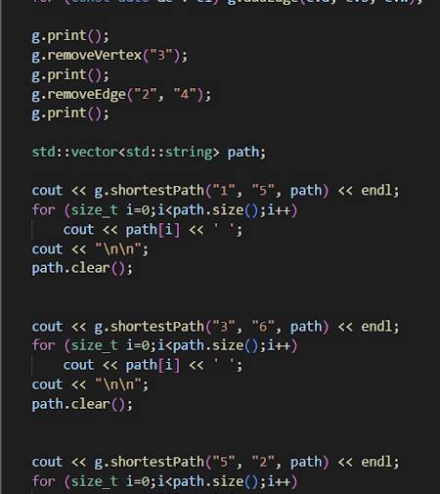
Main.cpp (Part 2)
As every vertice and edges are getting removed, the graph get printed each time. The purpose of this is to the change in structure of the graph.
Now the shortestPath function is implemented. This shows the shortest path by listing the least number of vertices between the pair of vertices called in the shortestPath function.
The vertices are then cleared from the path vector, ready to store new vertices when the shortestPath function is called

