Slide 1
Expense constrained bidder optimization in repeated auctions
Ramki Gummadi
Stanford University
(Based on joint work with P. Key and A. Proutiere)

Slide 2
Overview
Introduction/Motivation
Budgeted Second Price Auctions
A General Online Budgeting Framework
Optimal Bids for Micro-Value Auctions
Conclusion

Slide 3



Three Aspects of Sponsored Search
Sequential setting.
2. Micro-transactions per auction.
3. The long tail of advertisers
is expense constrained.
Notes:
Fundamental qn: why bother with additional constraints when utility function we defined is already taking into account the expense.
So maybe they exist, but is the effect significant?

Slide 4
Motivation: Expense Constraints
Payments are explicit, but valuations are abstract.
Significantly alters bidding behavior.
Critical for advertisers in the long tail.
Notes:
Fundamental qn: why bother with additional constraints when utility function we defined is already taking into account the expense.
So maybe they exist, but is the effect significant?

Slide 5

Modeling Expense Constraints
Fixed budget over finite horizon => any balance at time $T$ is worthless.
B
Balance
0
T
time

Slide 6
Modeling Expense Constraints
Stochastic fluctuations could cause spend rate different from target.
B
Balance
0
T
time

Slide 7
Modeling Expense Constraints
“…the nature of what this budget limit means for the bidders themselves is somewhat of a mystery. There seems to be some risk control element to it, some purely administrative element to it, some bounded-rationality element to it, and more…”
-- “Theory research at google”, SIGACT News, 2008.

Slide 8

Modeling Expense Constraints
Add a fixed income, $a$ per unit time to the balance and relax time horizon.
B
Balance
0
time

Slide 9
Responsibility for expense constraints
Auctioneer | Bidder
Bids fixed -- Auction entry throttled. | Bids adjusted dynamically.
Online bipartite matching between queries and bidders. | Online knapsack type problems.
Expense constraints = fixed budget. | Possible to model more general expense constraints.

Slide 10
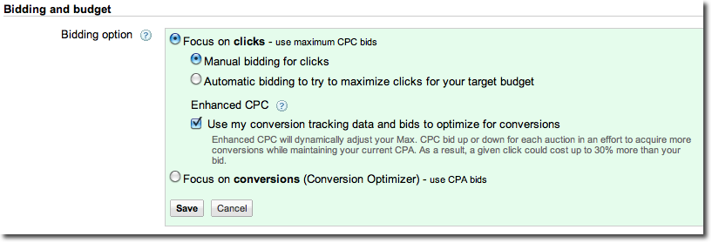
Bid optimization

Slide 11
Modeling aspects
Expense constraints include a running balance constraint together with a fixed income per time slot.
Random i.i.d. environment models aggregate statistics.
-- observable and non-observable components.
Bids are lower because any money saved can instead be used to buy a cheaper auction in the future.
Objective function is infinite horizon expected utility, but with a discount factor that models limited patience.

Slide 12
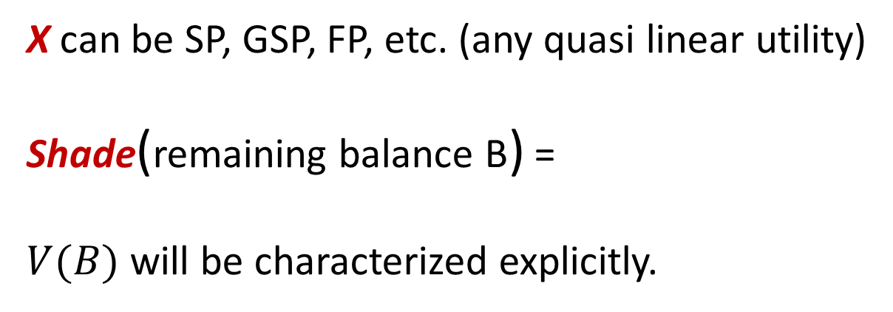
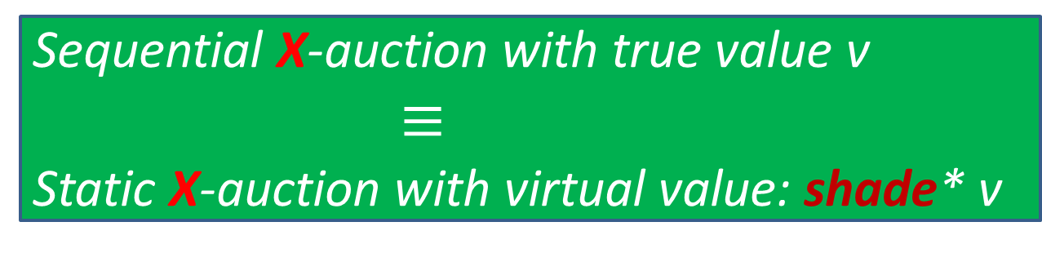
Preview
Sequential X-auction with true value v
$≡$
Static X-auction with virtual value: shade* v
X can be SP, GSP, FP, etc. (any quasi linear utility)
Shade(remaining balance B) =
$V(B)$ will be characterized explicitly.

Slide 13
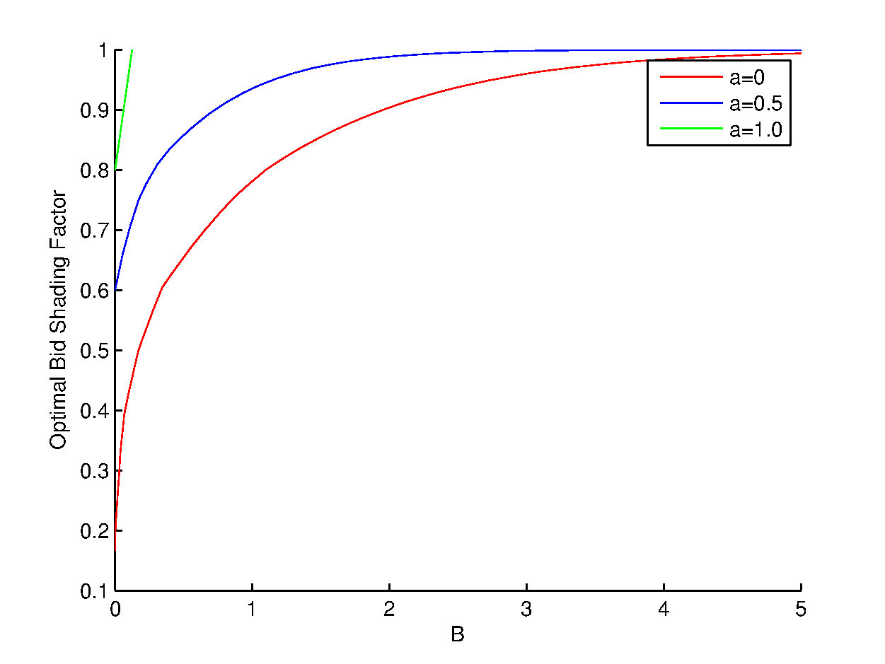
Preview: Optimal Shading factors

Slide 14
Overview
Introduction
Budgeted Second Price auctions
A General Online Budgeting Framework
Optimal Bids for Micro-Value Auctions
Conclusion

Slide 15
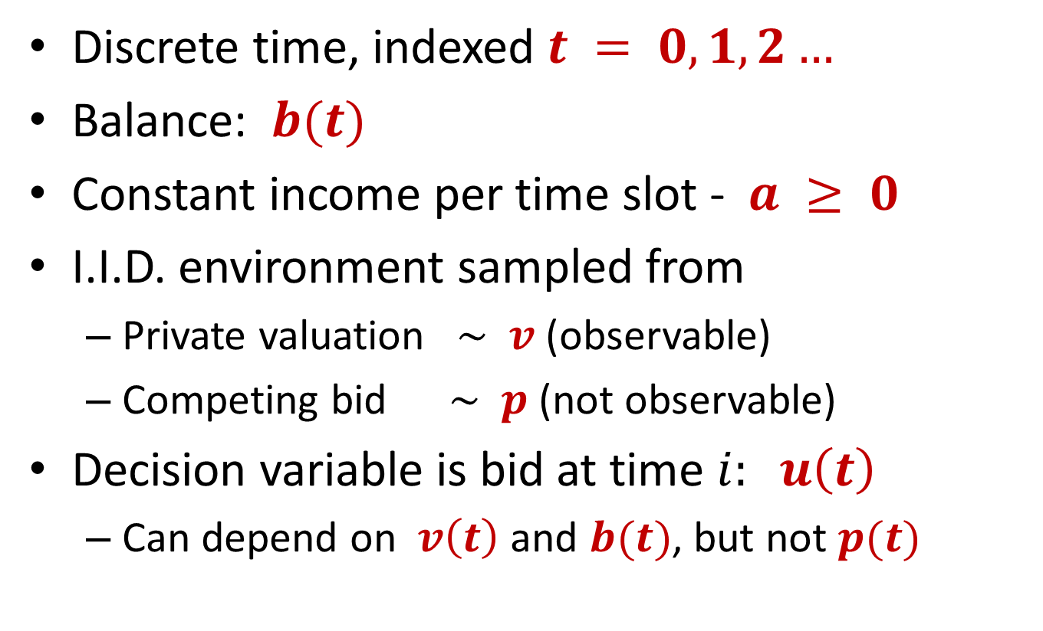
Model: Budgeted Second Price
Discrete time, indexed $t = 0,1,2…$
Balance: $b(t)$
Constant income per time slot - $a ≥ 0$
I.I.D. environment sampled from
Private valuation $\sim v$ (observable)
Competing bid $\sim p$ (not observable)
Decision variable is bid at time $i: u\left(t\right)$
Can depend on $v\left(t\right)$ and $b(t)$, but not $p(t)$

Slide 16
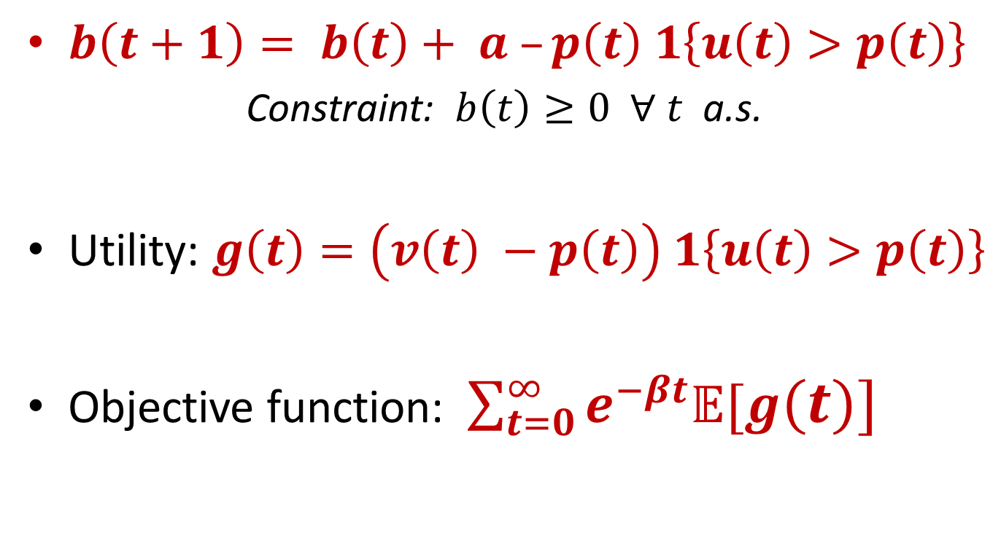
Model: Budgeted Second Price
$b\left(t+1\right)= b\left(t\right)+ a –p\left(t\right) 1\left\{u\left(t\right)>p\left(t\right)\right\}$
Constraint: $b\left(t\right)≥0 ∀ t$ a.s.
Utility: $g\left(t\right)=\left(v\left(t\right) −p\left(t\right)\right) 1\left\{u\left(t\right)>p\left(t\right)\right\}$
Objective function: $\sum_{t=0}^{∞}{e^{−βt}𝔼[g\left(t\right)]}$
Notes:
Mention the two types of expense constraints
Discount factor interpretation – life time of bidder in the system.

Slide 17
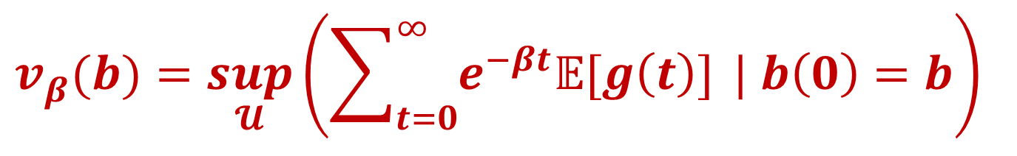
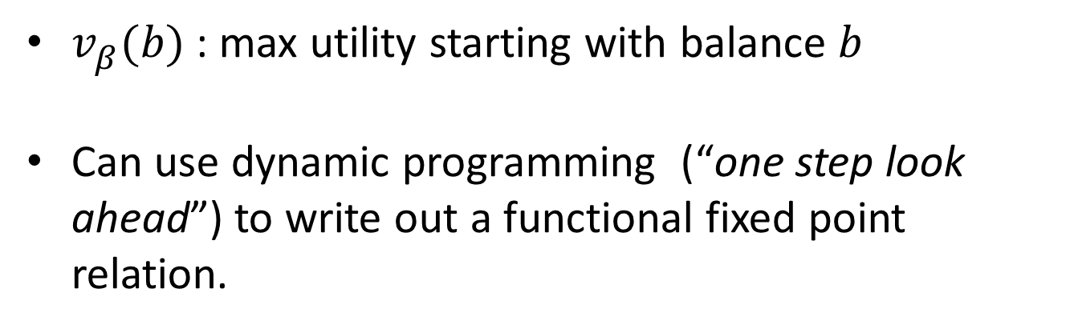
The Value Function
$$v_{β}^{}(b)=\sup_{𝓤}\left(\sum_{t=0}^{∞}{e^{−βt}𝔼[g\left(t\right)]} | b\left(0\right)=b\right)$$
$v_{β}^{}(b)$ : max utility starting with balance $b$
Can use dynamic programming (“one step look ahead”) to write out a functional fixed point relation.
Notes:
Mention parametrization in terms of beta.
Well defined quantity, but to solve for it we need to optimize over a huge class of policies.

Slide 18
The Value Function
Win
Currentauction
Loss
But boundary conditions can not be inferred from the DP argument.

Slide 19

Characterization of value function
Future opportunity cost
“Effective price” for nominal $p$ at balance $b$:
Theorem: Optimal bid is $u$*:
i.e: Buy all auctions with “effective price” $≤v$
$vβ(b)$ is a functional fixed point to:
Notes:
In a sequential setting , when an agent wins an auction, he pays a price equal to b’. But this is actually costlier than b’ in effect. How much costlier is it?
So lambda is a function that magnifies the opponent’s bid as a function of the current balance.
Mention value iteration interpretation to compute the function numerically.

Slide 20
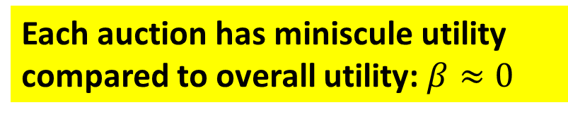

Value Iteration:
$$β=0.1$$
Each auction has miniscule utility compared to overall utility:$β≈0$

Slide 21

Value Iteration:
$$β =0.01$$

Slide 22
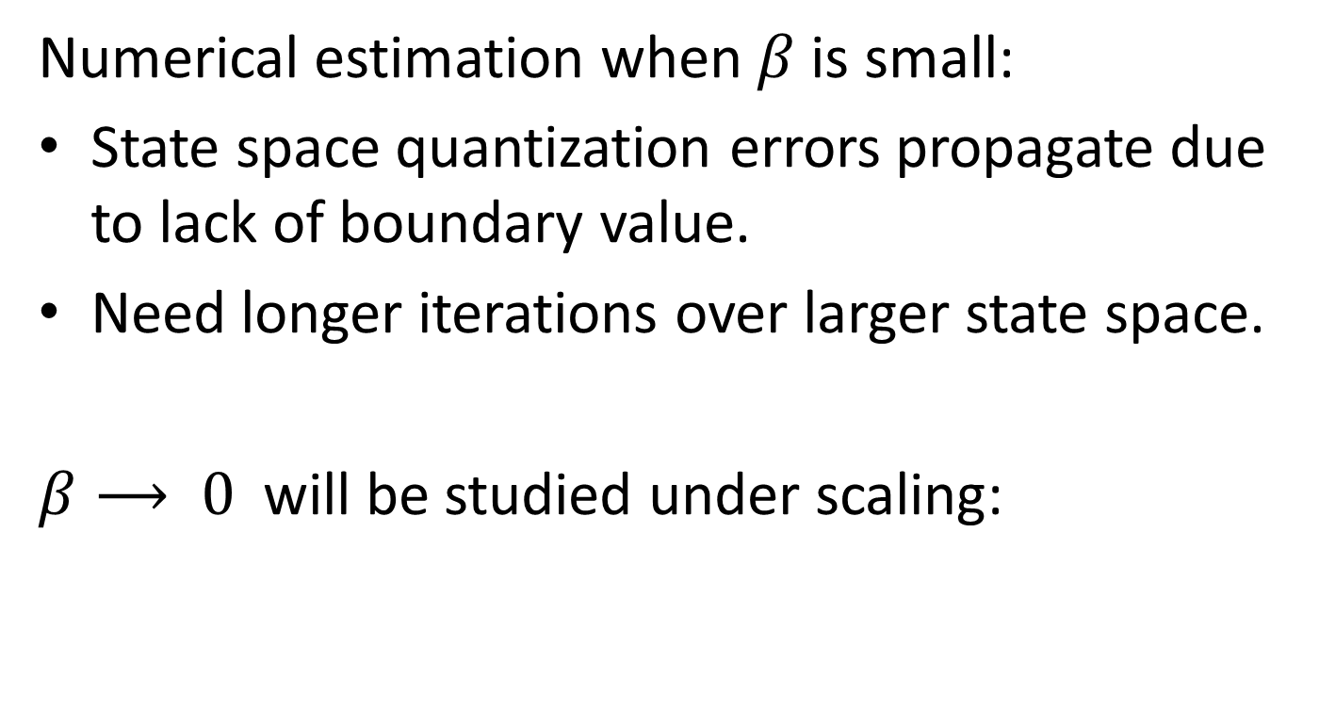
Limiting case: micro-value auctions
Numerical estimation when $β$is small:
State space quantization errors propagate due to lack of boundary value.
Need longer iterations over larger state space.
$β⟶ 0$ will be studied under scaling:
Notes:
Beta to zero implies the value function is blowing up to infty. But we need to scale the units correctly in terms of beta to understand the right behavior.

Slide 23
Overview
Introduction
Budgeted Second Price Auctions
A General Online Budgeting Framework
Optimal Bids for Micro-Value Auctions
Conclusion

Slide 24

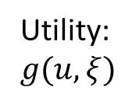
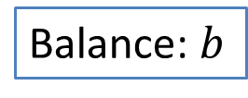



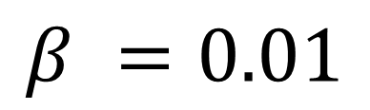
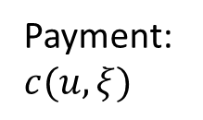
General Online Budgeting Model
Decision Maker
Environment
$ξ$, i.i.d
Income $a$
Payment:$c(u,ξ)$
Unobservable
Balance: $b$
Action $u$
Observable
$ℱ_{0}$
Utility:$g(u,ξ)$
$$Maximize \sum_{t=0}^{∞}{e^{−βt}𝔼\left[g(u\left(t\right),ξ\left(t\right)) \right]}{ }$$

Slide 25
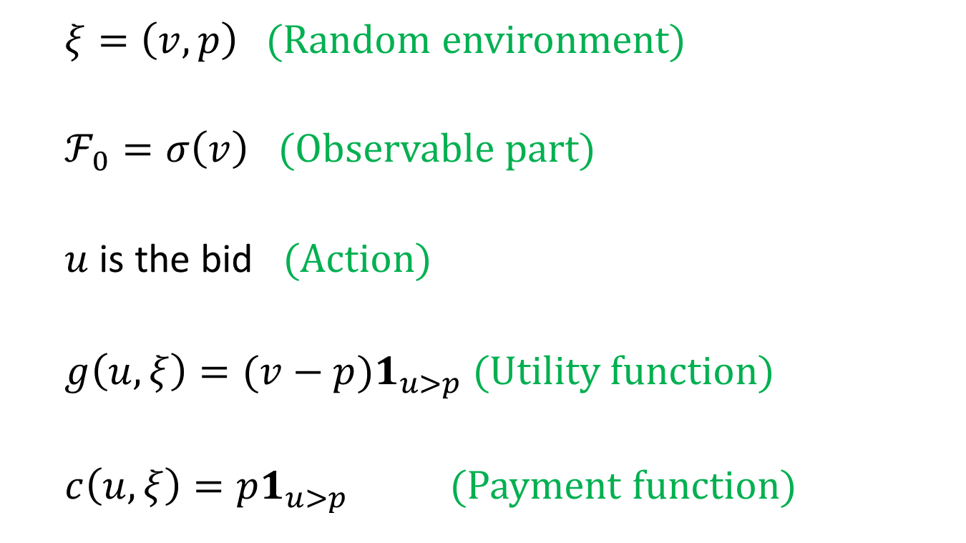
Ex1: Second Price Auction
$ξ=\left(v,p\right)$ (Random environment)
$ℱ_{0}=σ\left(v\right)$ (Observable part)
$u$ is the bid (Action)
$g\left(u,ξ\right)=(v−p)1_{u>p}$ (Utility function)
$c\left(u,ξ\right)=p1_{u>p}$ (Payment function)

Slide 26
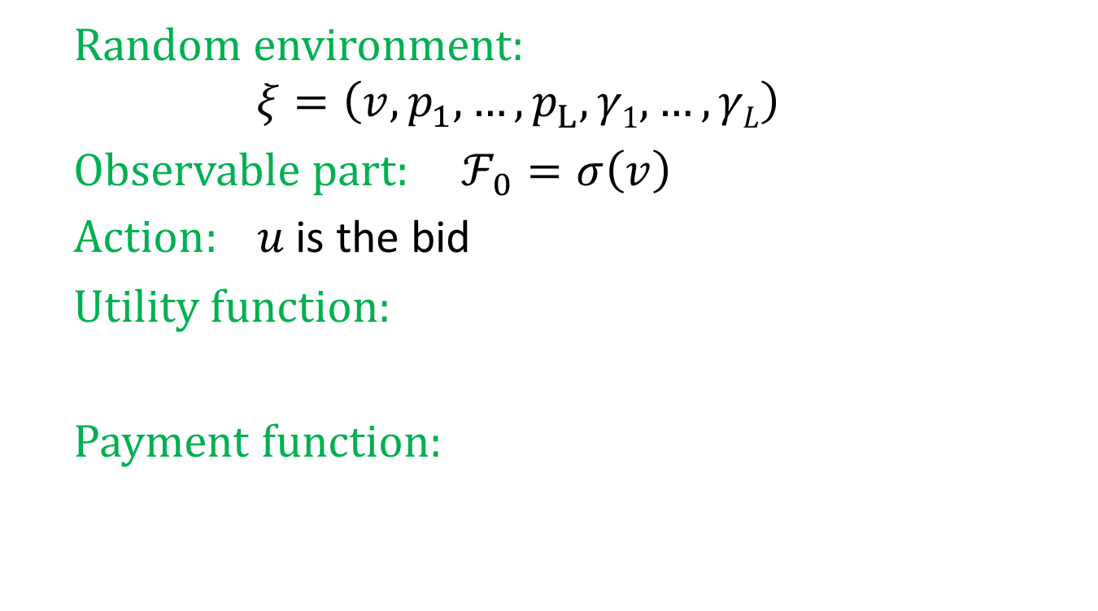
Ex2: GSP Auction
Click events for L slots
Random environment:
$$ξ=\left(v,p_{1}^{},…,p_{L}^{}, γ1,…,γL\right)$$
Observable part: $ℱ_{0}=σ\left(v\right)$
$\text{Action}: u$ is the bid
Utility function:
Payment function:

Slide 27
Overview
Introduction
Budgeted Second Price Auctions
A General Online Budgeting Framework
Optimal Bids for Micro-Value Auctions
Conclusion

Slide 28

Limiting Regime: $β⟶ 0$
Notation:

Slide 29
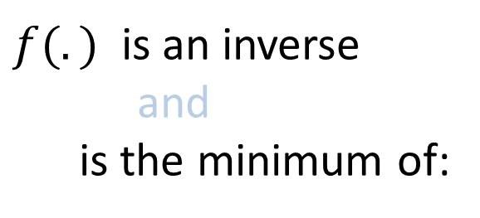
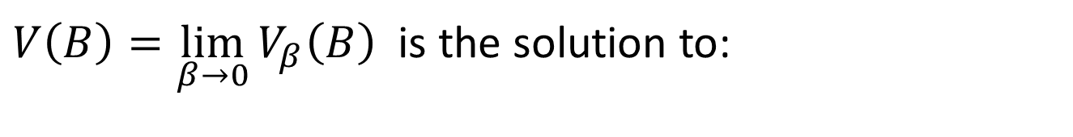
Theorem
$V\left(B\right)=\lim_{β→0}{V_{β}\left(B\right) }$ is the solution to:
$f(.)$ is an inverse
and
is the minimum of:
Notes:
Phi maps rate of change of value function to the value itself.

Slide 30





Theorem
$$V(B)$$
$$V$$
$V’$
$$x$$
$$B$$

Slide 31


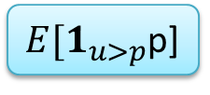
Application to Second Price Auctions
$$E[1_{u>p}\left(v−p\right)]$$
$φ\left(x\right)=ax+\sup_{u∈ℱ_{0}}(\overline{g}(u)−\overline{c}(u)x$)
= $a x+\sup_{u∈σ(v)}𝔼\left[1_{u>p}(v−p\left(1+x\right))\right]$
$= a x+𝔼\left[ (v−p{\left(1+x)\right)}^{+}\right]$
$E[1_{u>p}$p]

Slide 32
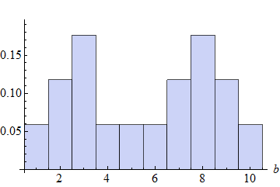
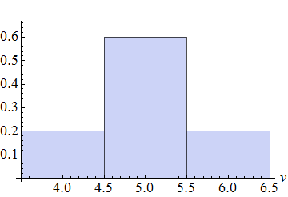
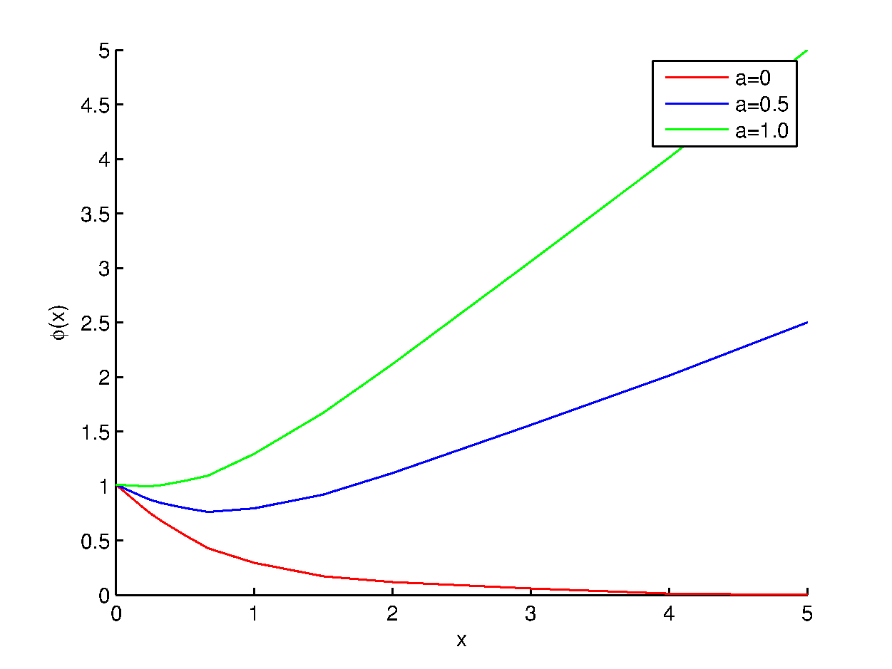
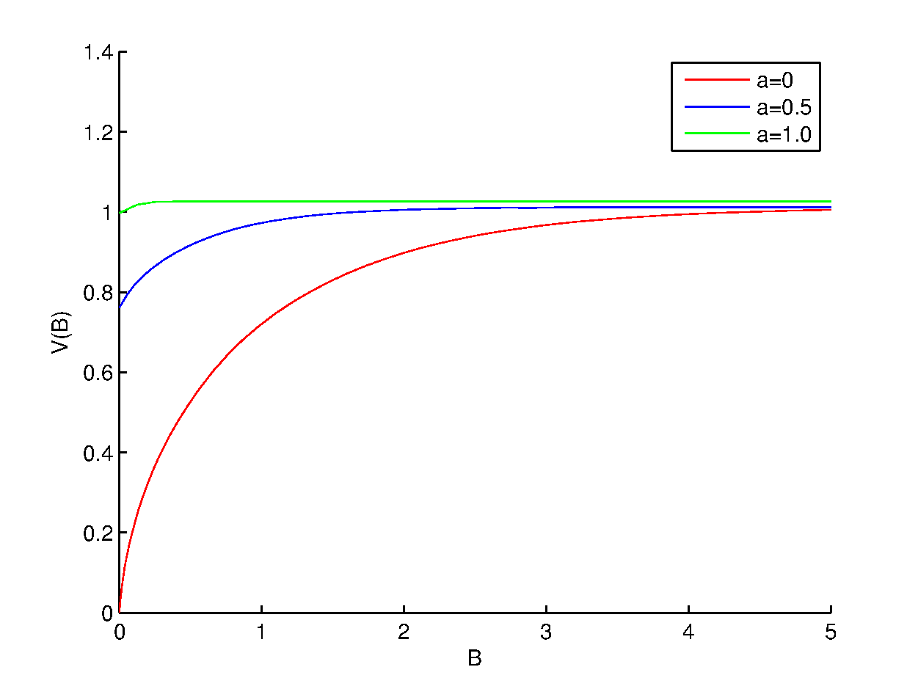


Second Price Auction Example
Opponents bid p
Private Valuation $v$
$$φ(x)$$
Value functions

Slide 33
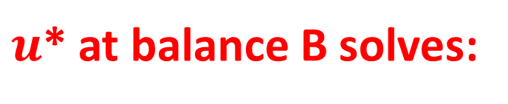
Optimal bid
$u$* at balance B solves:
i.e., Static SP with shaded valuation:

Slide 34
Optimal Scaling factor

Slide 35
Optimal Bid: GSP
Static GSP with “virtual valuation”:

Slide 36
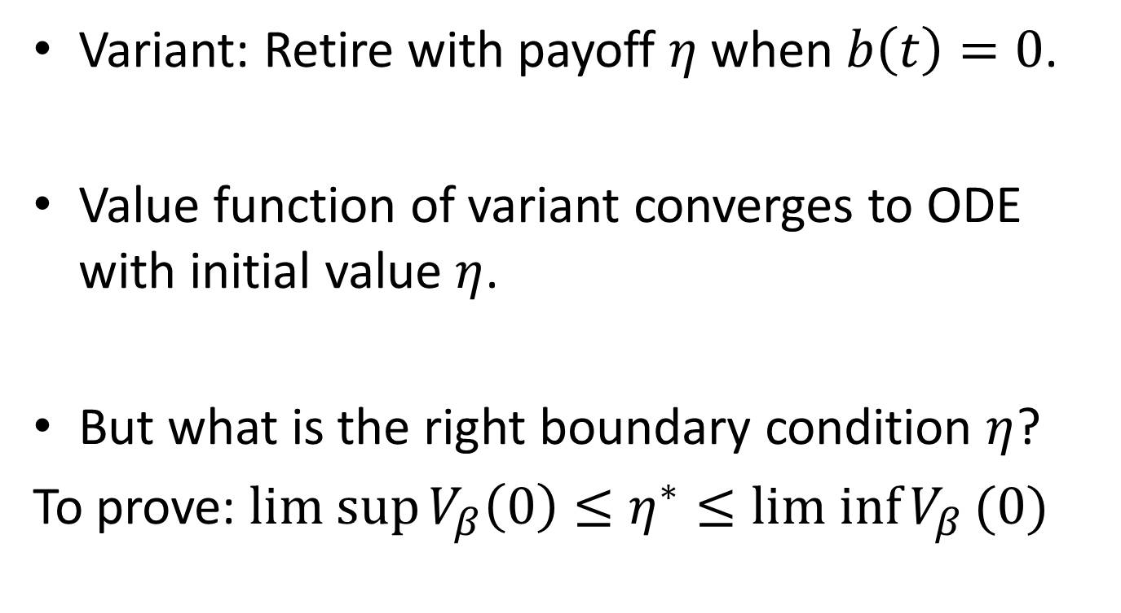
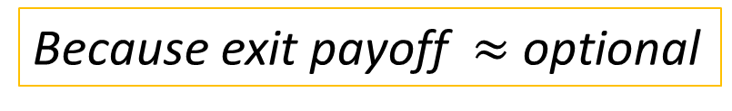
Proof Overview
Variant: Retire with payoff $η$when $b\left(t\right)=0$.
Value function of variant converges to ODE with initial value $η$.
But what is the right boundary condition $η$?
To prove: $lim sup{V_{β}\left(0\right)≤η^{∗}≤lim inf{V_{β}}}(0)$
Because exit payoff $≈$ optional
Next 2 slides

Slide 37

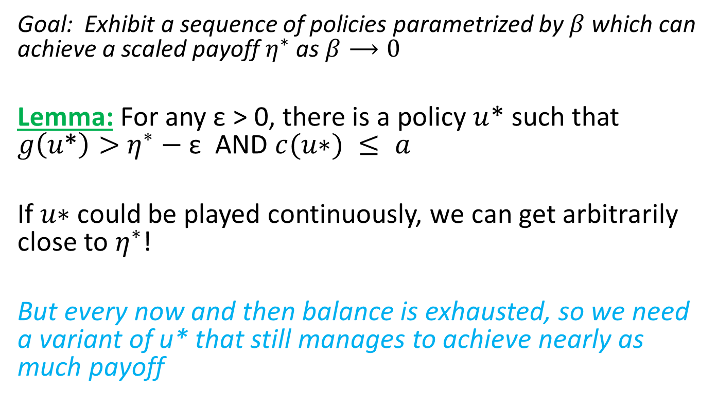
$$η^{∗}≤lim inf{V_{β}}(0)$$
Goal: Exhibit a sequence of policies parametrized by $β$ which can achieve a scaled payoff $η^{∗}$ as $β⟶0$
Lemma: For any ε > 0, there is a policy $u$* such that $g\left(u\text{∗}\right)>$ $η^{∗}−$ε AND $c(u\text{∗}) ≤ a$
If $u\text{∗}$ could be played continuously, we can get arbitrarily close to $η^{∗}$!
But every now and then balance is exhausted, so we need a variant of u* that still manages to achieve nearly as much payoff

Slide 38

$$η^{∗}≤lim inf{V_{β}}(0)$$
Play U*
B(t)
B
time
Show that fraction of time spent in green phase by the random walk gets arbitrarily close to 1 as $β$->0

Slide 39
Overview
Introduction
MDP for budgeted SP auctions
A General Online Budgeting Framework
Optimal Bids for Micro-Value Auctions
Conclusion

Slide 40
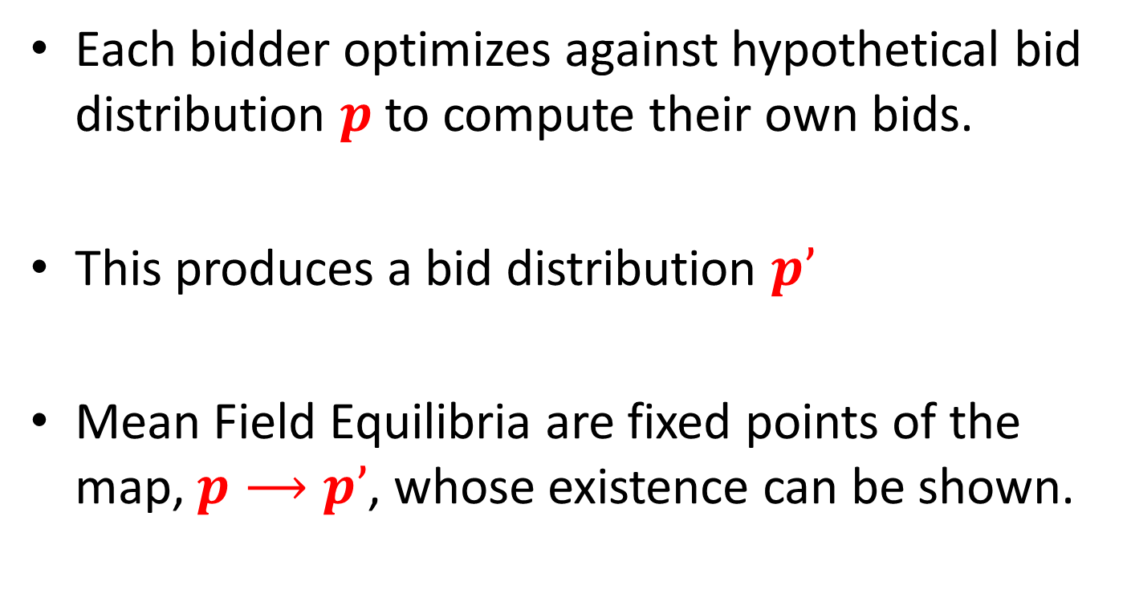
Stationarity in large markets
Each bidder optimizes against hypothetical bid distribution $p$ to compute their own bids.
This produces a bid distribution $p’$
Mean Field Equilibria are fixed points of the map, $p⟶p’$, whose existence can be shown.

Slide 41
Conclusion
A two parameter model for expense constraints in online budgeting problems.
Optimal bid can be mapped to static auction with a shaded virtual valuation.
Paper has more contents: MFE analysis and a finite horizon model.

