Slide 1
Coding and Scheduling for Erasures and Broadcast
Ramki Gummadi

Slide 2
Overview
Rateless codes in network applications
Efficient Repair in Storage Problems
Systematic Rateless Codes
Broadcasting with Side Information
Broadcasting over multiple hops
Role of Coding in Wireless Erasure Networks
Control of a Broadcast Server
Fixed Costs for Server
Online Constraint on Server
Notes:
3 parts, each of which deals with a combination of issues involving erasures/broadcast in networks
Part 1 designs rateless codes to deal with erasures in a variety of applications, out of which I will concentrate on storage for today’s presentation
Part 2 involves a setting with both erasures as well as broadcast where we focus on the additional role for coding because of the local broadcast property in wireless.
Part 3 considers a queue with customers who are all served by a single service from a broadcast server, and we look at two different types of optimal control problems on this model.
The color code represents the sections that I will be focusing on in the presentation today. Green indicates parts that I will present today and orange is material that I have presented during my prelim but will not talk about today.

Slide 3
Overview
Rateless codes in network applications
Efficient Repair in Storage Problems
Systematic Rateless Codes
Broadcasting with Side Information
Broadcasting over multiple hops
Role of Coding in Wireless Erasure Networks
Control of a Broadcast Server
Fixed Costs for Server
Online Constraint on Server
Notes:
We will first start with the section on Rateless codes by considering a storage problem.

Slide 4
A Dynamic Storage System
1 2….. k
Notes:
We have data, divided into k source symbols, that we wish to store in a dynamic storage system in the cloud to protect against failures.
Each blue rectangle represents memory equivalent in size to one source symbol and is used to store a code symbol.

Slide 5
A Dynamic Storage System
1 2….. k
Notes:
- Sometimes, there are failures.
- After a failure happens, the interest is not to simply recover the source symbols, but to reconstruct the destroyed code symbol from other code symbols as a means of repairing the code

Slide 6
A Dynamic Storage System
1 2….. k
Repair Complexity: # of purples per repair (avg)
Overhead: smallest δ such that any k(1+ δ) sufficient
Notes:
- We wish to do this reconstruction as efficiently as possible
To measure the efficiency, we propose a natural notion of repair complexity defined as the average number of symbol operations performed over each repair.
What we will see is that the repair complexity has a tension with the overhead of the code, defined as the minimum additional fraction of code symbols required beyond the number of source symbols coded over.

Slide 7

Fountain Codes for Storage?
1 2….. k
Low (En/De)-coding Complexity
Low Overhead
Rateless
Notes:
An attractive candidate for any application involving erasures are fountain codes, because of their low en/de ohd, and rateless property.

Slide 8
Fountain Codes for Storage?
Not possible to repair even one failure without dealing with the whole block!
Notes:
But if there is a failure and we wish to repair the code symbol using other fountain code symbols, the only way to do it is to simply recover the entire block and then do the encoding.

Slide 9
Fountain Codes for Storage?
1 2….. k
Low (En/De)-coding Complexity
Low Overhead
Rateless
Repair Complexity
Notes:
So what we have here is a code whose repair complexity could be of linear order per each symbol repaired.

Slide 10
Augmented LT Code
Ω
1 2….. k
1
2
3
….
k
Notes:
Our first construction is the augmented LT code.
For this code, there is a fixed part and a rateless part. The fixed part is defined by copying the source symbols directly.
The rateless part is an LT code.

Slide 11
Augmented LT Code
Repair Algorithm
1
2
3
….
k
Ω
Notes:
For this code, the repair algorithm is trivial as long as the symbols being repaired are all from the rateless part.

Slide 12
Augmented LT Code
Repair Algorithm
1
2
3
….
k
?
?
Notes:
The tricky part is how to do the repair when the symbols in need of repair are in the fixed part.

Slide 13
Repair of Fixed Symbols
Fixed
Rateless
Notes:
Let us look at how the repair algorithm works for repair of code symbols from the fixed part.
The basic idea to consider a set of symbols from the rateless part that would be sufficient to recover all the symbols in the fixed part. The iterative decoding algorithm would then proceed in steps where a random new symbol from the fixed part is decoded in each step. The symbols to be repaired can then be recovered in this imaginary decoding sequence by considering the corresponding steps.

Slide 14
Repair of Fixed Symbols
Notes:
Color code: yellow means degree one packets.

Slide 15
Repair of Fixed Symbols
Notes:
We pick one of those degree one symbols and imagine that it has been decoded.

Slide 16
Repair of Fixed Symbols
Notes:
Green implies processsed packets/edges.

Slide 17
Repair of Fixed Symbols
Notes:
Pick a new degree one. We now see that this would be the step in which a symbol to be repaired is due for decoding.

Slide 18
Repair of Fixed Symbols: Step 1
# of symbol operations in repair
= degree of code symbol processed = 2
Notes:
And this defines the repair step number 1. The number of symbol operations is given by the original degree of the code symbol being used in this step.

Slide 19
Repair of Fixed Symbols
Notes:
Now it is repaired and we proceed further with the remaining steps of the imaginary decoding.

Slide 20
Repair of Fixed Symbols

Slide 21
Repair of Fixed Symbols

Slide 22
Repair of Fixed Symbols
Notes:
And this would be the step in which the final symbol to be repaired would have been decoded. And the original degree of the corresponding code symbol defines the repair complexity involved.

Slide 23
Repair of Fixed Symbols: Step 2
# of symbol operations in repair
= degree of code symbol processed = 3

Slide 24
Repair of Fixed Symbols
Notes:
We have seen that each repaired symbol requires operations equal to the degree of some corresponding code symbol from the rateless part. By arguing that these code symbols are nearly typical, the expected degree of the symbols used in repair is then shown to be about the same as the average of the degree distribution used.

Slide 25

Augmented LT Code
Repair Algorithm
1
2
3
….
k
?
Repair Complexity: (1+ε)Ω’(1)
Reduced from θ(k) to θ(1), in exchange for overhead increase from ε to 1+ε
?
Notes:
To summarize, we just constructed a code whose repair complexity doesn’t scale with block length.
Overhead: at this point, all we can say is that as long as we have at least k(1+ep) from the rateless part, we can recover the source symbols. And this will obviously be the case if we consider k(2+ep) total symbols, since there can be at most k from the fixed part. So the overhead is 1 + ep

Slide 26
Augmented LT Code
Repair Algorithm
1
2
3
….
k
?
Repair Complexity: (1+ε)Ω’(1)
Reduced from θ(k) to θ(1), in exchange for overhead increase from ε to 1+ε
Next Goal: Improve overhead while keeping Repair complexity order optimal
?
Notes:
Next challenge is to improve the overhead. Ideally, we would like to get as close to zero as we can, while keeping the repair complexity down.

Slide 27
Augmented Raptor Codes
m₁ m₂ … m_{k}
Notes:
In the effort to reduce the overhead, we next describe augmented raptor codes.

Slide 28
Augmented Raptor Codes
m₁ m₂ … m_{k}
Rate (1+ε) “precode”
s₁ s₂ … s_{k(1+ε)}
Notes:
We first use a precode to expand the source symbols by a factor of 1 + ep with the property that any k out of those will suffice to recover the source symbols.

Slide 29
Augmented Raptor Codes
m₁ m₂ … m_{k}
Rate (1+ε) “precode”
s₁ s₂ … s_{k(1+ε)}
Ω
Object of optimization
s₁ s₂ s_{k(1+ε)}
….
Notes:
For the actual code, we again have a fixed part and a rateless part as before. The fixed part this time consists of the precoded symbols. And the rateless part is generating by applying an optimized degree distribution to the precode.
Its called augmented raptor because without the fixed part, it would be a raptor code but we augment it with an additional fixed part.

Slide 30
Overhead Optimization
Consider an arbitrary set of k(1+δ) symbols
s₁ s₂ s_{k(1+ε)}
….
Notes:
Let us say we wish to claim that this code achieves an overhead delta.
This means that any subset of k(1+delta) symbols should be enough to recover the data, represented by green.
These can come as an arbitrary combination of the fixed and the rateless parts and we should be able to recover the source data in all such possible scenarios.

Slide 31
Overhead Optimization
Consider an arbitrary set of k(1+δ) symbols
Fraction α from fountain part
s₁ s_{k(1+ε)}
k(1+δ)(1-α)
k(1+δ)α
Need to recover at least k for precode to take over
Notes:
Denote alpha to be the fraction of those k(1+delta) code symbols that comes from the rateless part.
In order to recover the data, it is sufficient to recover a net of k symbols from the fixed part due to the precode

Slide 32
Overhead Optimization
Consider an arbitrary set of k(1+δ) symbols
Fraction α from fountain part
Parameters
α (arbitrary)
δ (to minimize)
ε (to design)
s₁ s_{k(1+ε)}
k(1+δ)(1-α)
k(1+δ)α
Need to recover at least k for precode to take over
Notes:
To recap, we have 3 parameters: alpha, delta, epsilon where alpha is arbitrary/adversarial and delta is something to be minimized, subject to the recovery constraint, where epsilon comes from the precode.

Slide 33


Background: Degree design
x_{t}
r : # code symbols
Ω : Degree distn
# degree 1 packets
t
1
Fraction Decoded
[Darling and Norris, 2005]
Notes:
In general, given a degree distn omega and a received fraction r of code symbols, the evolution of degree one symbols, and halts when we this process goes to zero. The solution is specified by the ODE given above with three terms.
This gives a condition on Omega for recovering a given fraction of packets.

Slide 34
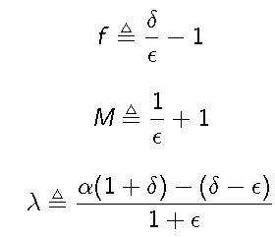
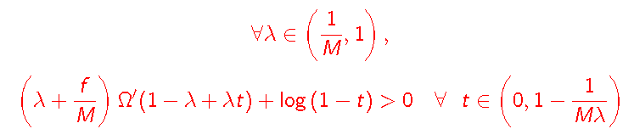
Recovery Constraint
δ : minimize
ε : design
α: adversarial
Notes:
In order to apply the recovery constraint to our setting, we need to transform some variables first.
These transformations are just for convenience and to make the equations look compact.
Lambda is the fraction of code symbols that are missing from the fixed part of the code. When lambda is less than 1/M there is nothing for the LT decoding to do because the precode can take over.
1- 1/Mlambda is the fraction that needs recovery (corresponds to recovering k packets)
lambda + f/M is a term that is proportional to the number of code symbols from the rateless part and
Omega(1-lam + lam t) is the projected degree distribution onto the unknown code symbols.

Slide 35

Optimal Overhead
By fixing M and Ω we get achievable ‘profiles’

Slide 36

Optimal Overhead
By fixing M and Ω we get achievable ‘profiles’

Slide 37

Optimal Overhead
By fixing M and Ω we get achievable ‘profiles’

Slide 38

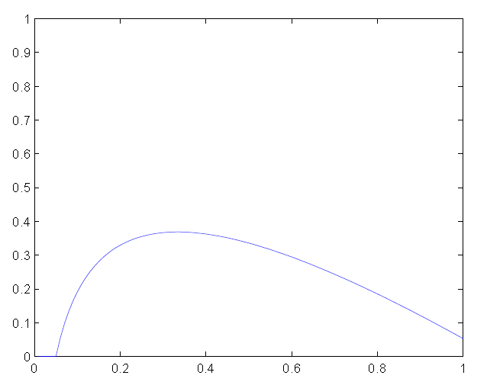
Thm: Achievable Profile

Slide 39
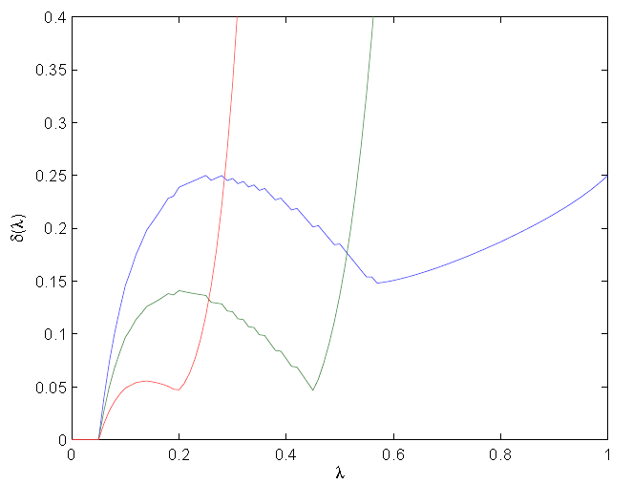
Some optimized profiles

Slide 40
Systematic Raptor Codes
m₁ m₂ … m_{k}
Matrix Multiplication
Θ(k) per symbol
y₁ y₂ … y_{k}
Raptor Code
Systematic Version

Slide 41
Systematic Rateless Codes
m₁ m₂ … m_{k}
Systematic precode
s₁ s₂ … s_{k(1+ε)}
Ω
Θ(1) per symbol
s₁ s₂ s_{k(1+ε)}
….

Slide 42
Overview
Rateless codes in network applications
Efficient Repair in Storage Problems
Systematic Rateless Codes
Broadcasting with Side Information
Broadcasting over multiple hops
Role of Coding in Wireless Erasure Networks
Control of a Broadcast Server
Fixed Costs for Server
Online Constraint on Server

Slide 43
Coding in Networks
Wireline:
- Multicast/ multiple unicast
- Erasures: As FEC
Wireless:
- Multicast/ multiple unicast
- Erasures: As FEC
- Local Broadcast

Slide 44
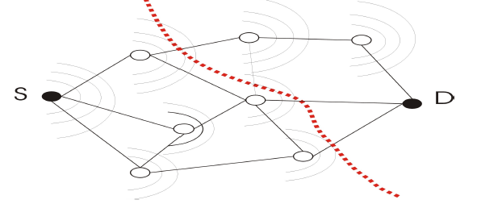
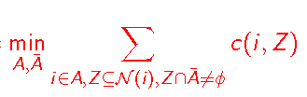
Wireless Erasure Unicast
Broadcast from i Z with probability c(i,Z)

Slide 45



Backpressure Policy for local broadcast
D

Slide 46
Backpressure Policy for local broadcast
D

Slide 47
Backpressure Policy for local broadcast
D

Slide 48
Backpressure Policy for local broadcast
Theorem: Backpressure achieves the mincut
Caveat: requires extensive coordination for every broadcast (which network coding can avoid)
Next Goal: Limitations of distributed routing
D

Slide 49
Formalizing a constraint on distributed Routing
D
p

Slide 50
Formalizing a constraint on distributed Routing
r₁(p)=1
1
p
r₂(p)=1
2
D
p
3
r₃(p)=0

Slide 51
Formalizing a constraint on distributed Routing
r*₁(p)=0
r*₂(p)=1
D
p
r*₃(p)=0

Slide 52

Formalizing a constraint on distributed Routing
r*₁(p)=0
r*₂(p)=1
D
p
r*₃(p)=0

Slide 53
Examples of schemes distributed routing constraint
Traditional routing: Address each packet to a specific relay
Flooding: Address each packet to all relays (Relays drop random subsets to accommodate the rate they can support)
Tagging: Address each packet to a specific subset. (Tag a fraction t(Z) of packets with Z where Σt(Z) = 1)

Slide 54
Capacity under distributed routing
Theorem: For any arbitrary scheme that satisfies the distributed routing constraint, there exists a tagging scheme with equal throughput
Optimization of throughput over tagging policies can be written as an LP with variables t(Z)
Characterization of capacity under routing constraint

Slide 55
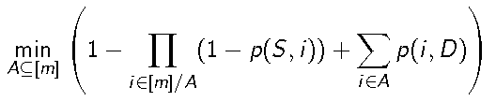

LB for independent erasures
p(S,i)
i
p(i,D)
A*
Mincut
C*=
Flooding

Slide 56

LB for independent erasures
p(S,i)
i
p(i,D)
A*
Mincut
C*=
Bound: C(P_{F}) ≥ 1 – e^{-c*}
Flooding

Slide 57
Dependent losses
p
1/m

Slide 58

Dependent losses
With probability
1 - ε
ε
p
p
1/m
1/m
p
p
p
C*= 1
Capacity under routing constraint:

Slide 59
Overview
Rateless codes in network applications
Efficient Repair in Storage Problems
Systematic Rateless Codes
Broadcasting with Side Information
Broadcasting over multiple hops
Role of Coding in Wireless Erasure Networks
Control of a Broadcast Server
Fixed Costs for Server
Online Constraint on Server
Notes:
In the next part of the talk, I will talk about an optimal control problem involving a queue where each service clears all the customers.

Slide 60

Broadcast Server
Single Class of Customers
Customers have holding Costs
Server has constraints on operation
Fixed Costs: Proved threshold optimality for convex holding costs (MDP on customer state space)
Online constraint: MDP on a “resource” state space
Notes:
We consider only one class of customers. There are two types of constraints on the server. The first one is that of fixed costs and for this, we have shown that optimal control is of threshold type. I will not go into the details of this part today.
What I will focus on is a different type of problem involving an online constraint on the server…

Slide 61

A General Online Problem
D-Time i.i.d. system with RV’s:
Server
Notes:
We have a discrete time system with iid copy of randomness over time. There is also a server which takes actions in each time slot.

Slide 62

A General Online Problem
Server
Action: u(i)
Utility: g_{i} = g(u(i),ξ(i))
Notes:
The proportional to F0 symbol is just a short hand to say that the random variable representing the control at time I has to be measurable wrt observable part of the randomness at time i.
The action leads to a random payoff, denoted gi.
So far there is nothing that connects the system across time

Slide 63

A General Online Problem
Income: a
Consumption
d(u(i), ξ(i))
Server
Resource Balance: b(i)
Action: u(i)
b(i+1) = b(i) + a(i) – d(u(i),ξ(i))
Utility: g_{i} = g(u(i),ξ(i))
Notes:
In order to take the action, the server also needs to consume a random amount of a resource, which is replenished at every time slot with a fixed income, a. The payment/consumption is given by d.

Slide 64

A General Online Problem
Optimize E [ ]
Val fn: v_{β}(b)
Income: a
Consumption
d(u(i), ξ(i))
Server
Resource Balance: b(i)
Action: u(i)
b(i+1) = b(i) + a(i) – d(u(i),ξ(i))
Utility: g_{i} = g(u(i),ξ(i))
Notes:
Our interest is in optimizing the utility subject to nonnegativity constraint on the resource…
So the resource is like money…. It does not figure into the utility no value in itself, but we need it to generate actions that actually lead to realy utility.
Let me say at the outset that things can also be generalized to a vector of resources with a conjunction constraint on all of them for operation. Each action leads to a consumption vector, etc.

Slide 65

Notation and Assumptions
bar on top denotes E[ ]
d and g are bounded & cts

Slide 66
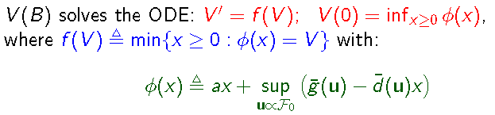

Theorem
V
V(B)
f(V)
x
B

Slide 67


V
f(V)
x
B
Cts time control problem with discount e^{-t} and gain rate g(u(t))
dB(t) = (a – d(u(t))dt
Exit payoff η when B(t) = 0

Slide 68

HJB
Cts time control problem with discount e^{-t} and gain rate g(u(t))
dB(t) = (a – d(u(t))dt
Exit payoff η when B(t) = 0

Slide 69
Proof Map
Ct-time
Dt-time
η₀
ODE
(B, η)
HJB
V(B,η)
η*
V_{β} (B)

Slide 70
Dt-problem with exit payoff
Cts time control problem with discount e^{-t} and gain rate g(u(t))
dB(t) = (a – d(u(t))dt
Exit payoff η when B(t) = 0
Interpolation argument [Kushner]
Discrete Time problem with exit payoff η

Slide 71
Proof Map
Ct-time
Dt-time
_{β 0}
η₀
ODE
(B, η)
Kushner
V(B,η)
_{β 0}
HJB
J_{β}(B, η)
η*
_{β 0}
V_{β} (B)

Slide 72
Proof Map
Ct-time
Dt-time
_{β 0}
η₀
ODE
(B, η)
Kushner
V(B,η)
_{β 0}
HJB
J_{β}(B, η)
η*
_{β 0}
Exit payoff ~optional
≤
V_{β} (B)

Slide 73
Proof Map
Ct-time
Dt-time
_{β 0}
η₀
ODE
(B, η)
Kushner
V(B,η)
_{β 0}
HJB
J_{β}(B, η)
η*
_{β 0}
≤
Exit payoff ~optional
≤
lim sup
_{β 0}
V_{β} (B)
lim inf

Slide 74

Assume (for proof illustration)
with argmax =
and
Φ(x) achieves minimum
at single point (not interval)

Slide 75

Subgradient at x
u*₋
u*₊
x*-h
x*
x*+h
η* ≤ Φ(x*+h) = g(u*₊) + (a – d(u*₊)) (x* + h)
η* ≤ Φ(x*-h) = g(u*₋) + (a – d(u*₋)) (x* - h)

Slide 76
Subgradient at x
u*₋
u*₊
Define u* as convex combination of u*₊ and u*₋
such that a = d(u*)
g(u*) ≥ η* - ε by choosing h small enough
x*-h
x*
x*+h
η* ≤ Φ(x*+h) = g(u*₊) + (a – d(u*₊)) (x* + h)
η* ≤ Φ(x*-h) = g(u*₋) + (a – d(u*₋)) (x* - h)

Slide 77
Assume (for proof illustration)
with argmax =
and
Φ(x) achieves minimum
at single point (not interval)

Slide 78
(0-)subgradient
ε
ε-subgradient

Slide 79

liminf V_{β}(0) ≥ η*
_{β 0}
If u* is played for all time, value attained is:
But every now and then balance is exhausted, so we need a variant of u* that still manages to achieve nearly as much payoff

Slide 80
liminf V_{β}(0) ≥ η*
_{β 0}
Play U*
B(t)
B
time

Slide 81
Server with Online Constraint
Time interval following i^{th} broadcast
Income: a(i)
Server
Consumption d(u(i)) = u(i)
Action: Rate, u(i)
Balance: b(i)
b(i+1) = b(i) + a(i) – u(i)
Cost: c_{i} is average holding cost
Customers x_{t}
Objective:

Slide 82



Let u(λ,b) denote the rate for arrival λ balance b
c_{i} = λ T/2 =>
If λ is deterministic, φ can be written compactly as

Slide 83
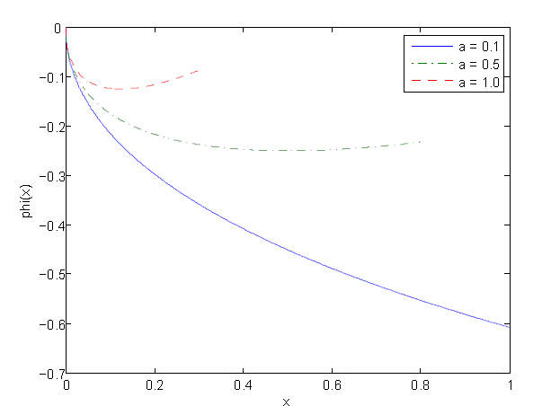
Plots of φ

Slide 84
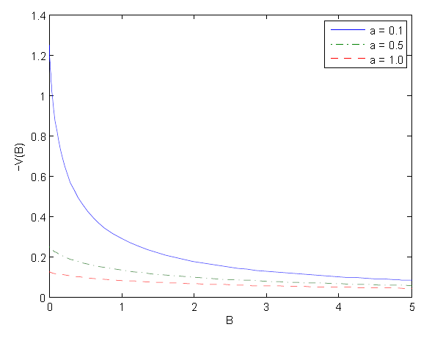
Plots of V(B)

Slide 85
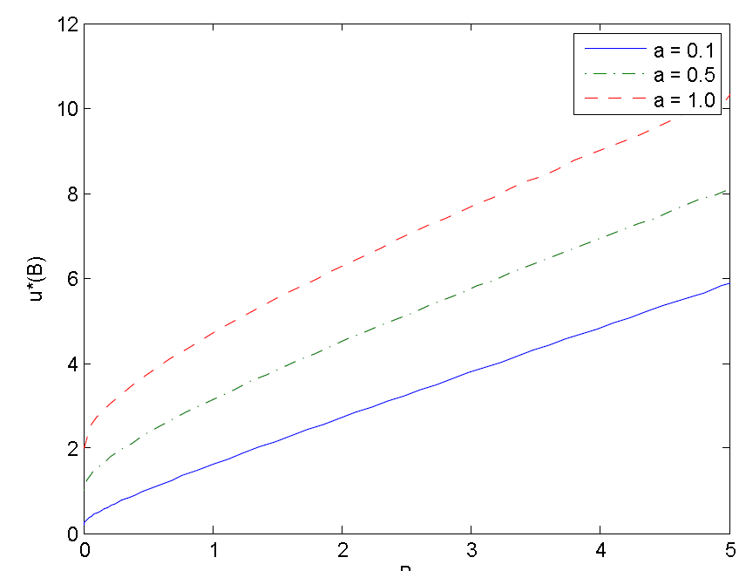
Plots of Optimal Control
Income
Asset

Slide 86
Thank you!

