Slide 1
Mean Field Equilibria of Multi-Armed Bandit Games
Ramki Gummadi (Stanford)
Joint work with:
Ramesh Johari (Stanford)
Jia Yuan Yu (IBM Research, Dublin)

Slide 2
Motivation
Classical MAB models have a single agent.
What happens when other agents influence arm rewards?
Do standard learning algorithms lead to any equilibrium?
Notes:
Let me begin with a brief motivation.
Multiarmed bandit models typically consider the sequential decision making problem of a single agent learning in an uncertain environment.
In contrast, the motivation for our work is to understand what happens when arm rewards also depend on choices made by multiple agents.
Specifically, we wish to know if an agent population using standard learning algorithms can reach some equilibrium state.

Slide 3
Examples
Wireless transmitters learning unknown channels with interference
Sellers learning about product categories: e.g. eBay
Positive externalities: social gaming.
Notes:
Bandit models are driven by large collection of applications, and a significant subset of these have natural analogs where rewards also depend on other agent choices.
The first example is that of a wireless transmitter learning unknown channels, which is the classical bandit problem, but with interference across multiple transmitters, it results in a bandit game.
The next example refers to sellers assigning a category to a product over time, but their reward could depend on competition from others, in addition to their own intrinsic preferences.
The above two examples indicate situations where competition hurts, but this doesn’t have to be the case in general. There could be situations where coordination improves rewards.

Slide 4
Example: Wireless Transmitters
Channel A
0.8
?
Channel B
0.6
Notes:
Lets take a closer look at the first example.
Here, we have a single agent, the transmitter.
The rewards are bernoulli r.v. indicating whether a packet transmission is successful.
Here, they are i.i.d. over time, with channel A slightly better than channel B but of course, the agent doesn’t know this.
So how does the agent decide between the channels?
It keeps track of total number of successes and failures an agent has experienced in each channel to compute the decision for the next time slot.

Slide 5
Example: Wireless Transmitters
Channel A
0.8 ; 0.9
?
Channel B
0.6 ; 0.1
Notes:
Now we introduce another agent, with its own preferences for the arms indicated in red.
But the rewards also depend on interference from the other agent in addition to the numbers written.
I should mention that the only thing an agent observes is its reward; for example, when a transmission fails, it can not directly infer whether it was because of interference from another agent, or if its intrinsic preference for that arm was low.
If we consider a PBE, the optimal strategy of each agent is no longer just a function of the aggregate number of wins/losses for each arm because the environment is no longer stationary.
So agent policies are functions of entire reward sequence; agent’s also need to keep beliefs/prob distributions on the opponent’s reward sequence, which gets quickly infeasible with more agents.

Slide 6
Modeling the Bandit Game
Perfect bayesian equilibrium
Implausible agent behavior.
Mean field model
Agents behave under an assumption of stationarity.
Notes:
The point I’m trying to make is that a PBE models implausible agent behavior, even though it remains an interesting mathematical problem.
What we consider instead, is a mean field model, which is basically a large agent population approximation.
In this model, agents hypothesize an aggregate environment that looks i.i.d. over time.
Of course, its not just enough to say that they assume this – having an equilibrium also requires consistency of what actually arises when agents behave with this assumption.

Slide 7
Outline
Model
The equilibrium concept
Existence
Dynamics
Uniqueness and convergence
From finite system to limit model
Conclusion
Notes:
Here is the outline for the rest of the talk:
I’ll start with the mean field model we consider for the bandit game. Note that the model is specified directly for the large agent limit in mind, which is why its called a mean field model.
I will then formally specify the equilibrium concept associated this model.
The first result is on existence, which holds under fairly broad conditions.
I will then talk about our results beyond existence, like dynamics, and provide conditions under which we can also infer uniqueness and convergence to the unique equilibrium.
I will then relate the limit model to a finite agent model and talk about an approximation result that connects these two under certain conditions.
And finally, I will conclude with some brief comments on the implications of these results, both from a practical as well as theoretical point of view.

Slide 8
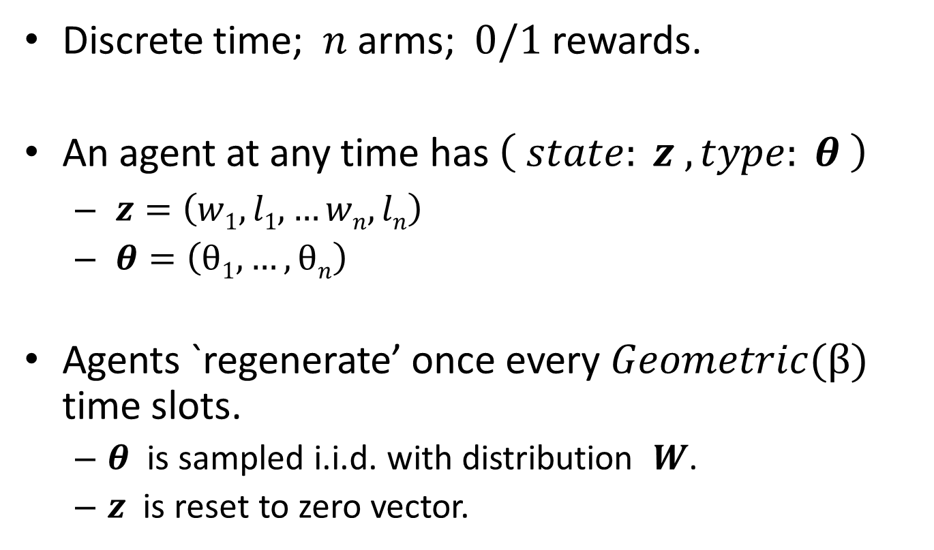
Mean Field Model of MAB Games
Discrete time; $n$ arms; $0/1$ rewards.
An agent at any time has $\left( state: z , type: θ \right)$
$z=\left(w1, l1, …wn, ln\right)$
$θ=\left(θ1, …,θn\right)$
Agents `regenerate’ once every $Geometric(β)$ time slots.
$θ$ is sampled i.i.d. with distribution $W$.
$z$ is reset to zero vector.
Notes:
Time is discrete and the number of arms is n and Rewards are 0/1.
At any given time, each agent has a state, z, which is a vector of 2n positive integers and indicates the aggregated number of wins and losses for each of the n arms.
*In a PBE, we saw that agents do need more complicated strategies that depend on the entire reward sequence, but it turns out that this is not necessary in our equilibrium.*
An agent also has its own intrinsic preferences for the arm, specified by a variable theta, which is a vector with n components, each between 0 and 1.
We assume that agents remain in the system for random geometric lifetimes, during which only their state evolves, but the type remains fixed. When an agent regenerates, its type is sampled from a given distribution W, and the state is reset to zero, effectively forgetting whatever was learnt with regard to its previous type.
The policy adopted by the agents is denoted by sigma, which maps the state z to a possibly randomized arm choice, a number between 1 to n. This formulation includes a broad class of policies developed for the classical bandit problem under i.i.d. rewards. A UCB based policy could be represented in this fashion, and so can the gittin’s index computed with some fixed priors on arm rewards.
At any given time, the population profile refers to the fraction of agents choosing each arm.
The reward distributions associated with each arm is Bernoulli, whose success probability is specified by a function Q with two arguments. The first argument is the type corresponding to the given arm, and the second is the population profile component.

Slide 9
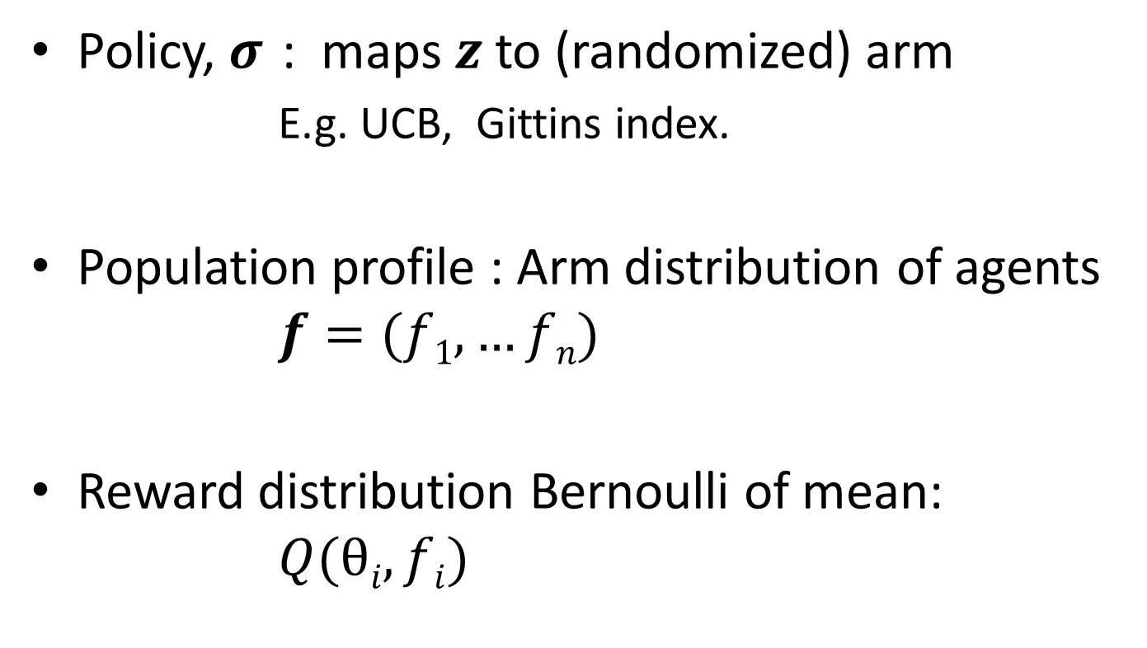
Mean Field Model of MAB Games
Policy, $σ$ : maps $z$ to (randomized) arm
E.g. UCB, Gittins index.
Population profile : Arm distribution of agents $f=(f1, …fn)$
Reward distribution Bernoulli of mean: $Q(θi,fi)$
Notes:
Time is discrete and the number of arms is n.
At any given time, each agent has a state, z, which is a vector of 2n positive integers and indicates the aggregated number of wins and losses for each of the n arms.
*In a PBE, we saw that agents do need more complicated strategies that depend on the entire reward sequence, but it turns out that this is not necessary in our equilibrium.*
An agent also has its own intrinsic preferences for the arm, specified by a variable theta, which is a vector with n components, each between 0 and 1.
We assume that agents remain in the system for random geometric lifetimes, during which only their state evolves, but the type remains fixed. When an agent regenerates, its type is sampled from a given distribution W, and the state is reset to zero, effectively forgetting whatever was learnt with regard to its previous type.
The policy adopted by the agents is denoted by sigma, which maps the state z to a possibly randomized arm choice, a number between 1 to n. This formulation includes a broad class of policies developed for the classical bandit problem under i.i.d. rewards. A UCB based policy could be represented in this fashion, and so can the gittin’s index computed with some fixed priors on arm rewards.
At any given time, the population profile refers to the fraction of agents choosing each arm.
The reward distributions associated with each arm is Bernoulli, whose success probability is specified by a function Q with two arguments. The first argument is the type corresponding to the given arm, and the second is the population profile component.

Slide 10
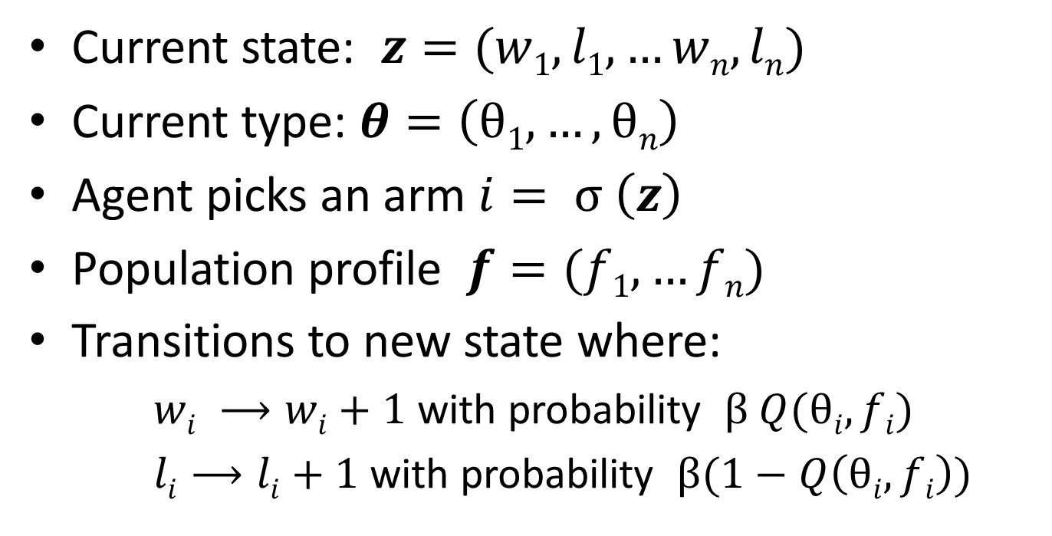
A Single Agent’s Evolution
Current state: $z=(w1, l1, …wn, ln)$
Current type: $θ=\left(θ1, …,θn\right)$
Agent picks an arm $i= σ \left(z\right)$
Population profile $f=(f1, …fn)$
Transitions to new state where:
$wi ⟶wi+1$ with probability $β Q(θi,fi)$
$li⟶li+1$ with probability $β(1−Q\left(θi,fi\right))$
Notes:
Lets take a closer look at how a single agent evolves under this model:
The agent has a state z where wi refers to the number of wins on arm i and li refers to the number of losses on arm i that this agent has seen so far.
It has a type theta, which specifies the unkown intrinsic arm preferences.
It chooses an arm that depends exclusively on the state, z. This results in a win or a loss with probability Q(thetai, fi), where I is the arm chosen according to sigma.
Conditional on there being no regeneration, with probability beta, the agent increments its win or loss component appropriately for the chosen arm.

Slide 11
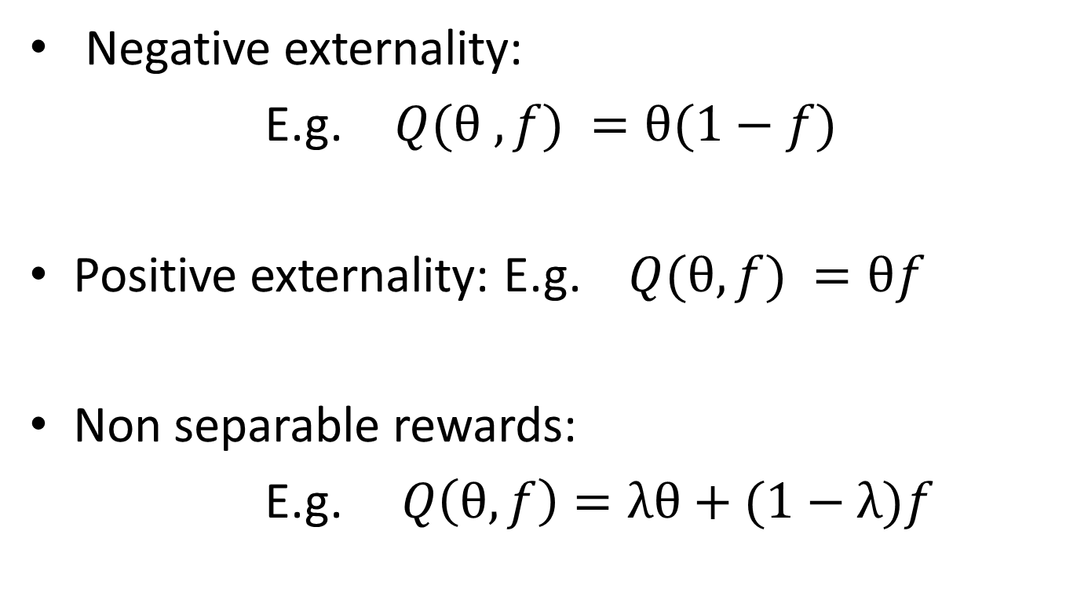
Examples of Reward Functions
Negative externality:
E.g. $Q(θ , f) =θ(1−f)$
Positive externality: E.g. $Q(θ,f) =θf$
Non separable rewards:
E.g.$Q\left(θ, f\right)=λθ+(1−λ)f$
Notes:
What kind of reward functions can we model within this framwork?
We could have a negative externality models, for which Q is decreasing in f for any theta.
Alternately, we could have positive externalities, for which one example is Q(theta, f) = theta *f.
Its not necessary to restrict ourselves to products of theta and some function of f. Here is an example which places an additive weight on theta and f according to the parameter lambda. So, when lamda is 0, the reward depends solely on the population profile and all arms are symmetric. Conversely, when lambda is 1, the agents are solving completely independent MAB problems.

Slide 12
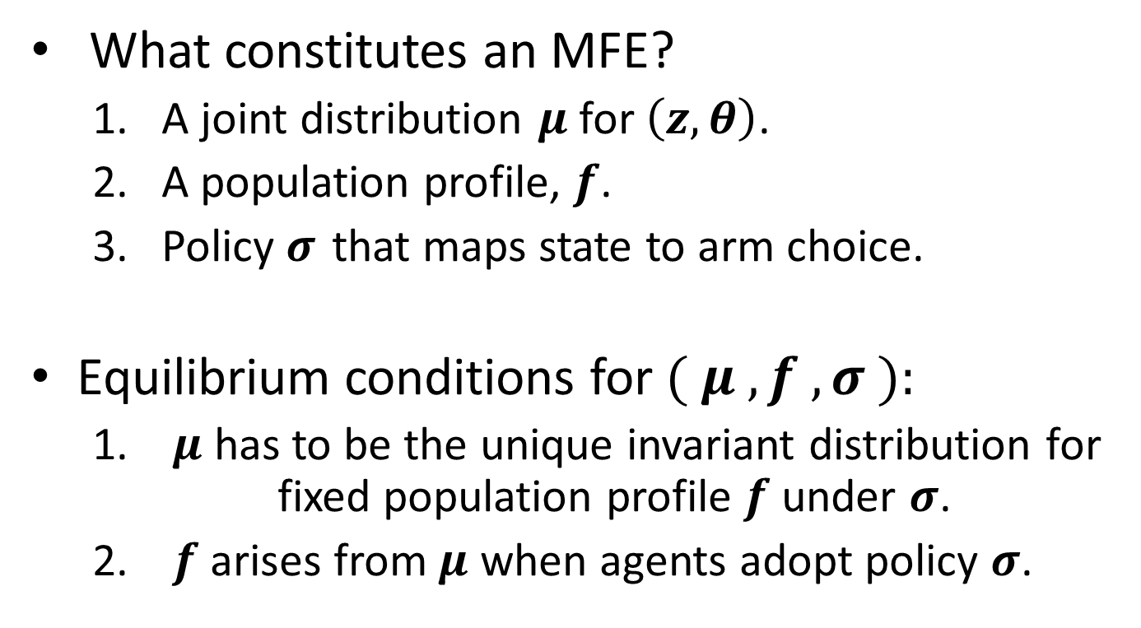
The Equilibrium Concept
What constitutes an MFE?
A joint distribution $μ$ for $\left(z,θ\right)\text{.}$
A population profile, $f\text{.}$
Policy $σ$ that maps state to arm choice.
Equilibrium conditions for $( μ , f , σ ):$
$μ$ has to be the unique invariant distribution for fixed population profile $f$ under $σ$.
$f$arises from $μ$ when agents adopt policy $σ\text{.}$
Notes:
Let me now specify what an equilibrium is.
It has three components.
The first is a joint distribution for the agent population on the state and type space, denoted mu.
The second is a population profile, f.
The third is the policy sigma.
Equilibrium conditions for this triple are:
If we fix the population profile constant at f, and look at the evolution of an agent’s state and type over time, this should converge to the unique stationary joint distribution mu.
The second condition requires that f should in fact be the population profile that arises when agent population in steady state mu uses policy sigma.

Slide 13
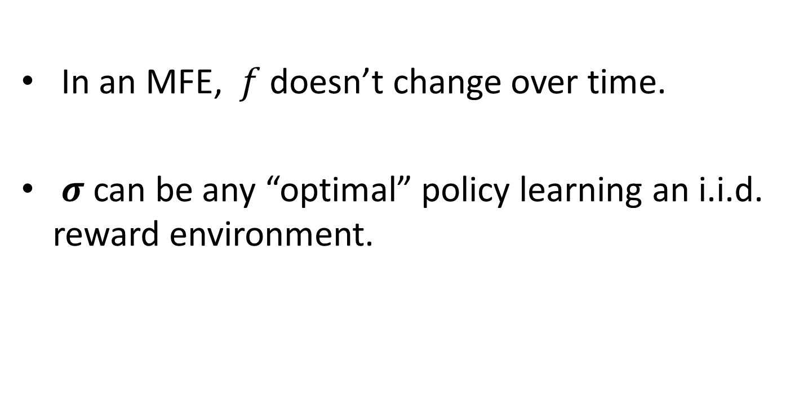
Optimality in Equilibrium
In an MFE, $f$ doesn’t change over time.
$σ$ can be any “optimal” policy learning an i.i.d. reward environment.
Notes:
A remark here is that we did not explictly discuss why agents find it acceptable to use some arbitrary sigma. The answer is that sigma could be any policy that agents consider optimal when the reward distribution is i.i.d., i.e. from the classical bandit framework. Since this holds in an equilibrium, such a policy is indeed optimal.

Slide 14
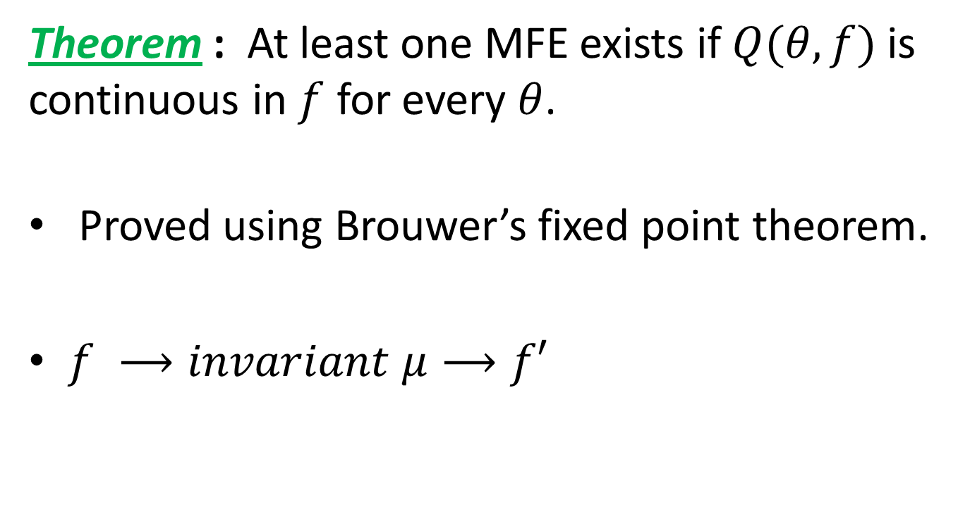
Existence of MFE
Theorem : At least one MFE exists if $Q(θ,f)$is continuous in $f$ for every $θ$.
Proved using Brouwer’s fixed point theorem.
$f ⟶invariant μ⟶f′$
Notes:
Our first result argues that an equilibrium exists whenever the reward function is cts in f for every theta.
The proof is fairly straightfoward and involves deriving conditions for continuity two mappings implicit in the equilibrium definition and then using brouwer’s fixed point theorem on their composition.

Slide 15
Beyond Existence
MFE exists, but when is it unique?
Can agent dynamics find such an equilibrium even if it is unique?
How does the mean field model approximate a system with finitely many agents?
Notes:
What can we say beyond existence?
When is it unique?
Even if it is unique, can the natural agent dynamics lead to such equilibrium?
And finally, how do we relate a finite agent model to the mean field model formally?

Slide 16
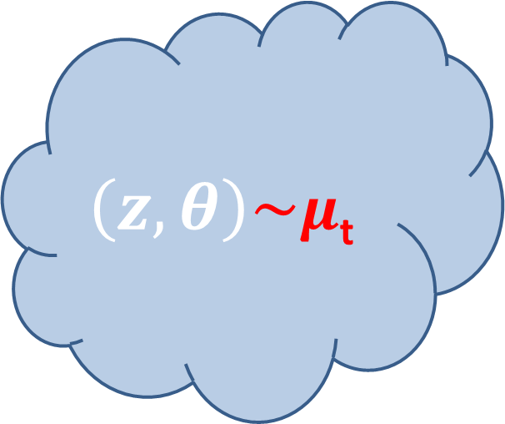
Dynamics
Arms
1
2
3
.
i
.
n
$$\left(z,θ\right)\sim μ\text{t}$$
Notes:
Lets start by taking a closer look at the dynamics.
Lets say we start with an agent population distributed according to mu_t at time t.
This results in a population profile ft.
Based on ft and the reward function Q(), the agent population collectively transitions into a new dist. Mu t+1.
We are interested in how this sequence of distributions behaves.
What makes this difficult is the fact that the transition kernel for (zt, thetat) changes over time, because it depends on f_t and f_t is not constant unless we start at an equilibrium.

Slide 17
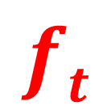
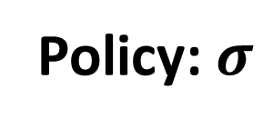
Dynamics
Arms
1
2
3
.
i
.
n
$$\left(z,θ\right)\sim μ\text{t}$$
Policy: $σ$
$$ft$$
Notes:
Lets start by taking a closer look at the dynamics.
Lets say we start with an agent population distributed according to mu_t at time t.
This results in a population profile ft.
Based on ft and the reward function Q(), the agent population collectively transitions into a new dist. Mu t+1.
We are interested in how this sequence of distributions behaves.
What makes this difficult is the fact that the transition kernel for (zt, thetat) changes over time, because it depends on f_t and f_t is not constant unless we start at an equilibrium.

Slide 18
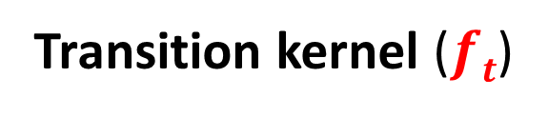
Dynamics
Arms
1
2
3
.
i
.
n
$$\left(z,θ\right)\sim μ\text{t}$$
Policy: $σ$
$$ft$$
Transition kernel ($ft$)
Notes:
Lets start by taking a closer look at the dynamics.
Lets say we start with an agent population distributed according to mu_t at time t.
This results in a population profile ft.
Based on ft and the reward function Q(), the agent population collectively transitions into a new dist. Mu t+1.
We are interested in how this sequence of distributions behaves.
What makes this difficult is the fact that the transition kernel for (zt, thetat) changes over time, because it depends on f_t and f_t is not constant unless we start at an equilibrium.

Slide 19
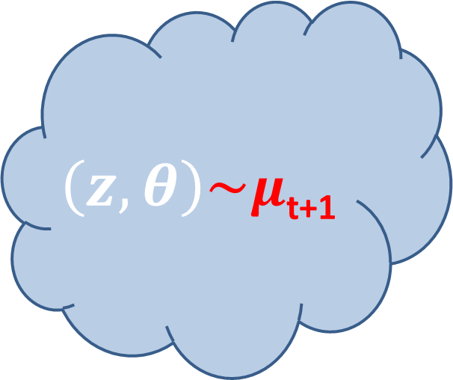
Dynamics
Arms
1
2
3
.
i
.
n
$$\left(z,θ\right)\sim μ\text{t}\text{+1}$$
Policy: $σ$
$$ft$$
Transition kernel ($ft$)
Notes:
Lets start by taking a closer look at the dynamics.
Lets say we start with an agent population distributed according to mu_t at time t.
This results in a population profile ft.
Based on ft and the reward function Q(), the agent population collectively transitions into a new dist. Mu t+1.
We are interested in how this sequence of distributions behaves.
What makes this difficult is the fact that the transition kernel for (zt, thetat) changes over time, because it depends on f_t and f_t is not constant unless we start at an equilibrium.

Slide 20
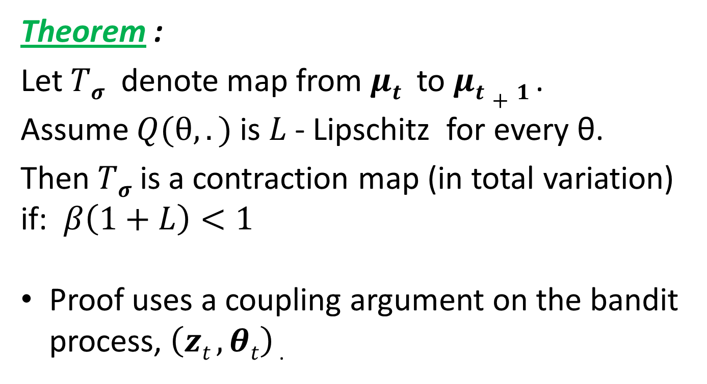
Dynamics
Theorem :
Let $Tσ$ denote map from $μt$ to $μt+1$.
Assume $Q(θ,.)$is $L$- Lipschitz for every θ.
Then $Tσ$ is a contraction map (in total variation) if: $β\left(1+L\right)<1$
Proof uses a coupling argument on the bandit process, $\left(zt , θt\right)$.
Notes:
Lets call the map tsigma.
Assume that the reward function is lipschitz in f for every theta with a lipschitz constant L, i.e. loosely speaking the partial derivative w.r.t. f is never more than L.
Then we show that tsigma is a contraction map when beta (1+L) <1.
Recall that we have a contraction when the map strictly shrinks the distance between any two elements by a multiplicative factor.
The proof uses a nice property of the total variation distance, which says that given two distributions mu_a and mu_b, the total variation distance between them is equal to the minimum possible probability that two random variables A and B are unequal, while having marginals mu_a and mu_b.
Using this, we can bound the tvar distance between the Tsigma maps of two arbitrary measures by defining an appropriate coupling on the one step transitions of their associated bandit processes.

Slide 21
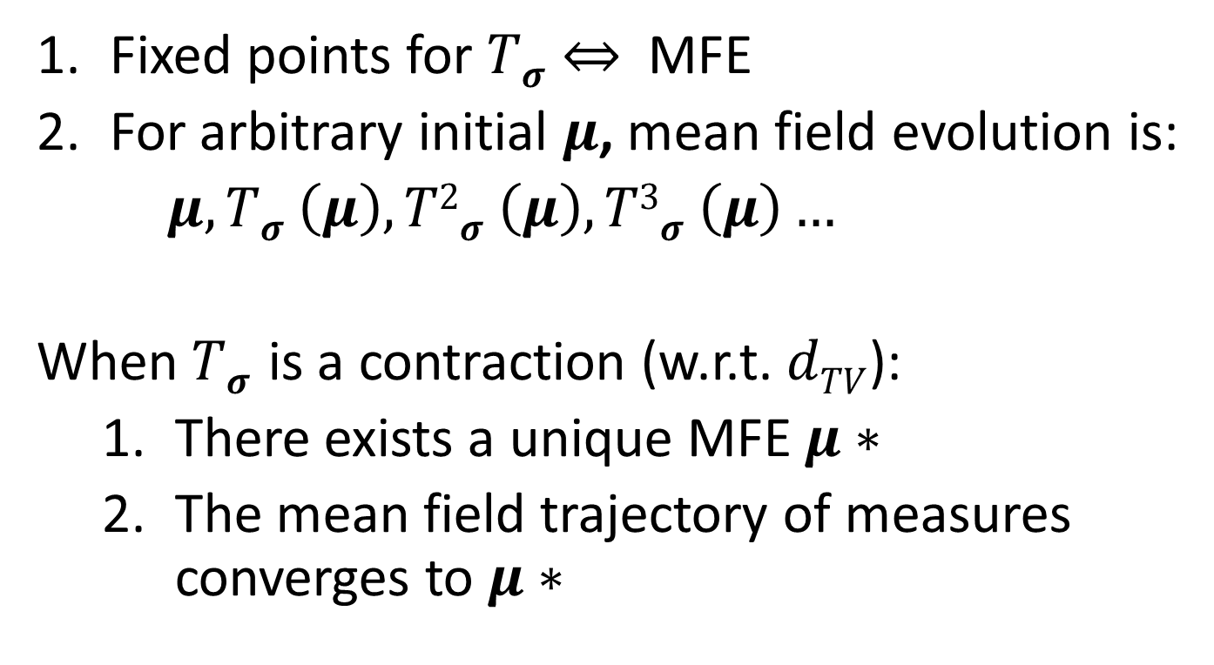
Uniqueness and Convergence
Fixed points for $Tσ⇔$ MFE
For arbitrary initial $μ$, mean field evolution is:
$μ, Tσ \left(μ\right), T2σ \left(μ\right), T3σ \left(μ\right)…$
When $Tσ$is a contraction (w.r.t. $dTV$):
There exists a unique MFE $μ∗$
The mean field trajectory of measures converges to $μ∗$
Notes:
The previous theorem has strong implications for uniqueness and convergence.
Note that a fixed point to the map Tsigma gives us an MFE and vice versa.
Also, repeated application of tsigma gives us the trajectory of measures associated with the bandit process.
So, when tsgima, is a contraction, not only does it have a unique fixed point, in other words, a unique MFE -- Moreover, agent dynamics starting from any arbitrary situation converge exponentially to this unique MFE mu*

Slide 22
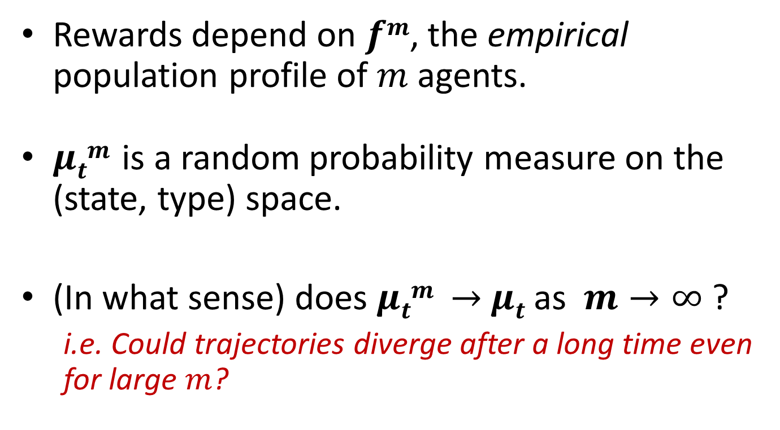
Finite Systems to Limit Model
Rewards depend on $fm$, the empirical population profile of $m$ agents.
$μtm$is a random probability measure on the (state, type) space.
(In what sense) does $μtm →$ $μt$ as $m→∞$ ?
i.e. Could trajectories diverge after a long time even for large $m$?
Notes:
So far, we have been talking exclusively about the infinite agent model. The main difference in a finite agent model is that reward function actually depends on the empirical population profile – we get the mean field model when we replace this random variable with its expectation
The measure mu_t was a probability distribution for the agent population which is a deterministic quantity. For a system of finite agents, its analogue has the superscript m, and denotes a *random variable* whose value is a proability measure on the (state type) space.
The main question is how does this empirical measure, which is a random variable, converge to the limiting distribution as the system size grows. What is easier to see is that if we fix the time, then based on LLN arguemnts, we get convergence. But this leaves open the possibility that trajectories could diverge eventually even for large m, after a large enough time.

Slide 23
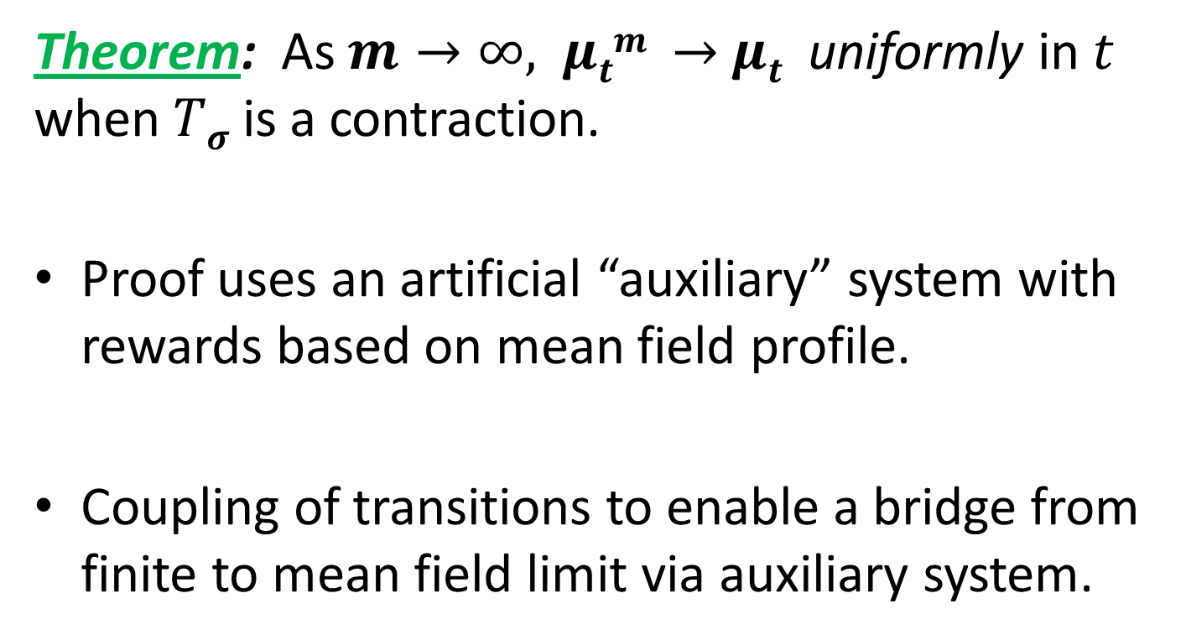
Approximation Property
Theorem: As $m→∞,$ $μtm →$ $μt$ uniformly in $t$ when $Tσ$ is a contraction.
Proof uses an artificial “auxiliary” system with rewards based on mean field profile.
Coupling of transitions to enable a bridge from finite to mean field limit via auxiliary system.
Notes:
Under the same condition that leads tsgima to be a contraction, we have a fairly strong statement for approximation which says that the emprical sequence of measures converges uniformly in time to the mean field limit. Therefore, if we let a large finite system evolve according to the natural MAB dynamics, it gets arbitrarily close to the unique MFE, which has some fairly strong implications from a practical standpoint.
To relate the finite agent system to the mean field limit, we introduce a hypothetical finite agent system called the auxiliary system, which nevertheless transitions based on the mean field limit and is therefore easier to relate to the mean field limit. It is then coupled with the finite system carefully and acts as a bridge between the two.

Slide 24
Conclusion
Agent populations converge to a mean field equilibrium using classical bandit algorithms.
Large agent population effectively mitigates non-stationarity in MAB games.
Interesting theoretical results beyond existence: uniqueness, convergence and approximation.
Insights are more general than theorem conditions strictly imply.
Notes:
To conclude we see that under appropriate conditions, large agent populations converge to a mean field equilibrium by using classical bandit algorithms.
Large agent populations can potentially mitigate the non stationarity that would arise from interlinked MAB problems.
In fact, these insights appear to hold more generally than the conditions needed for the theorems. This is not to say that the theorems are loose, because when these conditions fail, it is possible to design examples that don’t show uniqueness, but there are many situations that fall well outside the guarantees whose dynamics nevertheless show convergence.
These results are of particular theoretical interest because characterizations beyond existence are not common.
We also have some further work, which obtains another condition for unique MFE specifically for negative externalities by assuming a fairly mild condition on the policy used by the agents. This states that the arm choice has positive sensitivity to arm reward, in other words, if we bump up the reward distribution on certain arms while lowering it on others, then the policy used by the agent should make it more likely for it to choose the subset with higher rewards at all times.

