Slide 1

A new search for optimal binary arrays with minimum peak sidelobe levels
Gummadi S. Ramakrishna
Indian Institute of Technology, Madras
Wai Ho Mow
Hong Kong University of Science & Technology

Slide 2
Practical Motivations
Arrays are high-dimensional generalizations of sequences with growing no. of applications:
Code-fed omni-directional loudspeaker arrays (Kutruff-Quadt’82, El-Kamy et al.’89)
High resolution pulse compression radar (Alquaddoomi-Scholtz’89)
2D synchronization or positioning
2D system identification
Coded aperture imaging (Luke et al.’9x?)
Spread spectrum/CDMA watermarking (Tirkel et al.’93)
Multicarrier CDMA or MIMO-OFDMA (?)
…… more with the n-D CDMA interpretation

Slide 3
2D CDMA
f
t
Each active user is (adaptively) allocated a 2D (time-frequency or space-frequency) sub-block.
As in an TD-OFDMA scheme, no inter-user interference is resulted.

Slide 4
2D CDMA
f
t
When the area (or spreading factor) of each user’s sub-block is larger than the per-user area available, inter-user interference can be expressed in terms of the 2D aperiodic autocorrelation.

Slide 5
Theoretical Motivations
The best known minimum peak (aperiodic) sidelobe (MPS) level for polyphase (actually, specific Frank & Chu) sequences is O(√L).
But the MPS level of the best binary sequences seems to be a very slowly increasing function of L, maybe sub-log(L).
In fact, polyphase Barker sequences are known up to length 45 due to Brenner’98 (also Chang-Golomb, Bomer-Antweiler, Friese-Zottmann).
The gap is large, and we need more empirical observations on the pattern of MPS sequences.
Perhaps, we can see something in the higher dimensional MPS arrays … if we’re lucky!

Slide 6
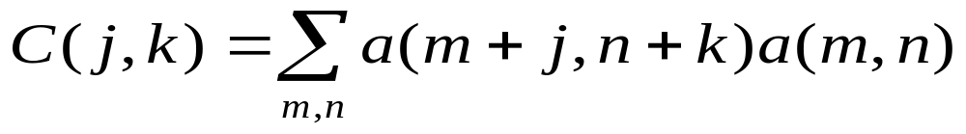
2D aperiodic autocorrelation
Consider a 2D binary array a, of size M x N with either 1 or –1 for each of its elements.
Its 2D aperiodic autocorrelation is defined by
(Here, we take a(m,n) as 0 when m or n are not in the ranges [1,M] and [1,N] respectively)
If all sidelobe levels |C (j,k)| are at most 1, it is called a Barker array.

Slide 7
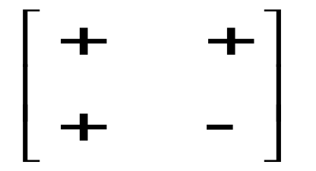
Any Barker array?
YES, there exists one:
… and is very likely to be the only one (up to some sidelobe-invariant transforms)!
Strong evidences of non-existence (Alquaddoomi-Scholtz’89, Jedwab’9x) are known and are closely related to Ryser’s Conjecture (originally put in difference set terminology) that no perfect binary sequence exists except the one
[+ + + −]
(up to some sidelobe-invariant transforms)

Slide 8
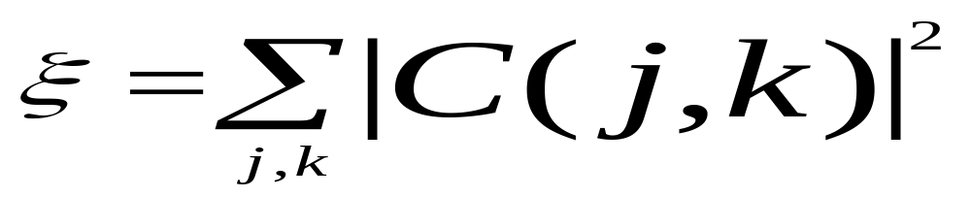
MPS arrays
The aim is to find the arrays which achieve minimum peak sidelobe (MPS) level, i.e., the minimum value for the maximum value of its |C(j,k)| ranging over all (j,k).
Such arrays which achieve this condition are called the optimal or MPS arrays and are the next best things to search for after Barker arrays.
A second criterion for obtaining good arrays is the smallest sidelobe energy (SSE)

Slide 9

Sidelobe invariant transformations
The sidelobe invariant transformations (SIT) which preserve 2D autocorrelation sidelobes:
Complementation----C
Horizontal Reversal----H
Vertical reversal-----V
Alternate row complementation--- P
Alternate column complementation----Q

Slide 10

Sidelobe invariant transformations
Each of the above transformations is of order 2 and let G denote the group that their combinations form.
This group acting on the set of all 2D arrays of a given size M x N and divides them into equivalence classes.
Let us identify a representative array from each equivalence class as the one that is the lexicographically smallest string read in row wise order with the 0/1-valued elements as logarithms to base –1 of the array values.

Slide 11
The order of the group G is 32
Proof is easily accomplished by establishing a one to one relation between the set G and the cross product of the 5 basic order 2 groups of the transformations C,H,V,P,Q.
We use the commutation relations between these elements during the proof. These commutation relations are written in the next slide.

Slide 12
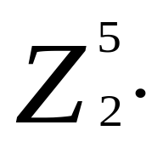

The structure of G
Already seen that its order is 32
The actual structure depends on the relations between the generating elements which depends on the parity of the dimension
All relations between C,H,V,P,Q are commutative except:
  When M is even, PV=CVP
  When N is even, QH=CHQ
For M and N both odd, neither special case arises and G is isomorphic to

Slide 13
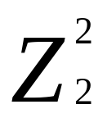
The structure of G
Suppose M is even and N is odd, then we have only one non-commutative relation which is PV=CVP. Also Q and H commutate with all the elements.
G can be decomposed as a direct product of the subgroup of order 8 formed by <C,V,P> and the group of order 4 by <Q,H>, which is

Slide 14
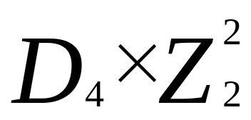
The structure of G
From the defining relations, one notes that the subgroup of order 8 formed by <C,V,P> is the order-8 dihedral group. So the structure is
By symmetry, the case of M odd and N even has a similar structure except that <C,H,Q> forms the dihedral group and <V,Q> forms the order 4 abelian group.

Slide 15
The structure of G
When M and N are both even and we have both the non-commutative relations occuring simultaneously.
G can then be identified as the central product of 2 order-8 dihedral groups of order 8 with C being the amalgamated element in the direct product. The 2 dihedral groups are <C,V,P> and <C,H,Q>.
The presentation relations have been compared and analyzed to identify that the structure of the group in this case is the “Extra special group of order 32 and type plus”.

Slide 16
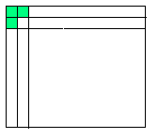
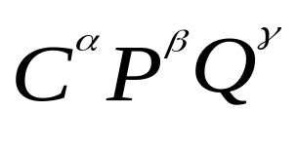
Representative array
Given an array a, we transform it into N(a) defined so that the three elements, a(1,1) , a(2,1) and a(1,2) are all normalized to 1.
With the exponents appropriately defined,
N(a)=

Slide 17
Representative array
Note that N(a) is the lex smallest element in the equivalence class of ‘a’ due to the subgroup generated by <C,P,Q>
Reason: N is the unique transform in the subgroup generated by <C,P,Q> such that the transformed array, N(a) satisfies the condition that all the three elements, a(1,1), a(1,2), a(2,1) are 1.

Slide 18
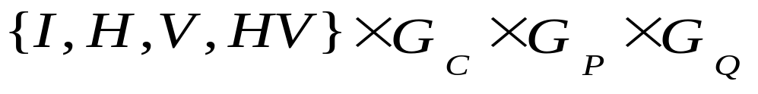
Representative array
Theorem: “a” is a representative element iff it is identical to the lex smallest of the four arrays, { N(a), N(H(a)), N(V(a)), N(HV(a))}
Proof: Decompose G into the union of four sets each corresponding to I,H,V,HV from
Using the previous result on a, H(a), V(a) and HV(a) seperately, we see that the lex smallest of each of these sets are the 4 listed arrays and hence the lex smallest in the whole class must be among these four arrays.

Slide 19
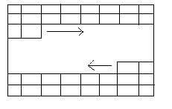
The search algorithm
The basic structure of the algorithm is the depth first backtracking search (Golumb-Baumert’65). Traversing down a path corresponds to assigning specific values to the array elements in a specific order. Backtracking conditions are used to avoid the useless paths. The order in which we fill the elements should be chosen to give stronger backtrack conditions early. The figure shows the order we adopted.
It is conceptually important to distinguish the backtrack conditions into 2 types.

Slide 20
Conditions of the First type
The first type is a consequence of the group of SIT’s. Ideally, the search should only generate and evaluate representative arrays. How efficient this can be achieved depends on the group structure.
These backtrack conditions implement a procedure to continually verify the condition of the last theorem and allow only paths where there is a possibility of representative arrays.
Checking that N(a) is not lex smaller than ‘a’ is easy. We could just set a(1,1) and a(2,1) and a(1,2) to 1 to begin with and avoid any more checking on this.

Slide 21
Condition of the First type
For checking if N(H(a)) is not lex smaller than ‘a’ for any possible completion of the reminder of the partially filled a, we need to compare the normalized version of the H-reversed array with the original.
But we don’t need to do this for all the arrays during the search – only as long as the immediate parent node returned an equality between a and N(H(a)) since an inequality at the parent node prevails with the children nodes and we can use a flag to remember this.
Checking for the other cases of N(V(a)) and N(HV(a)) is identical.

Slide 22
Condition of the Second type
These are related to the cost function to be optimized (i.e. autocorrelation constraints here). Basic purpose is to backtrack when a correlation coefficient exceeds some stipulated threshold.
To do this efficiently, we maintain an array of correlation coefficients [C(j,k)] where j ranges from –M+1 to M-1 and k from 0 to N-1. This array stores the partially determined coefficient values at each stage of the algorithm and is updated continuously. It is all zeros to begin with, and at an intermediate stage we can define its values by setting 0 for the not-yet-determined array values in the summation expression for C(j,k).

Slide 23
Implementation details
We also maintain another array zero(j,k) which indicates the number of terms that are zero while evaluating the partial C(j,k).
By analyzing the specific expression for C(j,k) with the summation limits one can verify that the total number of terms is (M-|j|) * (N-k). Hence at the beginning of the algorithm, the array zero(j,k) is initialized to this.
We update the affected portions of the arrays C(j,k) and zero(j,k) after every addition/backtrack in the array by making differential increments on C(j,k) and zero(j,k) at each point during the search.

Slide 24
Implementation details
This is done by evaluating which portions of [C(j,k)] are affected by an array element a(p,q) from the summation.
For a(p,q) occurring as the first term in the summation, the range turns out to be j = 1-p to M-p and k = 0 to N-q. For a(p,q) occurring as the second term in the summation, this range turns out to be j = p-M to p-1 and k = 0 to q-1.
This gives a minimal way of calculating the autocorrelation values. We make similar updates on zero(j,k) as well.

Slide 25
Updating the autocorrelation array
1. For j=1-p to M-p
For k=0 to N-q
if t = a(p,q) * a(p+j,q+k) is non-zero,
i) increment C(j,k) by t
ii) decrement zero(j,k) by 1.
2. For j=p-M to p-1
For k=0 to q-1
if t = a(p-j,q-k) * a(p,q) is non-zero,
i) increment C(j,k) by t
ii) decrement zero(j,k) by 1.
The above procedure is while giving a new non-zero value to a(p,q). We have similar updates while backtracking (changing a(p,q) to zero from a non-zero value) also.

Slide 26

Implementation details
Now that we have an array of correlations in hand, we can evaluate any backtrack condition on correlation values readily.
Clearly, the following is a backtrack condition for any (j,k) . The right hand side is the peak sidelobe threshold.

Slide 27
Code symmetry & reduced group
Applying the group G on the representative array need not in general create an isomorphic group of 32 arrays. It might be reduced when there is some kind of symmetry in the array.
The group would then be a reduced group of 16 or 8 elements and can be characterized based on the type of symmetry present. e.g., the presence of symmetry in either vertical or horizontal direction collapses a dihedral group D4 to a cyclic group Z4.
Knowing the group structure of SITs, all arrays in the same equivalence class can be generated efficiently from the representative, without generating all arrays & then eliminating repetition.

Slide 28
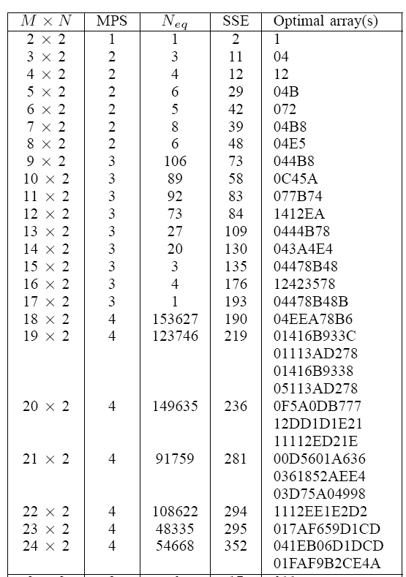
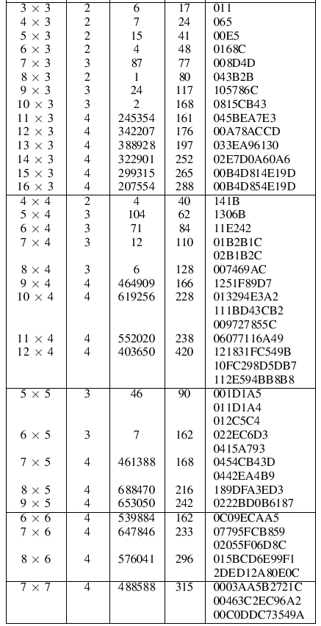
Result: MPS arrays with MN=<49
New MPS arrays
found
Neq for MPS sequences with L=<51 is known.

Slide 29
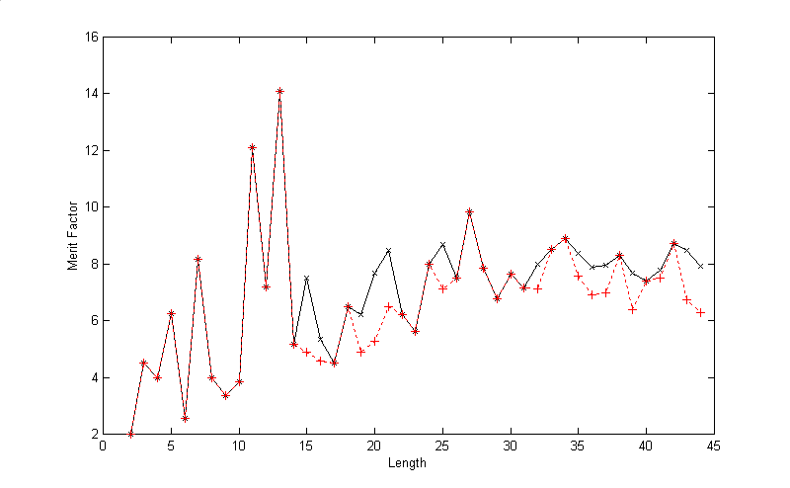
Is MPS a good sieve for Merit Factor?
Solid line: Optimal Merit Factor
Dashed line: Max MF of MPS sequences
Not bad for the sequence case!
Unfortunately, we don’t have the 2D results on Merit Factors for comparison.

Slide 30
Summary
The group structure for the 2D sidelobe-invariant transforms was presented
Efficient backtracking search algorithm that takes advantages of the group structure of sidelobe-invariant transformations was developed.
As a consequence of carrying out the search, numerous new MPS arrays with area up to 49 elements have been discovered and listed.

Slide 31
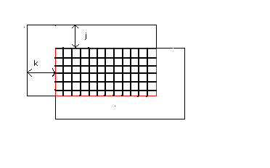
The overlapping area indicates the summation terms

