Slide 1

Distributed DGEMM
Using the Message Passing Interface (MPI)
Devashish Gupta
CSE 6230 High Performance Parallel Computing

Slide 2
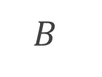
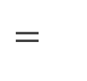
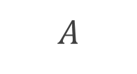

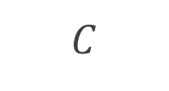
The problem
Double precision general matrix multiplication
$$dgemm\left(A,B,C,α,β\right): αAB+βC→C$$
$$×$$
$$B$$
$$=$$
4608 x 18432
$$C$$
$$A$$
36864 x 4608
36864 x 18432
Devashish Gupta

Slide 3



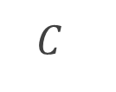



Domain decomposition
Determining the workloads for each process
2D decomposition
$$C$$
Column major
$$p=4$$
$$p=8$$
$$p=16$$
Policy
Preferential subdivision
along column axis
Devashish Gupta
Result
Better cache behaviour
$$p=32$$
$$p=64$$
$$p=128$$

Slide 4

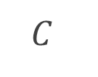
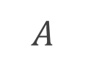

Domain decomposition
Decomposing A and B
Processor grid, $p=4$
r1
b1
b2
r1
b1
r1
b2
$$C$$
r2
b3
b4
c1
c2
$$A$$
Rank 0
Rank 1
c1
c2
$$B$$
r2
b3
r2
b4
Global matrices
c1
c2
Devashish Gupta
Rank 2
Rank 3

Slide 5
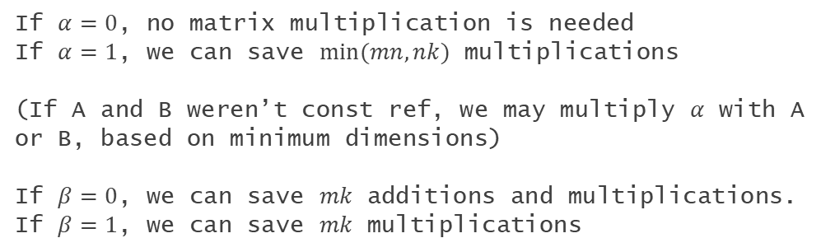
Observations
Potential optimizations
A and B scatters are independent
We can leverage non-blocking scatters for A and B to maximize bandwidth utilization.
Scalar and local dimension broadcasts are independent
The MPI datatypes for scalars and dimensions are different (MPI_Double and MPI_UINT64_T), so they need different broadcast calls. However, they are independent.
Local computation can be specialized based on $α$ and $β$
If $α=0$, no matrix multiplication is needed
If $α=1$, we can save $\min{(mn, nk)}$ multiplications
(If A and B weren’t const ref, we may multiply $α$ with A or B, based on minimum dimensions)
If $β=0$, we can save $mk$ additions and multiplications.
If $β=1$, we can save $mk$ multiplications
Devashish Gupta

Slide 6

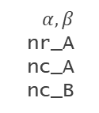
The algorithm
A quick walkthrough
Scalar Ibcast
Communicator
setup
Global matrix
allocation
scatter()
MPI_Waitall
Dim Ibcast
r1
Rank 0
$α, β$ nr_A nc_A nc_B
r2
r3
Rank conditioned
r4
c1
c2
c3
c4
A Iscatterv
Custom datatype creation: A, C
Scatter offsets & disp calc
B Iscatter
MPI_Waitall
C Iscatterv
A,B Ibcast
Local computation
gather()
Correctness check
Devashish Gupta
$$αAB+βC→C$$
C gatherv

Slide 7
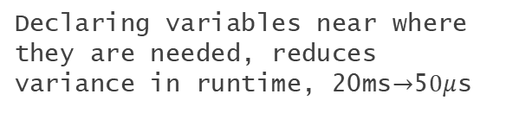
Local computation
A few highlights
Loop blocking optimization
Using OMP, if available
Better cache locality and coherence, block size: 64
parallel for with collapse(3) can speed up the computation.
JKI loop order
Variable declare locality
Best cache behaviour for column major matrices. Blocked order: jj, kk, ii, j, k ,i
Declaring variables near where they are needed, reduces variance in runtime, 20ms$→$5$0μ$s
Variable declare order
Loop invariant optimization
Most frequently accessed variables declared last. Reduces variance in runtime.
B_ = B.values[j * A_ncols + k];
Values of B do not change in inner most loop. Eliminates repeated array access, uses a register.
$α, β$ - specialization
FMA instructions
Significant additions and multiplications can be saved in special cases.
Devashish Gupta
M.values[j * A_nrows + i] += A.values[k * A_nrows + i] * B_;
Compiler uses FMA instructions for index calculation.

Slide 8
The code
Actual implementation
Devashish Gupta

Slide 9
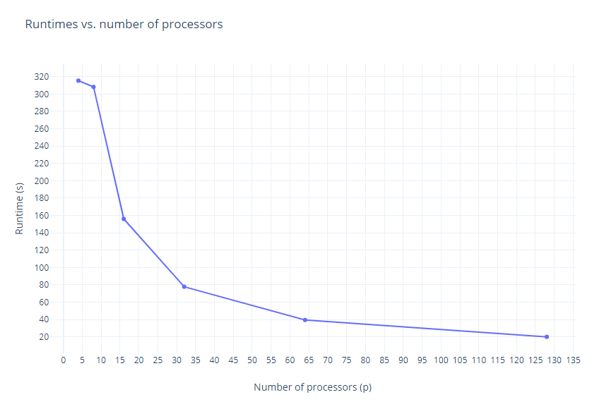

Performance
Let’s look at the metrics
Around 20s runtime
at $p=128$
Devashish Gupta

Slide 10
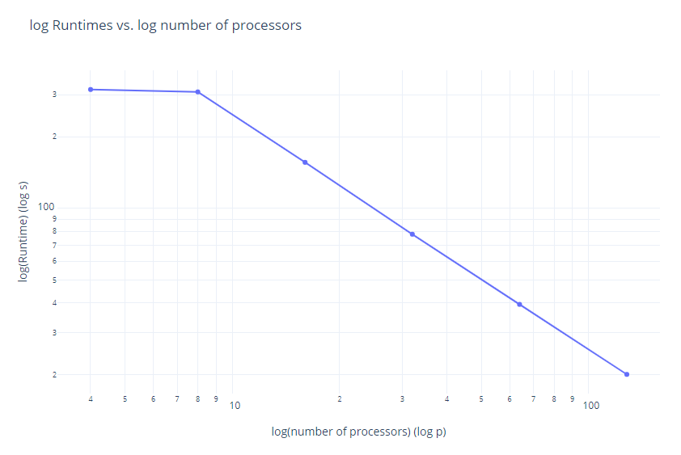

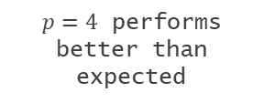
Performance
Let’s look at the metrics
$p=4$ performs better than expected
Linear for $p>8$
Devashish Gupta

Slide 11
Thanks!
Questions?

