Slide 1
Anime CRP (Anime Classifier, Recommender and Predictor)
Luddy school of informatics, computing and engineering
Eswar Eanumula,
Ram D. Kiran,
Gowri Badugu.
INDIANA UNIVERSITY BLOOMINGTON

Slide 2
Problem statement
SECTION 1

Slide 3

Motivation
To build an Anime CRP system(classifier, recommender and predictor) !
For a given user’s interests, can we recommend few anime?
Can we group all the anime based on few categories ?
Based on the anime watch history of the user, can we predict the anime he’s going to watch next ?

Slide 4
Objective
SECTION 1

Slide 5
Basic Idea
Import Dataset
EDA
Created a data frame using pandas module by importing anime.csv file which was downloaded from Kaggle.com
Exploratory Data Analysis (EDA) on anime.csv dataset with 18k records.
Classifying the anime based on attributes like genre, rating, popularity and no. of episodes.
Clustering the anime based on no of episodes to recommend top anime in a specific category(Beginner, Pro, and Advanced) with the limitation of episodes count.
KNN Classification to build a Recommender
Recommender
K means clustering for categorial recommendation
Clustring
Predictor
Results

Slide 6
Exploratory Data Analysis(EDA)
SECTION 2

Slide 7
Observations and Corrections on the data
Observations | Corrections
It is found that img_url & link columns are unnecessary and redundant attributes for the requirement. | So, these attributes are dropped from the data frame created.
Found duplicates based on Anime_ID in the data frame. | Removed the duplicate rows from the data frame created.
Found null values for some attributes in the data frame. | Replaced those with mean values of respective attribute.

Slide 8
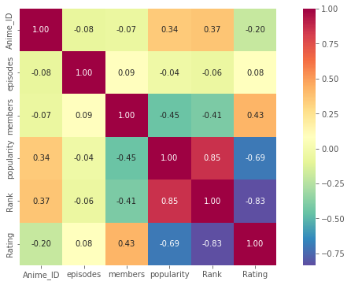
Renamed the column names (uid, ranked, score) to make sure, they convey the actual meaning.
From this plot, we can say that :
Rank and Rating are inversely proportional.
Rank and popularity are directly proportional.

Slide 9
Classification
SECTION 3

Slide 10
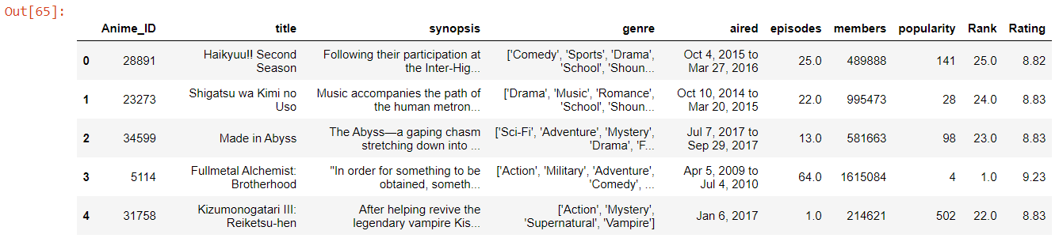
Recommender
Objective: User gives his/her preferences through metrics like(Genre, Ranking, Popularity & No. of episodes) and K value, which should return K anime’s which are recommendable based on those preferences.
Applied classification based on K-Nearest Neighbors(KNN) using Euclidean distance as proximity metric.
For the attribute Ranking, the respective values are considered as ‘0’ if the preferred value is more or else it is considered as ‘1’. The value ‘1’ refers it is very distant to unlabeled row.

Slide 11
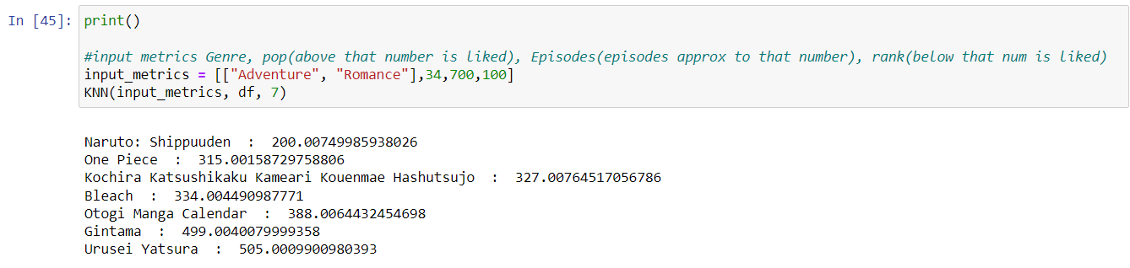
For the attribute Popularity, the respective values are considered as ‘1’ if the preferred value is more or else it is considered as ‘1’. The value ‘1’ refers it is very distant to unlabeled row.
Then, Euclidean distance is computed between all the records and unlabeled record and found the K nearest neighboring anime’s.

Slide 12
Clustering
SECTION 4

Slide 13
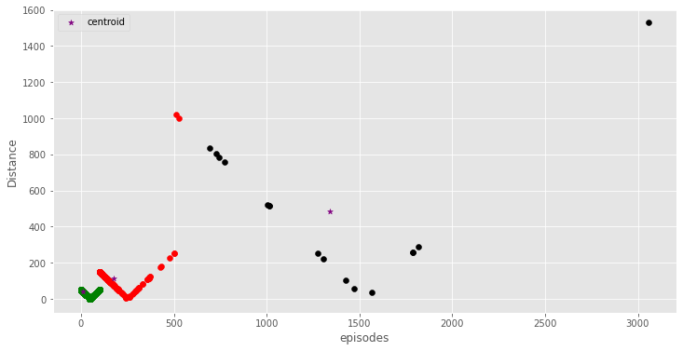
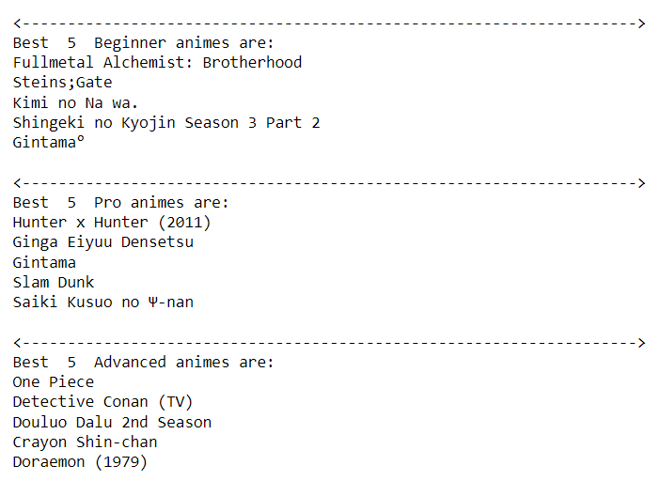
On basis of episode count
Our aim of clustering?
Based on the popularity and rating, can we group the anime into best, worst or avg ?
Based on the episodes count can we group the anime?
We wanted to group our anime dataset into clusters, enabling the user to choose the category from which the anime can be recommended.
The user should get a recommendation of top ‘k’ ranked anime from a selected category.
What are the best/top 5 anime with 500 or less num of episodes?

Slide 14
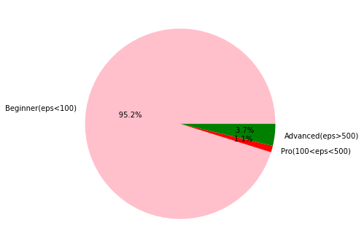
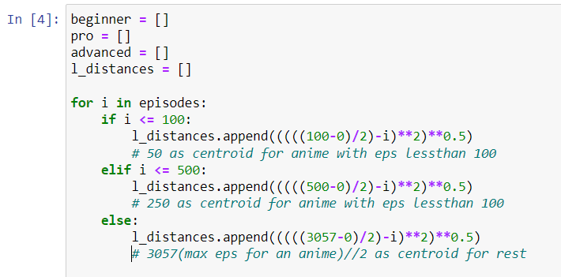
K means clustering
No of Clusters ? Centroids ? K = 3
Taking episodes column, we calculated 3 centroids
Using Euclidean distance, we found the anime nearest to these 3 centroids and clustered them.

Slide 15
Future Scope Can we predict the anime which a given user is going to watch next?
SECTION 5

Slide 16
Association Rules?
Based on a given user’s anime watch history, predicting the anime’s he/she is going to watch next.
How will we able to do it?
This predictor would be helpful for anime streaming websites !

Slide 17
Thank you
Arigatou Gozaimasu ☺

