Slide 1
Lecture by Dr. Srinivasa Rao Kola Department of MACS NITK, Surathkal

Slide 2
POSETS
(PARTIALLY ORDERED SETS)

Slide 3
POSETS
Posets
Totally ordered sets (Chains)
Lexicographic Ordering
Hasse Diagrams
Topological Sorting
Examples

Slide 4
POSET
A relation R on a set A is a partial order or partial ordering if it is reflexive, antisymmetric and transitive.
Poset:
A set A together with a partial order R defined on it, denoted by (A, R), is called a Partial Ordered set or Poset in short.
(A, ≤) and (A, ≥), are posets where
(A, |) is a poset, where
is a poset, where A is set
Notation:
A partial order is denoted by

Slide 5
Comparability
Let
be a poset. Let x, y є A.
We say that x and y are comparable if
We say that x and y are incomparable if
Example:
In the poset (A, |), where A = {2, 3, 6, 12, 24, 36}
Incomparable: 2, 3 ; 24, 36
2 is comparable with every element of A, except 3.
3 is comparable with every element of A, except 2.

Slide 6
Totally Ordered Sets
Let
be a poset.
If every two elements of A are comparable w.r.t the partial order
, then the partial order
is called a
total order or linear order and
is called totally
ordered set or a linearly ordered set or a chain.
Example:
The poset (A, ≤) is a chain, where
because for any x, y є A, we have
The poset (A, |), A = {2, 3, 6, 12, 24, 36} is a not a chain.
because, we have elements 2, 3 which are incomparable.

Slide 7

Hasse diagrams of finite posets
Draw the diagraph of the poset
Step – 1: Delete the loop at each vertex.
Step – 2: Delete all edges implied by transitivity
Step – 3: Omit all arrows and arrange all edges pointing
upward.
The resulting diagram is called Hasse diagram.
These diagrams are named after the 20th century German mathematician Helmut Hasse (1998 – 1979).

Slide 8
Example – 1
Draw Hasse diagram of the poset (A, |), where
A = {2, 3, 6, 12, 24, 36}
>
O
24
>
O
>
36
>
>
>
>
>
>
>
>
O
>
O
>
12
>
6
>
>
>
2
O
O
3
>
>
Draw the diagraph

Slide 9
Example – 1
Draw Hasse diagram of the poset (A, |), where
A = {2, 3, 6, 12, 24, 36}
>
O
24
>
O
>
36
>
>
>
>
>
>
>
>
O
>
O
>
12
>
6
>
>
>
2
O
O
3
>
>
Step – 1
Delete loop at each vertex

Slide 10
Example – 1
Draw Hasse diagram of the poset (A, |), where
A = {2, 3, 6, 12, 24, 36}
24
O
O
36
O
24
>
O
36
>
O
12
>
>
>
>
>
>
O
>
O
12
>
6
O
6
>
>
>
2
O
O
3
2
O
O
3
Step – 2
Delete all edges implied by transitivity (2, 12), (2, 24), (2, 36), (3, 12), (3, 24), (3, 36), (6, 24), (6, 36)
Step – 3
Omit all arrows and arrange all edges pointing upwards

Slide 11
Example – 2
Let n be a given natural number
Let D_{n} be the set of positive divisors of n.
Then (D_{n} , |) is a poset.
(D₁, |) , D₁ = {1} chain
(D₂, |), D₂ = {1, 2}
(D₆, |), D₆ = {1, 2, 3, 6}
(D₈, |), D₈ = {1, 2, 4, 8}
O
O
2
1
6
O
O
8
O
1
O
3
O
2
O
4
O
1
O
2
O
1

Slide 12
Example – 2
30
(v) (D₃₀, |), D₃₀ = {1, 2, 3, 5, 6, 10, 15, 30}
O
O
O
6
10
O
₁₅
O
2
O
O
₃
5
(vi) (D₁₂ , |) , D₁₂ = {1, 2, 3, 4, 6, 12}
O
1
O
12
O
O
6
4
O
3
O
45
2
O
O
1
15
O
O
9
(vii) (D₄₅ , |), D₄₅ = {1, 3, 5, 9, 15, 45}
O
O
5
3
O
1

Slide 13
Lexicographic Ordering
It is a special case of an ordering of strings on a set A constructed from a partial ordering on A.
Let
and
be posets. Consider A x B.
The Lexicographic ordering
on A x B is defined by
Then
is a poset.
Note:
If
and
are chains then so is
Example:
We know that (N, ≤) is a chain.
From the above
is a chain, where
is the
Lexicographic ordering on

Slide 14
Extension
Let
be a totally ordered set.
Let n be a given fixed natural number.
Let
i.e., P consists of strings of elements of A of length less than or equal to n.
A string of length p may be considered as a p – tuple.
Define a total ordering
on P, called Lexicographic ordering,
as follows:

Slide 15
Extension
Let (a₁, a₂ , …, a_{p}) and (b₁ , b₂ , …b_{p} , …,b_{q} ) be any two elements of P with p ≤ q.
If none of these conditions are satisfied then

Slide 16
Example
Let A = {a, b, c, …,z} be the lower case English alphabet.
Let the linear ordering, denoted by ≤ be the natural ordering
i.e., a ≤ b ≤ c ≤ … ≤ y ≤ z
Let
i.e., P consists of all words or strings of 6 or fewer than 6 letters from A.
((i), (ii), (iii) are not satisfied when we
compare opera with opened)

Slide 17
Example
Find the Lexicographic ordering of bit strings
0, 01, 11, 001, 010, 011, 0001 and 0101
based on the ordering 0 < 1.
Solution:
Our alphabet : A = {0, 1}
Total ordering : 0 < 1.
Hesse diagram
O
11
O
011
O
0101
O
010
Application of Lexicographic ordering
O
01
It is used in
O
001
SORTING CHARACTER DATA
O
0001
O
0

Slide 18
Extremal Elements
Let
be a poset.
An element a є A is a minimal element if A has no element b such that
i.e., a has no predecessor.
An element a є A is a maximal element if A has no element b such that
i.e., a has no successor.
The poset (N, ≤) has a minimal element but it has no maximal element.
O
O
36
24
e
O
O
12
c
O
d
O
O
6
O
a
O
b
Minimal elements : a, b
Maximal element : e
2
O
O
3
Minimal elements : 2, 3
Maximal elements : 24, 36
“Top” and “bottom” elements are maximal and minimal elements respectively in a Hasse diagram.

Slide 19
Lemma 1
Every finite nonempty poset has atleast one minimal element.

Slide 20
Least and Greatest Elements
Let
be a poset.
An element a є A is the least element of the poset if
for all x є A, i.e., a precedes every element of A.
An elementt b є A is the greatest element of the poset if
for all x є A, i.e., every element of A precedes b.
1 is the least element of the poset (N, ≤)
The least element (greatest element) is unique if exists.
O
O
36
24
e
O
12
O
c
O
d
O
6
O
O
a
O
2
O
O
b
3
There is no least element
Greatest element : e
No least element
No greatest element
The topmost and bottommost elements in the Hesse diagram are the greatest and least elements respectively.

Slide 21
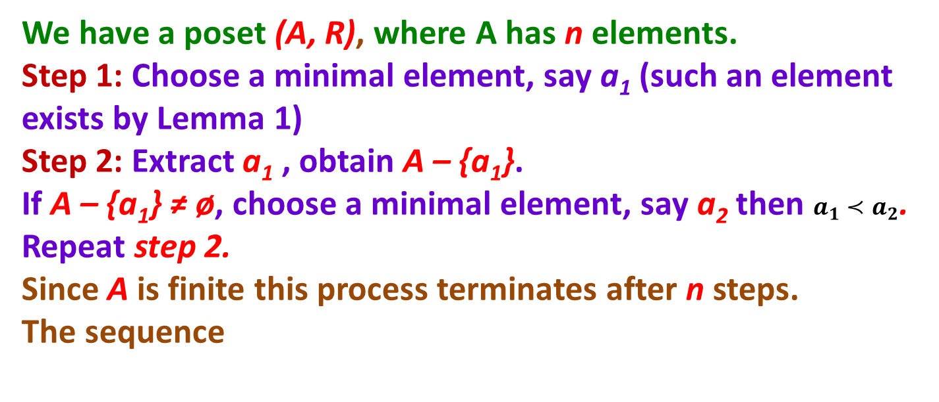
Topological Sorting
A total ordering
is said to be compatible with the partial
ordering R if
whenever a R b
Constructing a compatible total ordering
from a given
Partial ordering R is called topological sorting.
Procedure:
We have a poset (A, R), where A has n elements.
Step 1: Choose a minimal element, say a₁ (such an element exists by Lemma 1)
Step 2: Extract a₁ , obtain A – {a₁}.
If A – {a₁} ≠ ø, choose a minimal element, say a₂ then $a_{1}≺a_{2}$. Repeat step 2.
Since A is finite this process terminates after n steps.
The sequence
is the topological
Sorting of the elements of (A, R).
This total ordering
is compatible with the partial ordering R.

Slide 22
Example
Find a compatible total order for the divisibility relation on the set A = {2, 3, 6, 12, 24, 36}
(Topologically sort the elements of the poset (A, |))
24
36
O
O
24
36
24
36
36
O
O
24
36
24
36
O
O
O
O
O
O
O
O
12
O
12
O
12
O
12
O
12
O
6
O
6
O
6
O
6
2
O
O
3
2
O
O
3
O
3
3
6
12
24
36
M.e. 2
A linear order compatible with the given partial order is

Slide 23
Example
A project contains six sub projects, A through F. Results from some of the subprojects are needed by others as shown in the following table.
Find the ways the subprojects can be sequentially arranged.
Solution: The Hasse diagram of the poset is
Subject | Requires results from
A B C D E F | B, D C None C, E None A
O
F
O
A
B
O
D
O
O
C
O
E
By topological sorting, the possible sequences are
Do systematically !

Slide 24
Application of Topological Sorting
Topological Sorting has an application
To
SCHEDULING OF PROJECTS

Slide 25
GOOD LUCK
GOOD LUCK
GOOD LUCK

