Slide 1
Supply Chain Knowledge Assistant
Multimodal RAG over PDF, Word, HTML, CSV and extracted figures - Llama over REST, LangGraph, ChromaDB

Slide 2
Why: controlled knowledge is locked in documents and figures
1
Many formats
SOPs as PDF, deviations in Word, supplier status in HTML, lot data in CSV.
2
Answers hide in figures
Decision flowcharts, network maps and logger charts carry facts found nowhere in text.
3
Access is regulated
Confidential deviations must not reach partners or the wrong teams.
4
Slow root-cause work
Investigators read whole documents to find one excursion rule or lot status.
5
Goal
Ask, summarise or search across all formats - with citations, figures and clearance enforced.
6
Integration
Llama-based model behind REST APIs so enterprise apps can call it.

Slide 3
Ingestion: every format to Markdown, figures to captions
PDF
pdfplumber text + tables, font-size headings; PyMuPDF images
Word
heading styles, tables, inline pictures in order
HTML / MD / CSV
BeautifulSoup; rows -> records
Image markers
[[IMAGE:id]] kept where the figure appears
Vision captions
gemma3:4b transcribes + describes; cached by hash
Chunks + embed
text | table | image | record -> nomic -> ChromaDB
Each figure becomes its own 'image' chunk under the section heading where it appeared, so a question about the excursion flowchart cites 'SOP-CC-001 > Monitoring' and the UI shows the figure. Chunks never cross sections; tables stay whole up to 2,500 chars; CSV rows are one chunk each; every chunk carries its document classification.
50 chunks: 14 text, 2 table, 1 mixed, 3 image, 30 record.

Slide 4
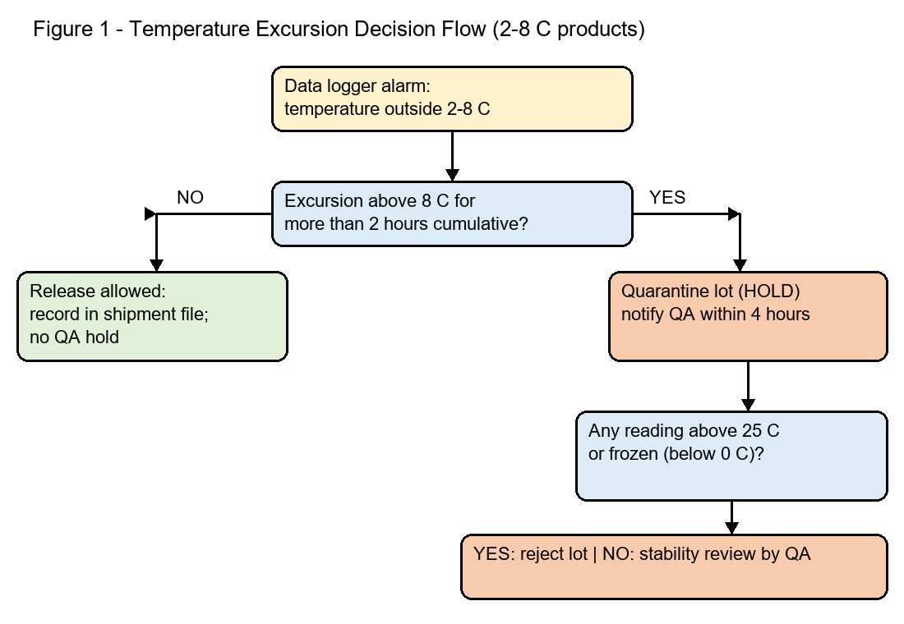
Image extraction: a figure becomes searchable
Vision caption (gemma3:4b, cached)
Text:
Figure 1 - Temperature Excursion Decision Flow (2-8 C products)
Data logger alarm:
temperature outside 2-8 C
NO
Excursion above 8 C for
more than 2 hours cumulative?
YES
Quarantine (HOLD)
notify QA within 4 hours
Any reading above 25 C
or frozen (below 0 C)?
YES: reject lot | NO: stability review by QA
Description:
The figure illustrates a decision flow for managing temperature excursions affecting 2-8°C products within
Extracted from page 1 of SOP-CC-001 (PDF) with PyMuPDF, captioned once, embedded as an 'image' chunk. Question: 'What should happen if a 2-8 C product is above 8 C for more than 2 hours?' is answered from this figure.

Slide 5
Single-agent RAG workflow (LangGraph)
guard_input
injection, medical, actions
classify_task
qa | summarize | search
authorize
task + clearance
retrieve
clearance filter first
grade
relevance floor
generate
prompt template v1
verify
numbers + IDs
Why a single agent: one knowledge domain and three tasks - a multi-agent design would add LLM calls and nondeterminism without new capability. Search needs no LLM at all; QA and summaries use one call each with versioned ChatPromptTemplates (qa/v1, summarize/v1 brief | detailed | executive).
REST endpoints for enterprise integration: POST /ask, /summarize, /search; GET /documents (clearance-filtered), /images/{id} (403 if not cleared), /metrics, /roles.

Slide 6
Sample roles and document clearance
Role | Clearance | Tasks
supply_planner | internal | qa, search, summarize
quality_assurance | confidential | qa, search, summarize
regulatory_affairs | confidential | qa, search, summarize
logistics_partner | public | qa, search
Classification (public < internal < confidential) is applied as a retrieval filter before ranking - restricted text never reaches the prompt.

Slide 7
Guardrails
1
Medical advice
Dosing / patient-use questions refused - supply-chain answers only.
2
QA decisions
Release / reject / quarantine / recall commands refused; procedures explained.
3
Access control
Clearance filter before retrieval; image and summary endpoints check classification.
4
Grounding
Numbers and LOT- / SHP- / DEV- / SOP- / CAPA- IDs must appear in retrieved context.
5
Injection + PII
Override attempts blocked; emails / phones redacted.
6
No guessing
Nothing relevant -> 'The documents I can access do not cover this.'

Slide 8
Evaluation results
Metric | Result
Retrieval hit@6 / MRR (10 questions) | 1 / 1
hit rate - table questions | 1
hit rate - text questions | 1
hit rate - image questions | 1
hit rate - record questions | 1
Image chunk retrieved for figure questions | 1
Restricted chunks returned to logistics_partner | 0
Guardrails precision / recall (11) | 1 / 1
RAGAS non-LLM context precision / recall | 0.888 / 0.625
RAGAS LLM-judged: Which packaging configuration is used for lane L | faith n/a | grounded 0.75 | recall 1
RAGAS LLM-judged: How often does the data logger record temperatur | faith n/a | grounded 0.75 | recall 1

Slide 9
Monitoring
1
LangSmith
traces of retrieval and generation; tags role / channel; feedback as user_rating
2
/metrics
supplykb_requests_total{intent,role,outcome}, latency histogram, guardrail blocks
3
Audit log
logs/audit.jsonl - question, task, citations, guardrails, latency

Slide 10
Run and test
cd 03-supply-chain-knowledge-assistant
ollama pull gemma3:4b # vision model for captions
python -m supplykb.vision # caption extracted figures (cached)
python -m supplykb.ingest # 50 chunks
uvicorn supplykb.api:app --port 8003 # http://localhost:8003/docs
streamlit run ui/streamlit_app.py --server.port 8503
pytest -q # 18 tests
python -m eval.run_eval # hit@k by source type, leakage, guardrails
python -m eval.ragas_eval --optimize --llm 2

Slide 11
Next steps
1
Connect to the document management system with revision-aware re-ingestion
2
OCR for scanned PDFs; richer chart extraction (data series)
3
Department-level access groups on top of clearance
4
Stronger judge model for LLM-judged RAGAS in CI

