Slide 1
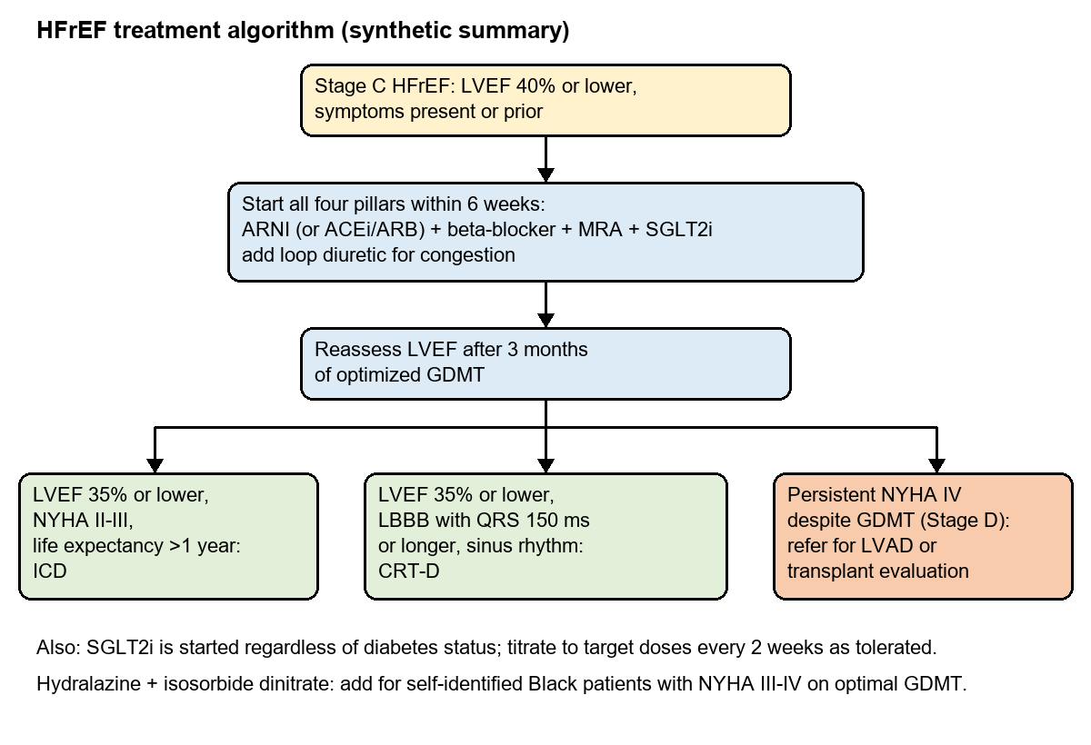
Condition Briefings in Minutes, Not Days
Health system strategy team
Prototype on synthetic data
An AI analyst that turns guidelines, pipelines and internal plans into a cited, structured briefing
THE PROBLEM
HOW IT WORKS
PROOF FROM THE PROTOTYPE
Every condition review takes days: guideline PDFs, pipeline registries and internal plans are read by hand.
The facts that matter hide in two-column PDFs, multi-page tables and figures that search tools cannot read.
Numbers are re-typed and pipelines go stale; briefings look different every time.
1
Read complex documents
Two-column PDFs, page-spanning tables, captioned figures
8 / 8
PDF extraction checks: headers, columns, merged table, figures, footnotes
2
Index with citations
Every chunk keeps its document, section and access level
100%
of 12 test questions found the right source (tables, figures, footnotes)
3
Four agents in parallel
Standard of care | pipeline | key players | internal strategy
0
internal documents shown to the external-consultant role
4
Counts computed in code
Trials, phases and rankings from the registry, live from ClinicalTrials.gov
100%
guardrail precision and recall (14 cases)
WHO USES IT
5
One writer, then checks
Numbers and IDs verified against sources; patient advice refused
BUILT TO BE TRUSTED
Strategy analysts and service-line directors
Executives (short executive briefing)
Physician advisor; external consultants see public sources only
Every bullet cites a numbered source
Counts and rankings computed, not generated
Vision misreads flagged (caught 'Hydralazine' read as 'Hydrochlorothiazide')
Role-based access, PHI redaction, audit log, LangSmith tracing
Extracted from page 2 of the guideline PDF and made searchable: 'When is CRT-D indicated?' is answered from this figure.
VALUE
NEXT STEP
Briefing prep from days to minutes, one consistent format, and pipeline views that refresh from ClinicalTrials.gov on demand.
4-week pilot: 3 service lines, your guideline library, Claude on Amazon Bedrock; measure prep time and analyst edits.
Notes:
Demo: generate the HFrEF briefing as strategy_analyst, then as external_consultant (no internal section); open the Extraction tab to show headers removed, the merged table and the figures; ask 'When is CRT-D indicated?' to show an answer that only exists in an image; toggle live data and brief 'atrial fibrillation' from ClinicalTrials.gov. Trade-offs: CPU-only 3B model is slow (minutes); Bedrock fixes latency. Vision captions can misread - flagged, not silently trusted.

