Slide 1

Software Bundle Promotion in Agile
Draft Version

Slide 2

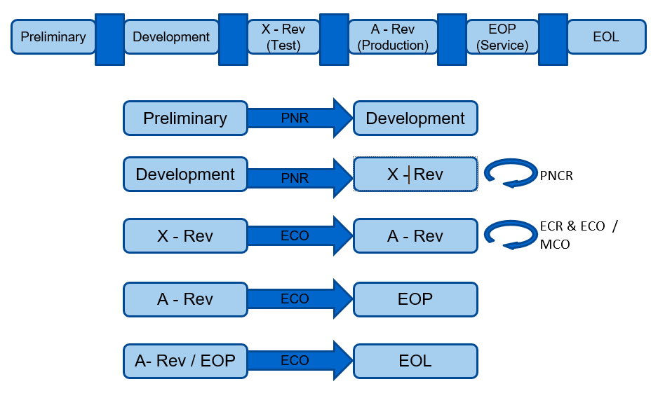
SWB - Life cycle states in AGILE

Slide 3
High level SWB Dup process in agile
Users login in to Agile or Automation Process explained in the diagram.
Create SWB Parts and move the life cycle state from Preliminary to X Rev and upload the payload files using Attachment Utility or automation process.
Once Pie/Mup files uploaded and then users trigger Create DUP from Agile UI or Automation.
DUP Process validate the content and bundle the package, upload .exe / bin files using Agile requestDupfile action API.
Testing Teams validate the content after the Dup process uploaded the dups.
PJMs moves SWB from X Rev to A Rev after Testing Teams validation.
Biz users create WPCO either through automation or login to Agile.
Agile Background process/ WPCO (Web Promotion Change Order) process in Agile, publish the files to ESupport FTP Servers.
ESupport publish the file content from FTP Servers to Dell Drivers and Downloads website..

Slide 4
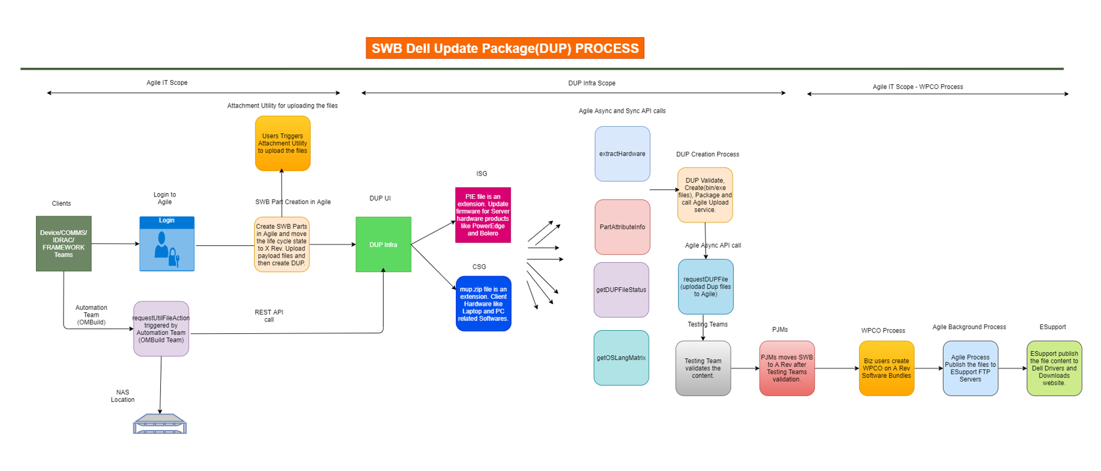
SWB Dell update package (DUP) process

Slide 5
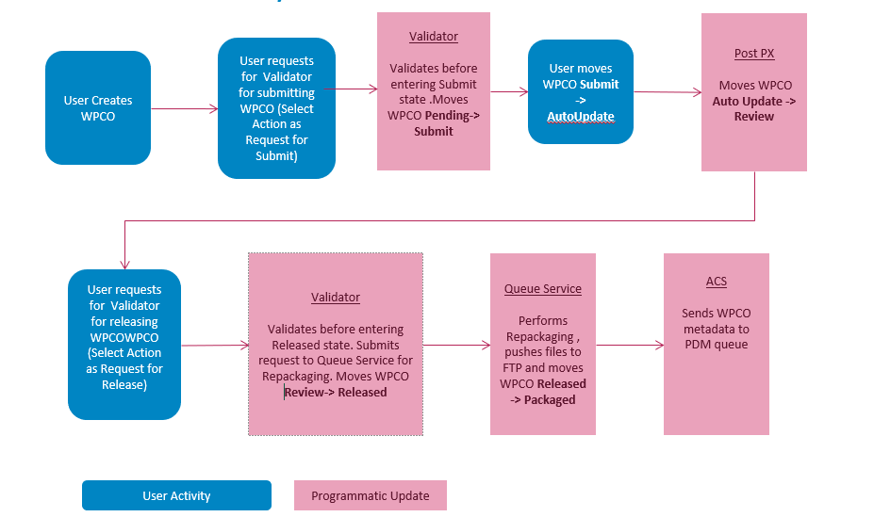
WPCO – Part Promotion

Slide 6
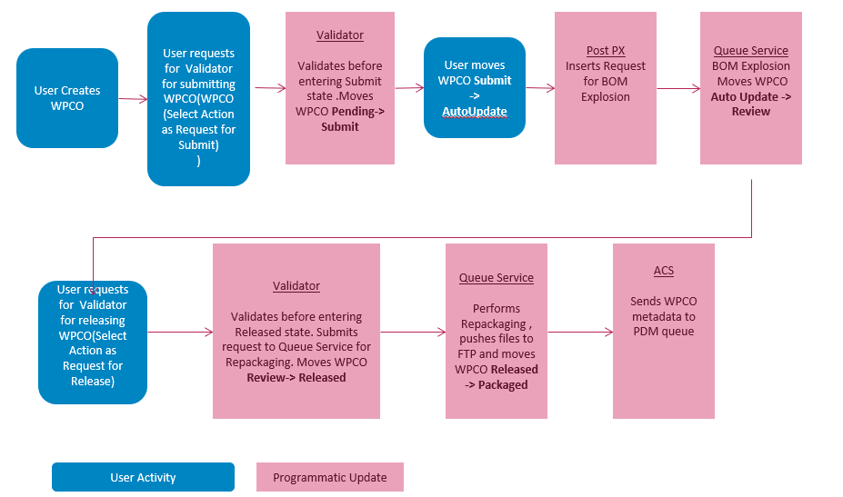
WPCO – PLATForm Promotion

Slide 7

Thank You
Rammohan_rao_kotni@dell.com

