Slide 1
Introduction to Operating Systems
THrough tracing, analysis and experimentation
george neville-neil

Slide 2
Objectives
A grounding in systems principles
A grand tour of the Operating System
Practical insights into how the OS works
Understand how to evaluate Systems Software

Slide 3
Course Outline
Introduction
Kernel services
High Level Definitions
History
Lab 1: System Setup
Introductions to
Memory Management
Resource Management
System Calls
Lab 2: System Calls

Slide 4
Course Outline
Tracing
processes
What is tracing?
How does tracing work?
Kernel Tracing Systems
DTrace
Lab: Using DTrace
The Process Model
Processes and Threads
Mutual Exclusion
Locking Primitives
Lab: Tracing process creation

Slide 5
Course Outline
memory
security
Physical Memory
Virtual Memory
Hardware support for VM
Shared Memory
Mid Term Test
Authentication
Isolation
Security and Data
Virtual Memory, Processes and Security
Hardware Support for Security

Slide 6
Course Outline
communication
storage
I/O
Inter Process Communication
Sockets and Network Communication
Lab: TCP Connection Setup
Lab: TCP State Machine
Storage Overview
Naming and Location
Virtual Filesystem Layer
Storing and Retrieving Data
Lab: Reading a file from disk

Slide 7
Course Outline
Whole system view
final exam
Serving Web Content
NGINX
Review
Covers all sections of the course outline

Slide 8
Lab Work
Tracing Systems Setup, Begin using DTrace
Processes Tracing the Process Life Cycle
Memory Following memory allocation and de-allocation
Security
Drivers How data moves in and out of the kernel
Communication Networking and TCP
Storage Storing and Retrieving Data

Slide 9
What do computers do?
Processing Converting information from one form to another.
Communication Moving information between one or more systems.
Storage Maintaining information over time.

Slide 10
What is an Operating System?

Slide 11
What is an Operating System?
[An OS is] the low-level software that supports a computer’s basic functions, such as scheduling tasks and controlling peripherals. - Google hive mind

Slide 12
General purpose operating systems
... are for general-purpose computers
• Servers, workstations, mobile devices
• Run ‘applications’ – i.e., software unknown at design time
• Abstract the hardware, provide ‘class libraries’
• E.g., Windows, Mac OS X, Android, iOS, Linux, FreeBSD,
...

Slide 13
General-purpose operating systems
User space
Kernel
Local and remote shells
management tools
daemons
Run-time linker
system libraries
tracing facilities
System calls
hypercalls
remote procedure call (RPC)
Processes
filesystems
IPC
sockets
System Call Interface

Slide 14
What does an operating system do?
Key hardware-software surface (cf. compilers)
System management: bootstrap, shutdown, watchdogs
Low-level abstractions and services
Programming: processes, threads, IPC, program model
Resource sharing: scheduling, multiplexing, virtualisation
I/O: device drivers, local/distributed filesystems, network stack
Security: authentication, encryption, permissions, labels, audit
Local or remote access: console, window system, SSH
Libraries: math, protocols, RPC, cryptography, UI, multimedia
Other stuff: system log, debugging, profiling, tracing

Slide 15
Key Functions of an Operating System
Provides the Programming Model
Protects Programs from each other
Controls access to hardware
Ensures fair sharing of resources
Does all these things efficiently

Slide 16
Operating System as Toolkit
A collection of code
Organized into a set of libraries
Built into a larger of programs
That work together to provide a service
At the lowest possible cost
With the highest possible efficiency

Slide 17
What an Operating System is
A single large program
Written in the C language
Built with make
More than 20, 000 files
12, 000, 000 lines of code

Slide 18
Why study operating systems?
Key interface between hardware and software
Strong influence on whole-system performance
Critical foundation for computer security
Exciting programming techniques, algorithms, problems
Virtual memory; network stacks; filesystems; runtime linkers; ...
Co-evolves with platforms, applications, users
Multiple active research communities
Reusable techniques for building complex systems
Boatloads of fun (best text adventure ever)

Slide 19
Performance Measures
Throughput
How much work can we do per unit time?
Latency
Time between request and useful response
Jitter
Variability in latency

Slide 20
Throughput
Everyone knows this one
Data moved
100 Mbps
Operations or Transactions Performed
Increase Frequency
Widen the bus

Slide 21
Who cares about throughput?
Everyone!
Video Streaming
Cat videos!
Database Systems
Transaction processing
Any form of data processing
Image manipulation
Machine Learning

Slide 22
Latency
Request to response
Governed by physical constants
The speed of light (c) matters
Rotational latency for spinning disks
CPU Caches
Memory flushes
Walking complicated data structures
Linear lists vs. hash tables

Slide 23
Who cares about latency
Has a direct effect on throughput
Increases system complexity
Hard to avoid when working with real world systems
Will be covered more fully in the Communication section

Slide 24
Jitter
PING yahoo.com (98.138.253.109): 56 data bytes
64 bytes from 98.138.253.109: icmp_seq=0 ttl=54 time=33.686 ms
64 bytes from 98.138.253.109: icmp_seq=1 ttl=54 time=33.469 ms
64 bytes from 98.138.253.109: icmp_seq=2 ttl=54 time=33.525 ms
64 bytes from 98.138.253.109: icmp_seq=3 ttl=54 time=35.267 ms
64 bytes from 98.138.253.109: icmp_seq=4 ttl=54 time=38.442 ms
^C--- yahoo.com ping statistics ---5 packets transmitted, 5 packets received, 0.0% packet lossround-trip min/avg/max/stddev = 33.469/34.878/38.442/1.902 ms
Least known or understood
Change in latency over time

Slide 25
Who cares about jitter?
Network time protocols such as NTP and PTP
Real-Time Operating Systems
Flight safety
Robotics
Things that move in the real world
High fidelity data recording
Climate
Oceanography
Audio Systems
Lipsynch

Slide 26
Complexity
Code should be no more or less complex than necessary
Measures of complexity
Number of structures required
Function Signatures
Locking hierarchy

Slide 27
Composability
Measurement of code re-use
How many places can this library, function or structure be reused?
All software should be like Lego blocks

Slide 28
Tractability
Can one person understand a (sub)system?
Library
Function
Let’s look at a nearly intractable function

Slide 29
FreeBSD
Open Source
Unix
Posix
Complete System
20 years of history
Used in real systems around the world

Slide 30
Computer History from the Operating System Perspective
The Hardware Environment
Defines what is possible.
Requirements
What are we asking the system to do?
Services
What can the OS provide.
Hardware/Software Co-Evolution
A recurring theme

Slide 31
In the beginning: early computers
Wired programs
Highly specialized to only one problem
Armies of programmers tend a single machine

Slide 32
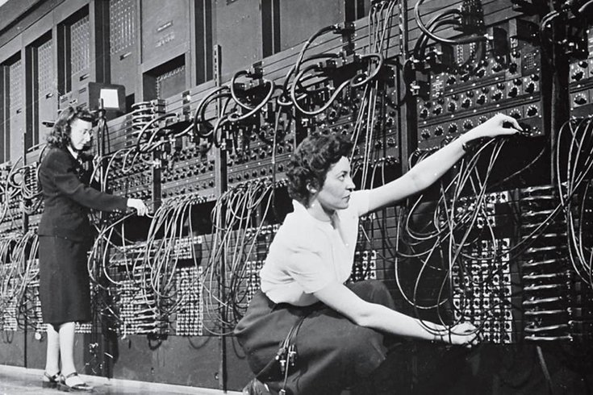
The First Programmers

Slide 33
Early Computers
Processing measured in hundres of Hz
Tiny memories
Limited to no input/output devices
Not much for an Operating System to do or provide

Slide 34
Mainframes and Batch Processing
Standardized input/output with cards
One program at a time (batch processing) • No interactive programming
Early disks and printers
What is a byte?
The rise of computer languages.
Earliest operating systems (monitors)

Slide 35
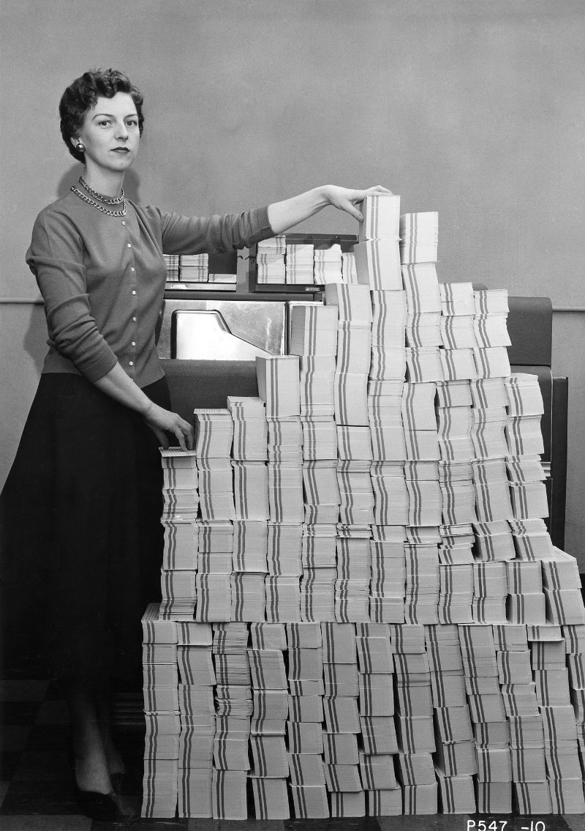
5Mb of Source Code

Slide 36
Mini-computers and Time Sharing Systems
Shrinking hardware and affordable computing resources
CTSS
MULTICS
C, the portable assembler
UNIX
(D)ARPANet

Slide 37
The Unix Kernel
Everything Else
System Calls
Kernel

Slide 38
The Rise of the Microcomputer
LSI shrinks hardware onto the first chip based processors • Moore’s Law
Less powerful than mini-computers
8-bitting
Single user
No networking
Operating System is a monitor and convience routines

Slide 39
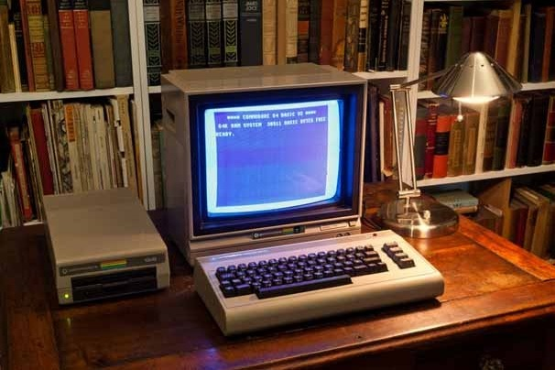
A typical microcomputer 1982

Slide 40
Workstations and Networking
VLSI provides faster and more powerful CPUs
Graphical Displays (X10 and X11)
Ethernet
TCP/IP
UNIX is the de-facto standard, sort of

Slide 41
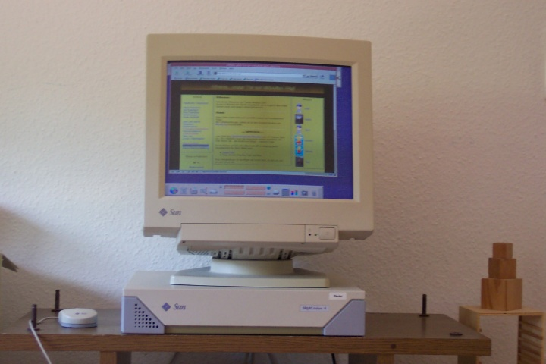
Workstation from the 1990s

Slide 42
Embedded and Real Time Systems
Applied kernel programming
Tasks have deadlines
Failure is not an option
Often forgo more expensive UNIX like features

Slide 43
Mobile Devices and the Ubiquitous Internet
Sensors
Always connected
A return to single user, but with a multi-user OS
Programming for power rather than speed

Slide 44
Today
Multi-user Unix like systems everywhere
Continued use of C for OS development
Heterogeneous environments

Slide 45
Our Challenge
How does data move in a real world system?
Serving Data from Storage to Clients
Program Web Server
Stored Data Filesystem
Communication Network Stack

Slide 46
UNIX Philosophies
Everything is a byte stream
Do a small number of things well
Build complex systems out of simple building blocks
Swiss Army Knife vs. Toolbox

Slide 47
Some Special Considerations
An OS kernel is one, large program.
More than 50, 000 functions.
5677 files
5, 131, 552 lines of C code just for the kernel
A unique programming environment

Slide 48
Design and Implementation Requirements
Fast Low overhead, high performaance
Safe Secure, tractable
Flexible Can be used by many applications

Slide 49
User vs. Kernel Space
User space
Kernel
Local and remote shells
management tools
daemons
Run-time linker
system libraries
tracing facilities
System calls
hypercalls
remote procedure call (RPC)
Processes
filesystems
IPC
sockets
System Call Interface

Slide 50
System Calls: The Operating System’s API
Border between User and Kernel Space
Everything that can be done with the OS
open(), read(), write(), close()
Over 1000 separate interfaces
Section 2 of the manual set
> man 2 open

Slide 51
OS Programming
C is the programming language
Simple data structures
Lists
Hash Tables
Hand crafted classes and objects
Programming without a net

Slide 52
Competing Kernel Architectures
Micro-Kernel
Monolithic
Kernel is Only a Scheduler
Services Model
in-kernel IPC
POSIX as a service
Mach, Barrelfish, L4
One big program
Function Calls
System Call API
FreeBSD, Linux, Windows

Slide 53
Review: What an Operating System Does

