Slide 1
Introduction to Operating Systems
THrough tracing, analysis and experimentation
George Neville-Neil

Slide 2
The Process Model and Virtual Memory
Without Virtual Memory a Process is just a C structure
The VM system enforces containment
All memory comes from the kernel
And returns to it when no longer needed

Slide 3
Types of Memory
Stack
Automatic variables
Function call frames
Heap
Pretty much everything else
Caches
L1, L2, L3, etc.

Slide 4
The Illusion of Memory
How much memory can one process have?
Early UNIX VM systems built on 32 bit hardware
4,294,967,296 bytes
Modern systems based on 64 bits.
18,446,744,073,709,551,615 bytes
How does the OS manage this illusion?

Slide 5
A Brief History of Memory
Delay Line
Core
Dynamic RAM

Slide 6
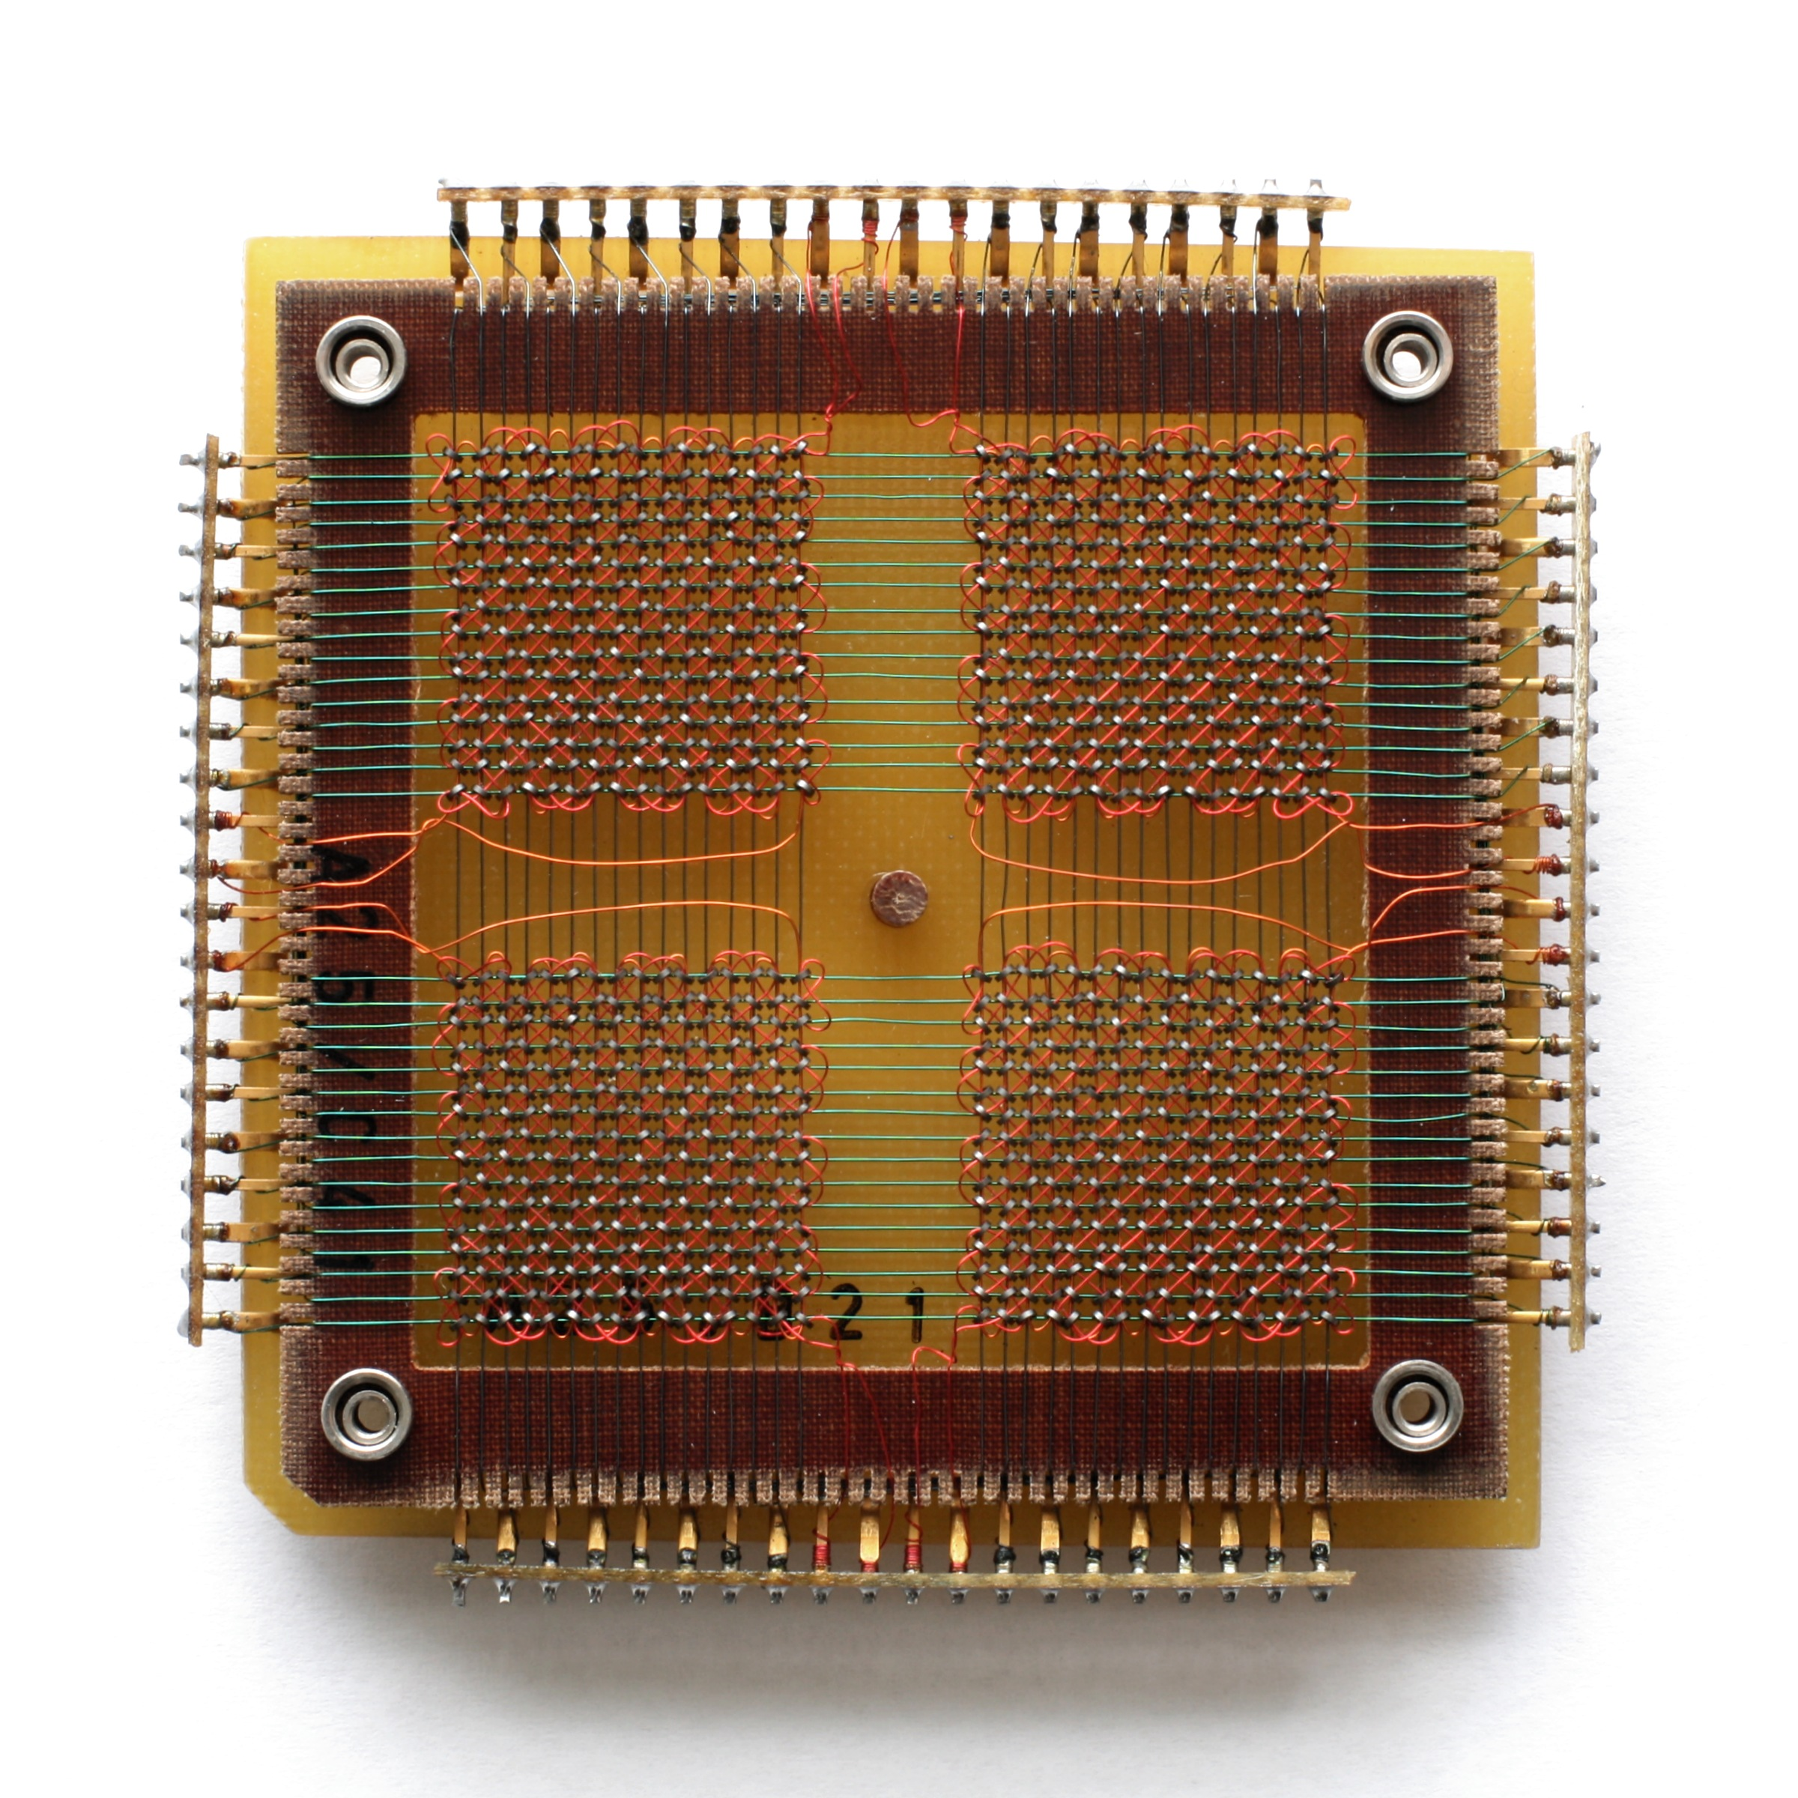
Core Memory

Slide 7
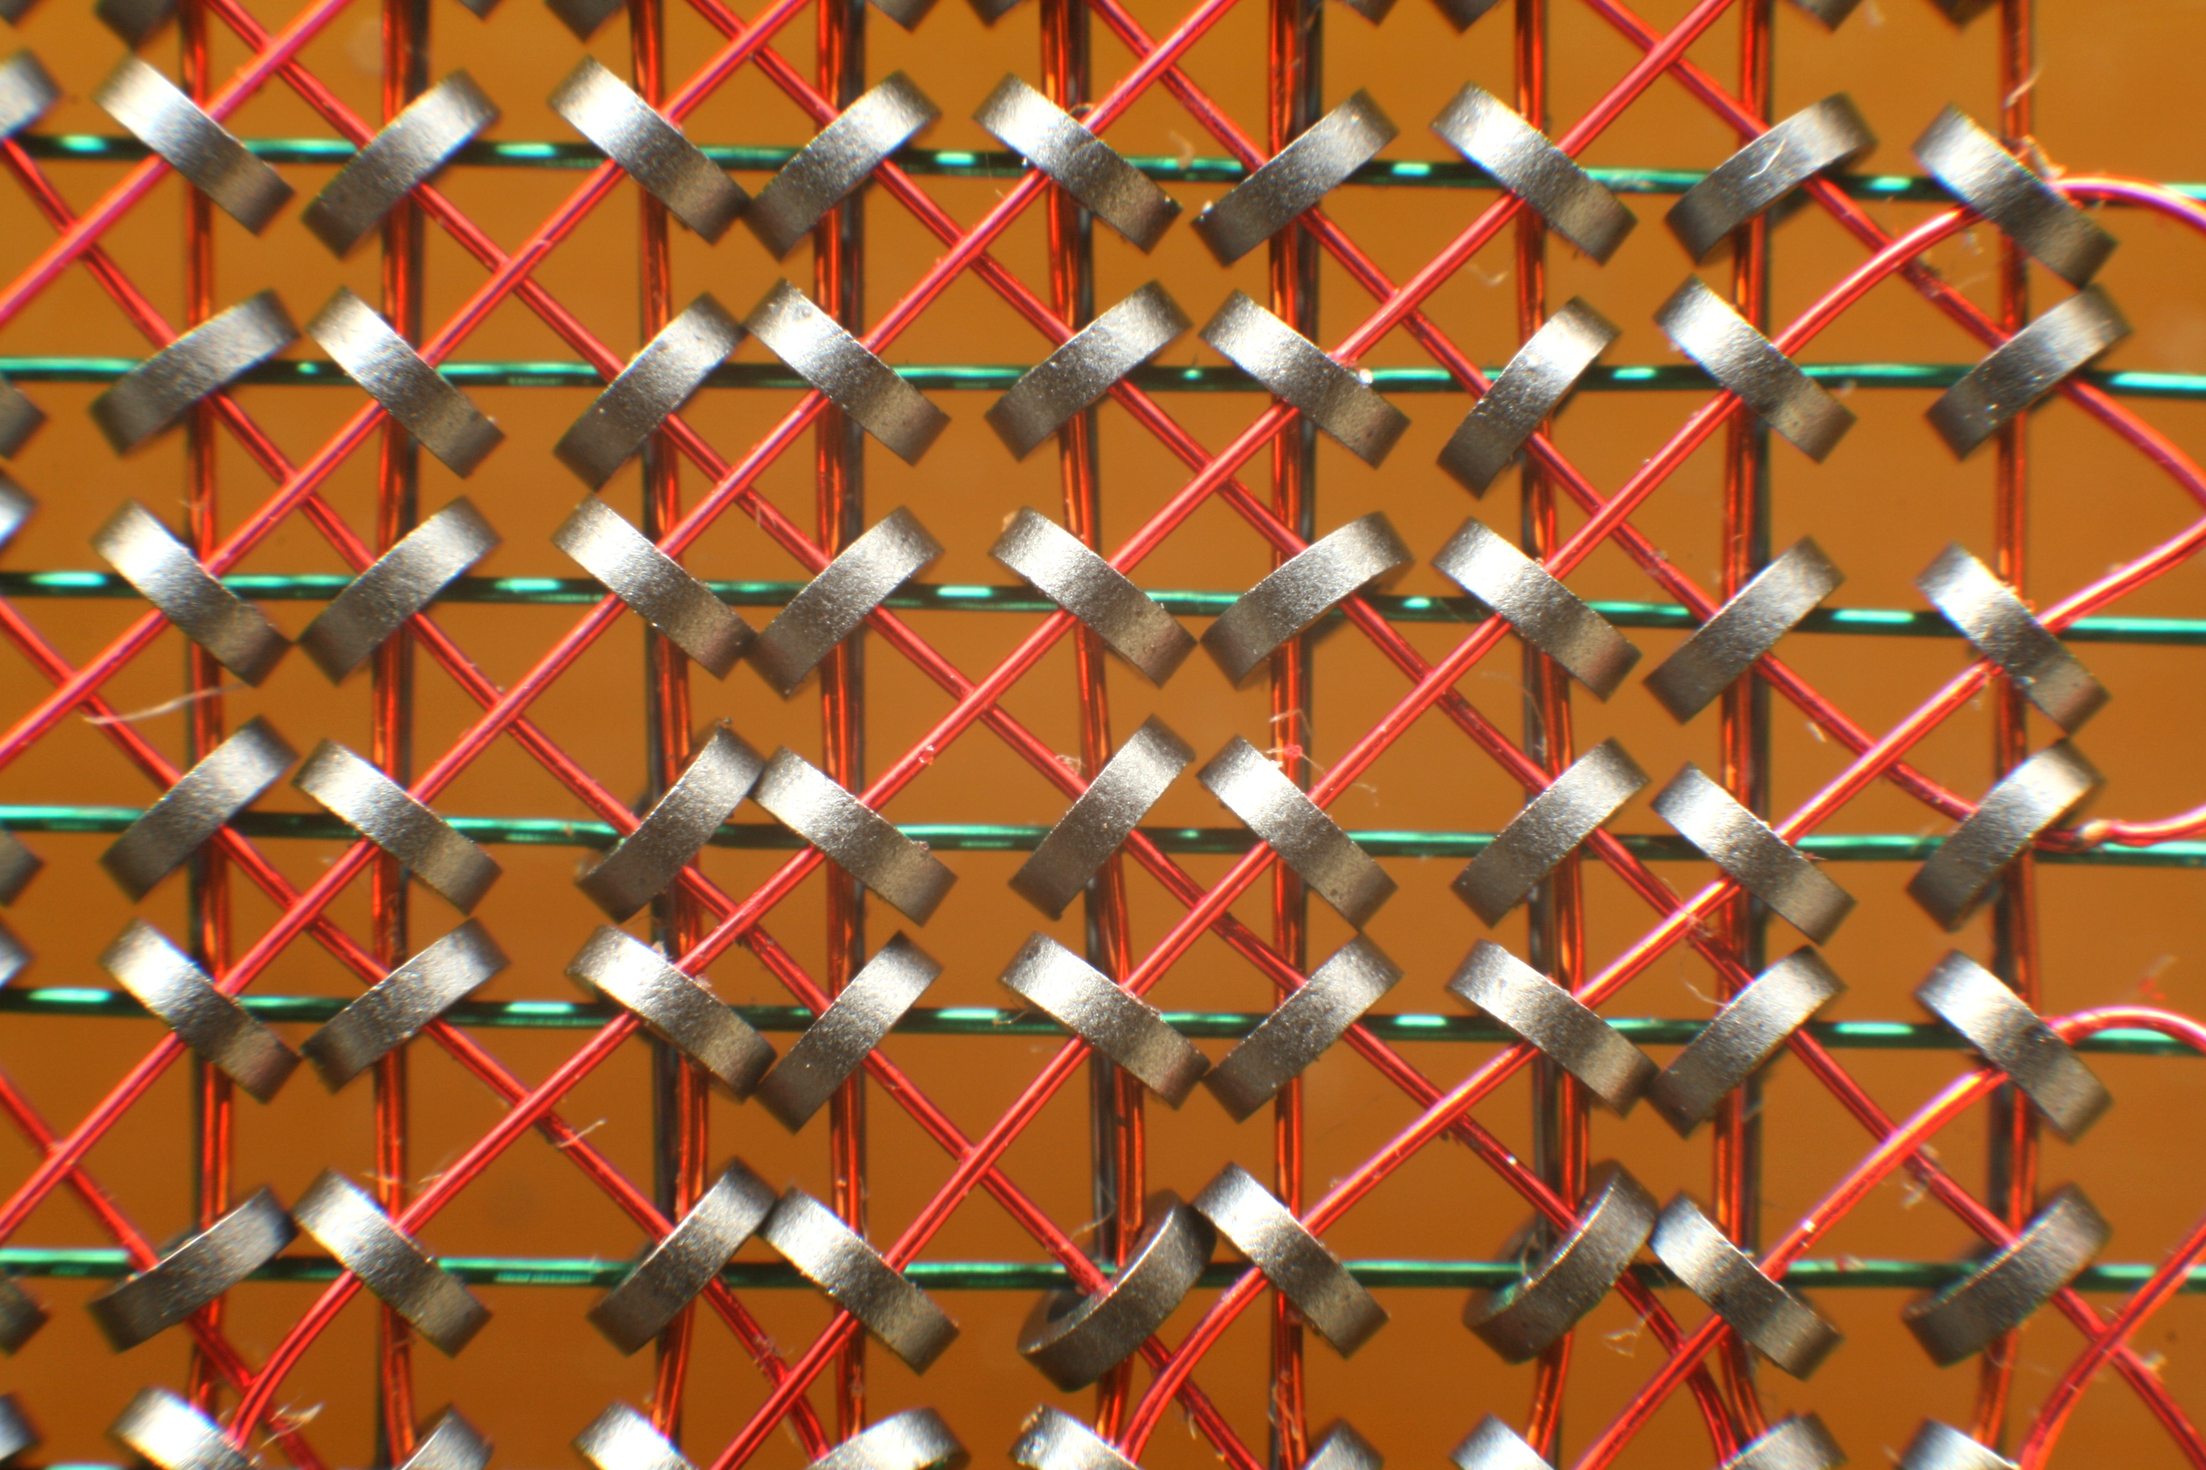
Cores Close Up

Slide 8
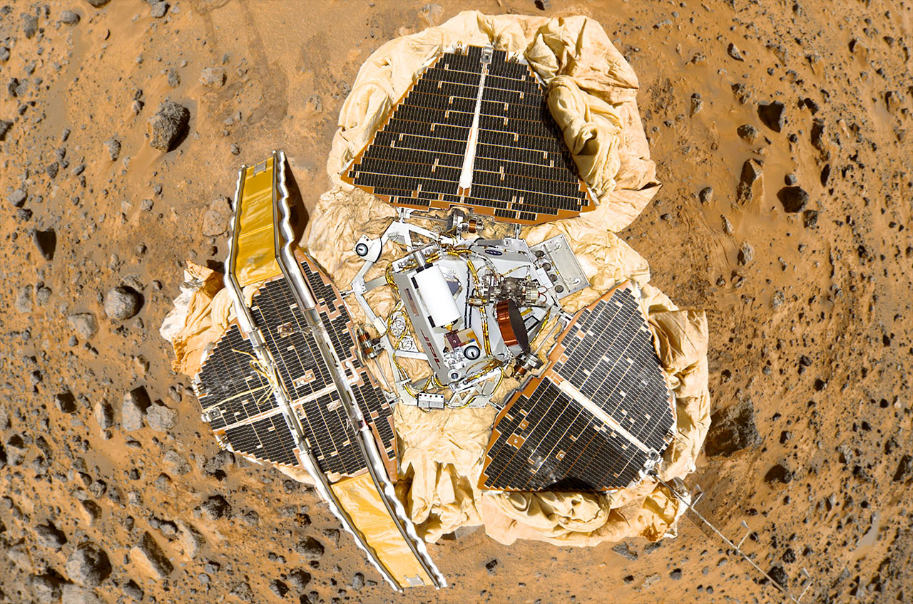
A World Without Virtual Memory
Single Address Space Systems
Embedded and Real Time Operating Systems (RTOS)
These still exist
There are several on Mars
There are even more in automotive braking systems

Slide 9
Advantages of Virtual Memory
Simplification Programs (mostly) don’t care about addresses
Code is position independent
Portability No memory location is more special than any other
Zero page
Protection All memory accesses go via the kernel
Enforces separation

Slide 10
High Level
Memory is laid out in pages (4K, 2M, 1G…)
Pages are controlled by the Memory Management Unit (MMU)
Transforms virtual addresses into physical addresses
Control available only in supervisor mode
Software handles failures (e.g., permissions) via traps
page faults
A program’s memory is its working set

Slide 11
Getting Access to Memory
A program reads or writes and address
If the page with that address is currently mapped it gets immediate access
A page fault occurs on an address that has not been seen
Process protection occurs at the page fault boundary
A process that touches an invalid address is terminated (SEGFAULT)

Slide 12
Memory Management Unit (MMU)
Transforms virtual addresses into physical addresses
Memory is laid out in virtual pages (4K, 2M, 1G, …)
Control available only to the supervisor (historically)
Software handles failures (e.g., permissions) via traps

Slide 13
Page Tables
SW-managed page tables provide virtual-physical mappings
Access permissions, page attributes (e.g., caching), dirty bit
Various configurations + traps implement BSS, COW, sharing, ...

Slide 14
Translation Look-aside Buffer (TLB)
Hardware cache of entries – avoid walking pagetables
Content Addressable Memory (CAM);
48? 1024? entries
TLB tags: entries global or for a specific address-space ID (ASID)
Software- vs. hardware-managed TLBs

Slide 15
Two Processes and their Memory

Slide 16
The Virtual Memory (VM) Subsystem
The process model’s isolation guarantees incur real expense
The VM subsystem works quite hard to avoid expense
Shared memory, copy-on-write, page flipping
Background page zeroing
Superpages to improve TLB efficiency
VM avoids work, but also manages memory footprint
Memory as a cache of secondary storage (files, swap)
Demand paging vs. I/O clustering
LRU / preemptive swapping to maintain free-page pool
Recently: memory compression and deduplication

Slide 17
Kernel programmer view of VM

Slide 18
Memory for Many Users
User Processes
Heap
Stack
Code
Shared Memory
Kernel
Heap
Meta-data
Process Stacks
Network Buffers
Disk Buffers for File Data

Slide 19
Page Allocation and Cleanup
Pages are managed on kernel lists
Free Memory that has never been used
Wired In use by the kernel
Active In used by a program
Inactive Has been used and awaiting re-use
Zero’d on Demand
Why?
What are the possible implications of this choice?
Reduce, reuse, recycle

Slide 20
Managing Memory
Every type of memory has a pager
Responsible for managing memory
Swap Pager
VNODE Pager

Slide 21
Kernel programmer view of VM

Slide 22
Pagers for Different Memory
Device
Physical
Swap
Scatter/Gather
Sparse memory pages
VNODE
File data

Slide 23
Pager Policies
SWAP
VNODE
Zero’s pages for use
Moves unused pages to storage
Retrieves pages on demand
Reads data from storage
Flushes data to storage
Must limit I/Os

Slide 24
Kernel Interface to VM
FreeBSD uses structured objects
All functions (methods) share a signature
Subsytems have init() and fini() routines
Constructor
Destructor
Allows for extensions
New types of hardware do not require a new API
Only a new sub-class

Slide 25
Kernel OO Programming
struct pagerops defaultpagerops = {
.pgo_alloc = default_pager_alloc,
.pgo_dealloc = default_pager_dealloc,
.pgo_getpages = default_pager_getpages,
.pgo_putpages = default_pager_putpages,
.pgo_haspage = default_pager_haspage,
};

Slide 26
Kernel OO Programming Con’t
default_pager_haspage(vm_object_t, vm_pindex_t, int *, int *);
swap_pager_haspage(vm_object_t, vm_pindex_t, int *, int *);
vnode_pager_haspage(vm_object_t, vm_pindex_t, int *, int *);
etc.

Slide 27
Evolution of Page Replacement
All algorithms are global to all usable memory
LRU Clock Hands Algorithm
Mark and Sweep
LRA Least Recently Active
Mark and Sweep
Increment a usage count

Slide 28
Observing Virtual Memory
FreeBSD’s vm provider has only one tracepoint
vm-lowmem_scan
Does not take any arguments
We can trace page faults
Also can see the pagers being active

