Slide 1


CineBot: An IMDb-powered RAG Assistant For Movie Information Retrieval
Submitted by: Swati Mishra, Phani Rama Krishna Yerroju, Vedasree Kommindala, Mintesnot Fikre Legese
Course Name: MSAI-633-M50: Ethics in Artificial Intelligence
Due Date: 07-25-2026

Slide 2
Agenda
Problem Statement
Solution
Project Objectives
Domain and Datasets
Technology Stack
CINEBOT UI
System Architecture
RAG Workflow
Project Demo
Evaluation Metrics
Outcomes
Ethics and Risk Assessment
Limitations
Future Enhancements

Slide 3
Problem Statement
Problem: Finding complete movie information if often difficult because:
IMDb information is distributed across multiple pages.
Users perform several searches to gather complete details.
Traditional key search cannot understand conversational questions.
It is time-consuming to retrieve information such as
Movies
Actors
Directors
Ratings
Genres

Slide 4
Solution
CineBot uses Retrieval Augmented Generated (RAG) to answer natural language questions with grounded and citation supported responses.

Slide 5
Project Objective
Building an AI-powered movie assistant.
Retrieving accurate movie information.
Support conversational queries.
Provide citation-supported responses.
Enable semantic search instead of keyword search.

Slide 6
Domain & Dataset

Slide 7
Domain
Entertainment & Movie Information Retrieval

Slide 8
Dataset
Offline IMDb Dataset
Data Set Contains:
Movies
Actors
Directors
Ratings
Genres

Slide 9
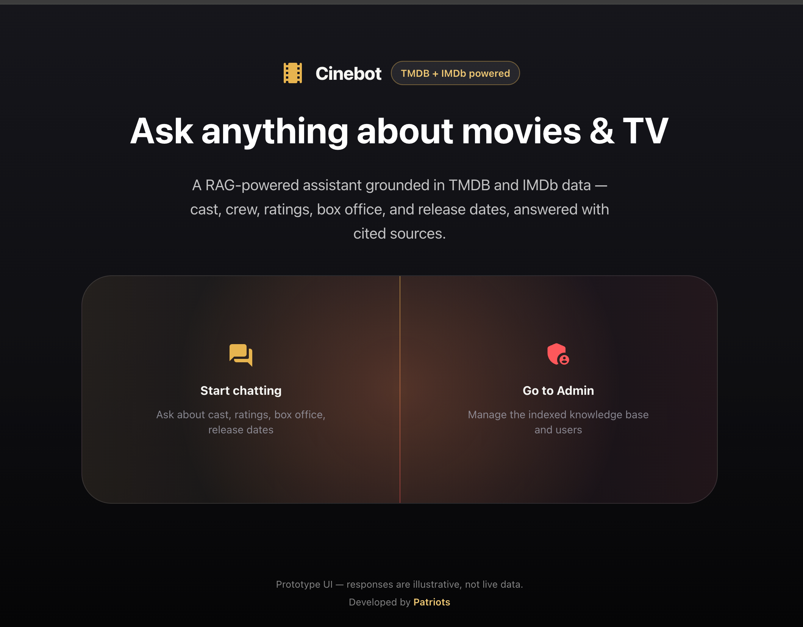
CINEBOT UI

Slide 10
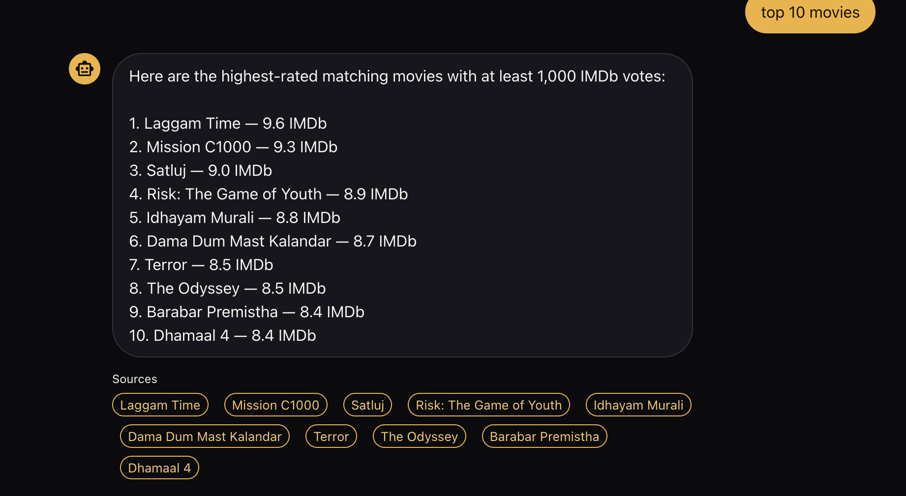
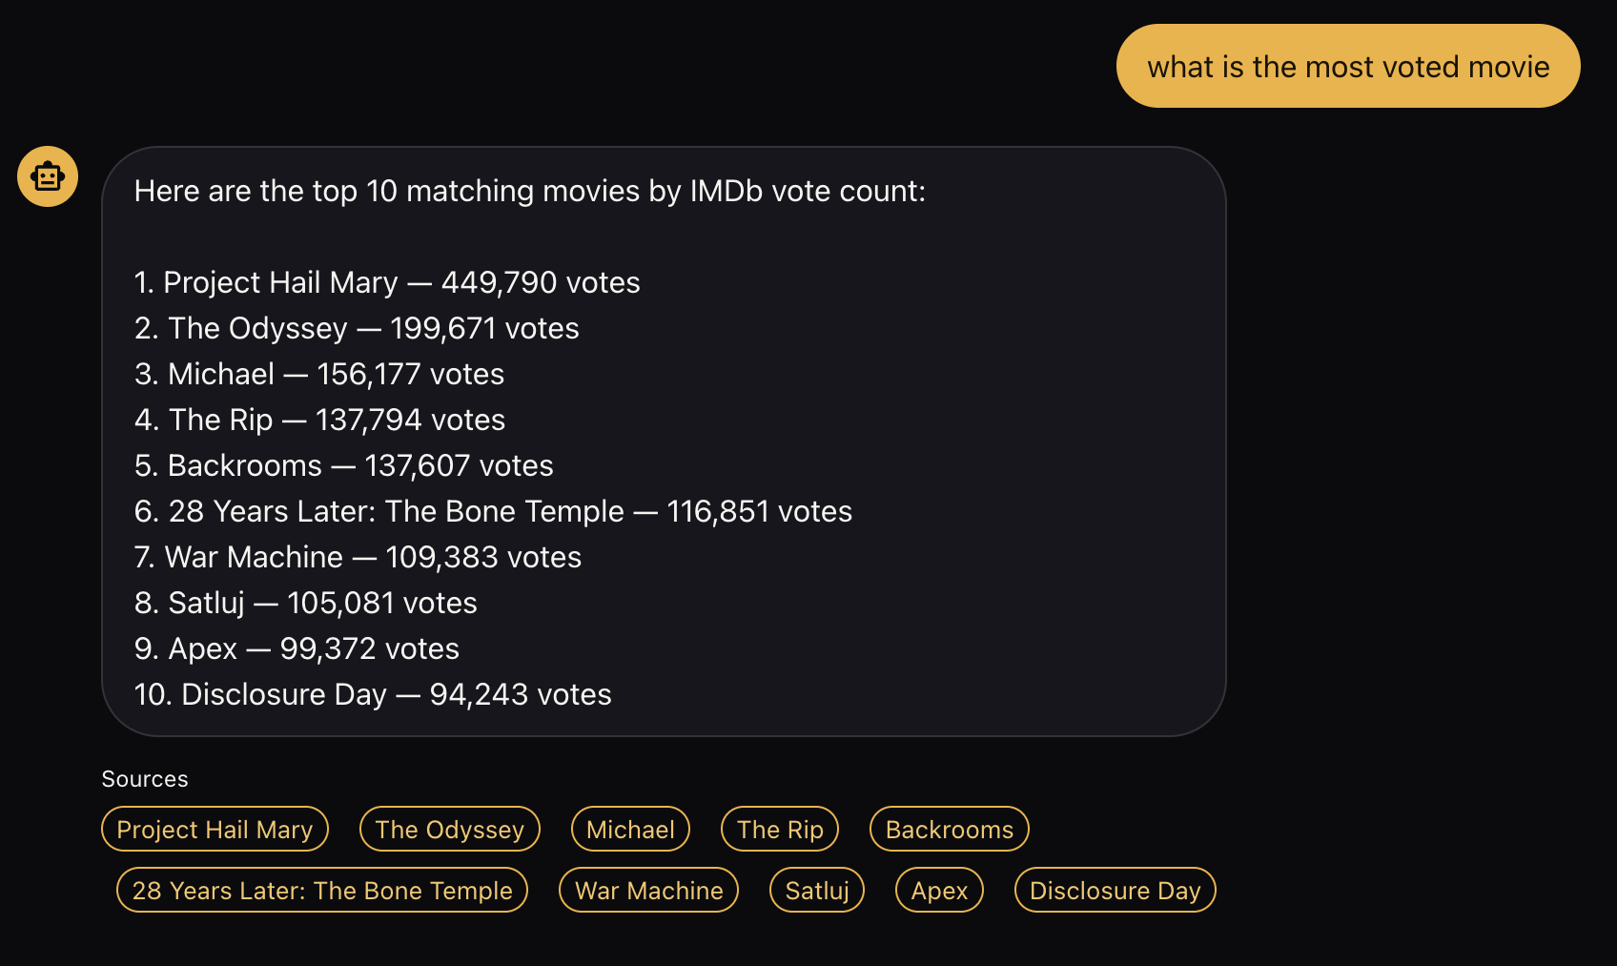
CineBot ScreenShotS

Slide 11
System Architecture

Slide 12
IMDb Dataset/ IMDb Web Pages
Chroma Database
Generate Sentence Embeddings
Chunking Documents
Citation Based Response
BM25 Index
Open AI GPT
Prompt Construction

Slide 13
Technology Stack
Component | Technology
Web Scraping | ScraperAPI
Chunking | LangChain Text Splitters
Embeddings | Sentence Transformers
Vector Database | ChromaDB
Backend | Flask
Frontend | Next.js + Material UI
LLM | OpenAI API
Version Control | GitHub

Slide 14
RAG Workflow
Retrieval-Augmented Generation Pipeline
User submits a query to CineBot.
Query embedding is generated.
Similar chunks retrieved from Chroma DB.
Relevant context passed to LLM.
LLM generates a grounded answer
Citation added to response.

Slide 15
Project Demo

Slide 16

Evaluation Metrics

Slide 17
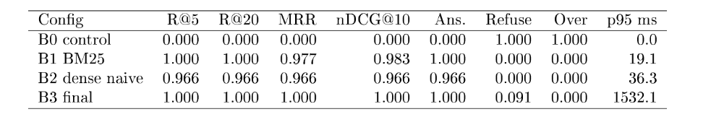
Evaluation Metrics – 1

Slide 18
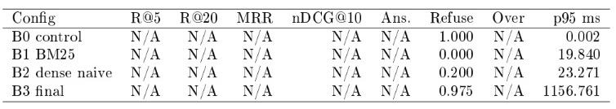
Evaluation Metrics – 2

Slide 19

Outcomes
The project will deliver an intelligent RAG-based conversational assistant capable of:
Retrieving the accurate movie information from IMDb.
Answering natural language questions with citation-supported responses.
Supporting semantic search across movies, actors, directors, and genres.

Slide 20
Ethics & Risk Assessment
Responsibly crawling.
Data Protection
Copyright
Retrieving metadata only.
Summarize instead of copying content.
Transparency

Slide 21
Limitations
API Limitations
Source data is not fully fetched.

Slide 22
Future Enhancements
Voice-based movie assistant
Multi-language support
Personalized recommendations
Conversational
Maintaing User History

Slide 23
Thank You

