Slide 1

Sanjivani College of Engineering, Kopargaon-423603
Sanjivani Rural Education Society’s
(An Autonomous Institute Affiliated to Savitribai Phule Pune University, Pune)
NAAC ‘A’ Grade Accredited
Department of Information Technology
(UG program, NBA Accredited)
Software Engineering Modeling & Design
“ Smart Campus Management System”
SEMD incharge Dr. S. N. Gunjal
Class : SY IT B

Slide 2

Group Members :
Roll No. | PRN | Name
114 | 0124UITM1114 | Sanket Walke
115 | 0124UITM1115 | Ramkrushn Kadam
117 | 0124UITM117 | Kiran Dhage
118 | 0124UITM118 | Manoj Shelke

Slide 3
Introduction :
A Campus Management System (CMS) is a software solution designed to manage and automate the daily operations of an educational institution. It helps in handling student records, attendance, fees, schedules, and communication in a centralized platform. By replacing manual processes with digital systems, it improves efficiency, reduces errors, and saves time. Overall, the system enhances administration and supports better decision-making within the campus.

Slide 4

Functional Requirements :
FR1: The system shall allow students, faculty, and administrators to register by providing necessary details.
FR2: The system shall allow registered users to log in using valid credentials.
FR3: The system shall allow administrators to add, update, and delete student records.
FR4: The system shall allow faculty to manage attendance for students.
FR5: The system shall allow faculty to upload and manage course materials and assignments.
FR6: The system shall allow students to view their attendance, results, and academic progress.
FR7: The system shall allow administrators to manage course details and timetables.
FR8: The system shall allow the system to generate and manage examination results.
FR9: The system shall provide a fee management module for fee payment and tracking.
FR10: The system shall enable communication between students, faculty, and administration through notifications or messages.

Slide 5

Non Functional Requirements :
NFR1 (Performance): The system shall respond to user requests quickly, ensuring smooth operation even during peak usage times.
NFR2 (Security): The system shall ensure secure authentication and protect sensitive data such as student records and financial information from unauthorized access.
NFR3 (Usability): The system shall provide an intuitive and user-friendly interface for students, faculty, and administrators.
NFR4 (Reliability): The system shall function consistently without failures under normal operating conditions.
NFR5 (Scalability): The system shall support a growing number of users, courses, and data without affecting performance.
NFR6 (Availability): The system shall be accessible 24/7, except during scheduled maintenance periods.
NFR7 (Maintainability): The system shall be easy to update, debug, and maintain with minimal downtime.

Slide 6
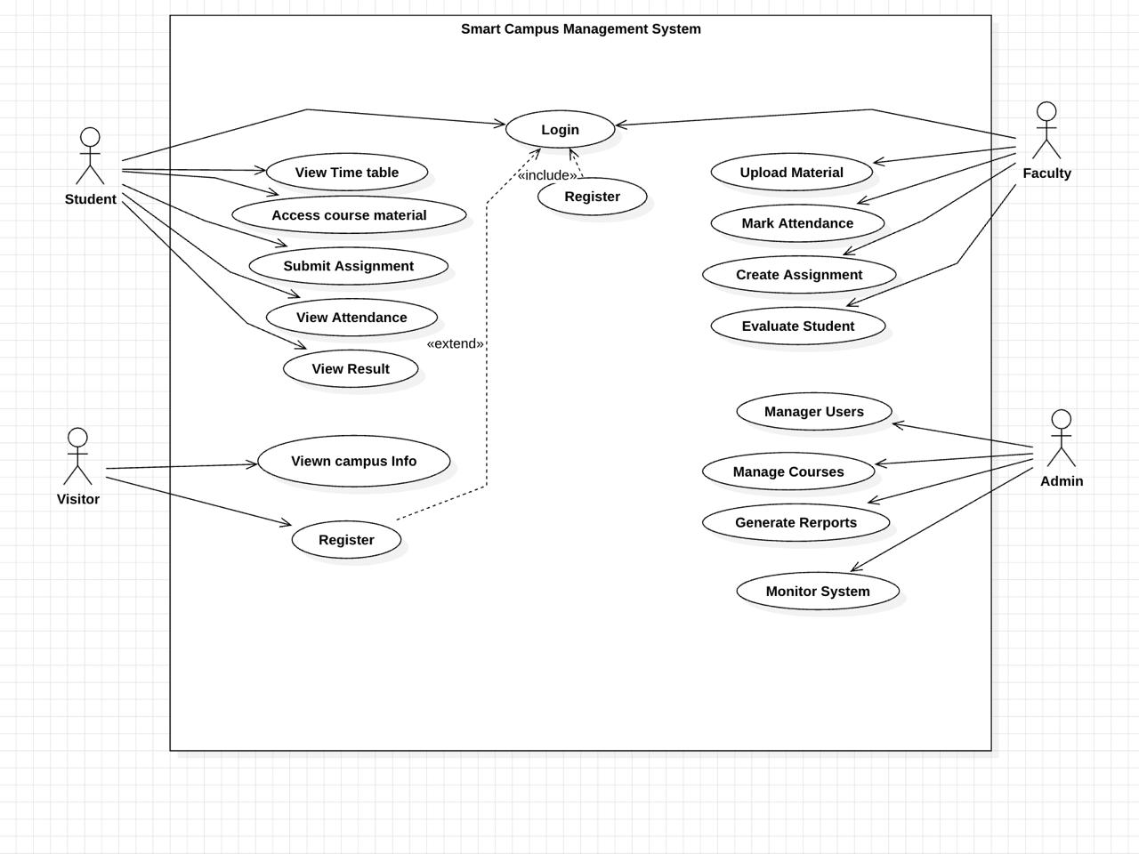
Use Case Diagram :

Slide 7
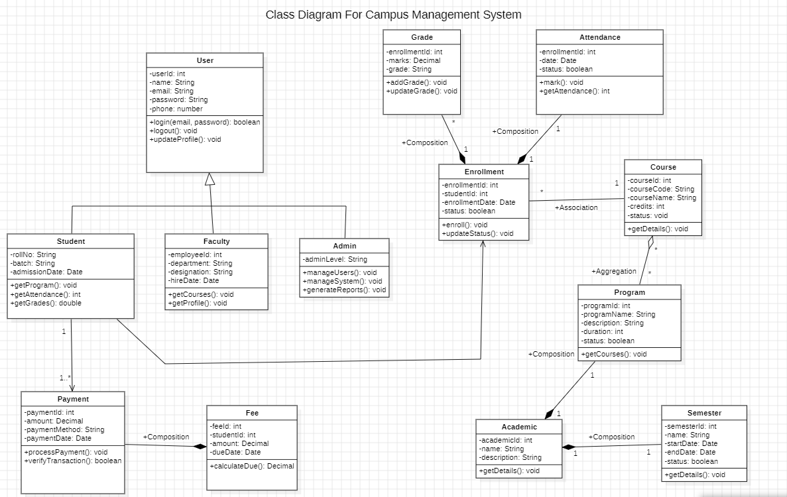
Analysis Class Diagram :

Slide 8
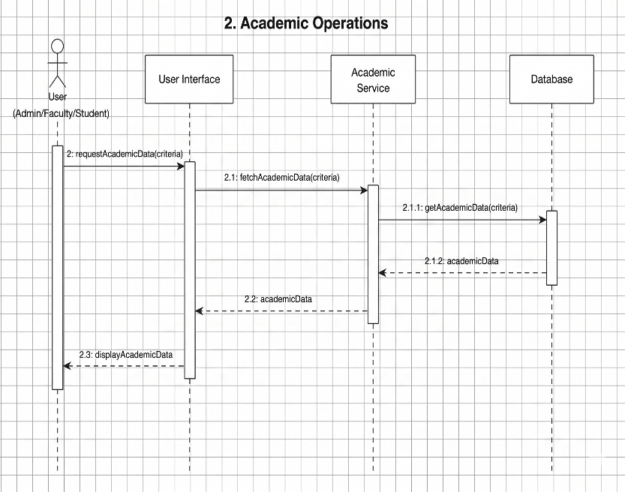
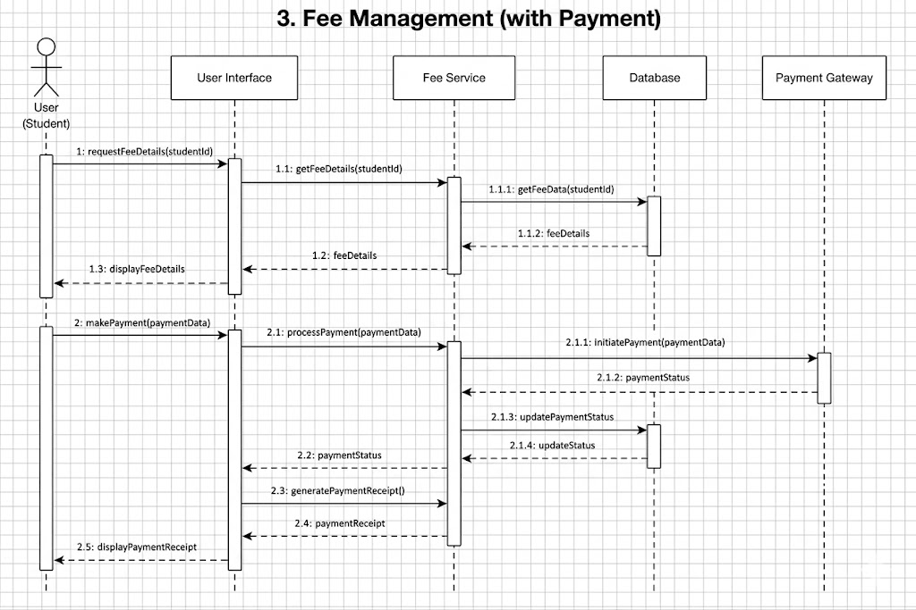
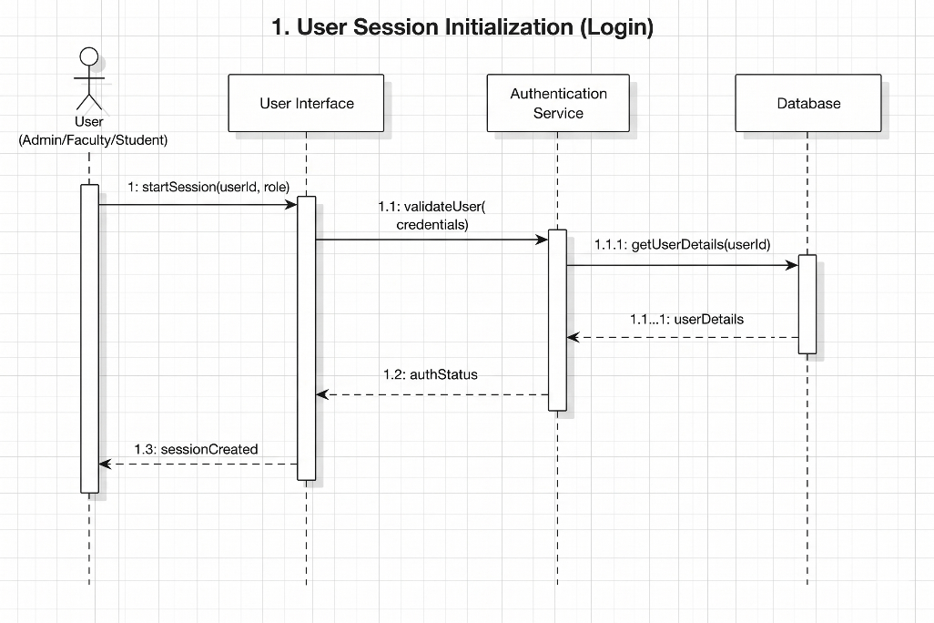
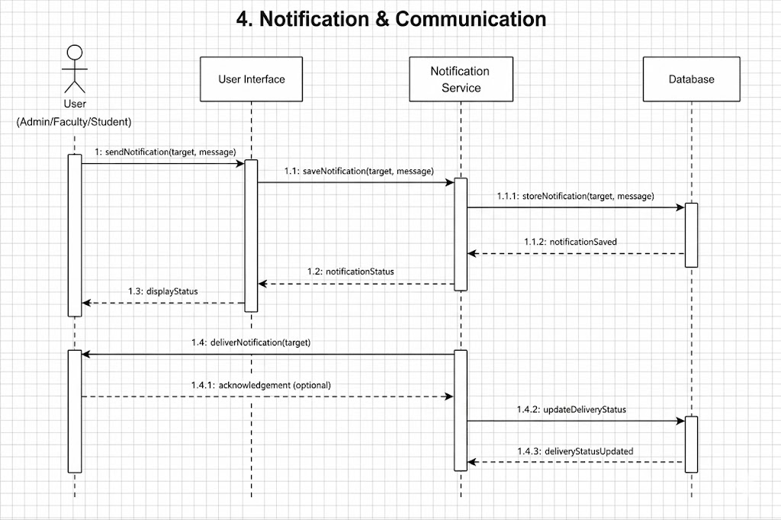
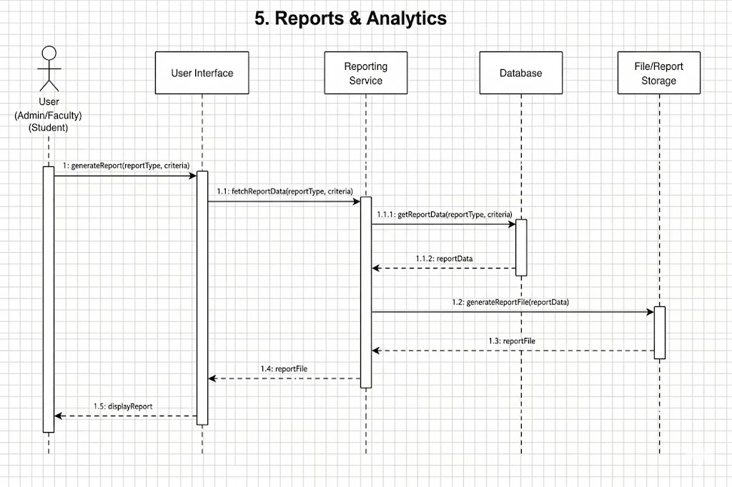
Sequence Diagram –

Slide 9
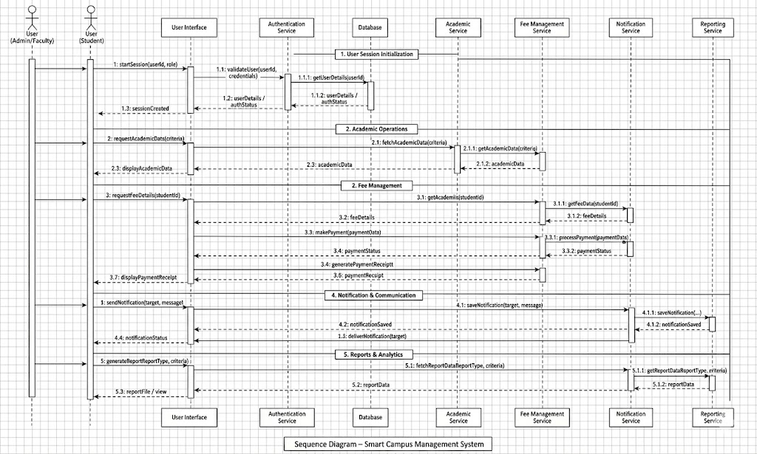
Sequence Diagram

Slide 10
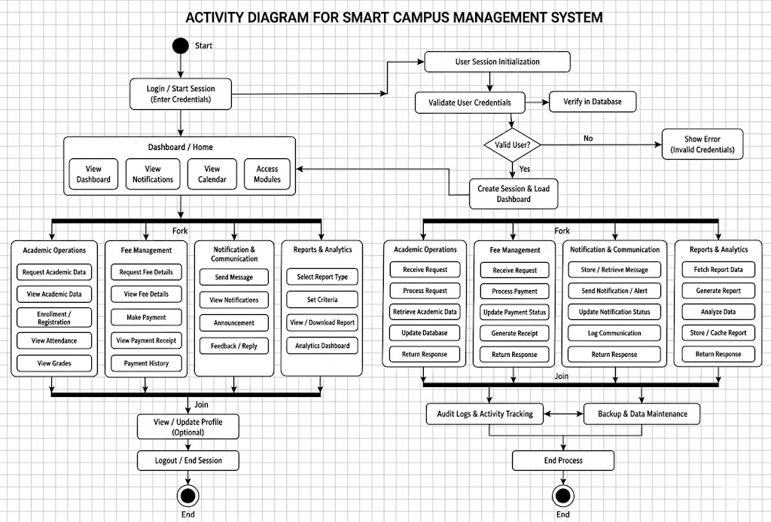
Activity Diagram :

Slide 11
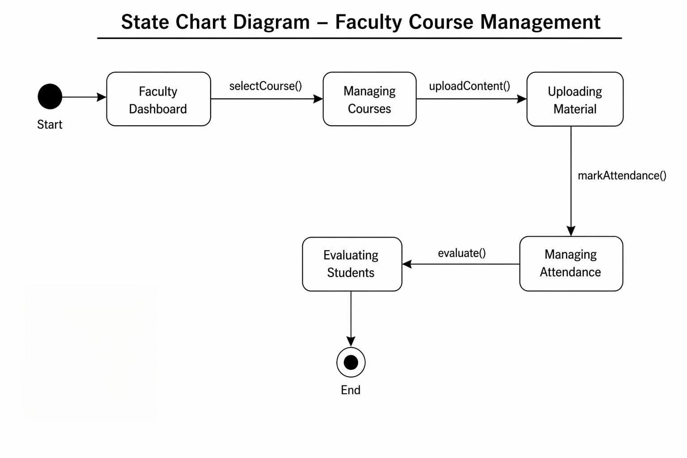
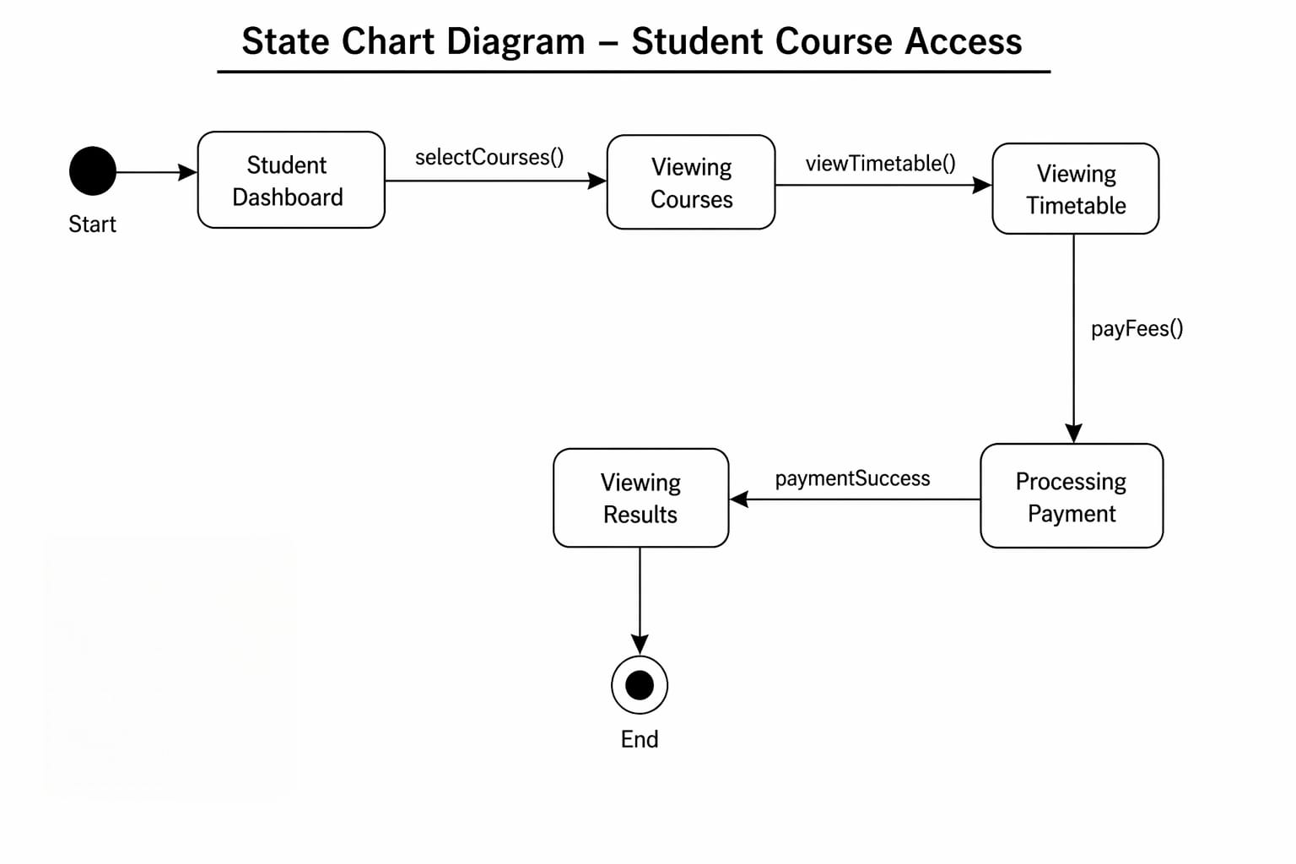
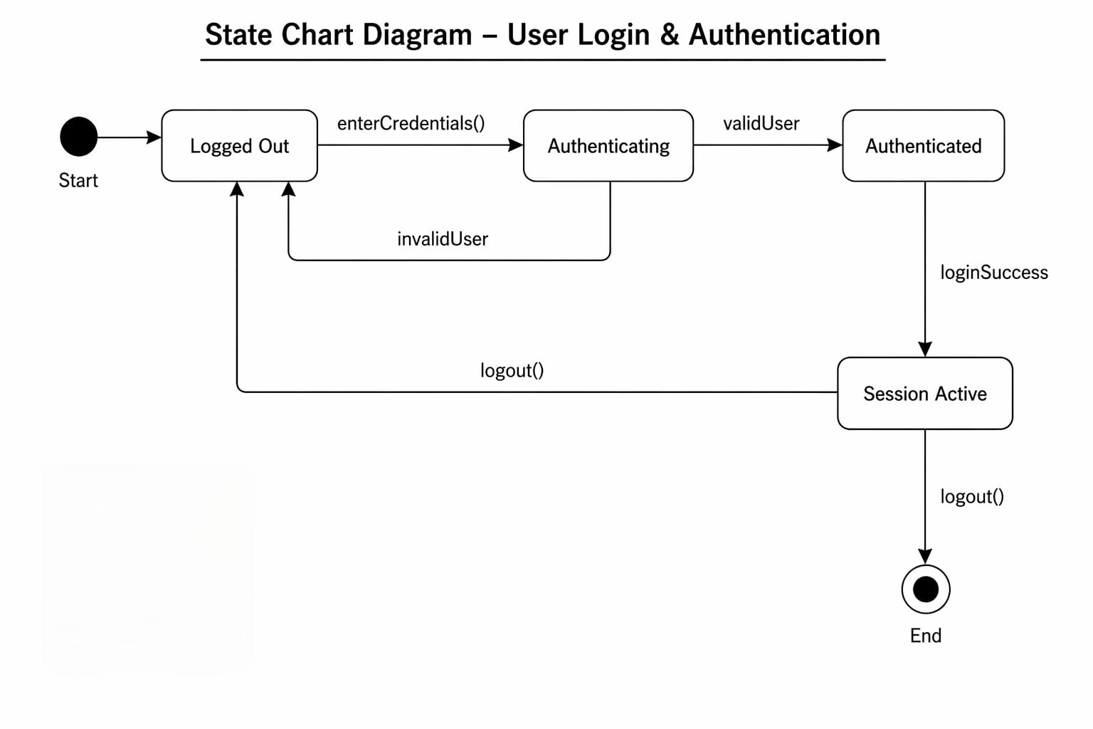
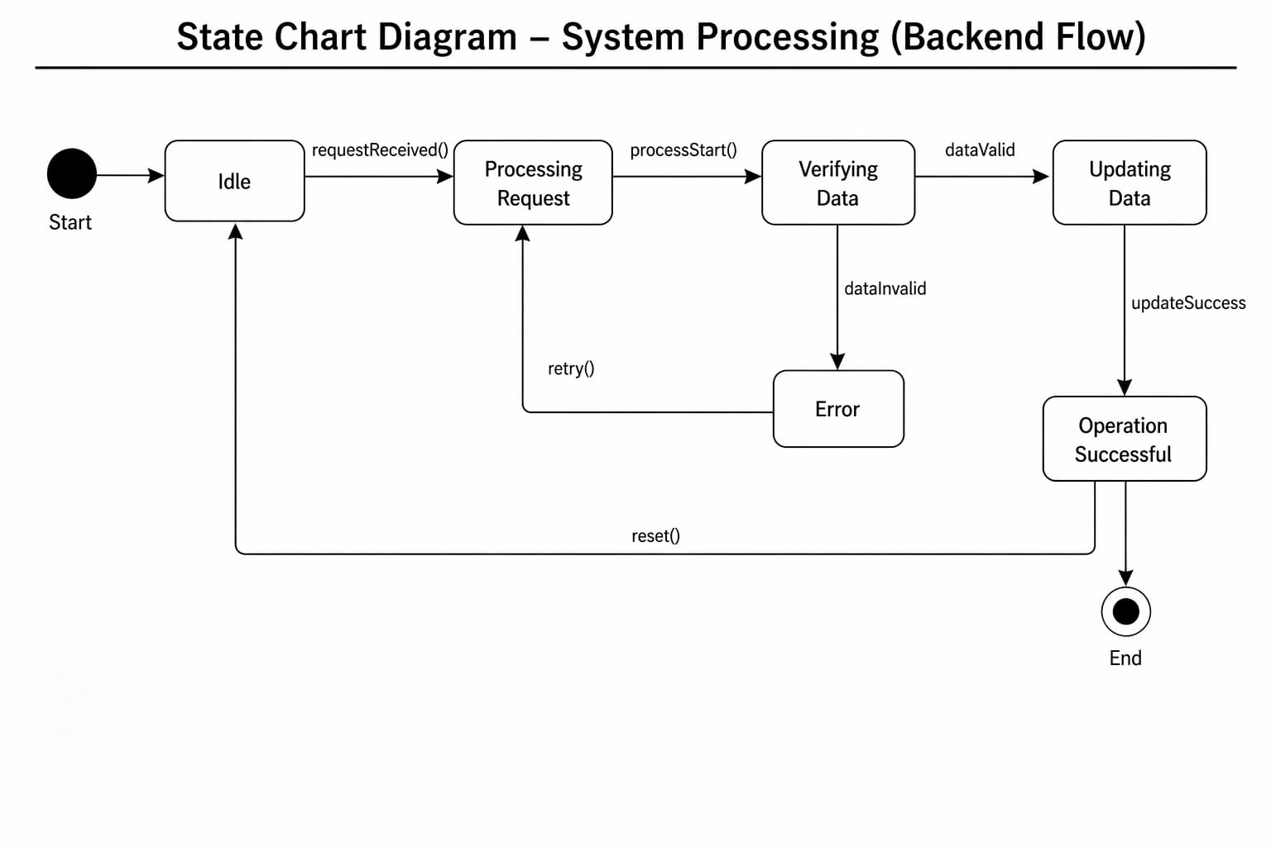
State Machine Diagram :

Slide 12
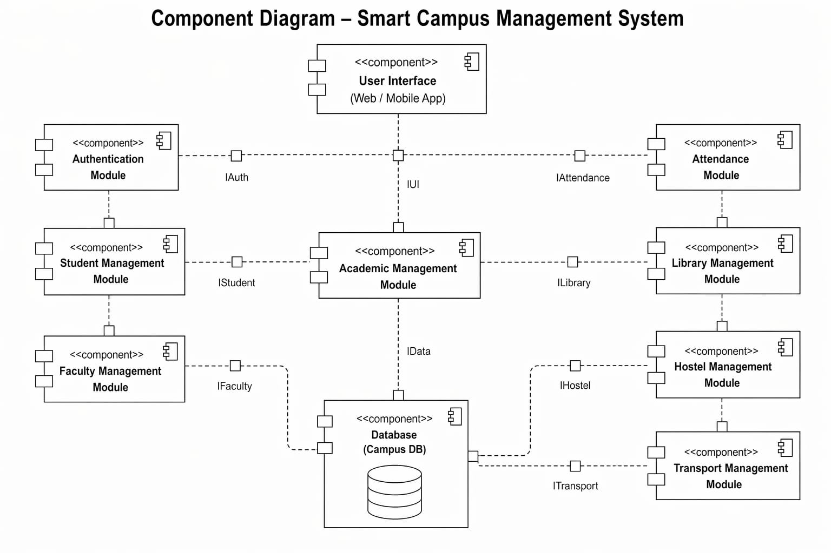
Component Diagram :

Slide 13
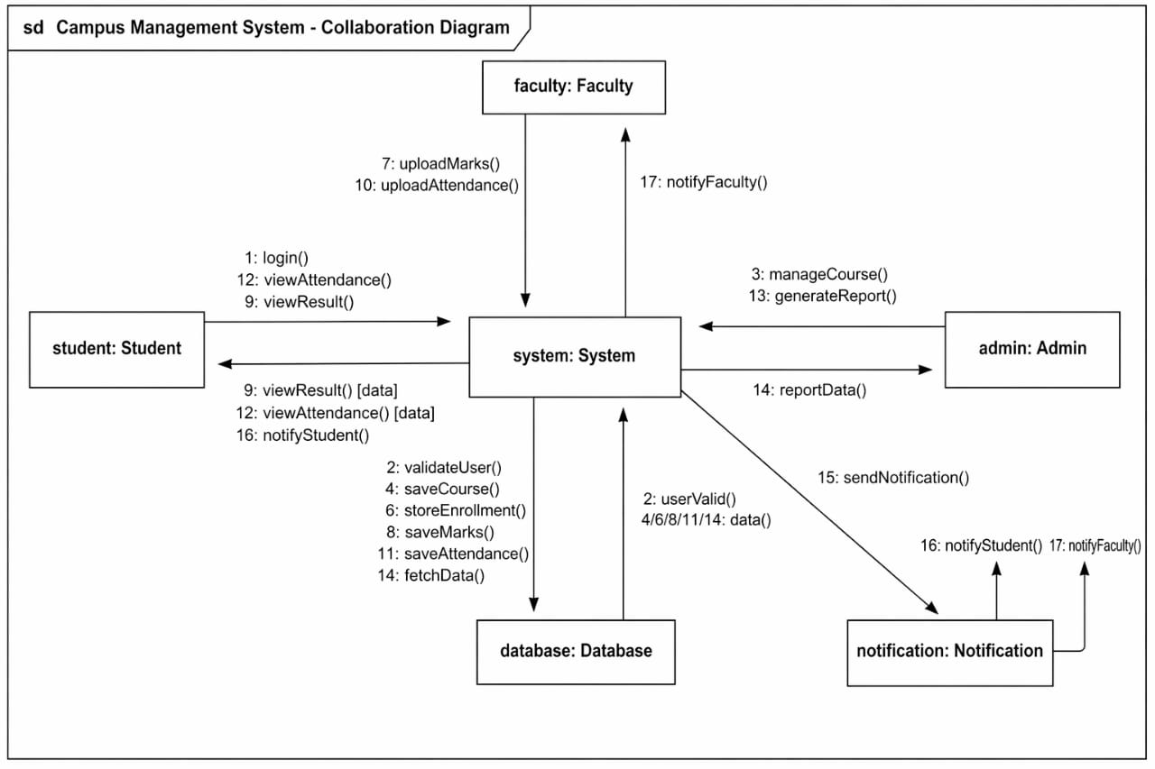
Collaboration Diagram :

Slide 14
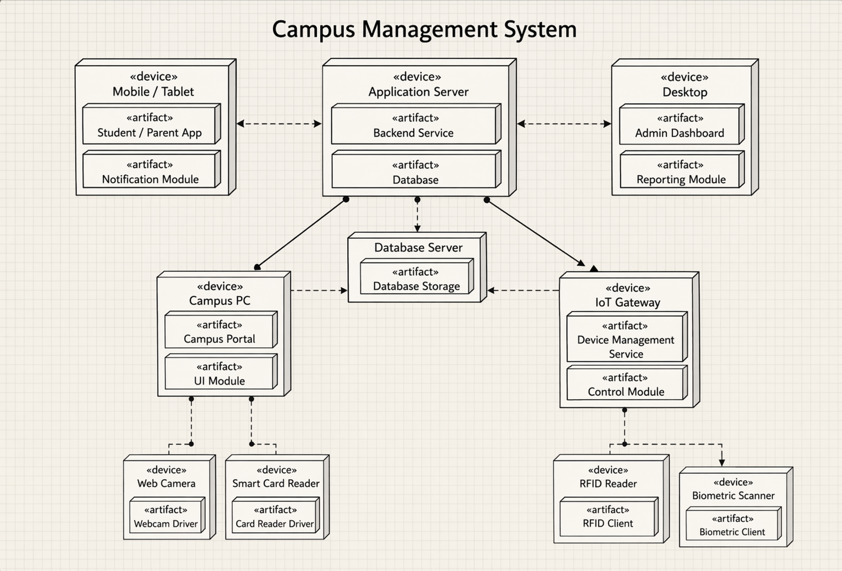
Deployment Diagram :

Slide 15
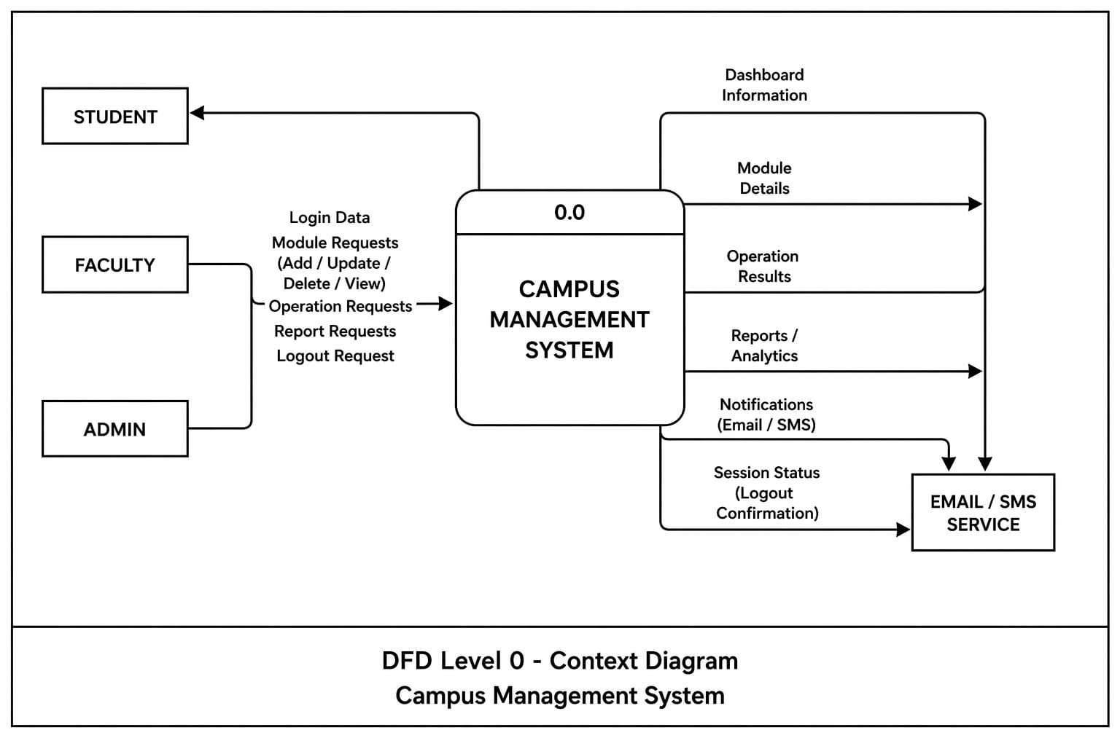
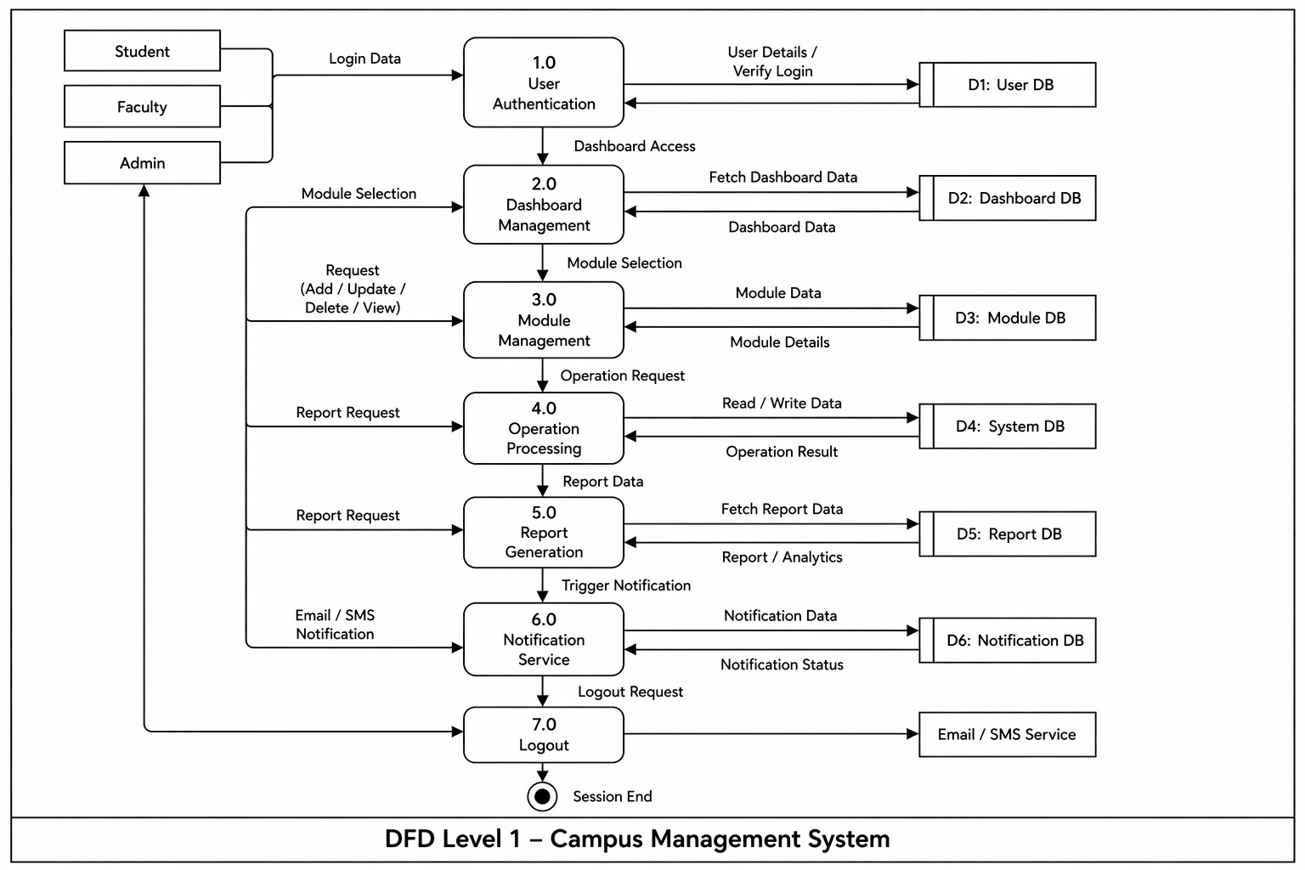
Data Flow Diagram (DFD):

Slide 16
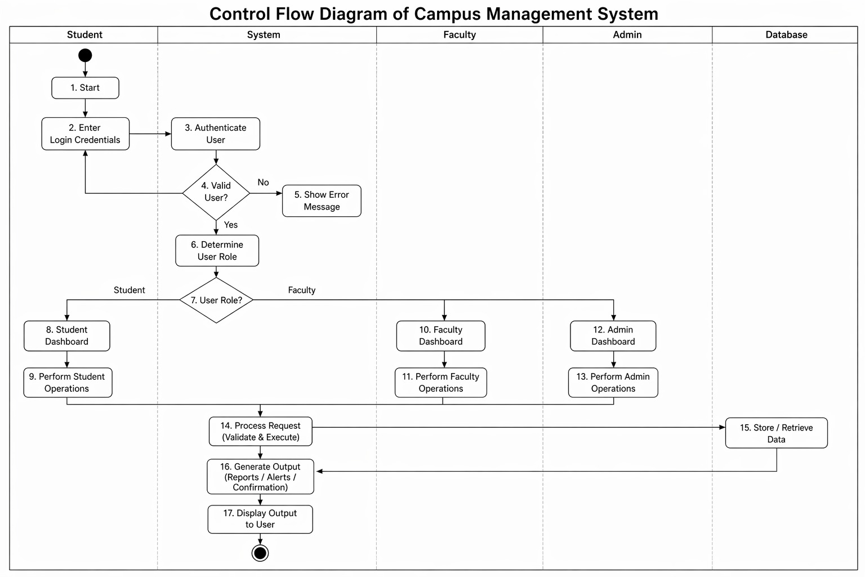
Control Flow Diagram (CFD):

Slide 17
Conclusion:
The Smart Campus Management System provides an efficient and integrated solution to manage various campus activities digitally. By automating processes such as attendance tracking, academic management, fee handling, notifications, and reporting, the system reduces manual work and improves overall operational efficiency.
The system enhances transparency and accuracy while enabling real-time access to information for students, faculty, and administrators. Features like automated attendance, performance monitoring, and centralized data management support better decision-making and improve communication across the campus.

Slide 18
References:
1. Sommerville, I. Software Engineering, 10th Edition, Pearson Education.
2. Pressman, R. S. Software Engineering: A Practitioner’s Approach, McGraw-Hill.
3. Elmasri, R. and Navathe, S. B. Fundamentals of Database Systems, Pearson.
4. Object Management Group (OMG), Unified Modeling Language (UML) Specification.
5. IEEE, Software Requirements Specification (SRS) Standards.
6. Research papers and articles on Online Agriculture Management.

