Slide 1

MLOPS Case Studies
Ramesh Sannareddy

Slide 2
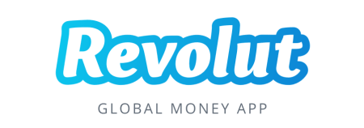
Revolut is a UK-based financial technology company that offers banking services to its customers. Its core business is to help its customers get the most out of their money.

Slide 3
How Revolut implements Machine Learning Operations (MLOps)
As a financial service, Revolut uses machine learning to autonomously scour millions of transactions and combat fraudulent card transactions to avoid losses due to fraud and secure customer transactions.
The card fraud prevention system that Revolut built is tagged Sherlock, and the completely serverless.

Slide 4
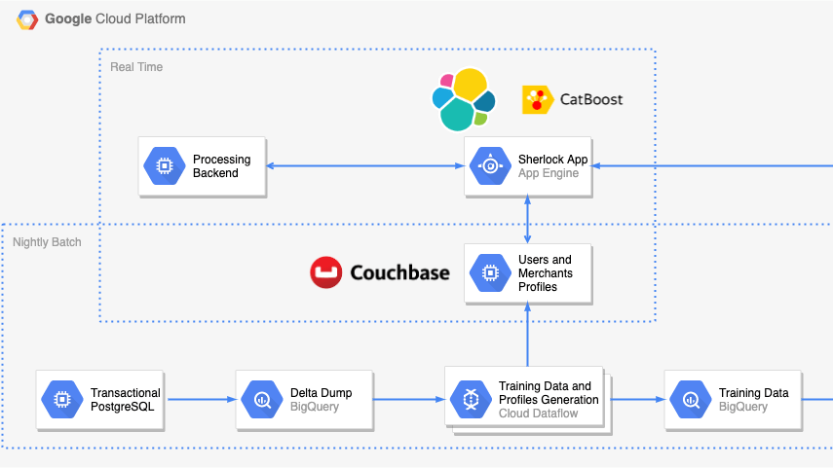

Slide 5
Tools used
In the case of data/feature management Sherlock uses Apache Beam transformations on DataFlow to transform data after it’s extracted.
CatBoost was used as the modeling library for building models with boosting algorithms.
Python was used as the primary language for both model development and model deployment.

Slide 6
Deploying models to production
Training to production orchestration was done with Google Cloud Composer (which runs on Apache Airflow).
The model was deployed as a Flask app on AppEngine.
For low latency, the models are cached in memory.
There’s also Couchbase (their in-memory database for storing customer and user profiles).
Upon receiving a transaction via an HTTP POST request, the Sherlock app fetches the corresponding user’s and merchant’s profiles from Couchbase
Then, it generates a feature vector — using the same features as the ones created in the Apache Beam job that produces the training data — and makes a prediction.
The prediction is then sent in a JSON response to the processing backend where a corresponding action is taken — all within 50 ms.”

Slide 7
Monitoring model’s performance in production
Google Cloud Stackdriver to monitor operational performance such as latency (how fast the system responds), number of transactions processed per second, and more. All in real-time!
Kibana was used for functional performance monitoring such as monitoring of merchants, number of alerts and frauds, true positive rates (TPR), and false positive rates (FPR).
For alerts, Google Cloud Stackdriver sends the team an email and SMS so issues can be triaged by the fraud detection team. You can find an example of the Kibana visualization below.

Slide 8
Monitoring
Google Cloud Stackdriver - to monitor operational performance such as latency (how fast the system responds), number of transactions processed per second, and more. All in real-time!
Kibana was used for functional performance monitoring such as monitoring of merchants, number of alerts and frauds, true positive rates (TPR), and false positive rates (FPR).
For alerts, Google Cloud Stackdriver sends the team an email and SMS so issues can be triaged by the fraud detection team. You can find an example of the Kibana visualization in next slide.

Slide 9
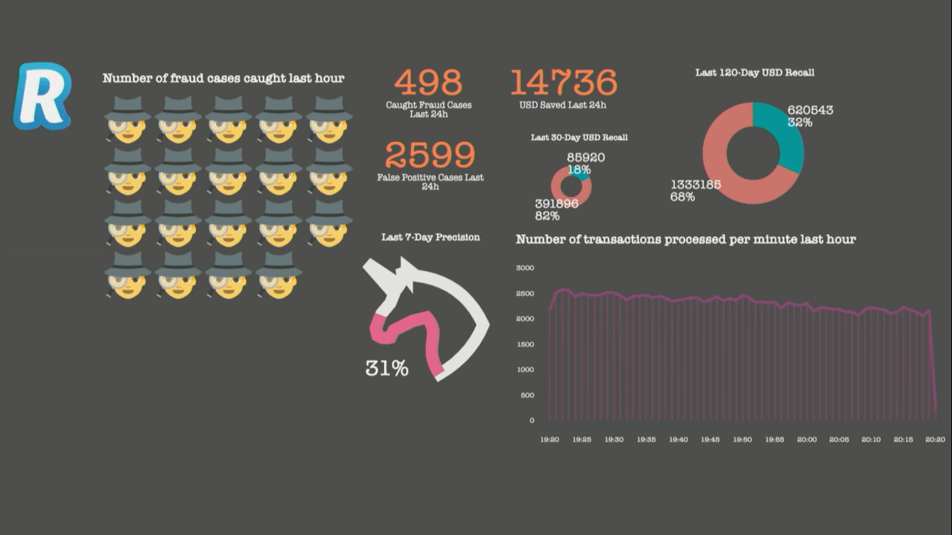

Slide 10
Iteration and model lifecycle management
The responsibility of confirming if a transaction is fraudulent or not is delegated to the users, therefore the team made more effort in building an intuitive user interface for a quality user experience. Below is an example of what a user sees in scenarios where Sherlock classes a transaction as fraudulent.
While there was no mention of how model retraining happens, it’s assumed that, the feedback from users is returned as ground truth (labels) into the database, and the model is scheduled for retraining between frequently and periodically.

Slide 11
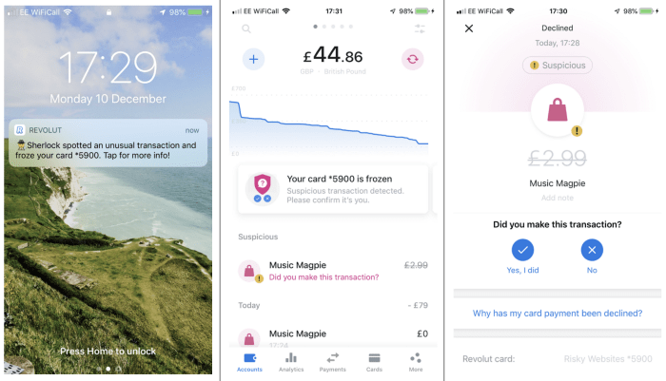

Slide 12
Model governance to explain and audit model usage
There was also no mention of how models are governed in production, especially for use cases like this where there has to be a human-in-the-loop SME (subject matter expert) to review. Based on the implementation, it’s assumed that users will send accurate information on whether or not a transaction processed with their account was fraudulent or not.
For auditing models, model versioning is enabled in Google Cloud AI Platform (Cloud ML Engine) with all the training and performance details so that model lineage can be traceable.

Slide 13

Uber is the most popular ride-sharing company in the world. Through the Uber app, those who drive and deliver can connect with riders, eaters, and restaurants.
A lot of Uber’s services make business sense as machine learning solutions. From intelligently estimating a driver’s time of arrival or a rider’s position, to determining an optimal trip fare based on the demand of users and supply of drivers – these are at the core of Uber’s business.

Slide 14
How Uber implements Machine Learning Operations (MLOps)
According to their engineering blog, Machine learning helps Uber make data-driven decisions. It not only enables services such as ridesharing (destination prediction, driver-rider pairing, ETA prediction, etc) but financial planning and other core business needs. Machine Learning solutions are also implemented in some of Uber’s other businesses such as UberEATS, uberPool, and Uber’s self-driving car division.
They operationalize their Machine Learning models through an internal ML-as-a-service platform called Michelangelo. It enables their team to seamlessly build, deploy, and operate machine learning solutions at scale. It’s designed to cover the end-to-end ML workflow: manage data, train, evaluate, deploy models, make predictions, and monitor predictions. You can find the architecture of the platform in the next slide.

Slide 15
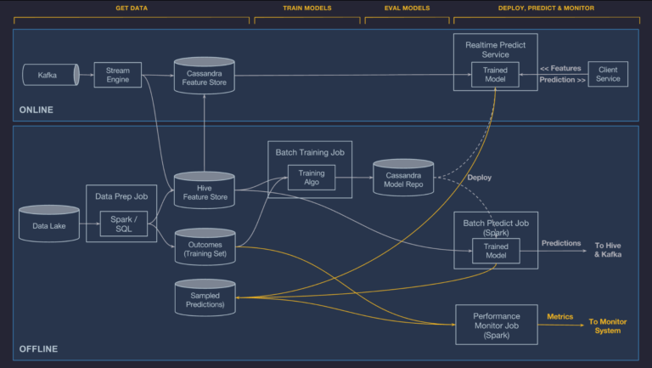

Slide 16
Deploying models to production
Uber, through the Michelangelo platform, successfully transitions its model from development to production in 3 modes:
Online Prediction: Uber implements this mode for models that need to serve real-time predictions. Trained models are packaged to multiple containers and run as prediction services within a cluster online. The prediction service accepts individual or batch prediction requests from clients for real-time inference. It works well for their services (like dynamic pricing, driver-rider pairing, and so on) that involve a continuous flow of data with a high degree of varying inputs.
Offline Prediction: Models that have been trained offline are packaged into a container and run in a Spark job. The deployed models can generate offline/batch predictions whenever there’s a client request or on a repeating schedule. Models that are deployed this way are useful for internal business needs that do not require live or real-time results.
Embedded Model Deployment: While it was stated in this article (from 2017) that Uber was planning to include library deployment, Jeremy Hermann (who is the head of Machine Learning Platform at Uber) did mention that models are now being deployed on mobile phones through their applications for edge inference.
PyML allows flexibility in not just development but also deploying a trained model to production, as you can deploy to production for batch / real-time prediction through an API or the Michelangelo user interface.
In the platform’s backend, the Cassandra database is used as a model store.

Slide 17
Monitoring model’s performance in production
Through Michaelangelo, Uber monitors thousands of models at scale by:
Publishing metric features and prediction distribution over time so teams or systems can spot anomalies.
Logging model predictions and joining to the observations (or ground truth) generated by their data pipeline to observe whether the model is getting its predictions right or wrong. An example here would be logging the ETA prediction of meal delivery for a client and joining it to the actual delivery time so that the estimation error made by the model can be monitored (for real-world measurements) on a dashboard.
Measure model accuracy based on the metrics used to measure the performance of the model.
They also monitor their data quality at scale using Data Quality Monitor (DQM), which is their internal data monitoring system that automatically finds anomalies across datasets and does automatic tests to trigger an alert on the data quality platform. After receiving the alert, the data table owner knows to check the quality tests for potentially problematic tables and, if many tests and metrics are failing, they can proceed with the root cause analysis and take action in terms to mitigate outages.
They also use the DQM system to automatically detect a failed job and scheduler.

Slide 18
Iteration and model lifecycle management
Uber uses an API tier to manage the lifecycle of models in production, and integrate their performance metrics to alerts and monitoring tools of the operations team.
According to this blog post, the API tier also houses the workflow system used to orchestrate the batch data pipelines, training jobs, batch prediction jobs, and the deployment of models both to batch and online containers.
Notable tools:
The Uber ML team uses Manifold – a model-agnostic visual debugging tool for machine learning – to debug the performance of models during development and when deployed to the production environment.

Slide 19
Model governance to explain and audit model usage
Michelangelo includes features for auditing and conducting traceability for data and model lineage. This includes understanding the path a model takes from experimentation, what dataset it was trained on, and which of the models has been deployed to production for what specific business use-case. The platform also includes the various persons that took part in the lifetime of a particular model or managing a dataset.

Slide 20

Popular TV show and movie streaming platform that has undoubtedly revolutionized the way we watch shows and movies online.
Machine learning majorly helps Netflix personalize the experience of their customers and the content necessary for that experience to be optimal (for their customers).

Slide 21
How Netflix implements Machine Learning Operations (MLOps)
Use cases for machine learning in Netflix are all around the place. From catalog composition to optimizing the streaming quality of content, to recommending what shows to produce, to detect anomalies in a user’s sign-up process – these are all centered around the business need for optimizing the experience of users through personalization.
Let’s take their recommendation use case for example. This use case ranges from:
Personalizing a member’s homepage,
Recommending what shows to watch,
Displaying artworks (that might be relatable to a viewer for each movie title).
The business goal with this use case is to predict what a user wants to watch before they watch it. The successful implementation of their machine learning solution will hinge on this business goal.

Slide 22
Deploying models to production
Similar to Uber, the ML (machine learning) team at Netflix deploys models both online and offline modes. In addition to both modes, they also perform nearline deployment (where models are deployed to an online prediction service but don’t need to perform real-time inference). This mode increases the responsiveness of their system to client requests together with the online prediction service.
Models are trained offline by the team, validated, and deployed offline. The offline models are deployed online as a prediction service through an internal publication and subscription (or pub/sub) system. I will go into the details below.
In the case of personalization systems (recommendation) at Netflix, various models are trained and validated on historical viewing data during the development phase and are tested offline to see if they meet the required performance. If they do, the trained models are deployed to live A/B testing to see if they perform well in production. Results can also be computed by the models offline as batch inference depending on the need. You can learn more about the architecture of Netflix’s recommendation system here.
In terms of tools, the Netflix team built and uses Metaflow, an open-source Machine Learning framework-agnostic library that helps data scientists rapidly experiment by training machine learning models and effectively managing data. It offers an API that assembles ML pipelines as a DAG (directed acyclic graph) workflow with each node in the graph as a processing step.

Slide 23
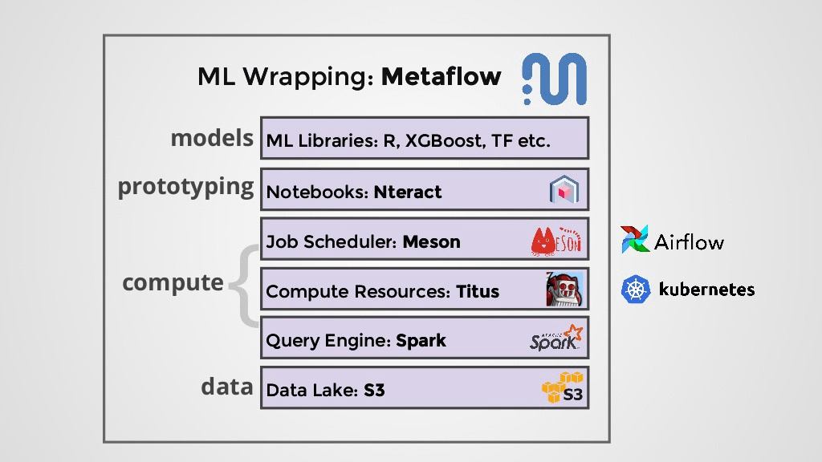

Slide 24
Using the Metaflow API, their ML workloads seamlessly interact with AWS Cloud infrastructure services such as storage and compute, Netflix’s development notebooks (Polynote), and other user interfaces – all through a series of steps called “flow”.
For scheduling model training jobs, Meson is the internal orchestration engine used by the Netflix team for workflow orchestration when moving models from development to production for scheduling model training jobs. It also ensures models don’t get stale in production and continuously perform online learning for dynamic workloads.
The Meson engine integrates with Mesos (which is their infrastructure engine for cluster management), performs job scheduling, submits training ETL (extract transform and load) jobs to Spark clusters and provides active monitoring and logging of these workflows and metrics around the workflow.
Meson integrates with an internal model lifecycle management system (called Runway) to deploy training pipelines to production, rapid prototyping, and testing out new models.

Slide 25
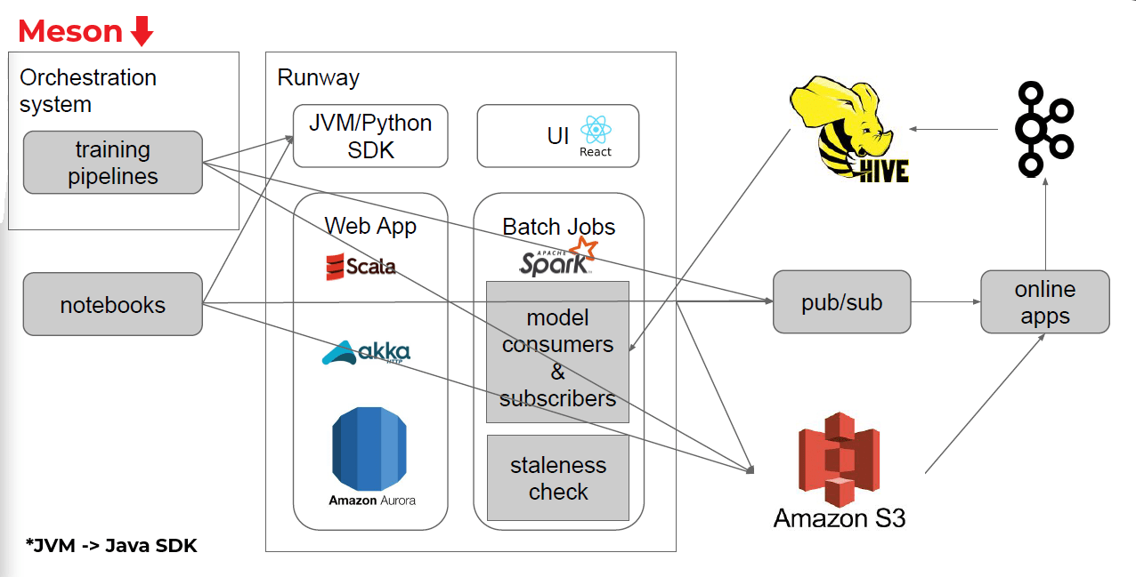

Slide 26
Monitoring model’s performance in production
Netflix uses internal automated monitoring and alerting tools to monitor bad data quality generated through the aggregation of online features from the client-side before it’s fed to their recommendation service so that data drift can be detected.
Netflix uses an internal tool called Runway to monitor and alert the ML teams for models that are stale in production. For monitoring the model performance in case of recommendation, the ground truth data (which is whether or not a user plays a recommended video) is collected and compared to the outcomes of the model to track its performance.
Runway also keeps a monitoring timeline of the model that includes the model publication history, alert history (including the resolution time), and model metrics. This helps the team spot model staleness (as mentioned above) and also potential problems for triaging and troubleshooting. Users can easily configure staleness alerting by setting a threshold to check for model staleness based on the comparison of the model’s prediction with the ground truth, and model metrics.
Using the Runway tool, the Netflix team can also visualize the application clusters that consumed a model’s prediction down to the model instance (that includes the model information) so that system metrics and model loading failures can be effectively monitored.

Slide 27
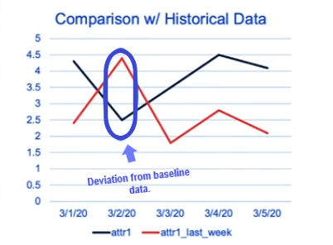
Beyond spotting mismatch, the tool also checks for the underlying distribution in the input data attributes (distributions are computed independently for each attribute) by comparing it with baseline data attributes (or features, as you may know) which could be data from a few days to weeks back, or the actual training data.

Slide 28
Iteration and model lifecycle management
Thousands of machine learning models are driving Netflix’s use cases such as their personalization system, and Runway is used for managing all of these models in production.
Runway—Netflix’s model lifecycle management system—provides a store to keep track of model-related information, including artifacts and the model lineage. According to Liping Peng, a Senior Software Engineer part of Netflix’s Personalization Infrastructure team, Runway also provides the ML team with a user interface to search and visualize model structure and metadata to easily understand models in production, or about to be deployed to production.
Management is also made easier as you can debug and troubleshoot models thanks to seamless navigation within the Runway page, and the integration with other Netflix systems. The tool also provides a role-based view of models in production and those that are unused – this again makes model management easier.
Netflix also has systems in place that perform fact logging. Their ML teams can keep training and testing models with new data offline.
The Netflix team works with an in-house A/B testing framework (which collects metadata on the test so teams can easily search and compare tests). It’s used to test and track if the model deployed and used by real people solves the actual business problem it was intended for. (Source)

Slide 29
Model governance to explain and audit model usage
Runway enables traceability by giving ML teams a way to trace model lineage through tracking of model metadata (such as DAGs, hyperparameters, and model files) and configuration instances (which can be thought of as the versions), such as pipeline run details. Through a central dashboard, the team can see what data (and features) a model was trained on, publication information, alerting and validation configuration, and prediction results.

Slide 30
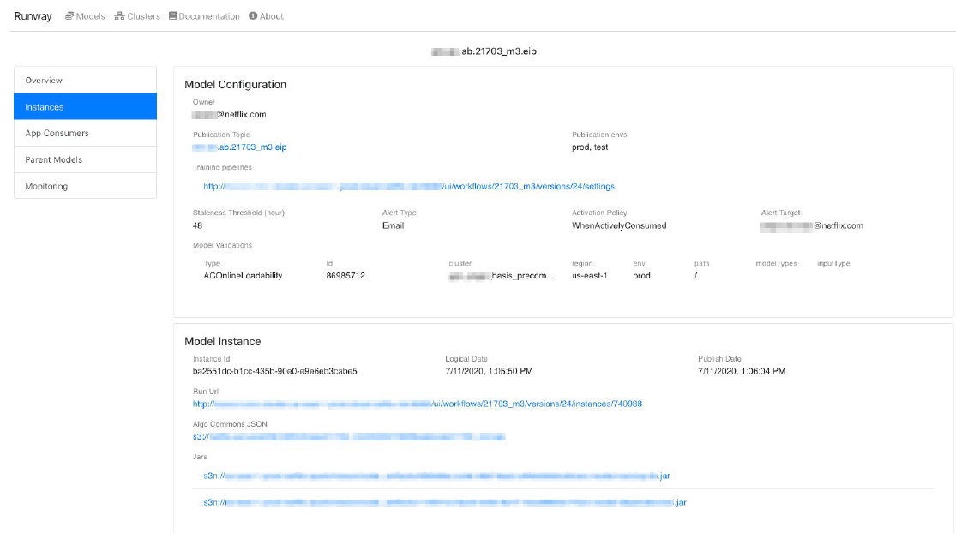

Slide 31
The Netflix team also audits the quality of data being generated from the client-side using SparkSQL and internal auditing libraries that audit individual attributes for a dataset, letting the team set a threshold for alerting and triaging. For example, when an anomaly is detected in the average duration that content is played, the developer team should get an alert for auditing.

Slide 32

DoorDash is a technology company that’s focused on being the last mile logistics layer in every city. It does this by empowering local businesses to offer delivery, connecting them with consumers looking for delivery, and dashers who are the delivery personnel.
- Raghav Ramesh (engineering manager at DoorDash)

Slide 33
How DoorDash implements Machine Learning Operations (MLOps)
DoorDash uses Machine Learning for several cases that are intended to optimize the experience of dashers, merchants, and consumers.
One major machine learning solution that DoorDash employs is within their internal Logistics Engine. At DoorDash, Machine Learning models power:
The forecasting and balancing of supply (of dashers) with the demand (of consumers) at any given time
Estimation of delivery time when a customer places an order
Dynamic pricing (as in the case of Uber)
Recommendations of merchants to consumers
Search ranking of the best merchants for DoorDash

Slide 34
As of January (2021), the DoorDash team has deployed about 38 models to production to solve different business problems with around 6.8 million peak predictions per second.
The team at DoorDash uses a centralized machine learning platform for training, serving predictions, monitoring, logging, evaluation, and so on. Their platform is heavily based on a microservice architecture.

Slide 35
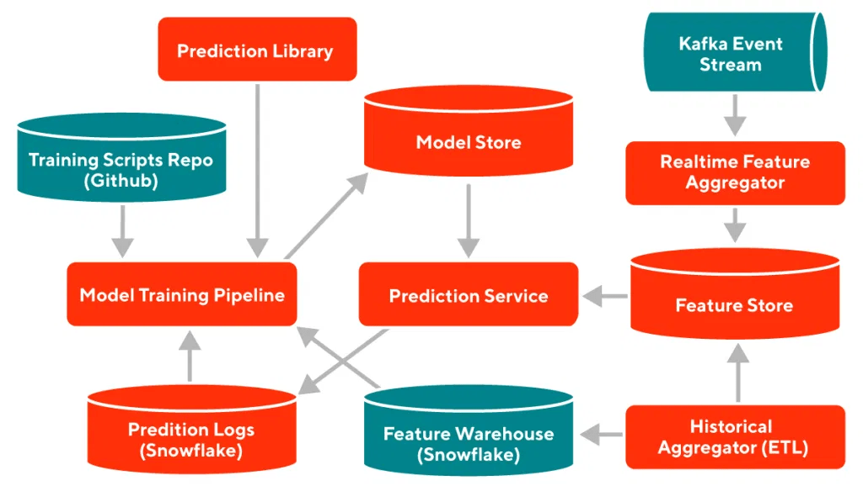

Slide 36
Deploying models to production
Machine Learning models at DoorDash are developed either for exploratory (research) reasons or production needs. Production models are often scheduled as a job in a training pipeline. The team employs external (open-source) Machine Learning frameworks, such as:
LightGBM for tree-based models,
and PyTorch for neural network models.
A machine learning wrapper is used to wrap the training pipeline to make it model-agnostic. The team uses Apache Airflow to schedule and execute training jobs. The files (native formats of models and model configs) and metadata (training data used, training time, hyperparameters used) are written to a model store (stored in Amazon S3), where they’re ready to be loaded by a service that integrates with the entire DoorDash microservice architecture.
Sibyl is DoorDash’s prediction service for serving output to various use cases. It was developed using Kotlin and deployed using Kubernetes containers. The team uses a model service to load models from the model store and cache them in memory to avoid latency while serving them to Sibyl. The model service also helps handle shadow predictions and optionally A/B test experimentations.

Slide 37
Deploying models to production
When a prediction request comes in, the platform checks for missing features and if there are any, it contacts a feature service that tries to fetch them from the feature store (which is a Redis in-memory cache of feature values)—this is also the case for requests where the service needs extra features for predictions. The feature service supports multiple feature types (that include aggregate features, embeddings, and so on). The DoorDash team standardizes the features in the feature store to make the data (that the prediction service will use to serve predictions) more robust.
Predictions are either served in real-time, asynchronously (batch predictions), or in “Shadow Mode”, depending on the use case. The team uses the “Shadow Mode” prediction type to test out multiple models in production while only making sure the results from only one version of the model is what’s returned as a response to the prediction request.
Prediction responses are returned to the client as a protobuf object with gRPC rather than the popular XML or JSON serialized formats. Predictions are also logged to a Snowflake data store with metadata such as the prediction time and the id of the model that was used for the prediction for auditing and debugging.

Slide 38
Monitoring model’s performance in production
DoorDash uses a monitoring service to monitor its models in production. The service tracks the following:
Predictions that are made by Sibyl to monitor model metrics,
The distribution of the features are visualized and an alert set up to monitor data drift,
A log of all predictions generated by the prediction service and those from the prediction request.
The DoorDash team uses the Prometheus monitoring framework to collect and aggregate monitoring statistics, and also to generate metrics to be monitored. They use Grafana (which has an intuitive UI and dashboard) to visually monitor these metrics by visualizing them on graphs and charts. For alerting, they use Prometheus’ Alertmanager and their internal Terraform repository to send alerts to relevant service owners when a threshold for a metric (such as data drift) is exceeded.
The service owner(s) and/or team receives alerts in their channel through a connected Slack application or PagerDuty. For logging, they make use of an in-house Apache Kafka streaming solution for logging different events and predictions.

Slide 39
Iteration and model lifecycle management
The retraining of models in production is scheduled and executed through the training pipeline. Model files and metadata are written to the model store. These models are used as shadow models (testing new models on production data without returning their results to the client), and their predictions logged so that metrics for the new models can be monitored, and new models can be improved before being fully deployed as the de facto model in production.

Slide 40
Model governance to explain and audit model usage
The Model Store stores metadata (training data used, training time, hyperparameters used) for each model for audit trails, and enables the model lineage to be traceable. This helps in troubleshooting and debugging models in production. Details on if the system is role-based and includes ACL (access control level) weren’t specified.

Slide 41
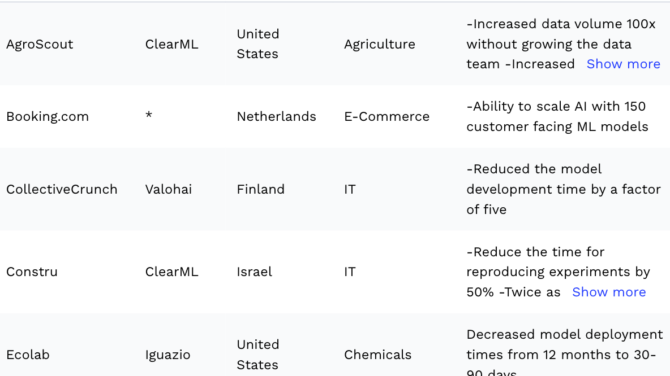

Slide 42
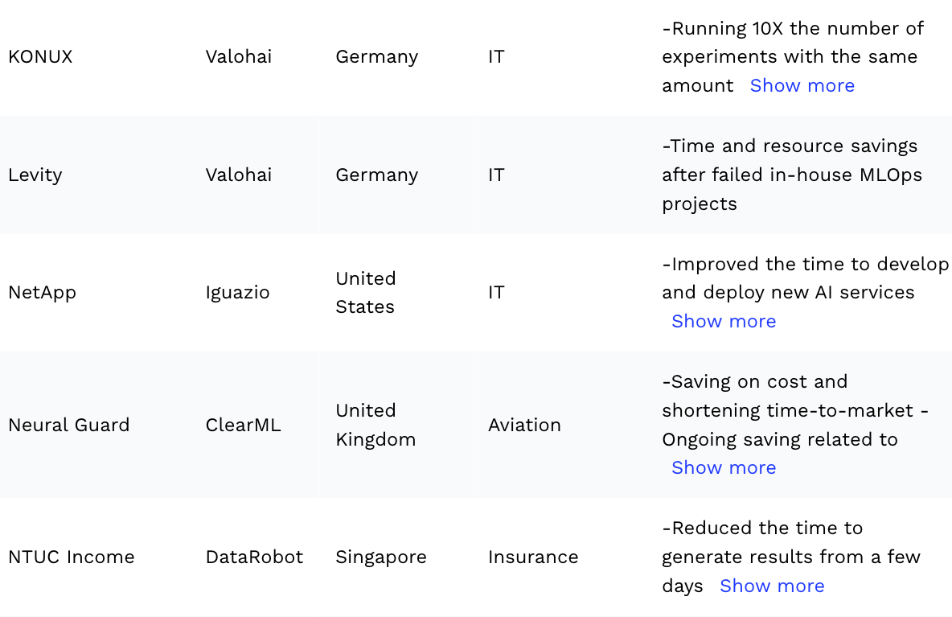

Slide 43
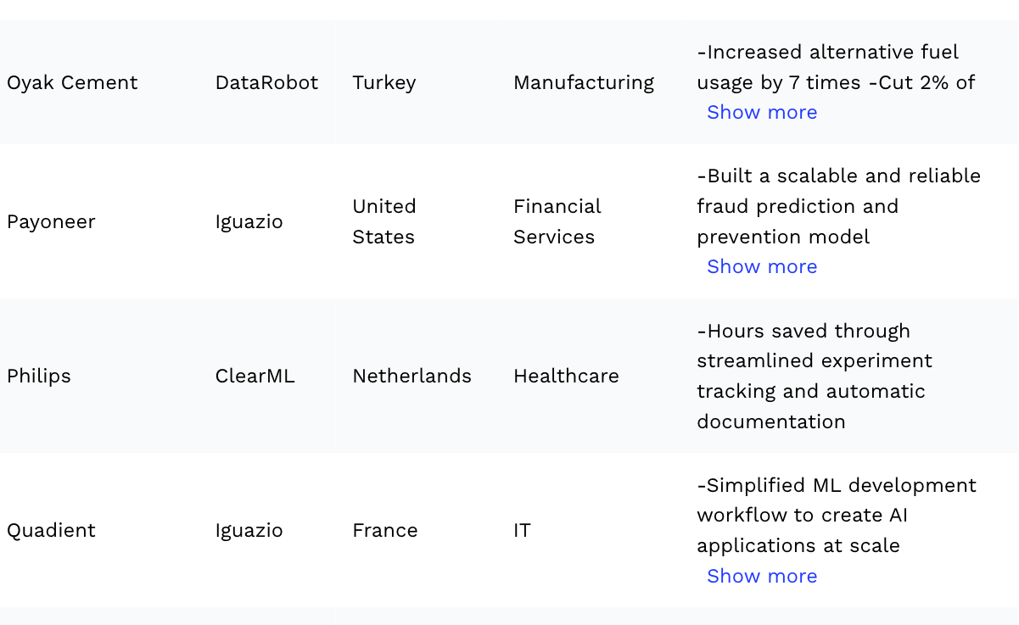

Slide 44
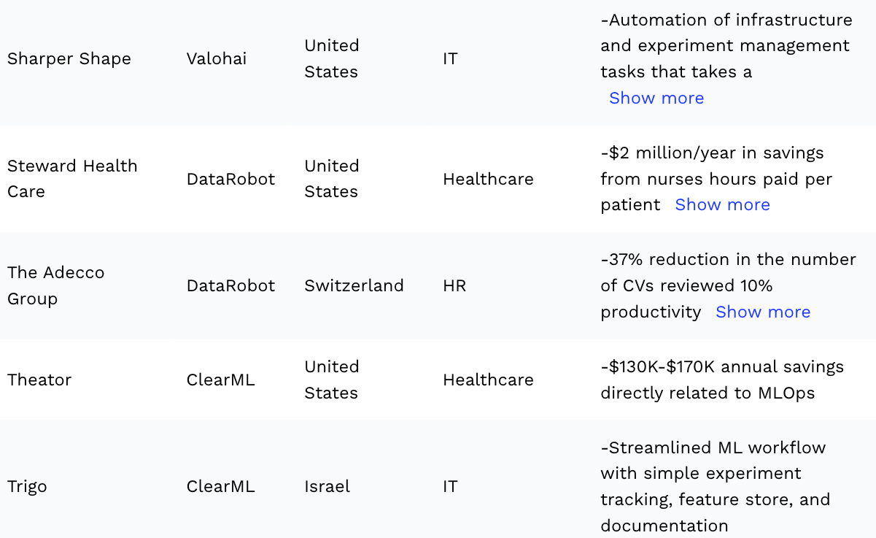

Slide 45
PPT based on articles from
Netpute.ai
research.aimultiple.com

