Slide 1

ML Ops
Ramesh Sannareddy

Slide 2
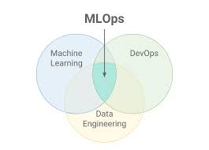

Slide 3
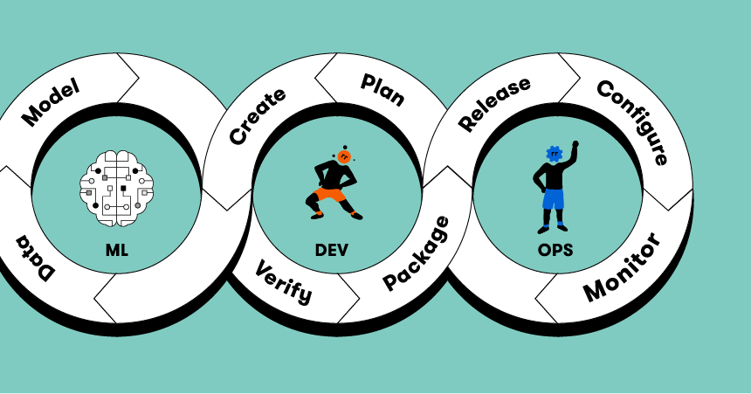

Slide 4
ML Ops
Data Collection and Preparation
01
Model Development and Training
02
Model Evaluation and Validation
03
Model Deployment
04
Monitoring and Management:
05
Continuous Integration and Deployment (CI/CD)
06
Feedback Loop and Iteration
07

Slide 5
Data Collection and Preparation
Identify and collect relevant data for the ML project.
Perform data cleaning, preprocessing, and feature engineering.
Split the data into training, validation, and testing sets.

Slide 6
Model Development and Training
Select an appropriate ML algorithm or model architecture.
Write code to implement the model and define evaluation metrics.
Train the model using the training data.
Regularly monitor and log the model's performance during training.

Slide 7
Model Evaluation and Validation
Evaluate the trained model's performance on the validation dataset.
Fine-tune hyperparameters and iterate on the model architecture if needed.
Validate the model against the testing dataset to assess its generalization capabilities.

Slide 8
Model Deployment
Package the trained model and its dependencies into a deployable format.
Set up infrastructure or cloud resources for hosting the model.
Create an API or service endpoint for the model to receive prediction requests.
Implement model versioning and ensure backward compatibility.

Slide 9
Monitoring and Management
Implement
Implement monitoring and logging systems to track the model's performance and behavior in production.
Collect and analyze
Continuously collect and analyze data on model predictions, accuracy, and any anomalies.
Set up
Set up alerts and notifications for detecting performance degradation or drift.

Slide 10
Continuous Integration and Deployment (CI/CD)
Automate the deployment process using CI/CD pipelines.
Integrate the model deployment with version control and continuous integration systems.
Trigger automated tests and validations before deploying new versions of the model.
Deploy new model versions to production with minimal downtime or disruption.

Slide 11
Feedback Loop and Iteration
Gather feedback from users, stakeholders, or monitoring systems.
Incorporate feedback to improve the model's performance and address any issues.
Iterate on the model development and deployment process based on lessons learned.

