Slide 1
FINANCIAL RISK SIGNAL AGGREGATOR
Problem Understanding
Compliance teams manage AML/KYC risk by pulling together transaction ledgers, account records, sanctions lists, adverse media and analyst notes — scattered across formats and systems.
Manual, siloed review
Structured transaction/account data and unstructured alerts are reviewed separately, slowing investigations.
No consistent prioritisation
Analysts lack a transparent, repeatable way to rank which customers need attention first.
Hidden relationships missed
Per-customer scoring alone can't see shared intermediaries linking two flagged accounts.
Regulatory pressure
SAR filing, MLRO escalation and EDD decisions need to be fast, defensible and auditable.
Ramkumar Arcot Dharmalingam

Slide 2
SOLUTION APPROACH
From Raw Signals to a Prioritised Risk Register
1
2
3
4
Ingest
Score
Explain
Act
Load structured transactions (CSV) and customer records (JSON), plus free-text alerts, adverse media and analyst notes — or use a bundled example dataset.
A deterministic, transparent rules engine flags signals — round-number wires, structuring, dormant reactivation, high-risk jurisdictions, sanctions/PEP hits — and rolls them into an auditable risk score and tier.
Google Gemini reads the scored signals and case context to generate a plain-language executive summary and investigation order — explanation layered on top of, never replacing, the deterministic score.
Output is a ranked Risk Register with recommended actions — File SAR, Escalate to MLRO, Enhanced Due Diligence, Monitor — plus a counterparty network view and CSV/JSON export.
Deterministic scoring stays auditable; generative AI adds narrative explanation — not the score itself.

Slide 3
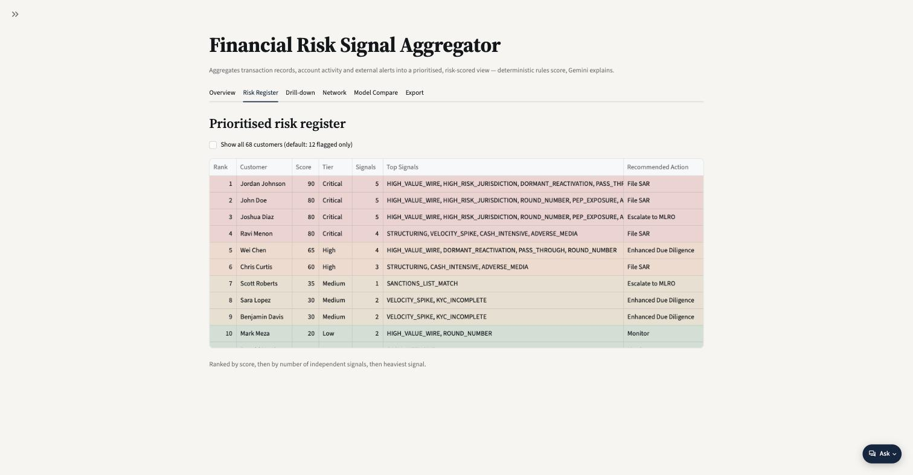
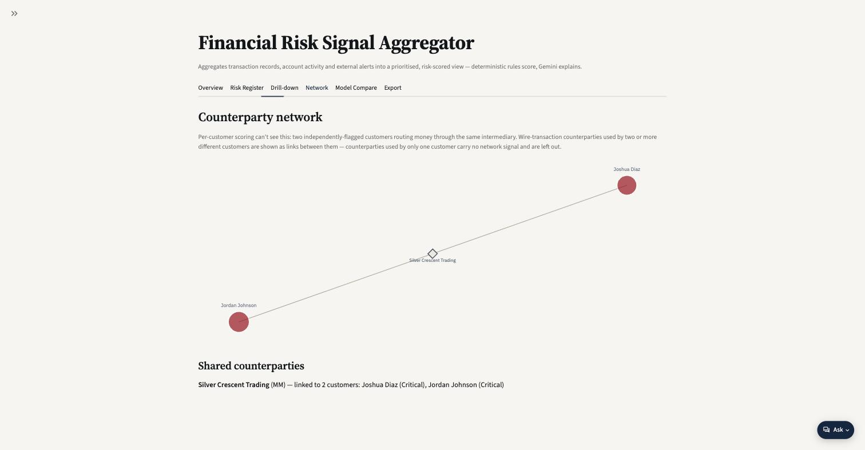
KEY HIGHLIGHTS
Live Prototype, Working End-to-End
68
1,974
4
0.93
customers screened
transactions ingested
Critical-tier cases
OFAC match confidence
Prioritised risk register — ranked by score, tier, and recommended action
Counterparty network — surfaces shared intermediaries linking two Critical customers

Slide 4
CHALLENGES
What Was Hard to Get Right
Keeping AI explanation from becoming the score
!
Investigators need a defensible, reproducible number. Gemini narrates and orders priorities — the rules engine still owns the score, so a bad LLM call can't silently shift a rating.
Structuring free-text intelligence
!
Compliance-inbox notes and adverse-media snippets arrive as unstructured prose; parsing them into consistent, comparable signals per customer was non-trivial.
Seeing relationships, not just records
!
Per-customer scoring is blind to shared counterparties. Building a network view to catch layering patterns across two “independent” cases took a different data model.
Balancing model choice
!
Comparing Gemini against alternative inference providers for cost, latency and accuracy trade-offs — without destabilising the core scoring logic.

Slide 5
LEARNINGS
What This Build Reinforced
Hybrid beats either extreme
Graph-level context changes conclusions
Deterministic rules give auditability regulators need; generative AI adds the narrative and triage speed analysts need. Neither alone was enough.
A view of shared counterparties turned two “separate” Critical cases into one connected typology — flat, per-record scoring alone would have missed it.
The last mile is the workflow, not the model
Ship a working example path
A ranked list with a recommended action (File SAR / Escalate / EDD / Monitor) is what makes a risk score usable — the scoring logic is only half the product.
Bundling a realistic example dataset let the prototype be evaluated end-to-end in minutes, without needing real customer data on hand.

