Slide 1
Banking Risk and Portfolio Analytics
Power BI dashboard and Python EDA on 3,000 bank clients
Ramkumar Sharma | Final-year B.Tech IT
Notes:
Project: a four-page Power BI banking dashboard built on a MySQL dataset, backed by a Python exploratory analysis.

Slide 2



Project overview
The problem
MySQL
Banks need to see where lending is concentrated and how exposed each client group is, so lending decisions carry less risk of loss.
Source: banking_case database, customer table
Power BI
Power Query cleaning, DAX measures, 4 report pages
What this project does
Turns 3,000 client records into a four-page Power BI dashboard and backs it with a Python exploratory analysis.
Python
pandas, matplotlib and seaborn in Jupyter

Slide 3
Dataset at a glance
3,000
25
0
1995-2021
Clients
Raw columns
Data gaps
Joining years
One row per client
Profile, product and segment fields
No missing values or duplicate rows
Age range 17 to 85
Client profile
Products
Segments
Age, nationality, occupation, estimated income
Bank loans, business lending, credit card balance, deposits, checking, savings, foreign currency
Branch type, gender, investment advisor, loyalty tier, fee structure, risk weighting

Slide 4
From raw data to dashboard
1 Extract
2 Clean
3 Model
4 Visualise
The customer table from the banking_case MySQL database is loaded into Power BI.
Gender and branch codes relabelled, Income Band added, money columns set to Currency.
DAX measures for Total Loan, Total Deposit, Total Clients and High Fee Clients.
Four pages with slicers for branch, gender, advisor and joining year.
In parallel: Python EDA on the same 3,000 rows covers distributions, correlations, missing values and duplicates.

Slide 5
Headline KPIs
4.38B
3.77B
3,000
1,476
Total Loan
Total Deposit
Total Clients
High Fee Clients
Bank loans + business lending + credit card balance
Bank + savings + checking + foreign currency
Distinct client IDs
49% of clients on the High fee structure
Loans exceed deposits by about 16%, and 62% of clients owe more in loans than they hold in deposits.

Slide 6
Business lending is 59% of the loan book
Loan book by type (billions)
Deposits by type (billions)
Source: Power BI model. Currency as stored in the source data.

Slide 7
Private Bank holds 45% of clients and loans
Total Loan vs Total Deposit by branch (millions)
1,352
Private Bank clients
45% of all clients
1.15-1.19
Loan to deposit ratio
Above 1 in every branch

Slide 8
European clients drive 44% of lending
Total Loan by nationality (millions)
1,309
European clients
44% of all clients
1.42-1.50M
Avg loan per client
Similar across nationalities

Slide 9
Income and risk weighting track loan size
Avg Total Loan per client by income band (M)
Avg Total Loan per client by risk weighting (M)
Income Band: Low under 100k, Medium 100k to 300k, High 300k and above. Risk-weighting 5 clients average 2.8x the loan balance of weighting 1.

Slide 10
What the Python EDA shows
Correlation with Estimated Income
0.84
Bank Deposits vs Checking Accounts
0.75
Bank Deposits vs Saving Accounts
0.00
Age vs Estimated Income

Slide 11
Key insights and next steps
Findings
Risk signals
Next steps
Loans are 1.16x deposits
Private Bank and European clients dominate
629 clients joined in 2019 to 2021
62% of clients owe more than they hold
Loans rise with income and risk weighting
Fee tier and loyalty tier barely change loan size
Add repayment and default data
Track loan to deposit by branch
Build a default-risk model

Slide 12
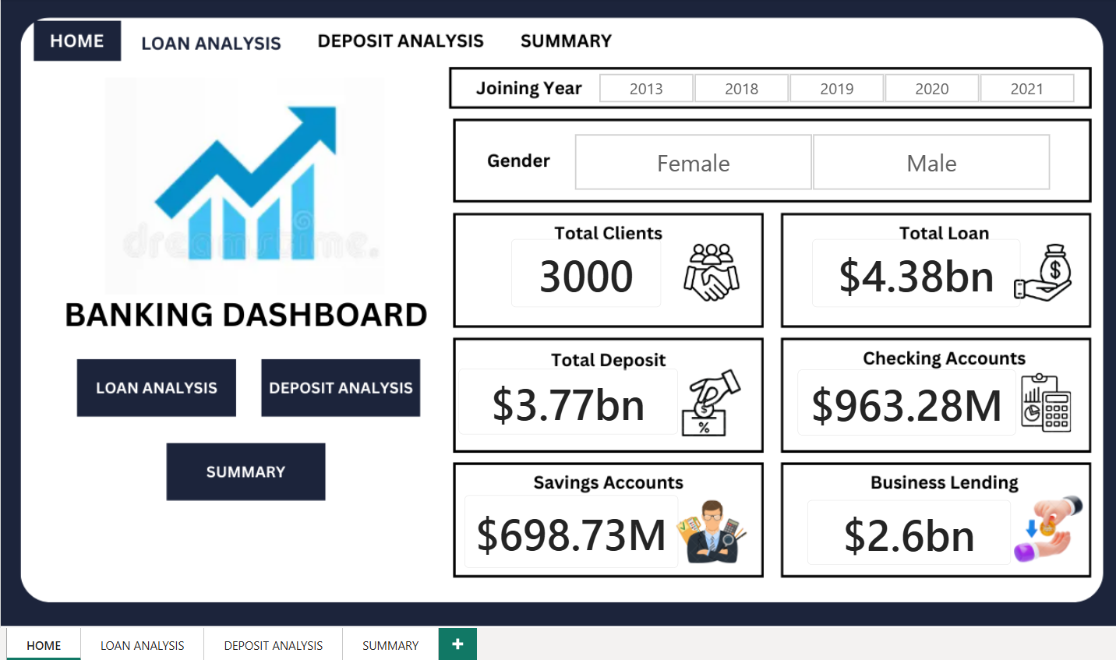
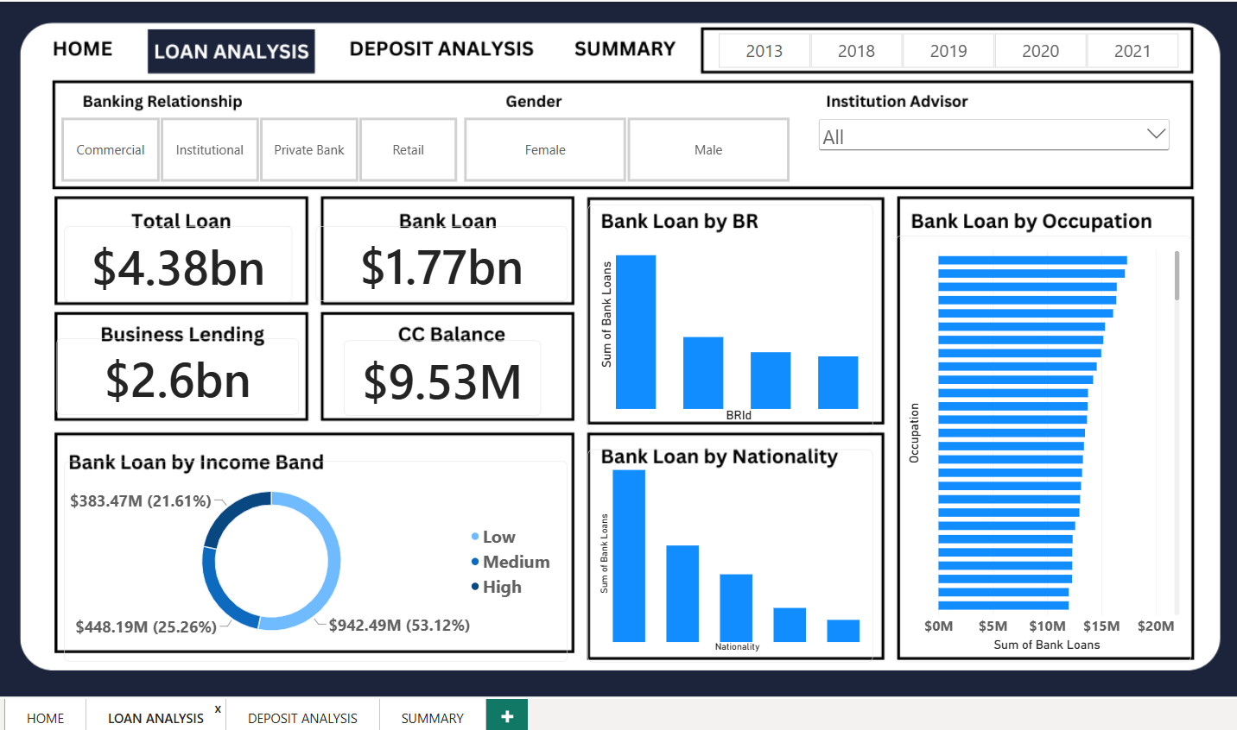
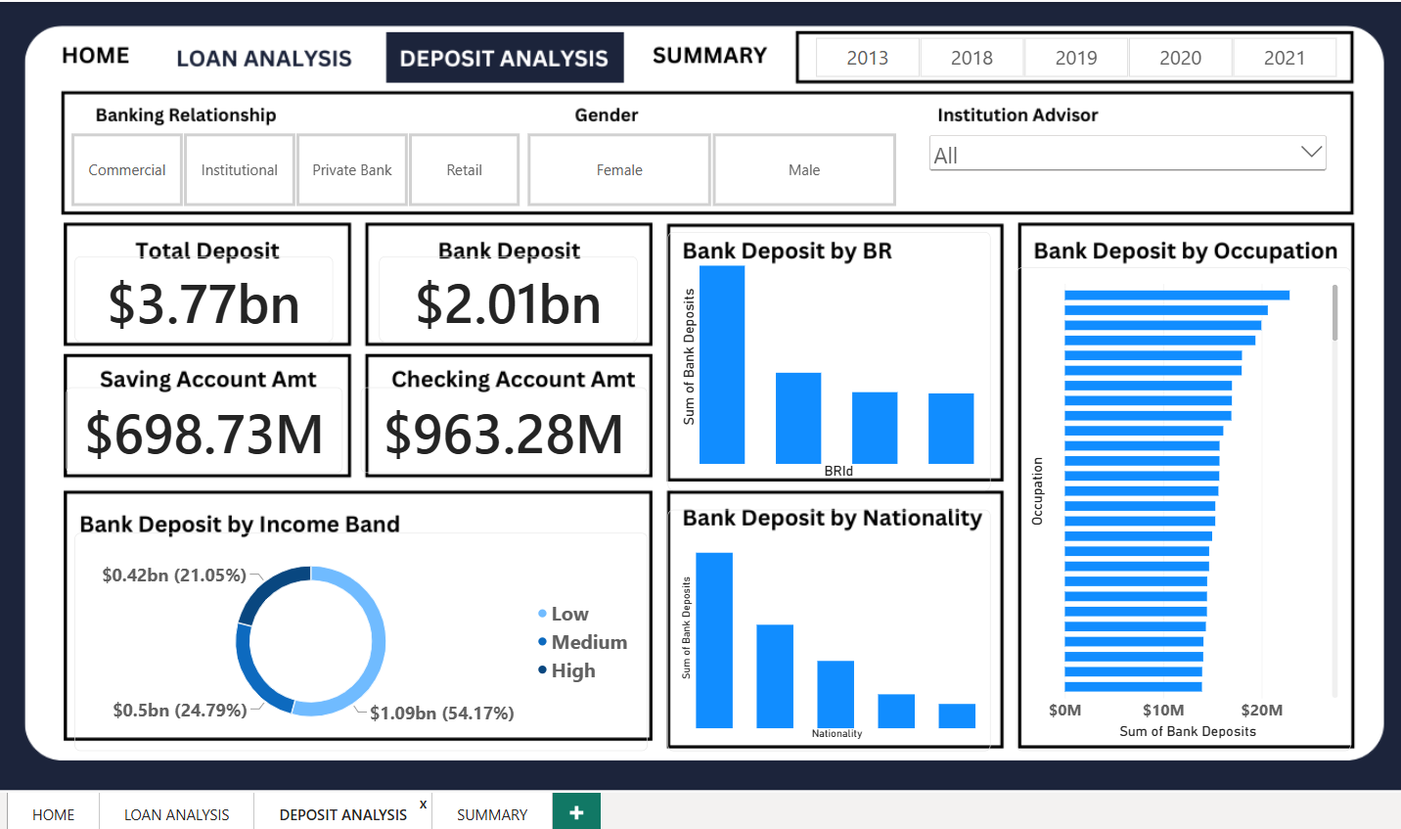
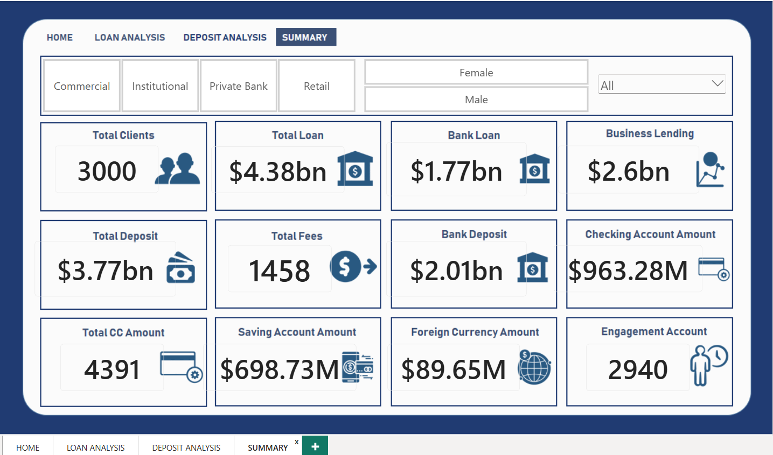
The Power BI dashboard
Home
Loan Analysis
Deposit Analysis
Summary
Notes:
Replace each dashed frame with a screenshot of the matching Power BI page.

Slide 13
Thank you
Ramkumar Sharma | Data Analyst
Portfolio: https://ramkumar-data-analyst-portfolio.vercel.app/
GitHub: github.com/ramkumar1804
LinkedIn: linkedin.com/in/ramkumar-sharma-843b752b8

