Slide 1
Mobile Robotics

Slide 2
OBJECTIVE
To identify the defected and non defected objects
To pick the objects place defected in rejected lot
And place non defected in warehouse
Fully Automated

Slide 3
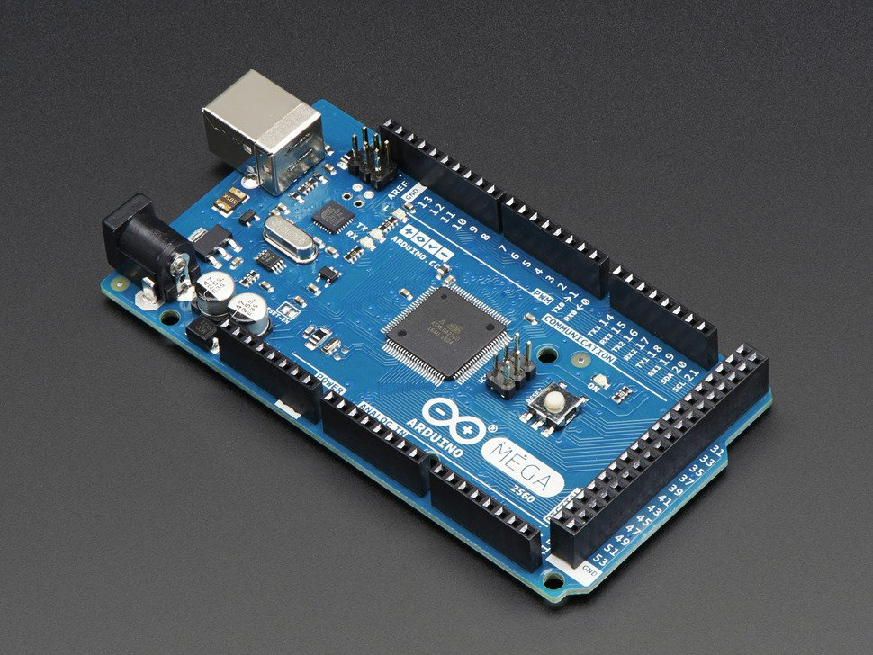
MICROCONTROLLER
ARDUINO MEGA
Digital i/o 54pins
Analog 16pins
Current rate i/o pins 40mA
LINE FOLLOWER CHASSIS
dimension 160 x 140 mm

Slide 4
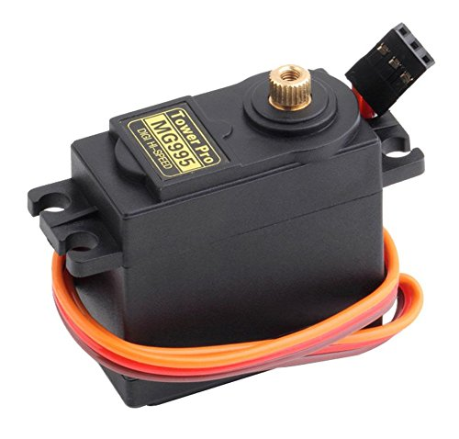
DC SERVO MOTOR
PURPOSE: Positioning Gripper
SPECS:
SERVO MG995
STALL TORQUE: 4.8v – 9.4 kg-cm
6.0v – 11.0 kg-cm
Speed : 0.2sec/60deg
0.16sec/60deg

Slide 5
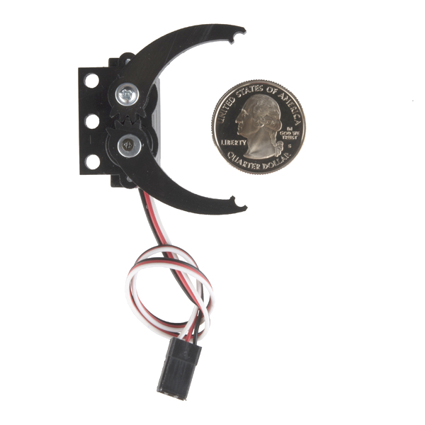
GRIPPER
Servo Gripper
PURPOSE: Hold objects
SPEC: Max Opening range 70mm

Slide 6
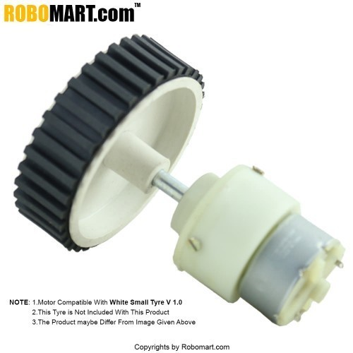
DC GEARED motor
SPECS:
Speed = 500RPM,
Vs=12V ,
No-load current = 60 mA(Max),
Load current = 300 mA(Max)
High friction wheels
BATTERY:
V LI-ion rechargeable battery is used

Slide 7
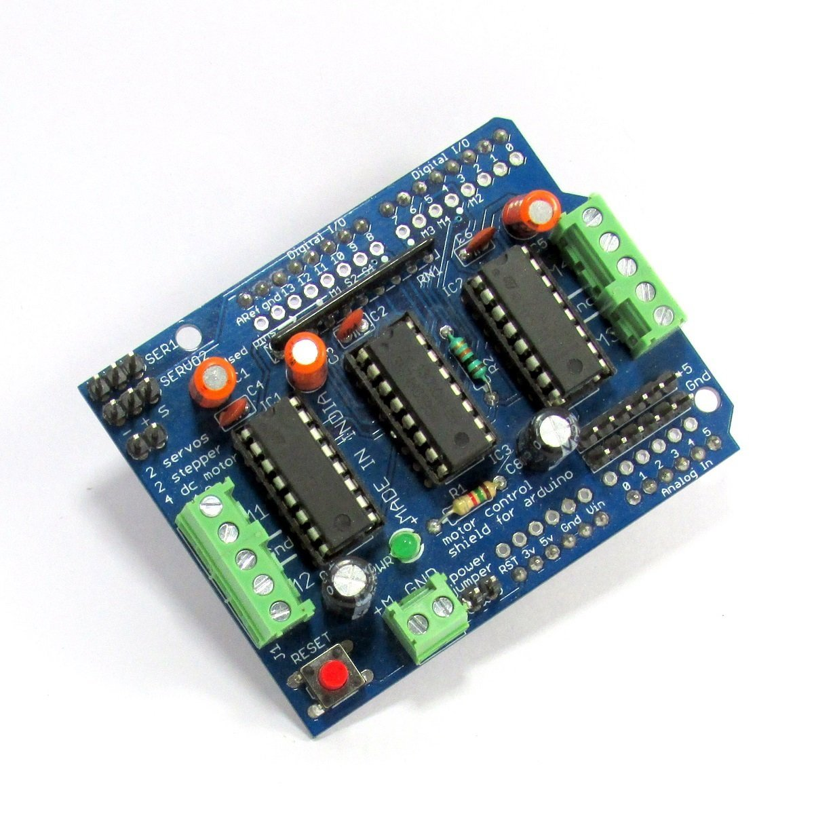
MOTORS DRIVES
PURPOSE: To drive motors
SPECS:
4H-BRIDGE MOTOR DRIVER:
2 servo drive with no jitters
4 dc motor drive with current rate
of 0.6A – 1.2 A(PEAK)

Slide 8
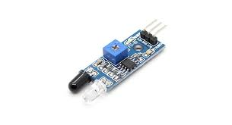
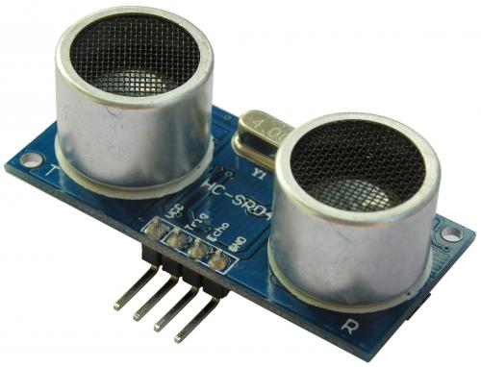
IR SENSOR & ULTRASONIC SENSOR
IR:
PURPOSE: Follow the line
HC – SR04
PURPOSE: Detect the objects
SPECS:
Working current rating : 15mA
Max range : 4 cm
Min range : 2 cm

Slide 9
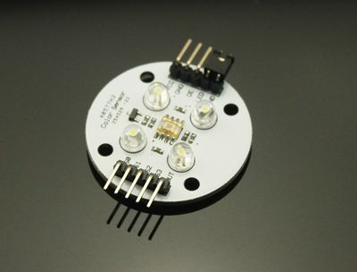
COLOR SENSOR
TCS 230
PURPOSE: check whether object is defected or not

Slide 10
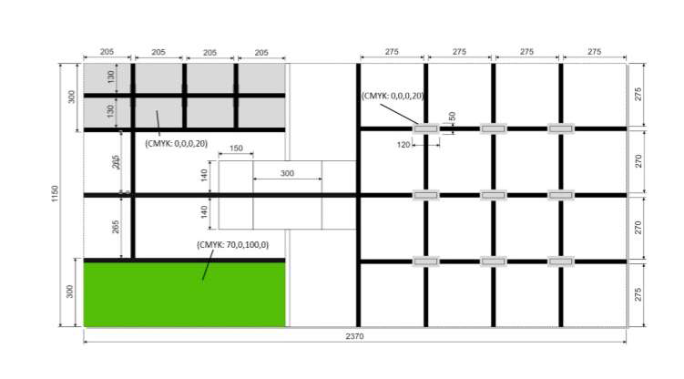
ALGORITHM
GRID- follower algorithm

Slide 11
ANY QUERIES
?

Slide 12
THANK YOU

