Slide 1
Mobile Robotics

Slide 2
OBJECTIVE
To identify the defected and non defected objects
To pick up the objects place defected in rejected lot
And place non defected in warehouse

Slide 3
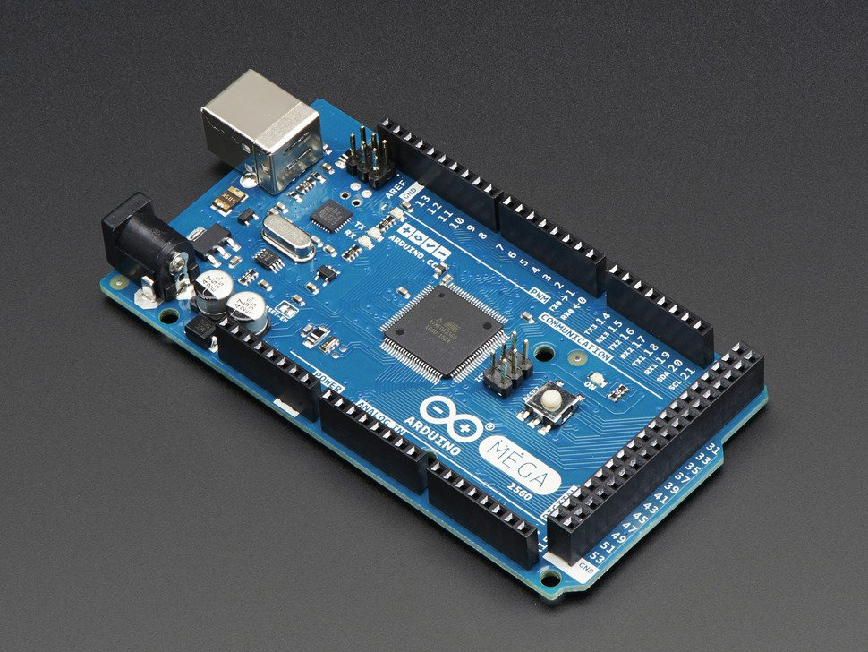
MICROCONTROLLER
Digital i/o 54pins
Analog 16pins
Current rate i/o pins 40mA

Slide 4
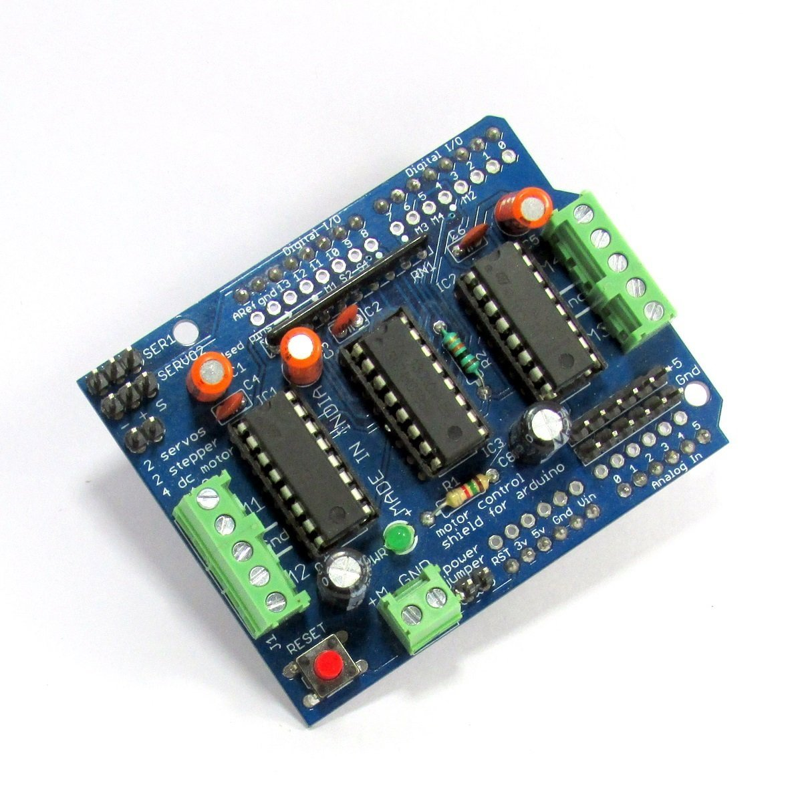
MOTORS DRIVES
SPECS:
4H-BRIDGE MOTOR DRIVER:
2 servo drive with no jitters
4 dc motor drive with current rate
of 0.6A – 1.2 A(PEAK)

Slide 5
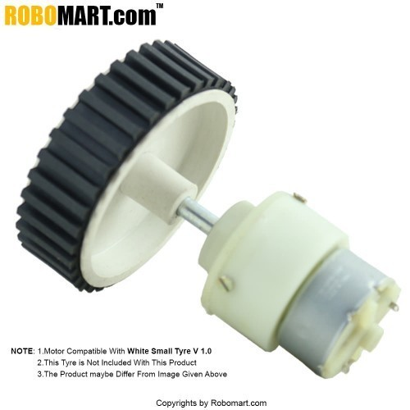
DC GEARED motor
SPECS:
Speed = 500RPM,
Vs=12V ,
No-load current = 60 mA(Max),
Load current = 300 mA(Max)
High friction wheels
V LI-ion rechargeable battery is used

Slide 6
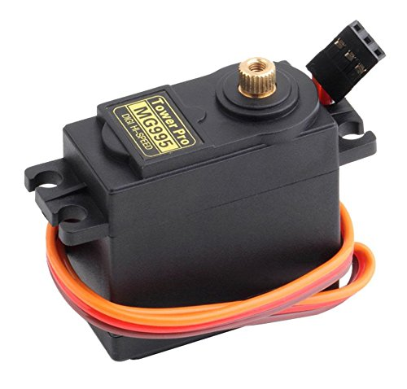
DC SERVO MOTOR
SPECS:
SERVO MG995
STALL TORQUE: 4.8v – 9.4 kg-cm
6.0v – 11.0 kg-cm
Speed : 0.2sec/60deg
0.16sec/60deg

Slide 7
GRIPPER
Servo Gripper

Slide 8
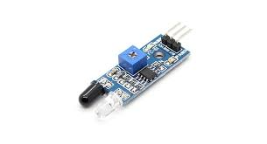
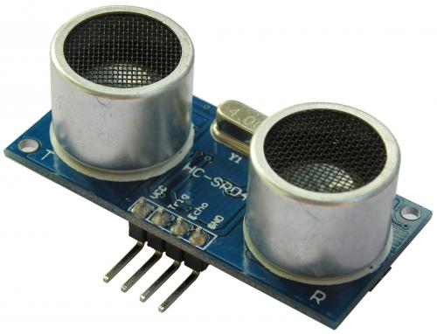
IR SENSOR & ULTRASONIC SENSOR
SPECS:
HC – SR04
Working current : 15mA
Max range : 4 cm
Min range : 2 cm

Slide 9
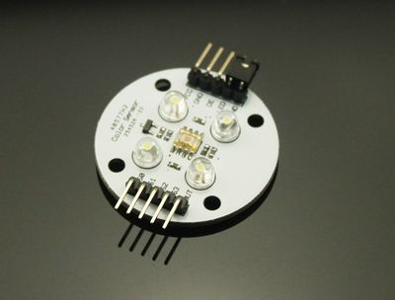
COLOR SENSOR
TCS 230

Slide 10
ALGORITHM

Slide 11
ANY QUERIES
?

Slide 12
THANK YOU

