Slide 1

Analysis of Airplane Crashes and Fatalities
DSC 530 – Data Exploration and Analysis
Professor: Fadi Alsaleem
Student: Ramkumar Perumalagaram Subramanian
Date: 01/03/2025

Slide 2

Introduction
This project analyzes airplane crashes and fatalities using statistical methods to explore trends, survival rates, and potential risk factors. The primary focus is on the following:
Presenting the statistical questions and hypothesis relevant to aircraft crashes and fatalities
Identifying the key variables from the dataset to aid with statistical analysis
Applying various EDA methods to the dataset
Understanding crash distribution over time and geography
Identifying key factors influencing fatalities
Testing hypotheses and performing regression analysis to gain insights
Conducting a regression analysis to analyze the relationship between a dependent variable and explanatory variable

Slide 3
Dataset Overview
The dataset was obtained from Kaggle titled Airplane Crashes and Fatalities
The following data is presented in the dataset:
index: the index of the row
Date: the date of the incident
Time: the time of the incident
Location: the location of the incident
Operator: the operator of the aircraft
Flight #: the flight number of the aircraft
Route: the route of the aircraft
Type: the type of aircraft
Registration: the registration of the aircraft
cn/In: the construction number/serial number of the aircraft
Aboard: the number of people on board the aircraft
Fatalities: the number of fatalities in the incident
Ground: the number of people on the ground killed in the incident
Summary: a summary of the incident

Slide 4
Statistical Questions
Following statistical questions were outlined as part of analysis:
Descriptive Statistics:
How has the frequency of airplane crashes changed over time?
What percentage of crashes had no fatalities?
What is the average number of fatalities per crash?
Which airlines have the highest number of crashes?
Geographical Analysis:
Which countries have the highest number of airplane crashes?
Is there a correlation between a country's air traffic volume and the number of crashes?
Hypothesis Testing:
H0: The number of airplane crashes has remained constant over decades | H1: The number of airplane crashes has decreased over time.
H0: The survival rate of airplane crashes is independent of the decade in which the crash occurred. | H1: The survival rate of airplane crashes has improved in recent decades.
H0: There is no significant difference in the number of crashes between different airlines. | H1: Certain airlines have a significantly higher crash rate than others.
H0: Airplane crashes are evenly distributed across all countries. | H1: Certain countries have significantly higher crash frequencies.
H0: Crashes are equally likely to occur in all months of the year. | H1: Certain months or seasons have higher crash rates.

Slide 5
Key Variables
A few key variables from the dataset were taken into consideration to perform Exploratory Data Analysis (EDA) on airplane crashes and fatalities:
Date – The date of the crash, used for analyzing trends over time, such as changes in crash frequency, survival rates across decades, and seasonal variations
Location (Country) – The geographical location of the crash. This is crucial for identifying which countries have the highest number of crashes and exploring potential correlations with air traffic volume
Operator – The airline or entity operating the aircraft. This helps determine which airlines have the highest number of crashes and whether certain operators have significantly different crash rates
Aboard – The total number of people on board the aircraft. This is important for calculating survival rates and understanding the severity of crashes
Fatalities – The number of fatalities in the crash. This allows for analyzing crash severity, computing survival rates, and assessing whether fatality rates have changed over time
Ground – The number of people killed on the ground. This helps understand the overall impact of crashes beyond just those on board, particularly for major incidents with high ground casualties
Type – The type of aircraft involved in the crash. This provides insight into whether certain aircraft models/types are more prone to crashes, helping identify trends in aviation safety
These variables will be used to answer key statistical questions related to airplane crashes and fatalities, focusing on temporal trends, geographical distribution, airline safety, and crash severity

Slide 6
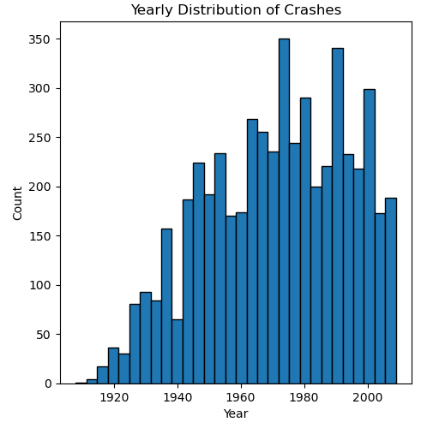
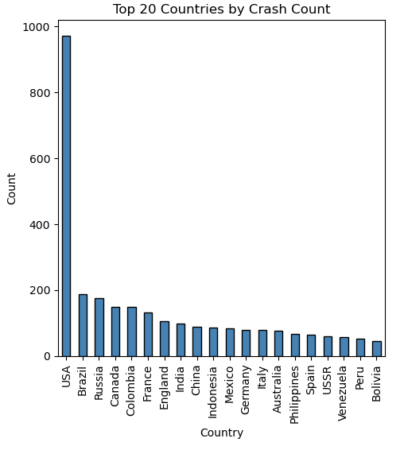
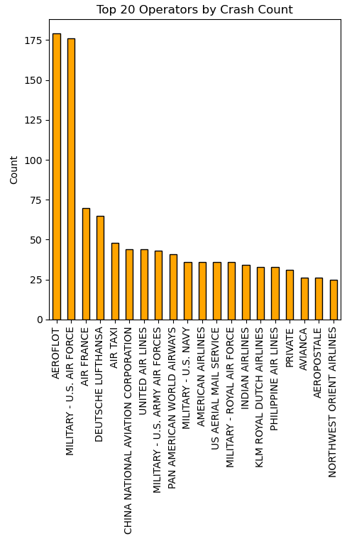
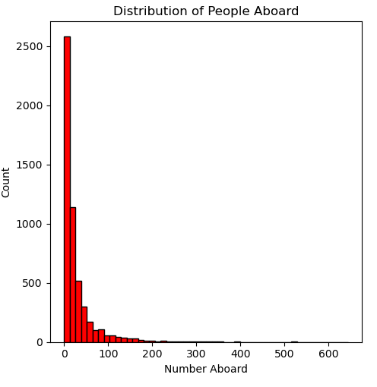
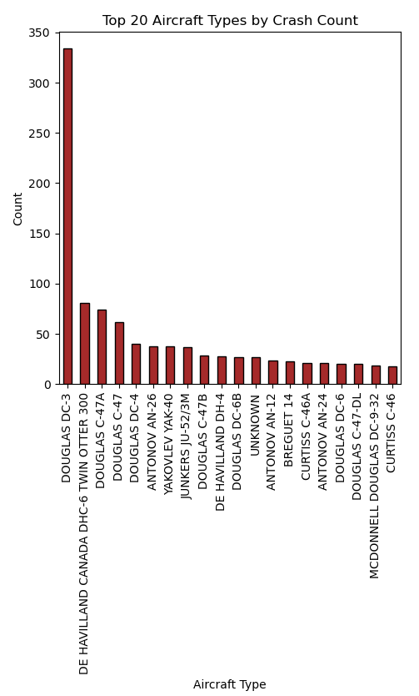
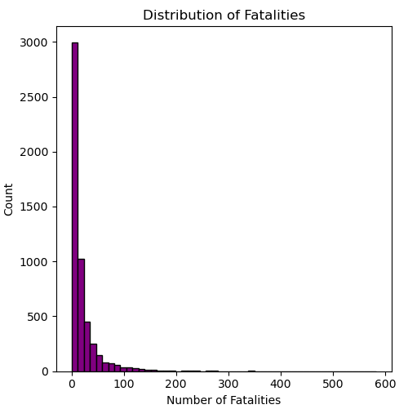
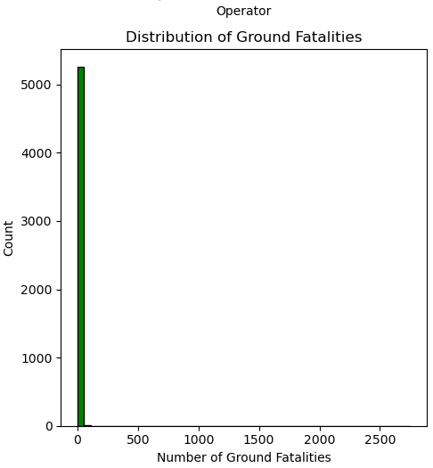
Histogram of Key Variables
A histogram was conducted for the selected key variables to visually represent the data distribution and identify any outliers in the dataset

Slide 7
Analysis from Histogram
Crashes peaked in the 1970s-80s, then declined; early aviation years had few crashes.
The USA has the highest crash count, reflecting its dominant aviation traffic.
Aeroflot, U.S. Air Force, and other operators show high crash counts; military and commercial airlines should be analyzed separately.
Most flights had under 100 passengers, but some exceeded 500.
Fatalities were usually low, though some crashes had over 500 deaths.
Most crashes caused no ground fatalities, but rare events (eg. 9/11) had extreme casualties.
Certain aircraft models (eg. Douglas DC-3) had high crash counts, possibly indicating safety concerns.

Slide 8
Descriptive Statistics
Descriptive Statistical Analysis was performed to provide key insights into the spread and distribution of the numerical variables in the dataset. Based on the results, we can make some interpretations for each variable
People Onboard
Most crashes involved few passengers, but some had over 600.
High skewness and kurtosis indicate rare extreme cases, which should be retained.
Fatalities
Most crashes had low fatalities, but some exceeded 500.
Extreme fatality events create a highly skewed distribution, requiring separate analysis.
Ground Fatalities
Most crashes had no ground fatalities, but rare events (eg. 9/11) caused severe casualties.
Right-skewed distribution highlights rare, high-impact cases.
Summary
Data is right-skewed with rare severe events.
Outliers are essential for aviation safety insights.

Slide 9
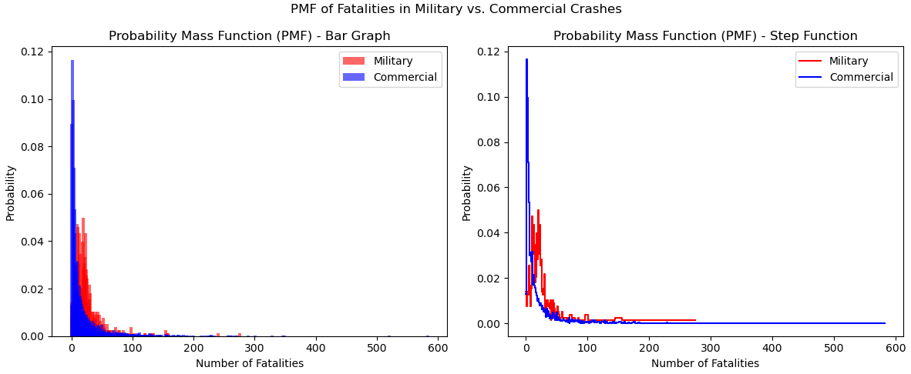
Probability Mass Function (PMF)
Probability Mass Function was performed to compare the distribution of fatalities in military and commercial airplane crashes.

Slide 10
Analysis from PMF
Most crashes (both military and commercial) have a low number of fatalities
The highest probability is concentrated around zero fatalities
Many incidents have few or no deaths, indicating successful emergency landings or survivable crashes
Military crashes tend to have higher fatality probabilities than commercial crashes
The probability of crashes resulting in complete fatalities is higher in the military sector
This could be due to riskier operations, combat-related incidents, and smaller aircraft
Commercial crashes have a long-tailed distribution
A few extreme cases (major airline disasters) lead to high fatalities
Although rare, these events significantly impact commercial aviation safety

Slide 11
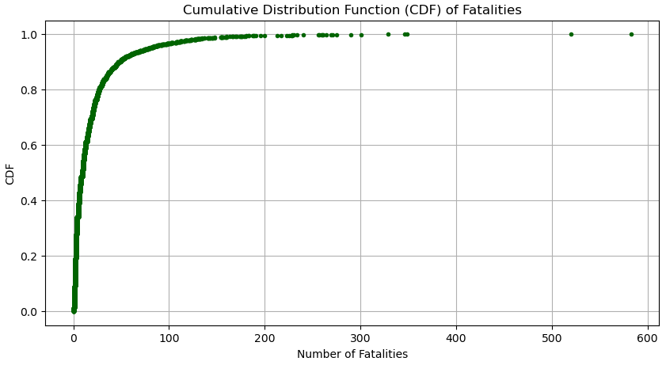
Cumulative Distributive Function (CDF)
Cumulative Distributive Function was performed on the Fatalities dataset

Slide 12
Analysis from CDF
Most crashes result in low fatalities
The CDF rises steeply near zero, indicating that a large percentage of crashes have low fatalities
More than 80% of crashes have fewer than 50 fatalities
There are rare but extreme fatality events
The curve flattens toward the upper tail, suggesting that a small percentage of crashes result in very high fatalities (200-500 deaths)
These represent major aviation disasters with near-total loss of life
Comparison to Statistical Questions
This analysis helps address the question of survival rates over time by providing an understanding of fatality distributions
The steep rise at low fatalities suggests that survival rates may have improved over time, supporting the hypothesis that aviation safety has increased

Slide 13
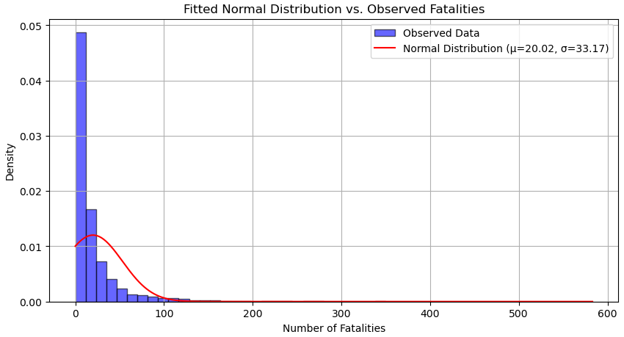
Analytical Distribution

Slide 14
Analysis from Analytical Distribution
Analytical Distribution: Normal Distribution Fit for Fatalities
Fatalities Do Not Follow a Normal Distribution
The histogram is highly skewed to the right, meaning most crashes have low fatalities, but a few crashes have very high fatalities
The normal distribution assumes symmetry, which does not hold true for this dataset
Mismatch Between Data and the Normal Curve
The normal distribution underestimates the peak near zero fatalities and fails to capture the extreme right tail of high-fatality crashes
This suggests that fatalities follow a long-tailed distribution rather than a symmetric normal distribution
Why Normality Assumption Fails
A high proportion of crashes have zero or very few fatalities, creating a high peak at the lower end
There are extreme outliers (e.g., crashes with 200+ fatalities) that the normal model does not predict well

Slide 15
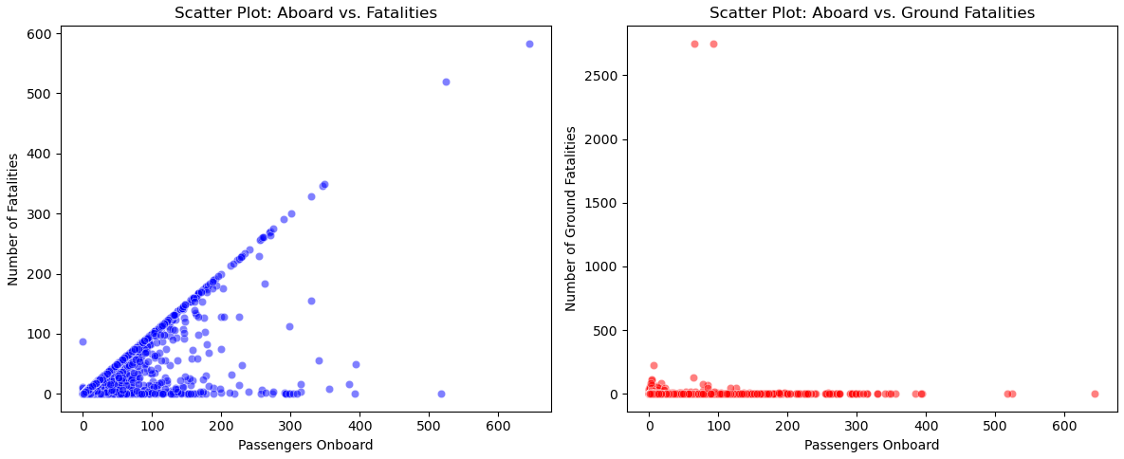
Scatter Plots
Scatter Plot analysis was performed for Aboard vs Fatalities and Aboard vs Ground Fatalities

Slide 16
Analysis from Scatter Plots
Scatter Plot 1: Number Aboard vs. Fatalities
This scatter plot shows the relationship between the number of people aboard the aircraft and the number of fatalities in a crash
A strong positive correlation (Pearson's r = 0.76) indicates that crashes with more people aboard tend to have more fatalities
Covariance = 1083.39, suggesting a strong linear relationship, but this does not imply causation
Other factors like crash severity and aircraft type matter
The linear pattern suggests that in most crashes, fatalities increase proportionally with the number of people aboard
However, there are cases where survival is possible, showing some variation
Scatter Plot 2: Number Aboard vs. Ground Fatalities
This plot examines the relationship between the number of people aboard and the number of ground fatalities
The Pearson correlation is very weak (r = 0.02), indicating little to no relationship between these variables
Covariance = 54.03, which is low, reinforcing the lack of a strong relationship
The data is highly dispersed, with a few extreme outliers where ground fatalities are extremely high (eg. events like 9/11)
Most crashes have zero or very low ground fatalities, suggesting that ground casualties are rare and depend on factors unrelated to the number of people aboard

Slide 17
Hypothesis Testing
Based on the various hypothesis testing scenarios that were mentioned earlier, one scenario was picked, and Chi-Square Test was applied to test our hypothesis:
H0 (Null Hypothesis): Airplane crashes are evenly distributed across all countries.
H1 (Alternative Hypothesis): Certain countries have significantly higher crash frequencies.
Method: Chi-Square Test
We selected the top 10 countries with the highest number of crashes
We compared the observed crash counts in these countries to an expected uniform distribution (assuming crashes were equally likely across these countries)
We applied the Chi-Square Test to assess whether the differences in crash counts were statistically significant
Results
Chi-Square Statistic: 717.98
p-value: 9.42e-149 (which is essentially 0)
Interpretation
The extremely low p-value (< 0.05) suggests that the observed distribution of crashes is not uniform across countries
Since the Chi-Square statistic is very high (717.98), the variation in crash counts among countries is highly significant
This means that certain countries experience significantly more crashes than others, rejecting the null hypothesis
Conclusion
Airplane crashes are not evenly distributed across all countries
Certain countries experience higher crash frequencies, possibly due to higher air traffic volumes, safety regulations, or geographic factors
This result aligns with expectations, as countries with major aviation hubs or difficult terrain (eg. mountains, extreme weather) may experience more crashes

Slide 18
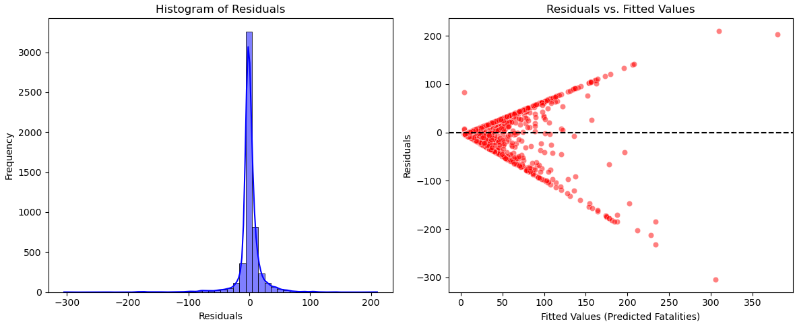
Regression Analysis
Ordinary Least Squares (OLS) regression was performed on Fatalities vs Aboard to analyze the relationship between:
Dependent Variable (Y): Number of fatalities in a crash
Explanatory Variable (X): Number of people onboard the aircraft

Slide 19
Analysis from Regression Analysis
Positive Relationship Between Aboard and Fatalities
The coefficient 0.5837 suggests that for every additional person aboard, the expected number of fatalities increases by ~0.58
This confirms that larger aircraft crashes tend to have higher fatalities
Strong Statistical Significance
The p-value (0.000) for the Aboard variable indicates that the relationship is highly statistically significant
The F-statistic (7065) with a p-value of 0.000 shows that the model has explanatory power
Model Fit (R-squared = 0.573)
57.3% of the variability in fatalities is explained by the number aboard
While this suggests a strong correlation, other factors such as crash severity, safety measures, emergency response also contribute
Potential Issues
Skewness & Kurtosis: The model residuals exhibit high kurtosis (36.119), suggesting the presence of outliers or non-normality
Heteroscedasticity: Variance may not be constant, and transformations may be necessary

Slide 20
Conclusion
The analysis confirms that survival rates have improved over time
Certain countries experience more crashes due to higher air traffic volume and geography
Larger crashes result in higher fatalities, however correlation does not imply causation
There are still some disparities in crash distributions and fatality causes
Future research should integrate additional external factors mentioned below to create a more comprehensive safety analysis
Weather
Aircraft Maintenance
Regulatory Measures

