Slide 1

Apache ActiveMQ
Enterprise Messaging in Action

Slide 2

About me
Bosanac Dejan
Senior Software Engineer at FUSESource - http://fusesource.com
Apache ActiveMQ commiter
Co-author of ActiveMQ in Action

Slide 3
The Basics

Slide 4
Messaging is
Loosely coupled exchange of messages between applications
Location transparency
Can be persistent or non-persistent
Can be transactional

Slide 5
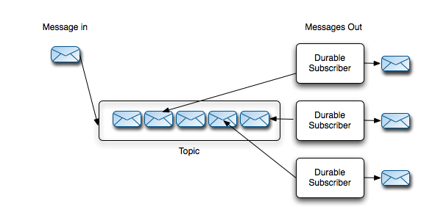
Topics

Slide 6
Topics
One message goes to 0-to-many consumers based on the current subscribers
  Think like mailing lists or discussion forums
Ideal for publishing business events
  Distributed observer pattern
  Allows one part of your system to notify anyone else who may be interested in an event

Slide 7
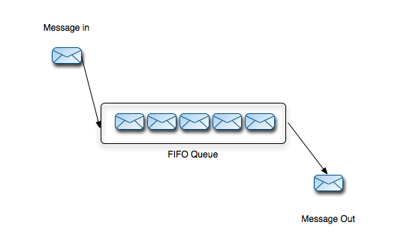
Queues

Slide 8
Queues
Messages are load balanced across many consumers
  Each message goes to exactly one consumer
  Consumers compete for messages
Its easy to browse and monitor queues
Ideal for grid style applications

Slide 9
What is ActiveMQ?

Slide 10
Apache ActiveMQ
Apache ActiveMQ
  Leading Open Source messaging platform
  Supported Java Standards:
        JMS 1.1, J2EE 1.4, JCA 1.5 and XA
Reliable, high performance messaging
  Out-performs many legacy proprietary message queues
  Configurable for many different deployments
Multi-Protocol/Multi-Language Support

Slide 11
Background
ActiveMQ started in 2005 at CodeHaus
Moved to Apache Software Foundation in 2006
914,898 lines of code
24 committers
Now the most widely used open source messaging system on the planet

Slide 12
Enterprise Features

Slide 13
Enterprise Features
Failover
High Availability
Clustering
Wide area deployment
Management
Security

Slide 14
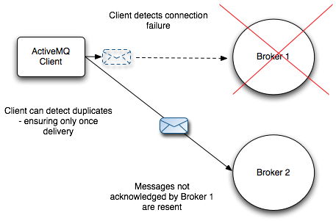
Client Failover
Java and C++ clients support seamless failover

Slide 15
High Availability
Pure Master/Slave
JDBC Master/Slave
Shared File System Master/Slave

Slide 16
Pure Master/Slave
Shared nothing
Fully replicated
  All messages
  All acknowledgements
  All transactions
Slave does not start any transports or network connections

Slide 17
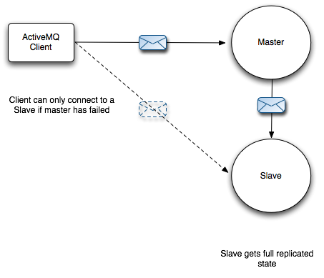
Pure Master/Slave

Slide 18
Pure Master/Slave
On Master Failure:
  Slave will shutdown
  Or Slave will start all network and transports – becoming the master

Slide 19
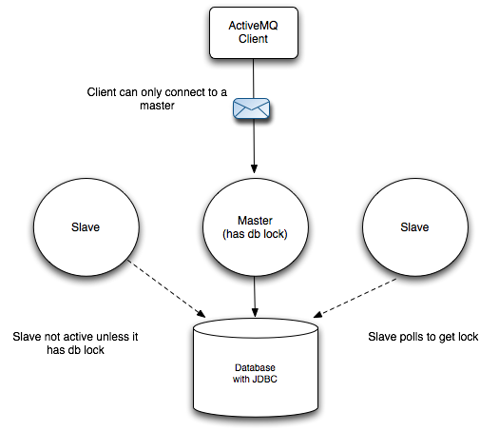
JDBC Master/Slave

Slide 20
JDBC Master/Slave
Extreme reliability – but not as fast
Recommended if already using an enterprise database
No restriction on number of slaves
Simple configuration

Slide 21
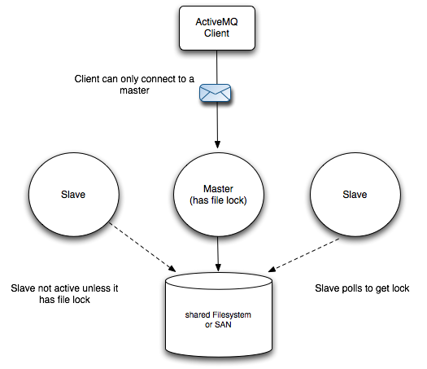
Shared Storage Master/Slave

Slide 22
Shared Storage Master/Slave
Recommended if you have a SAN
No restriction on number of slaves
Simple configuration
N.B. – ensure file locking works – and times out – NFSv4 good!

Slide 23
Security
Secure channels (SSL)
Authentication
  File based
  JAAS plugin (Certificates, LDAP)
Authorization
  Destination Level
  Message Level

Slide 24
Monitoring
Java JConsole – via JMX
FuseHQ – via JMX
ActiveMQ Web Console
Advisory messages
Statistics plug-in (agnostic)

Slide 25
Performance Tuning

Slide 26
Tuning Producers
Persistent vs Non-persistent Messages
Transactions
Embedding Brokers

Slide 27
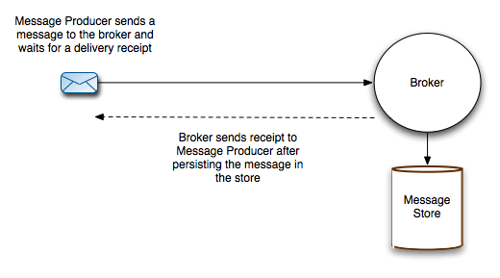
Persistent Messages

Slide 28
Non-Persistent Messages
Non-persistent delivery is signaficantly faster
  Message Producer sends message to the Broker asynchronously
  Message is held in temporary storage
  20x improvement in performance

Slide 29
Non-Persistent Reliability
Non-persistent may be reliable enough
  Messages are cached for resending on the Producer
  Broker can filter out duplicates
  Consumer can filter out duplicates

Slide 30
Transactions
Use Transactions for Persistent Messages
  Only the transaction boundary (commit) is synchronous
  Messages are batched to storage
  Messages cached in broker until a Transaction boundary
  Benefits of persistence – performance of non-persistence

Slide 31
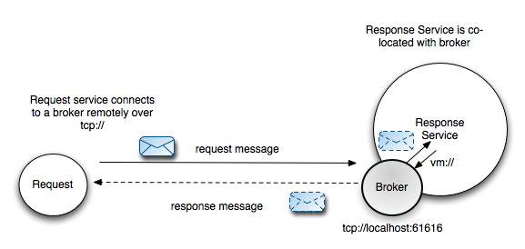
Embedded Brokers

Slide 32
Tuning Consumers
Concurrent Consumers
Prefetch Limit
Acknowledgment modes
Asynchronous delivery

Slide 33
Concurrent Consumers
Processing messages concurrently – improve performance
Message order will be affected however
Can achieve concurrency by:
  Multiple Sessions and Consumers
  Use JMS ConnectionConsumer
  Use a container – e.g. Spring
  MessageDrivenBeans

Slide 34
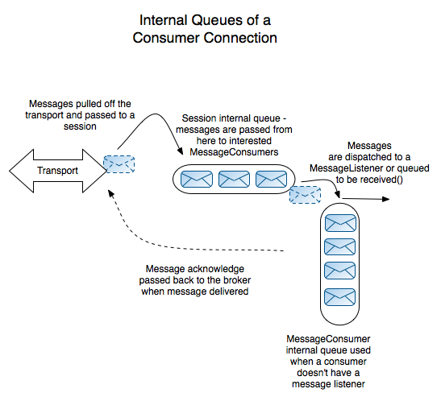
Prefetch Limit

Slide 35
Acknowledgment modes
Different Acknowledgement Modes:
  Session.AUTO_ACKNOWLEDGE
  optimizeAcknowledge
  Session.CLIENT_ACKNOWLEDGE
  Session.SESSION_TRANSACTED
  Session.DUPS_OK
  ActiveMQSession.INDIVIDUAL_ACKNOWLEDGE
Notes:
optimizeAck 65% with AUTO
DUPS_OK_ACK 50%

Slide 36
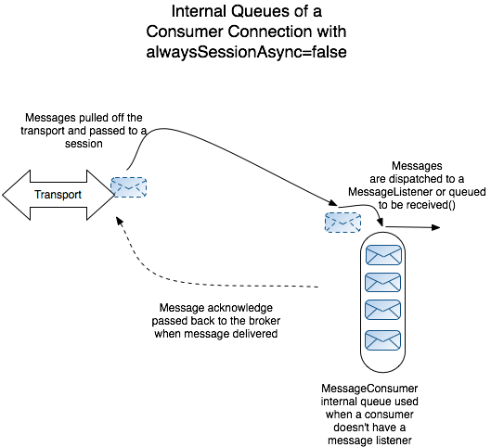
Asynchronous Dispatch

Slide 37
Scaling

Slide 38
Vertical Scaling
Vertical Scaling: Increase load capacity using a single broker can handle.
  Enable optimzeDispatch
  Disable UseDedicatedTaskRunner
  Disable tight encoding in wire format
  Increase memory allocation to the broker
  Try using the NIO transport
  Upgrade the hardware
Cons
  There is a limit to the scalability a single machine can give

Slide 39
Horizontal Scaling
Horizontal Scaling: Increase load capacity using many brokers
  Implemented using a Network of Brokers
  Messages a forwarded between brokers to interested consumers.
  Lifts the limit of using a single machine to scale.
Cons
  Advisory messages must be abled to support demand based forwarding.
  Delivery failure between brokers will result in re-delivery and a possible duplicate message.
  Complex network topologies can lead to non-optimal message routing.

Slide 40
Hybrid Scaling
Hybrid of Vertical and Horizontal Scaling
  Multiple broker nodes are used by the clients
  Brokers are NOT networked
  The client application send message to different brokers, typically based on some defined partitioning of the data.
Pros
  You can use all the tuning techniques used in Vertical scaling
  Have better Horizontal scaleability than using Network Of Brokers (Less broker cross talk)
Cons
  Added complexity required on the end user Application

Slide 41
Beyond Java

Slide 42
Stomp
Designed and implemented by ActiveMQ team
Designed to be easy to use and implement
Lots of client implementations:
Ruby,C, Dynamic C, C++, C#, .Net, Delphi, Flash, hx, Perl, PHP, Pike, Python, Smalltalk – to name a few.

Slide 43
OpenWire clients
Efficient binary implementation
Network outage detection
Client failover
Java, C++ and C# clients.

Slide 44
Web
REST
Ajax
WebSockets

Slide 45
Apache Camel
XMPP Gateway
FTP
Sockets
Mail
Esper
Atom
Cometd
Many, many more

Slide 46
Delivery Scheduling
Modes
  Timer
  Cron
  Hybrid
Example
Usage
  Distribute repeated jobs
  Replace Cron, Java Timer or Quartz
message.setStringProperty(ScheduledMessage.AMQ_SCHEDULED_CRON, "30 * * * *");
message.setLongProperty(ScheduledMessage.AMQ_SCHEDULED_DELAY, 10*1000);
message.setLongProperty(ScheduledMessage.AMQ_SCHEDULED_PERIOD, 10*1000);
message.setIntProperty(ScheduledMessage.AMQ_SCHEDULED_REPEAT, 9);

Slide 47
Future (ActiveMQ 6.0)
New Java/Scala Core - fast, scalable, modular
Modular design - OSGi friendly, Hot Deployment, Dynamic Configuration
New Stores (Apache Cassandra - replicated datacenter store)
New Protocols (AMQP 1.0, Beanstalkd, Stomp 1.1 and 2.0)
Better Web (RestMQ, WebHooks, WebSockets)

Slide 48
Conclusions
Dynamic community
Leading in terms of messaging innovation
Built for Enterprise
Scalable, Good Performance, Reliable

Slide 49
Questions?
ActiveMQ Web sites:
  http://activemq.apache.org/
  http://fusesource.com/products/enterprise-activemq/
Blog:
  http://www.nighttale.net/
Twitter:
  http://twitter.com/dejanb
  http://twitter.com/fusenews

