Slide 1

High Powered Messaging with
James Carr
Software Engineer
OCI

Slide 2

About Your Speaker

Slide 3
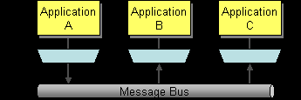
A Brief Introduction to Messaging
How can I integrate multiple applications to work together and share data?
Use Messaging to transfer packets of data frequently, immediately, reliably, and asynchronously, using customizable formats.

Slide 4
You might need messaging if…
Need to integrate different systems to work together
Need to scale
Need to be able to monitor data feeds
Decoupled Publishers and Subscribers
Queuing and Buffering for later delivery

Slide 5
You Might Not Need Messaging If…
Just need single process asynchronous behavior
Want to just isolate concepts within the application (package scope or even OSGi might work better here)
Use your best judgement! ☺

Slide 6
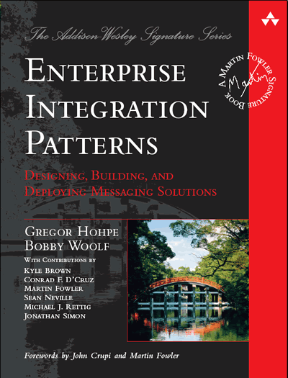
The Bible On Messaging
Ignore all the SOA books, if you really want to dig deep and understand messaging, I suggest

Slide 7
Brief Overview of Messaging
Before we dig deep, it’s good to have a brief overview of concepts that are used in messaging

Slide 8
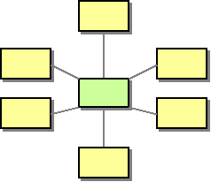
Message Broker
How do we decouple the destination from the sender?
Manages the routing of messages to intended destinations

Slide 9
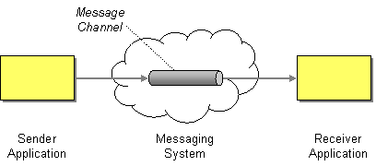
Message Channel
A message channel is what connects two peers
Sender writes to channel, receiver reads from channel

Slide 10
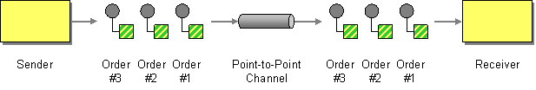
Point-to-Point Channel
A channel that connects one sender with only one reciever

Slide 11
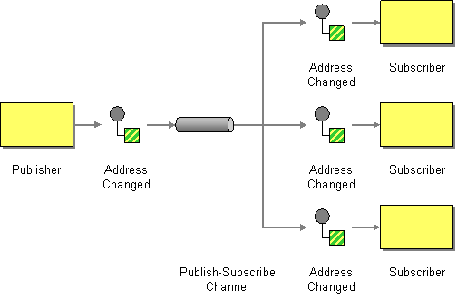
Publish-Subscribe Channel
Delivers a copy of the message to each receiver subscribing to the channel

Slide 12
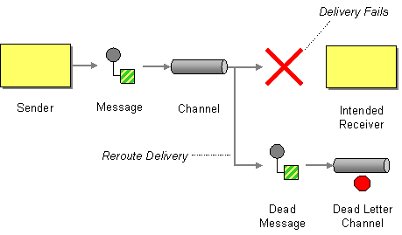
Dead Letter Channel
Where a messaging system sends a message that is undeliverable

Slide 13
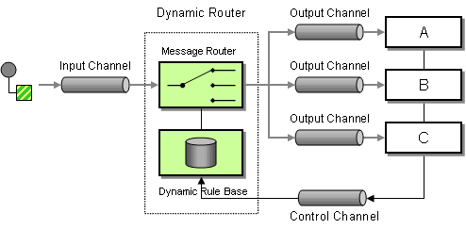
Dynamic Router
Route a message to different receiver based on some property of the message

Slide 14
The Sad State of Messaging
Message oriented middleware is the “holy grail” of many enterprises
Lots and lots of vendor locked in solutions exist (yes, I’m looking at YOU, Oracle)
Complex, proprietary, and closed
Support contracts and licensing fees can shoot into the stratosphere

Slide 15
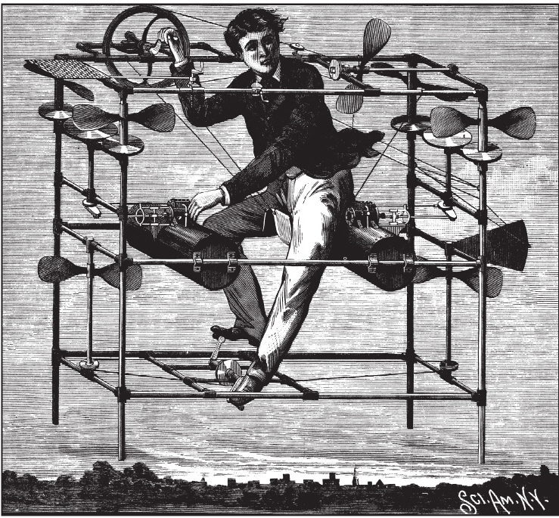
EPIC FAIL

Slide 16

Open Standards to the Rescue!
AMQP
STOMP
XMPP
JSON-RPC
For this presentation I’ll mostly cover AMQP, but delve a little into STOMP

Slide 17

AMQP Features

Slide 18


Where? Who?

Slide 19
AMQP Advanced Message Queuing Prototcol
Defines the wire level protocol (whereas JMS defines only an API)
Completely open and specified by the AMQP Working Group
Includes many companies, such as J.P. Morgan, Bank of America, Cisco, Red Hat, iMatrix, Rabbit Technologies, etc.
Defines the semantics of server and client behavior to ensure interoperability.

Slide 20
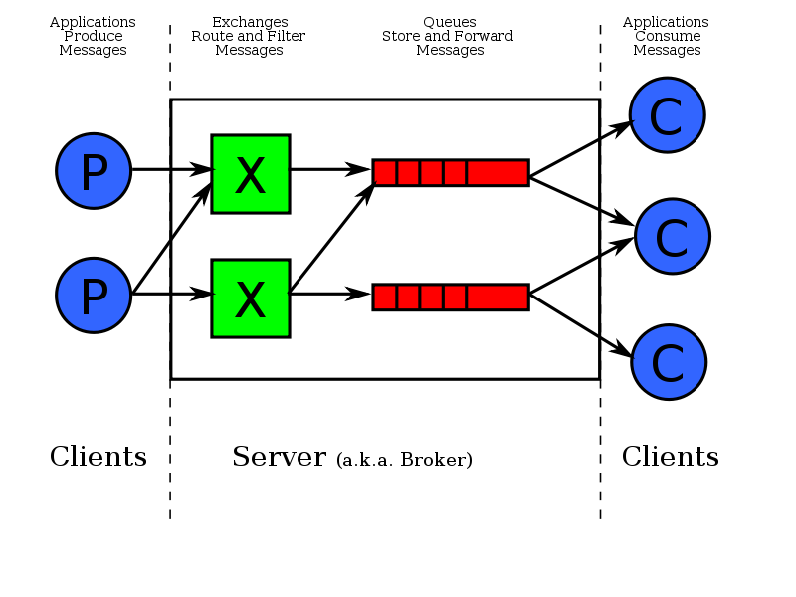
A Quick Overview

Slide 21
Components of AMQP
Broker – Manages exchanges, queues, etc.
Channel – Logical representation of the connection, maintains state
Exchanges – entities to which a message is sent
Queues – receive messages sent to an exchange
Binding – Relationship between an exchange and a queue
Messages – The actual message sent and received. Two important parts: a routing key and the body

Slide 22
Message Headers
Routing Key – used to route messages, dependent on the type of exchange (more on this soon)
Priority – a value 0 to 9 that indicates if this message has priority in queues over others
Delivery-mode – can be used to indicate if the message will need persistence.
Expiration – duration in milliseconds that the broker should use to dertermine of the message is unroutable.

Slide 23
Exchange Types
Direct: if a queue is bound with routing key “A” only messages with that routing key will be sent to the queue.
Topic: broker will match the routing key against a pattern to dermine which queue to send to. For example, “uk.#” will receive any messages with a key starting with “uk.”
Fanout: 1 to N delivery pattern in which routing keys are ignored. All queues bound to the exchange will receive the message.

Slide 24
Exchanges
Who creates exchanges?
Clients do.
Other configurable properties:
Passive: will not create the exchange, but will fail if it doesn’t exist.
Durable: exchange will survive a broker restart
Auto-delete: exchange will get deleted as soon as there are no more queues bound to it.

Slide 25
Queues
Queues receive messages, in order
Consumers subscribe to queues
Consumers can also consume the queue as they see fit
Inherits the same properties an exchange has (durable, auto-delete,passive) with a couple additional ones:
Exclusive: only one client can subscribe to this queue
Alternate-exchange: exchange to reroute rejected or orphaned messages

Slide 26
Binding
Specifies how messages flow from exchange to queue
Match the routing algorithm used in the exchange
Direct: “foo.bar.baz”
Fanout: “#”
Topic: “foo.*.baz” or “foo.#”

Slide 27
Check out http://www.amqp.org if you want to learn more.

Slide 28
AMQP Brokers
ActiveMQ - http://activemq.apache.org/
ZeroMQ (integrates with) – http://zeromq.org
Apache Qpid - http://qpid.apache.org/
RabbitMQ - http://www.rabbitmq.com/

Slide 29
Why RabbitMQ?
Built on top of Open Telecom Platform erlang libraries
Used by leading telecom companies for high performance distributed network applications
Clustering support
Implements the latest AMQP spec (0.9)
Various plugins for additional features (json-rpc, STOMP, HTTP, etc)
Popular framework integration: Spring, grails, rails, node.js, etc.

Slide 30
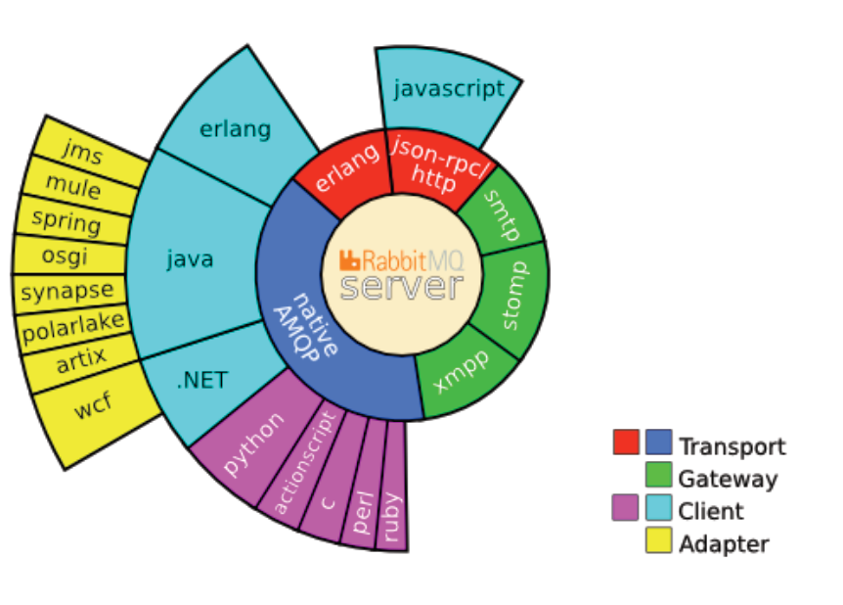

Slide 31
Side Note…
Personally I like ActiveMQ because it’s easy to embed within an existing java application
It also supports STOMP over websockets
I often do this for integration tests against components that interact with JMS
You can also do this and hit rabbitmq in the real app as well (Open Standards FTW)
Okay, that’s kind of a moot point, in java I can do this if I use Weblogic JMS, SeriesMQ, etc.

Slide 32
Commandline Control
Start up: rabbitmqctl start_app
Status: rabbitmqctl status
List queues: rabbitmqctl list_queues

Slide 33

Enough Jibber Jabber! Show me an example fool!

Slide 34
Use Case
Site written in node.js needs to make use of existing, well established JEE backend services
We want the whole operation to be asynchronous
Node.js sends message on exchange A
JEE application picks up message off queue, does work, sends message out on exchange B
Node.js picks message up off queue and does required work.

Slide 35
Using RabbitMQ in Java
The client library from the rabbitmq site
Apache camel’s amqp component to send and receive messages from rabbitmq
spring-amqp (currently available as a milestone release, 1.0.0.M1)
This means you mavenizers will need to use the alternate repository location
http://maven.springframework.org/milestone
There’s also a rabbitmq grails plugin. ☺

Slide 36
Dirty Details…
Licensed under the Mozilla Public License
Commercial Support Exists
Get it now, be up and running in minutes.
Contribute!

Slide 37
Links
My Node.js example: http://github.com/jamescarr/nodejs-amqp-example
Spring AMQP: http://www.springsource.org/spring-amqp
Apache Camel: http://camel.apache.org/
RabbitMQ http://www.rabbitmq.com
Open Source Repository: http://www.rabbitmq.com
RabbitMQ plugin for grails: http://blog.springsource.com/2010/08/23/rabbitmq-plugin-for-grails-early-access/

