Slide 1
The RabbitMQ Message Broker
Martin Toshev

Slide 2
Agenda
Messaging Basics
RabbitMQ Overview
Messaging Patterns
Administration

Slide 3
Agenda
Scalability and High Availability
Integrations
Security

Slide 4
Messaging Basics

Slide 5
Messaging Basics
Messaging provides a mechanism for loosely-coupled integration of systems
The central unit of processing in a message is a message which typically contains a body and a header

Slide 6
Messaging Basics
Use cases include:
Log aggregation between systems
Event propagation between systems
Offloading long-running tasks to worker nodes

Slide 7
Messaging Basics
Messaging solutions implement different protocols for transferring of messages such as AMQP, XMPP, MQTT and many others
The variety of protocols implies vendor lock-in when using a particular messaging solution (also called a messaging broker)

Slide 8






Messaging Basics
A variety of messaging brokers can be a choice for applications …

Slide 9
Messaging Basics
Messaging solutions provide means for:
securing message transfer, authenticating and authorizing messaging endpoints
routing messages between endpoints
subscribing to the broker

Slide 10
Messaging Basics
An enterprise service bus (ESB) is one layer of abstraction above a messaging solution that further provides:
adapters for different for messaging protocols
translation of messages between the different types of protocols

Slide 11
RabbitMQ Overview

Slide 12
RabbitMQ Overview
An open source message broker written in Erlang
Implements the AMQP Protocol (Advanced Message Queueing Protocol)
Has a pluggable architecture and provides extension for other protocols such as HTTP, STOMP and MQTT

Slide 13
RabbitMQ Overview
AMQP is a binary protocol that aims to standardize middleware communication
The AMQP protocol derives its origins from the financial industry - processing of large volumes of financial data between different systems is a classic use case of messaging

Slide 14
RabbitMQ Overview
The AMQP protocol defines:
exchanges – the message broker endpoints that receive messages
queues – the message broker endpoints that store messages from exchanges and are used by subscribers for retrieval of messages
bindings – rules that bind exchanges and queues
The AMQP protocol is programmable – which means that the above entities can be created/modified/deleted by applications

Slide 15
RabbitMQ Overview
The AMQP protocol defines multiple connection channels inside a single TCP connection in order to remove the overhead of opening a large number of TCP connections to the message broker

Slide 16
RabbitMQ Overview
Subscriber
Publisher
binding
queue
exchange
binding
Subscriber
queue
Publisher
exchange
queue
binding
Subscriber

Slide 17
RabbitMQ Overview
Subscriber
exchange=“xyz”
key=“abc” payload=“bcd”
Publisher
binding
queue
exchange
binding
Subscriber
queue
Publisher
exchange
queue
binding
Subscriber

Slide 18
RabbitMQ Overview
Each message can be published with a routing key
Each binding between an exchange and a queue has a binding key
Routing of messages is determined based on matching between the routing and binding keys

Slide 19
Messaging Patterns in RabbitMQ

Slide 20
Messaging Patterns with RabbitMQ
Different types of messaging patterns are implemented by means of different types of exchanges
RabbitMQ provides the following types of exchanges:
default
direct
fanout
topic
headers

Slide 21
Messaging Patterns with RabbitMQ
A default exchange has the empty string as a name and routes messages to a queue if the routing key of the message matches the queue name (no binding needs to be declared between a default exchange and a queue)
Default exchanges are suitable for point-to-point communication between endpoints

Slide 22
RabbitMQ Overview
Subscriber
exchange=“”
key=“general” payload=“XYZ”
Publisher
(AMQP default)
general
Subscriber
chat
error
Publisher
log
warning
binding
Subscriber
(AMQP default) is a system exchange

Slide 23
Messaging Patterns with RabbitMQ
A direct exchange routes messages to a queue if the routing key of the message matches the binding key between the direct exchange and the queue
Direct exchanges are suitable for point-to-point communication between endpoints

Slide 24
RabbitMQ Overview
Subscriber
exchange=“chat”
key=“b_general” payload=“XYZ”
Publisher
b_general
(AMQP default)
general
Subscriber
chat
error
Publisher
log
warning
Subscriber
chat is defined as a direct exchange upon creation

Slide 25
Messaging Patterns with RabbitMQ
A fanout exchange routes (broadcasts) messages to all queues that are bound to it (the binding key is not used)
Fanout exchanges are suitable for publish-subscribe communication between endpoints

Slide 26
RabbitMQ Overview
Subscriber
exchange=“log”
key=“” payload=“XYZ”
Publisher
(AMQP default)
general
Subscriber
chat
error
Publisher
log
warning
Subscriber
log is defined as a fanout exchange upon creation

Slide 27
Messaging Patterns with RabbitMQ
A topic exchange routes (multicasts) messages to all queues that have a binding key (can be a pattern) that matches the routing key of the message
Topic exchanges are suitable for routing messages to different queues based on the type of message

Slide 28
RabbitMQ Overview
Subscriber
exchange=“log”
key=“warning.#” payload=“XYZ”
Publisher
(AMQP default)
general
error
Subscriber
chat
Publisher
warning.server
warn.server
log
warning.client
warn.client
Subscriber
log is defined as a topic exchange upon creation

Slide 29
Messaging Patterns with RabbitMQ
A headers exchange routes messages based on a custom message header
Header exchanges are suitable for routing messages to different queues based on more than one attribute

Slide 30
Messaging Patterns in RabbitMQ
(demo)

Slide 31
Administration

Slide 32
Administration
Administration of the broker includes a number of activities such as:
updating the broker
backing up the broker database
Installing/uninstalling and configuring plug-ins
configuring the various components of the broker

Slide 33
Administration
Apart from queues, exchanges and bindings we can also manage the following types of components:
vhosts – for logical separation of broker components
users
parameters (e.g. for defining upstream links to another brokers)
policies (e.g. for queue mirroring)

Slide 34
Administration
Administration of single instance or an entire cluster can be performed in several ways:
using the management Web interface
using the management HTTP API
using the rabbitmq-admin.py script
using the rabbitmqctl utility

Slide 35
Administration
(demo)

Slide 36
Scalability and High Availability in RabbitMQ
RabbitMQ provides clustering support that allows new RabbitMQ nodes to be added on the fly
Clustering by default does not guarantee that message loss may not occur

Slide 37
Scalability and High Availability in RabbitMQ
Nodes in a RabbitMQ cluster can be:
DISK – data is persisted in the node database
RAM – data is buffered only in-memory
Nodes share only broker metadata – messages are not replicated among nodes

Slide 38
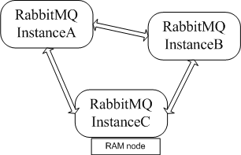
Scalability and High Availability in RabbitMQ
Let’s create the following three-node cluster:

Slide 39
Scalability and High Availability in RabbitMQ
InstanceA node (root node):
set RABBITMQ_NODENAME=instanceA &
set RABBITMQ_NODE_PORT=5770 &
set RABBITMQ_SERVER_START_ARGS= -rabbitmq_management listener [{port,33333}] &
rabbitmq-server.bat –detached

Slide 40
Scalability and High Availability in RabbitMQ
InstanceB node (DISK node):
set RABBITMQ_NODENAME=instanceB &
set RABBITMQ_NODE_PORT=5771 &
rabbitmq-server.bat –detached
rabbitmqctl.bat –n instanceB stop_app
rabbitmqctl.bat –n instanceB join_cluster instanceA@MARTIN
rabbitmqctl.bat –n instanceB start_app

Slide 41
Scalability and High Availability in RabbitMQ
InstanceC node (RAM node):
set RABBITMQ_NODENAME=instanceC &
set RABBITMQ_NODE_PORT=5772 &
rabbitmq-server.bat –detached
rabbitmqctl.bat –n instanceC stop_app
rabbitmqctl.bat –n instanceC join_cluster –ram instanceA@MARTIN
rabbitmqctl.bat –n instanceC start_app

Slide 42
Scalability and High Availability in RabbitMQ
However …
If a node that hosts a queue buffers unprocessed messages goes down – the messages are lost

Slide 43
Scalability and High Availability in RabbitMQ
Default clustering mechanism provides scalability in terms of queues rather than high availability
Mirrored queues are an extension to the default clustering mechanism that can be used to establish high availability at the broker level

Slide 44
Scalability and High Availability in RabbitMQ
Mirrored queues provide queue replication over different nodes that allows a message to survive node failure
Queue mirroring is establishing by means of a mirroring policy that specifies:
number of nodes to use for queue replication
particular nodes designated by name for queue replication
all nodes for queue replication

Slide 45
Scalability and High Availability in RabbitMQ
The node where the queue is created is the master node – all others are slaves
A new master node can be promoted in case the original one goes down
A slave node is promoted to the new master in case it has fully synchronized with the old master (by default)

Slide 46
Scalability and High Availability in RabbitMQ
Let’s define the test queue in the cluster and mirror it over all other nodes:
rabbitmqadmin.py -N instanceA declare queue name=test durable=false
rabbitmqctl -n instanceA set_policy ha-all "test" "{""ha-mode"":""all""}"

Slide 47
Scalability and High Availability in RabbitMQ
However …
The RabbitMQ clustering mechanism uses Erlang message passing along with a message cookie in order to establish communication between the nodes
… which is not reliable over the WAN …

Slide 48
Scalability and High Availability in RabbitMQ
In order to establish high availability among nodes in different geographic locations you can use the federation and shovel plug-ins
The shovel plug-ins works at a lower level than the federation plug-in

Slide 49
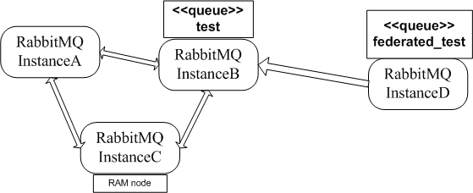
Scalability and High Availability in RabbitMQ
Assuming we have a remote node instanceD we can make the test queue federated on that node:

Slide 50
Scalability and High Availability in RabbitMQ
Declare the remote instanceD instance and enable the federation plug-in for it:
set RABBITMQ_NODENAME=instanceD &
set RABBITMQ_NODE_PORT=6001 &
set RABBITMQ_SERVER_START_ARGS= -rabbitmq_management listener [{port,44444}] &
rabbitmq-server.bat –detached
rabbitmq-plugins -n instanceD enable rabbitmq_federation
rabbitmq-plugins -n instanceD enable rabbitmq_federation_management

Slide 51
Scalability and High Availability in RabbitMQ
Declare the federated_test queue:
rabbitmqadmin.py -N instanceD -P 44444 declare queue name=federated_test durable=false

Slide 52
Scalability and High Availability in RabbitMQ
Declare the upstream to the initial cluster and set a federation link to the test queue:
rabbitmqctl -n instanceD set_parameter federation-upstream upstream "{""uri"":""amqp://localhost:5770"",""expires"":3600000, ""queue"":""test""}"
rabbitmqctl -n instanceD set_policy federate-queue --apply-to queues "federated_test" "{""federation-upstream"":""upstream""}"

Slide 53
Scalability and High Availability in RabbitMQ
The shovel plug-in provides two variants:
static (all links between the source/destination nodes/clusters) are defined statically in the RabbitMQ configuration file
dynamic (all links between the source/destination nodes/clusters) are defined dynamically via RabbitMQ parameters

Slide 54
Scalability and High Availability in RabbitMQ
The shovel plug-in provides two variants:
static (all links between the source/destination nodes/clusters) are defined statically in the RabbitMQ configuration file
dynamic (all links between the source/destination nodes/clusters) are defined dynamically via RabbitMQ parameters

Slide 55
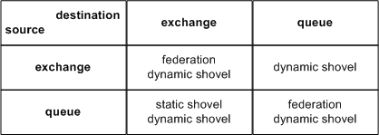
Scalability and High Availability in RabbitMQ

Slide 56
Scalability and High Availability in RabbitMQ
(demo)

Slide 57
Integrations

Slide 58
Integrations
RabbitMQ provides integrations with other protocols such as STOMP, MQTT and LDAP by means of RabbitMQ plug-ins
The Spring Framework provides integration with AMQP protocol and RabbitMQ in particular

Slide 59
Integrations
The Spring AMQP framework provides:
RabbitAdmin class for automatically declaring queues, exchanges and bindings
Listener container for asynchronous processing of inbound messages
RabbitTemplate class for sending and receiving messages

Slide 60
Integrations
Utilities of the Spring AMQP framework can used either directly in Java or preconfigured in the Spring configuration
The Spring Integration framework provides adapters for the AMQP protocol

Slide 61
Integrations
The following Maven dependency can be used to provide the Spring AMQP framework to the application:
<dependencies>
<dependency>
<groupId>org.springframework.amqp</groupId>
<artifactId>spring-rabbit</artifactId>
<version>1.4.5.RELEASE</version>
</dependency>
</dependencies>

Slide 62
Integrations
RabbitAdmin (plain Java):
CachingConnectionFactory factory = new CachingConnectionFactory("localhost");
RabbitAdmin admin = new RabbitAdmin(factory);
Queue queue = new Queue("sample-queue");
admin.declareQueue(queue);
TopicExchange exchange = new TopicExchange("sample-topic- exchange");
admin.declareExchange(exchange);
admin.declareBinding(BindingBuilder.bind(queue).to(exchange)
.with("sample-key"));
factory.destroy();

Slide 63
Integrations
Container listener (plain Java):
CachingConnectionFactory factory =
new CachingConnectionFactory(
"localhost");
SimpleMessageListenerContainer container = new SimpleMessageListenerContainer(
factory);
Object listener = new Object() {
public void handleMessage(String message) {
System.out.println("Message received: " + message);
}};
MessageListenerAdapter adapter = new MessageListenerAdapter(listener);
container.setMessageListener(adapter);
container.setQueueNames("sample-queue");
container.start();

Slide 64
Integrations
RabbitTemplate (plain Java):
CachingConnectionFactory factory =
new CachingConnectionFactory("localhost");
RabbitTemplate template = new RabbitTemplate(factory);
template.convertAndSend("", "sample-queue", "sample-queue test message!");

Slide 65
Integrations
All of the above examples can be configured using the Spring configuration
Must cleaner and decouples RabbitMQ configuration for the business logic

Slide 66
Integrations
(demo)

Slide 67
Security

Slide 68
Security
RabbitMQ uses SASL for authentication (SASL PLAIN used by default)
RabbitMQ uses access control lists (permissions) for authorization

Slide 69
Security
SSL/TLS support can be enabled for the AMQP communication channels
SSL/TLS support can be enabled for node communication between nodes in a cluster
SSL/TLS support can be enabled for the federation and shovel plug-ins

Slide 70
Summary
RabbitMQ is a robust messaging solution that can be used in a variety of scenarios based on you application needs
RabbitMQ may not be the best possible solution compared to other messaging brokers – always consider benchmarks based on size and number of messages

Slide 71

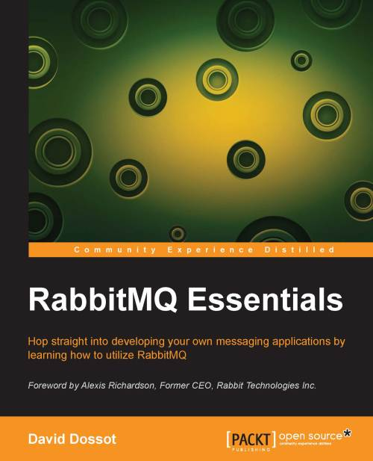
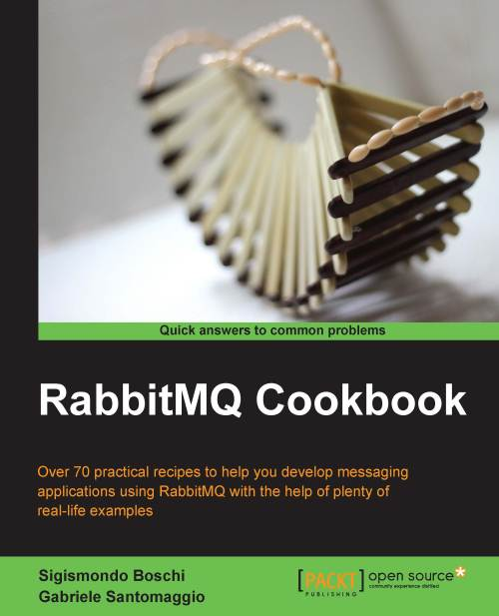
Readings

Slide 72
Thanks
?

