Slide 1

Track2Crack
“Your smart way to retain and revise coding topics”
By HackSmith (Team 19)
Ram Lal
Bhumika Agrawal
Remanshu Goyal
Riya Khandelwal

Slide 2

WHY STUDENTS STRUGGLE WITH CODING RETENTION
🔹 Coding students forget what they’ve learned over time
🔹 Lack of structured revision.
🔹 No cross-platform topic tracking (LeetCode, GFG, CF, etc.)
🔹 Result: Weak retention, poor performance in interviews.

Slide 3
HOW TRACK2CRACK SOLVES IT
🔹 Track2Crack — an AI-powered web platform
🔹 Syncs progress across platforms
🔹 Automatically quizzes past topics
🔹 Identifies weak areas and recommends revision
🔹 Encourages spaced repetition-based retention

Slide 4
HOW ITS WORK?
Secure account linking – Connect coding profiles (LeetCode, GFG, CF) via API integration.
Data aggregation & topic classification – Auto-fetch and organize solved problems by topic and difficulty.
AI-based retention engine – Detects weak topics and schedules revision using spaced repetition.
Auto-generated quizzes – Personalized micro-quizzes for reinforcement and memory strengthening.
Real-time progress dashboard – Visual insights on strengths, gaps, revision streaks, and consistency.

Slide 5
MARKET OPPORTUNITY
🔹 5M+ Indian college students in CS/IT
🔹 Thousands actively using platforms like LeetCode, GFG,Angaar batch
🔹 Current tools focus on practice, not retention
🔹 B2B integration (colleges, edtechs)

Slide 6
REVENUE MODEL
Freemium Model (Base Features Free)
Premium Tier (Paid Subscription)
Sync accounts
Basic analytics
Daily limited quizzes
Weekly weak topic summary
Full AI-powered analytics
Unlimited personalized quizzes
Spaced repetition scheduler
Company-specific coding questions (Amazon, Google, etc.)
Interview question sets

Slide 7
B2B Partnerships (Colleges, Coding Institutes)
Sell campus-wide subscriptions to colleges.
Partner with:
Coaching centers
Coding institutes
Skill development companies

Slide 8
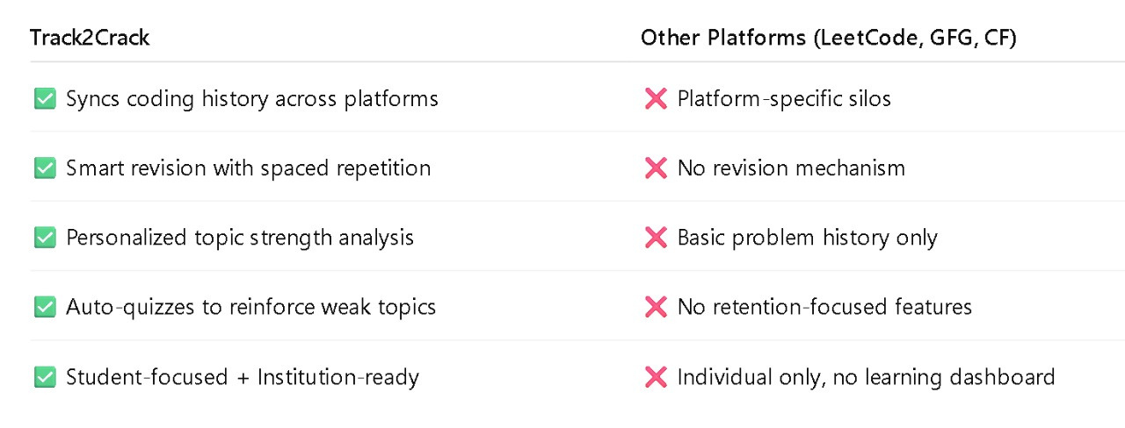
What Sets Us Apart!
“We’re not building another coding tracker — we’re building the memory muscle coding students need to succeed.”

Slide 9
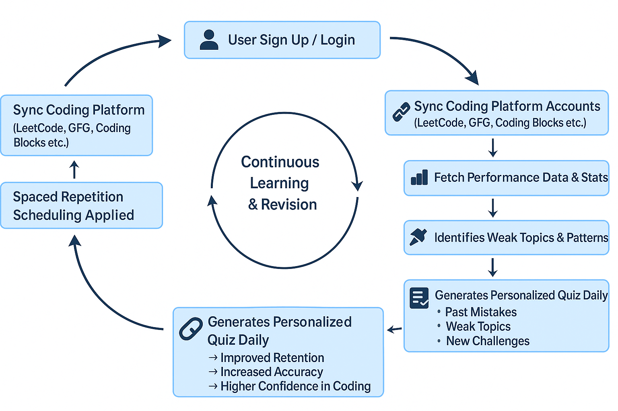

Slide 10
THANK YOU

