Slide 1
Internet of Things
2

Slide 2
What is the internet of things (IoT)?
The internet of things, or IoT, is a system of
interrelated computing devices,
mechanical and digital machines,
objects,
animals or
people that are provided with unique identifiers UIDs

Slide 3
What is the internet of things (IoT)? (Cont…)
The ability to transfer data over a network without requiring
human-to-human
or
human-to-computer interaction.
A thing in the internet of things can be a person with
a heart monitor implant,
a farm animal with a biochip transponder,
an automobile that has built-in sensors to alert the driver when tire pressure is low
or
any other natural
or
man-made object that can be assigned an Internet Protocol (IP) address and is able to transfer data over a network.

Slide 4
Increasingly, organizations in a variety of industries are using IoT to operate
more efficiently,
better understand customers to deliver enhanced customer service,
improve decision-making and
increase the value of the business.

Slide 5
With out IoT.
The devices do most of the work human intervention, although people can interact with the devices -- for instance, to set them up, give them instructions or access the data.
User process / Applications / Programs
Operating System
Memory Driver
Disk
Network Interface
CPU

Slide 6
With IoT.
Collect data
Collate data
analyze data, take action
IoT (e.g. Sensor)
User Interface (smartphone, human machine)
IoT Hub
IoT Device
(e.g. antenna)
or
Analytics of business applications (e.g. customer relationship management, ERP)
IoT Device
(e.g. microcontroller)
IoT Gateway
Back end systems

Slide 7
How does IoT work?
An IoT ecosystem consists of web-enabled smart devices that use
embedded systems, such as
processors,
sensors and
communication hardware, to collect, send and act on data they acquire from their environments.
IoT devices share the sensor data they collect by connecting to an IoT gateway or other edge device where data is either sent to the cloud to be analyzed or analyzed locally.
Sometimes, these devices communicate with other related devices and act on the information they get from one another.

Slide 8
Why is IoT important?
The internet of things helps people live and work smarter, as well as gain complete control over their lives.
In addition to offering smart devices to automate homes, IoT is essential to business.
IoT provides businesses with a real-time look into how their systems really work, delivering insights into everything from the performance of machines to supply chain and logistics operations.
IoT enables companies to automate processes and reduce labor costs.
It also cuts down on waste and improves service delivery, making it less expensive to manufacture and deliver goods, as well as offering transparency into customer transactions.
As such, IoT is one of the most important technologies of everyday life, and it will continue to pick up steam as more businesses realize the potential of connected devices to keep them competitive.

Slide 9
Benefits of IoT
Some benefits are industry-specific, and some are applicable across multiple industries.
Some of the common benefits of IoT enable businesses to:
monitor their overall business processes;
improve the customer experience;
save time and money;
enhance employee productivity;
integrate and adapt business models;
make better business decisions; and
generate more revenue.

Slide 10
Pros of IoT
ability to access information from anywhere at any time on any device
improved communication between connected electronic devices
transferring data packets over a connected network saving time and money
automating tasks helping to improve the quality of a business's services and reducing the need for human intervention

Slide 11
Cons of IoT
As the number of connected devices increases and more information is shared between devices, the potential that a hacker could steal confidential information also increases
Enterprises may eventually have to deal with massive numbers -- maybe even millions -- of IoT devices, and collecting and managing the data from all those devices will be challenging.
If there's a bug in the system, it's likely that every connected device will become corrupted
Since there's no international standard of compatibility for IoT, it's difficult for devices from different manufacturers to communicate with each other

Slide 12
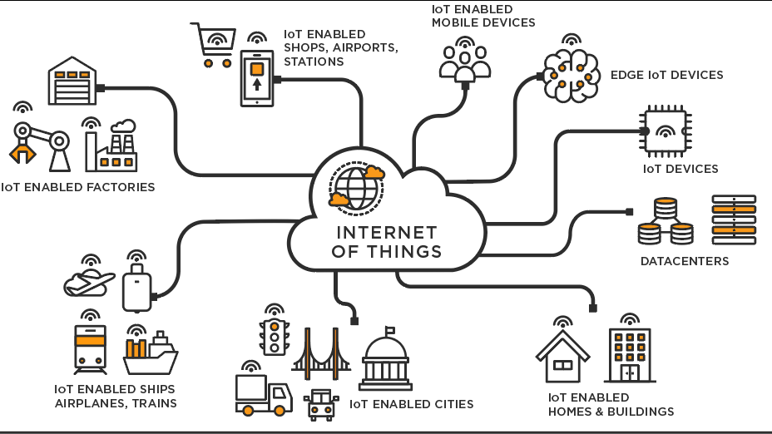

Slide 13
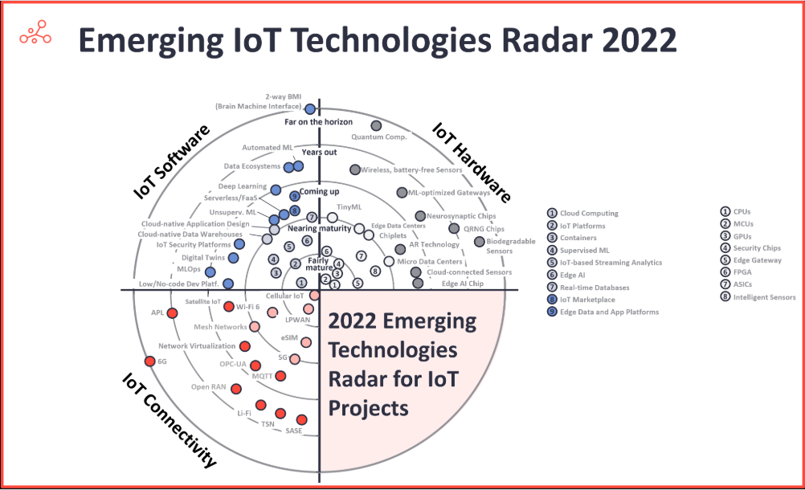

Slide 14
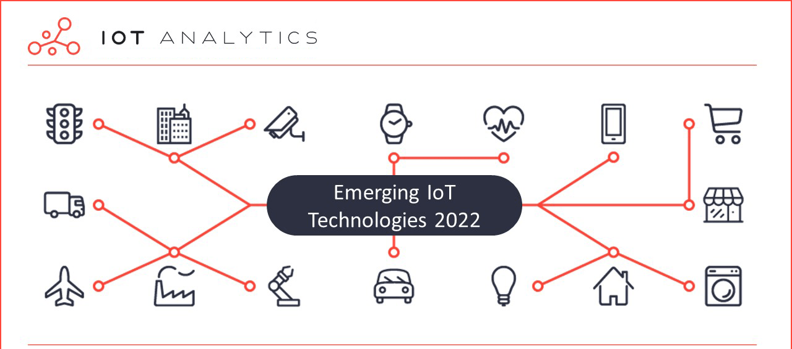

Slide 15
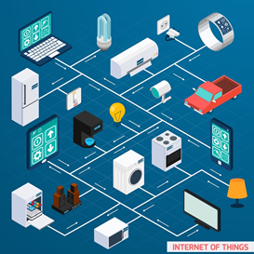
“The infrastructure of the information society.”
The Global Standards Initiative on Internet of Things (IoT-GSI)
"Anything that can be connected, will be connected.” Forbes

