Slide 1
PRACTICAL EXCEL DATA ANALYTICS PROJECT
Insurance Policy & Claims Dataset — Cleaning, Analysis & Dashboard Design
Prepared by:
Ramla Abdi Osman
Institution: Deero Institute
Course: Excel for Data Analysis Dataset: 22_Insurance_Original_Raw.xlsx

Slide 2
PART A & B
Dataset Overview & Data Cleaning
300 → 278
Raw → Clean Records
What was cleaned
22 records removed
Missing Policy_ID, duplicate rows, one invalid negative-premium duplicate
7 → 17
Original → Total Columns
Text standardized
Policy_Type & Claim_Status case-normalized (e.g. "motor" → "Motor")
5
Policy Types
Missing values imputed
Age, Premium & Claim_Amount filled using Policy_Type averages; dates filled with median
Health, Motor, Life, Property, Travel — with Policy_Date, Customer_Age, Premium, Claim_Amount, Claim_Status.
Every change logged
Full before/after rationale recorded in the Cleaning_Log sheet
2 / 7

Slide 3
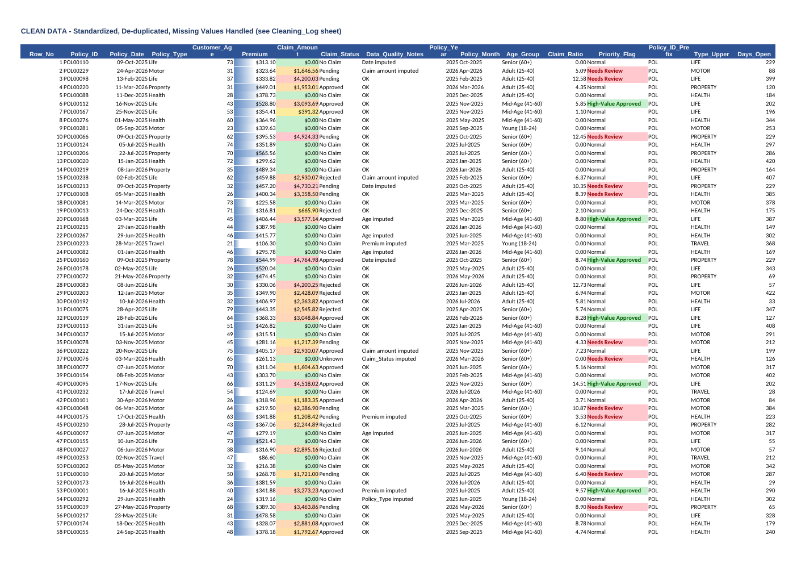
PART D & E
Formulas — Basic, Conditional, Logical, Date & Text
Basic & Conditional
Logical & Date
Text & Sorting
SUM / AVERAGE / COUNT / MIN / MAX
COUNTIF, SUMIF, AVERAGEIF by Policy Type
SUMIFS — Approved claims by type
IFS → Age_Group (Young/Adult/Mid-Age/Senior)
IF + AND + OR → Priority_Flag
YEAR, NETWORKDAYS, TODAY → Days_Open
LEFT, UPPER, TRIM applied across all records
AutoFilter table: sort A–Z, Z–A, oldest–newest
Top-10 claims via LARGE + INDEX/MATCH
Conditional Formatting Applied
3 / 7

Slide 4
PART G & H
PivotTables & Data Visualization
5 Pivot Summary Tables
Policy Type Summary — Count, Premium, Claims
Claim Status Summary — Count, % of Total
Policy Type × Claim Status Cross-Tab
Monthly Trend — 19 months
Age Group Summary — Count, Averages
Built with SUMIFS / COUNTIFS / AVERAGEIFS — fully live, no hard-coded numbers.
4 / 7

Slide 5
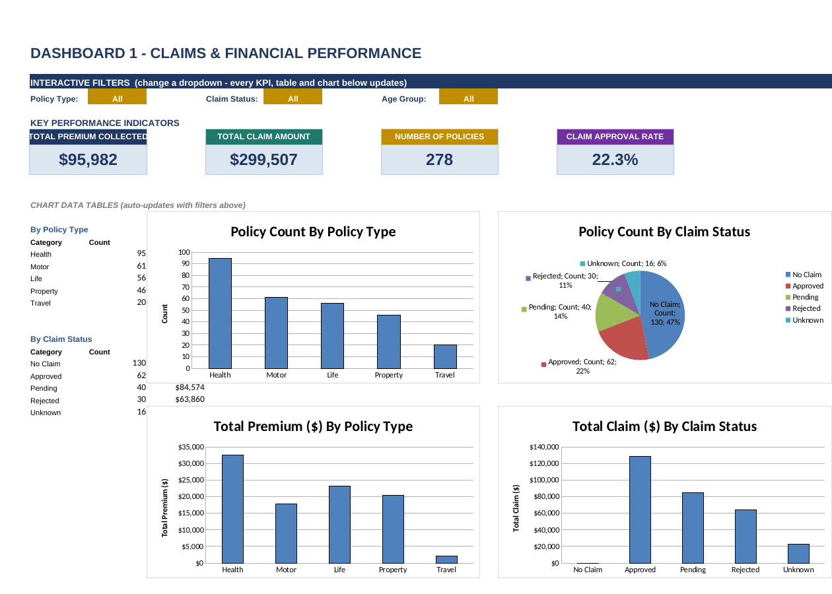
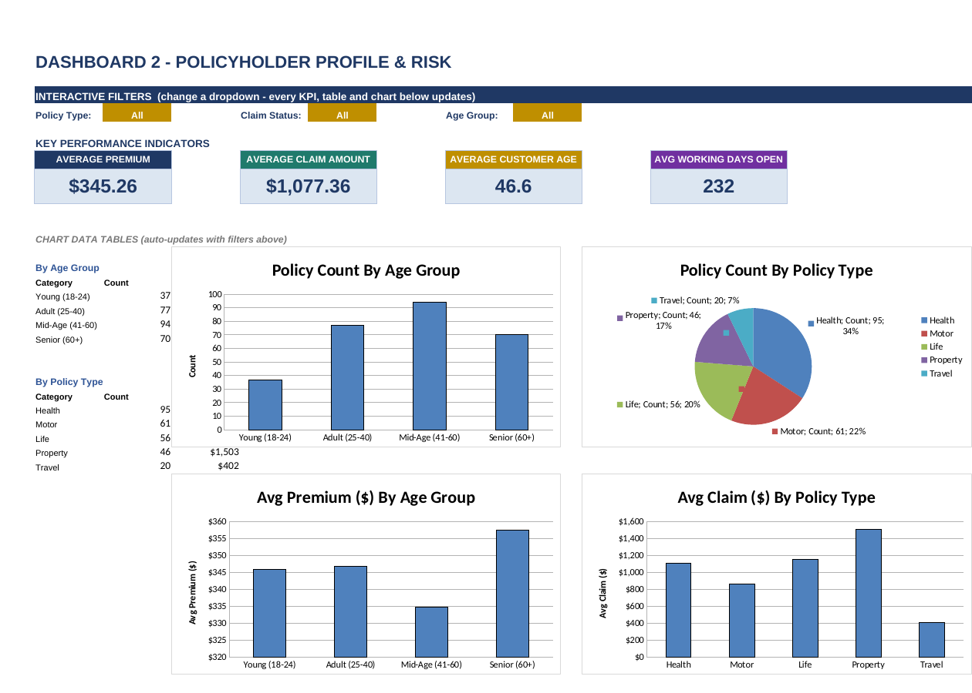
PART I & J
KPI Cards & Interactive Dashboards
TOTAL PREMIUM
TOTAL CLAIM AMOUNT
POLICIES
APPROVAL RATE
$95,982
$299,507
278
22.3%
Two dashboards, each with 3 dropdown filters (Policy Type, Claim Status, Age Group) wired to live SUMIFS / COUNTIFS formulas — changing a dropdown instantly updates every KPI and chart.
5 / 7

Slide 6
PART M
Findings & Recommendations
Key Findings
Recommendations
Property = highest value: highest avg premium ($443.55) & claim ($1,502.69)
Only 41.9% of filed claims are approved (62 of 148)
Loss ratio ~134% — approved payouts exceed premium collected
Claim severity rises with age: Seniors avg $1,295.59 vs $817.68 (Young)
Travel is the smallest, lowest-risk line (20 policies)
Oct-2025 was an outlier month: 29 new policies, $9,733 premium
Reprice Property & Life
1
Clear the claims backlog (Pending/Unknown)
2
Age-adjusted pricing & cleaner data intake
3
6 / 7

Slide 7
Thank You
Questions & Discussion
Ramla Abdi Osman | Deero Institute

