Slide 1

Attendance Management System
--- By Team Alpha
A Summer Internship Project
Funded By Altran Technologies India
Mentored By Centum Foundation
Supported and Controlled by NASSCOM FOUNDATION
GitHub URL : https://github.com/ramm8469/AMS

Slide 2
TEAM ALPHA
BUILD SOMETHING BETTER
Team Members and their respective role play
Name | Roles | Project Module
Abhishek Raj | Frontend | Module - 2
LavKush Giri | Frontend and Backend | Module - 3
Rakshita | Frontend and Documentation | Module - 2
Ram Mohan | Backend and Database | Module – 1,4
Shikha Rani | Frontend and Documentation | Module - 3
Varsha | Database Designing and Managing | Database Administrator

Slide 3
About The Project
Attendance Management System is a web application developed for daily student attendance in schools, colleges and institutes
This Project is all about Creation and Maintenance of Attendance of a particular organisation for a particular group of people like student,faculty,employee etc.
Moreover, this project is divide in 4 – separate module, integrating altogether makes the whole project effective and time saver in comparison to the traditional way of taking the attendance.

Slide 4
Modules Of Project
Module -1 : Maintenance of Student’s Daily Attendance
Module -2 : Provide an Interface for Parents/Faculty/Students to Communicate
Module -3 : Generate Attendance Report at any given point of time
Module -4 : Submission of Assignment(online) and Receive study material/ email notifications from the respective department
Technologies Used :
Frontend : HTML,CSS,JavaScript and Bootstrap
Backend : Java, Servlet and JSP
Database : MySQL

Slide 5
Module -1 : Maintenance of Student’s Daily Attendance
Members to Access this Module : Faculties / Students / Guardians
Operations to be done : Create/Read/Delete/Update Attendance
Student’s Accessibility : Can Only Read the Attendance
Guardians Accessibility : Can Only Read the Attendance
Faculties Accessibility : Can Read/Update

Slide 6
Module -2 : Provide an Interface for Parents/Faculty/Students to Communicate
A Common place for interaction among Students/Faculty/Guardians
We use The Concept of Blogging/Forum for this Module
Each user can create / raise an issue in this forum regarding any concern

Slide 7
Module -3 : Generate Attendance Report at any given point of time
Generate the Attendance of each user by it’s roll or by unique id
Generate the attendance of whole class or a section
Generate the whole attendance of a Specific Branch
Generate the Attendance Report specified by the followings :
Individual Student/Subject/Date
Subject Wise
Date Wise
Class/Section Wise

Slide 8
Module -4 : Submission of Assignment(online) and Receive study material / email notifications from the respective department
This Module is Concerned with a Form Page For the online assignment submission and Emailing System
For Email notifications from the department we will use java mail API
Online Assignment Submission have majority of work to be done, so this may be also considered as a Module in itself
The java Mail API should be Handled Additionally

Slide 9
Admin Panel
Admin Have all the access
It can Create Users
It Can Delete Users
It Can Update Users
It Can Read All Users Data
It can Modify Assignments and Attendance of the Students
Note: User referred to Student/Faculty/Gaurdian

Slide 10
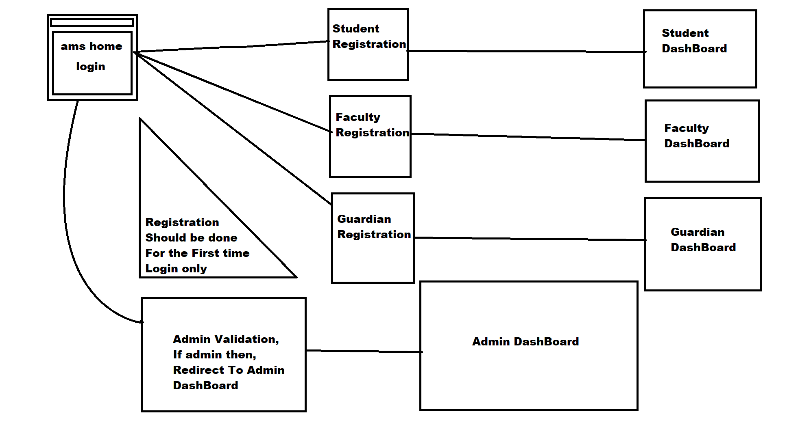
Project Flow…

Slide 11
Q N A ?

Slide 12
Now Let’s have a Live Demo

Slide 13
Individual learning… Ram Mohan
Learned More Concepts in Java
Learned and Applied Servlet and Jsp : Java Server Side Technology
Enhanced Database Concepts regarding Project
Learned Team Management and Co-ordination between Individuals
Better Mentorship : Special thanks to Debashish Sir for his humble guidance and support throughout the training.
Special Mention : Thanks to Lavkush Giri for Helping and balancing Frontend and Backend of the project
Special Mention : Thanks to Brajesh Sir and TNP Dept. IIMT, for support of this summer training.

Slide 14
Individual learning… LavKush Giri
Learned more concept in HTML,CSS,BOOTSTAP,Core Java,Adv. Java And Database.
Learned Team management and co-ordination between individuals.
Better Mentorship: Special thanks to Debashish sir for his humble guidance and support throughout the training.
Special mention: Thanks to Shikha for front-end design.
Special mention: Thanks to Ram Mohan for Back-end design
Special mention: Thanks to Rakshita agarwal for helping me out in documentation of the project.
Special mention: Thanks to TNP Dept. IIMT, for support of this project.

Slide 15
Individual learning… Varsha
Interactive java training guides to learn java concepts under the mentorship of DebashishBarua.
•Plenty of practice was helpful to understand and deal with programming problems
•The database concept also covered in the training program
•Mainly I I design the database table for the project with the help of Ram Mohan.

Slide 16
Individual learning… Shikha
Learned more concept in HTML,CSS,BOOTSTAP.
Learned Team management and co-ordination between individuals.
Better Mentorship: Special thanks to Debashish sir for his humble guidance and support throughout the training.
Special mention: Thanks to Lavakush giri for front-end design.
Special mention: Thanks to Rakshita agarwal for helping me out in documentation of the project.
Special mention: Thanks to TNP Dept. IIMT, for support of this project.

Slide 17
Individual learning… Rakshita
Learned more concept in java, HTML, CSS, BOOTSTRAP.
Learned Team Management and Co-ordination between individuals.
Better Mentorship:- Special Thanks to Debashish sir for his humble guidance and support throughout the training.
Special Mention:- Thanks to Ram Mohan and Abhishek Raj for helping me in communication interface and Shikha rani in helping me in documentation.
Special Mention:- Thanks to TNP Dept.IIMT for support of the summer training.

Slide 18
Individual learning… Abhishek Raj
Learned more concept in java, HTML, CSS, BOOTSTRAP.
Learned Team Management and Co-ordination between individuals.
Better Mentorship:- Special Thanks to Debashish sir for his humble guidance and support throughout the training.
Special Mention:- Thanks to Ram Mohan and Rakshita Aggrawal for helping me in communication interface and Shikha rani in helping me in documentation.
Special Mention:- Thanks to TNP Dept.IIMT for support of the summer training.

Slide 19
Finally...
Special Thanks to Mr Devashish Sir for a very humble support and mentorship throughout the project
Special thanks to Ravita Mam for guidance from time to time during the project
Thanks to the TNP Dept. of IIMT College of Engineering for Conducting this Summer Internship
Thanks to Altran Technologies India for funding the Summer Training
Thanks to Centum Foundation for the Training and Mentorship
Thanks to NASSCOM for the Support

