Slide 1

Research Question – Date: 24 -11 - 2024
Group Name: A97 Name of Student Presenting: Ram Manchem

Slide 2
DS074 Snippet Total Rows :93

Slide 3
This dataset is of interest to us because it provides insights into how food costs vary between states over a period of time. . Our Independent variable is: State Agency. This Independent variable datatype is : Nominal. Our Dependent variable is: Cumulative Cost. This Dependent variable datatype is : Interval.
Dataset ID: (DS074) (Food_Cost.csv)
Notes:
Before specifying your Research Question you must define the type of data you are analysing. Are the variables you select interval data (measurement data you can divide, multiple, etc), OR are they ordinal (there is a definite order but the intervals between each variable are not necessarily equal, or the terms might be subjective like in a likert scale); OR are they just categorical/nominal (Items such as film names, cities, etc., that you can count numbers of occurrences? You also need to understand whether the variable is either dependent or independent and this will vary according to the context. Independent variables may cause an effect, whereas the dependent variable might be effected by the independent variable. Check the lecture notes on the RQ for more information and examples.
You will get only one opportunity to present your Research Question ahead of the submission date. Have your questions ready, and be ready to take notes on feedback.

Slide 4
“Which states incurred the highest and lowest cumulative costs during this time period ?"
Our Research Question is

Slide 5
PRE 7COM1079-2024 Student Group No: A97
Hypothesis
Null hypothesis (H₀): There is no significant difference in cumulative costs between states.
2. Alternative hypothesis (H₁): There is a significant difference in cumulative costs between states.

Slide 6
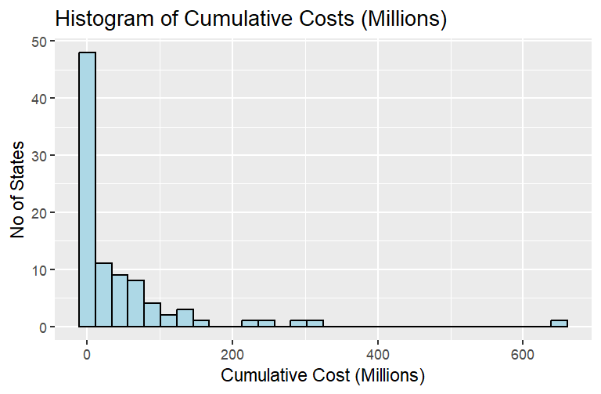
Visualization :Histogram
The histogram indicates that the data is not normally distributed and is positively skewed, meaning that most states have relatively low cumulative costs, with a few having significantly higher costs.

Slide 7
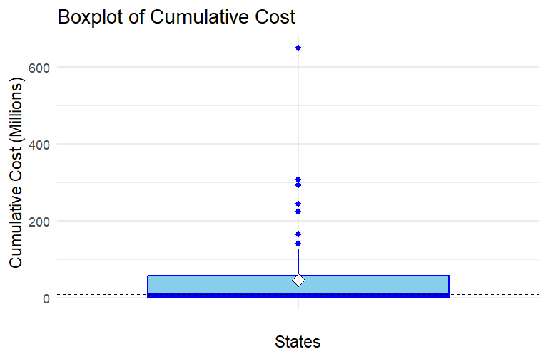
Visualization: Boxplot
The box plot represents that states incurred the highest and lowest cumulative costs during this period, with a higher concentration of data with in the interquartile range.

Slide 8
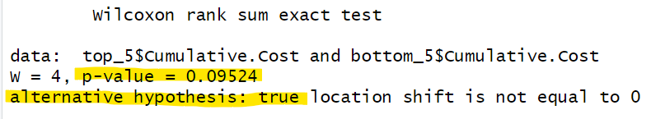
Test Conclusion:
From the histogram, we observed that the data is not normally distributed. Therefore, we selected the 5 states with the minimum and maximum cumulative costs and performed the Wilcoxon rank-sum test (Mann-Whitney U test). The resulting p-value was 0.09524, which is greater than the significance level (α = 0.05).
As a result, we fail to reject the null hypothesis. This means that there is no significant difference in cumulative costs between the states with the highest and lowest costs.

