Slide 1


22CSP72 – PROJECT WORK II PHASE I
A MULTIMODAL ADAPTIVE AI INTERVIEW SYSTEM USING TABULAR FOUNDATION MODELS
DONE BY,
23CSR137 MOUNISH C
23CSR172 RAMNATH BASKAR
23CSR176 RITHAN AK
SUPERVISED BY,
Mr.N.P.Saravanan
1

Slide 2
PROBLEM DEFINITION
Fixed interviews lack personalized, adaptive questioning.
Resume, answer, behaviour, and context are rarely combined for interview policy prediction.
LLMs generate questions but lack a structured policy-decision layer.
Multimodal features are rarely used to predict the next interview action.
Limited research explores TabPFN for next interview-policy prediction.
Need for clear separation between policy decision-making and question generation
OBJECTIVES
Develop a multimodal adaptive AI interview system for personalized questioning.
Extract resume-based candidate skills, education, projects, and experience.
Evaluate answers using correctness, coverage, reasoning, and missing concepts.
Analyze behaviour using engagement, confidence, hesitation, and eye contact.
Use TabPFN to predict the optimal next interview policy.
Use a Local LLM to generate questions based on the predicted policy.
Generate a personalized final interview report with recommendations.
2

Slide 3
LITERATURE SURVEY
Paper | Summary | Research Gap
Adaptive Interview Strategy Based on Interviewees Speaking Willingness Recognition for Interview Robots (2024) | Uses multimodal audio-visual features to recognize the interviewee’s speaking willingness and adaptively select the next question | Does not consider resume information candidate skills answer quality or knowledge gaps for question selection.
Fairness-Aware Multimodal Learning in Automatic video Interview Assessment (2023) | Uses multimodal learning to assess interviews while improving fairness | Focuses on assessment not adaptive question selection
MAG-BERT-ARL for Fair Automated Video Interview Assessment (2024) | Combines MAG-BERT and ARL For fair multimodel interview assessment | Does not predict next interview policy or generate adaptive questions.

Slide 4
LITERATURE SURVEY
Paper | Summary | Research Gap
Automatic Skill-oriented question Generation and Recommendation for Intelligent Job Interviews (2023) | Generates skill-based interview questions using skill extraction, neural generation, and recommendation. | Does not use resume-based profiling, multimodal performance features, or TabPFN-based next interview-policy prediction.
AI-Powered Interview Preparation System: Integrating Resume Analysis, HR Simulation, and Technical Skill Assessment (2025) | Integrates resume analysis, HR simulation, technical assessment, speech recognition, and CNN-based emotion detection to evaluate candidates and provide performance feedback | Does not use TabPFN to predict the next interview policy or a Policy → LLM → Adaptive Question architecture.
Real Time Adaptive Question Crafting with Accuracy Feedback enabled by Machine Learning and Artificial Intelligence (2025) | Proposes an AI-based interview framework that uses NLP/ML to evaluate candidate responses and dynamically adjust question difficulty and topic focus, generating contextual follow-up questions in real time | Lacks resume profiling, a structured multimodal feature vector, and TabPFN-based policy prediction followed by policy-guided LLM question generation.

Slide 5
RESEARCH GAPS IDENTIFIED
After studying previous research, the following gaps were identified:
Fixed question sequences limit personalization and adaptability.
LLM systems lack a dedicated interview policy-decision layer.
Limited separation between policy decision-making and question generation.
Most systems adapt only question difficulty, not multiple interview actions.
Limited use of semantic, behavioural, and contextual features together.
Need for a lightweight, explainable, and efficient detection framework.
5

Slide 6














ARCHITECTURE DIAGRAM
Candidate Response Video+Audio
Candidate Resume Input PDF/DOCX
Semantic
Behavioral
Context
Resume Intelligence Module
Feature Vector Construction
Initial Question Generation Local LLM
Tabpfn Policy Predictor
Policy-guided Question Generation – Local LLm
Question To User
Interview Completed?
Interview Report Module
Continue Interview..

Slide 7
PROPOSED WORK WITH PLANNED INNOVATION
Proposed Work
Planned Innovation
  Resume-Based Candidate Profiling
  Personalized Interview Question Generation
  Semantic Answer Evaluation
  Multimodal Behavioral Analysis
  Interview Feature Vector Construction
  Adaptive Interview Report Generation
  TabPFN-Based Policy Prediction
  Policy–Question Separation
  11-Feature Interview Vector
  Policy-Guided Questions
  Multimodal Feature Integration
  Personalized Performance Report

Slide 8
MODULES OF THE PROJECT
Resume Intelligence Module
Interview Question Generation Module
Multimodal Feature Extraction Module
Interview State & Dataset Module
Adaptive Interview Policy Module
Interview Report Module

Slide 9
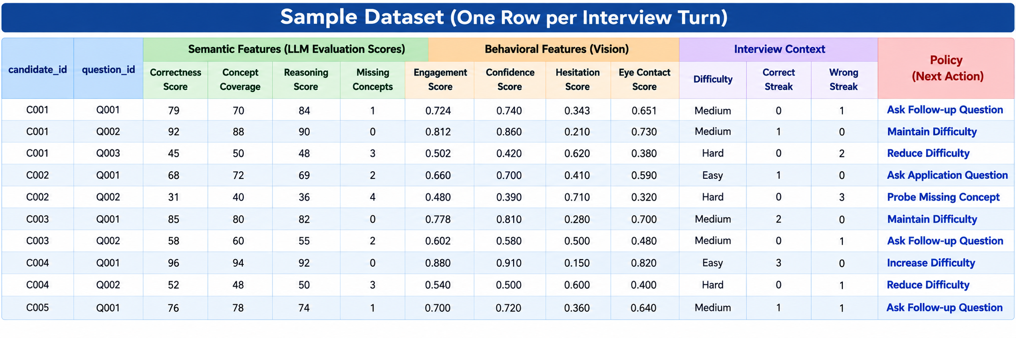
DATASET
Name : Multimodal Adaptive Interview Dataset
Source : Custom-Created Synthetic Dataset
Total Samples : Around 1,00,000
Feature Vector : 11 Features

Slide 10
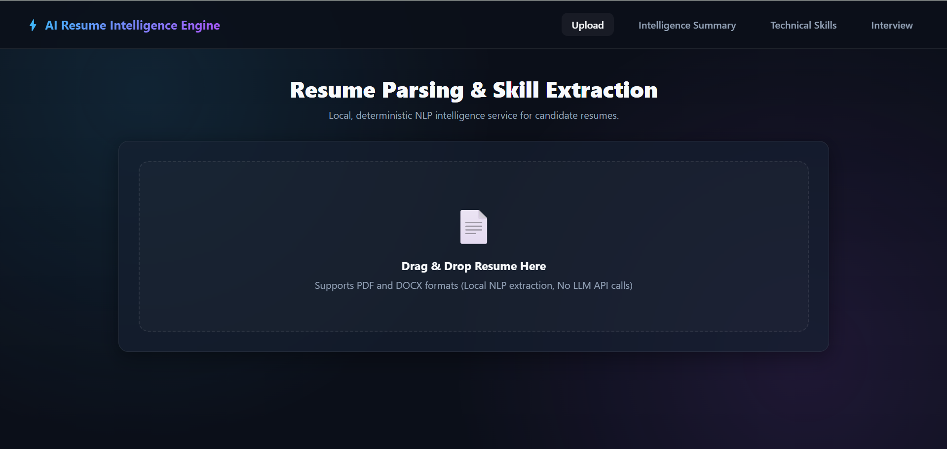
IMPLEMENTATION
ResumeUpload

Slide 11
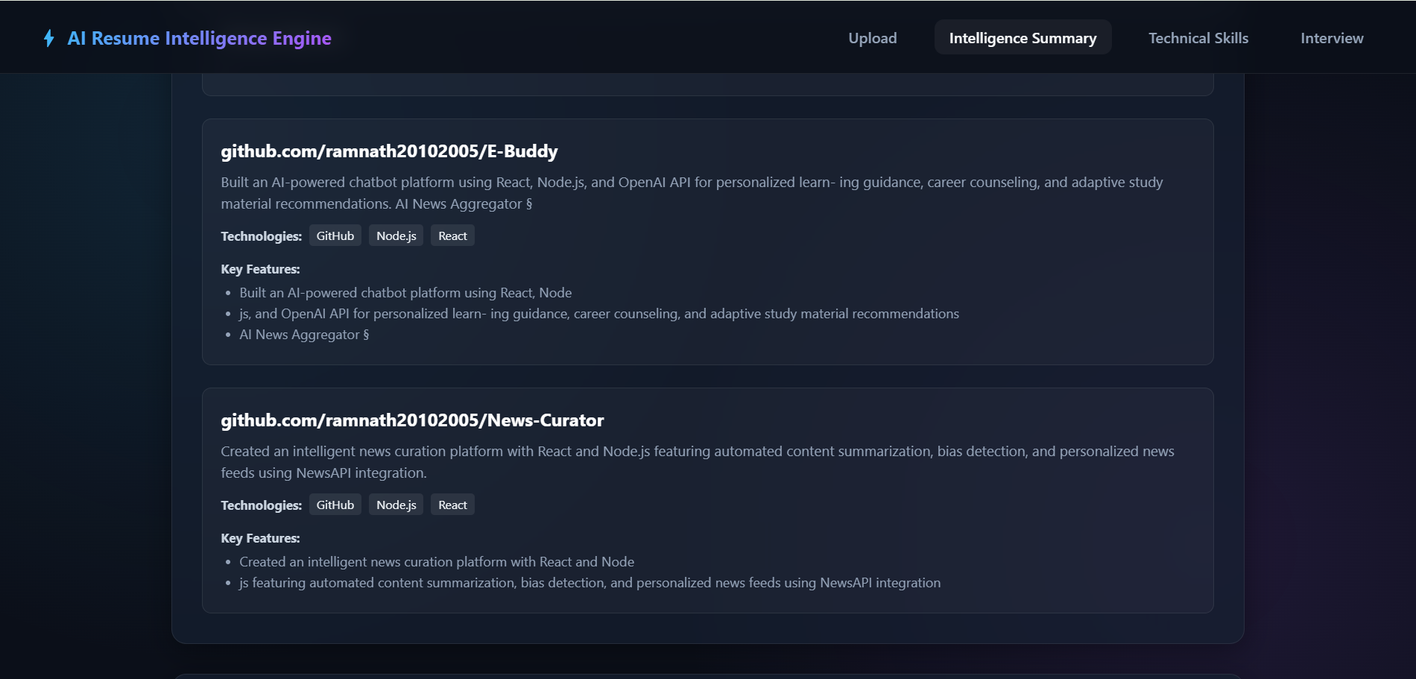
Summary Of Resume

Slide 12
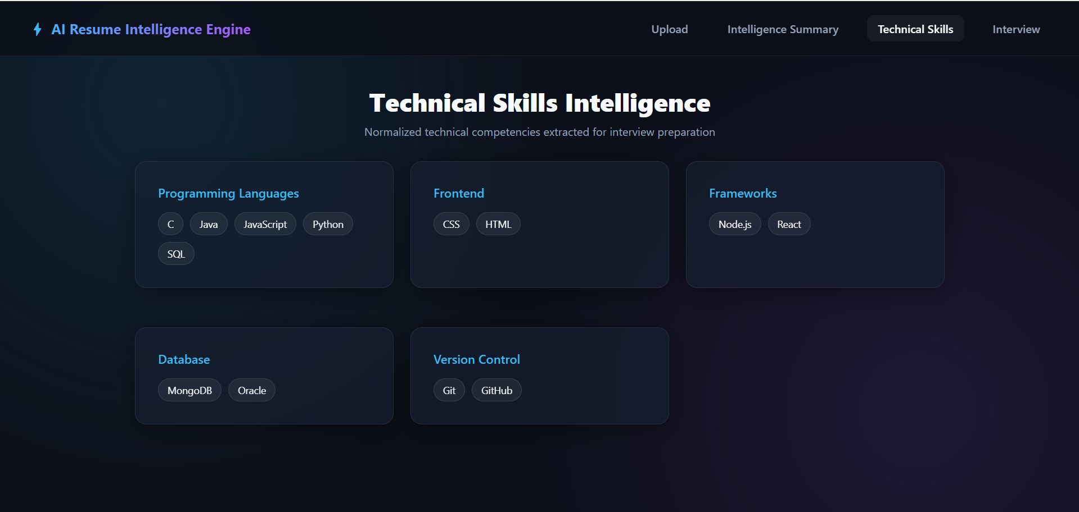
Skills Extracted

Slide 13
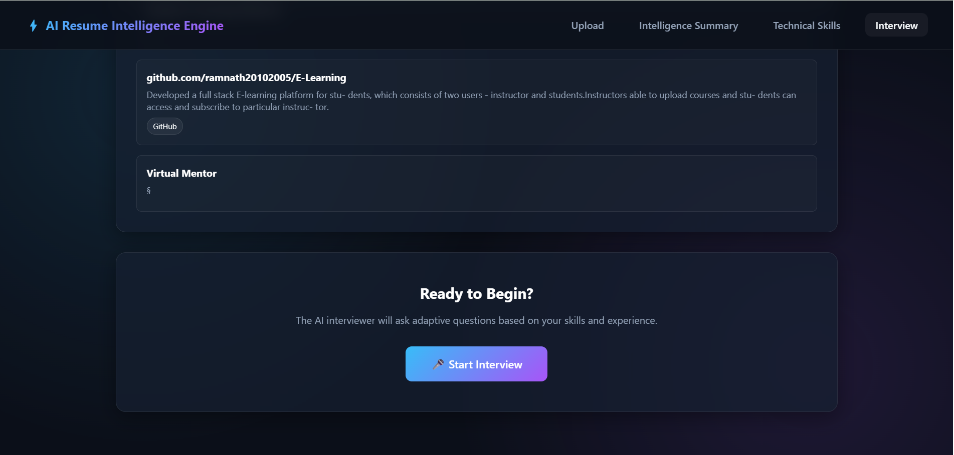
Interview Page

Slide 14
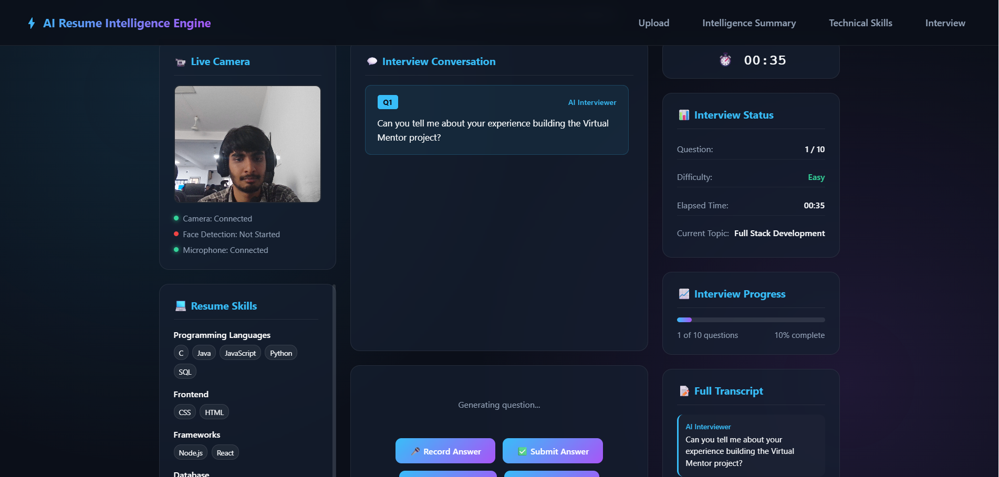
Start Interview

Slide 15
BASELINE COMPARISON
Parameter | Baseline / Existing Approach | Proposed System
Candidate Profiling | Limited or not fully integrated | Resume-based candidate profiling
Question Selection | Fixed rules or direct LLM generation | TabPFN-based policy prediction
Decision Engine | Rule-based / heuristic | TabPFN
Policy Decision | Limited adaptive actions | 7 interview policies
Question Generation | Direct question generation | Policy-guided Local LLM generation
Answer Evaluation | Basic response assessment | Semantic evaluation using LLM
Behavior Analysis | Rule-based or limited | Data-driven policy adaptation
Architecture | Decision and generation often combined | Policy decision separated from question generation
Final Output | Basic feedback | Personalized interview report

Slide 16
COMPLEXITY AND COST
Computational Complexity
Local Qwen LLM performs semantic answer evaluation and adaptive question generation.
Whisper STT converts the candidate's spoken response into text for evaluation.
Video Analysis extracts measurable behavioural features from the candidate's response.
TabPFN performs lightweight inference on the 11-dimensional interview feature vector to predict the next interview policy.
Overall processing time depends mainly on LLM inference, speech duration, video processing, and available GPU resources.
Cost
Component | Cost
Dataset | Synthetic / Custom-created interview dataset
Local Qwen LLM | Open-source, local inference
Whisper STT | Open-source
TabPFN | Pretrained model / local inference
Video Analysis | Open-source computer vision libraries
Resume Processing | Local PDF/DOCX processing
GPU | Depends on local hardware / usage
Deployment | Can be deployed locally without mandatory cloud API costs

Slide 17
THANK YOU!

