Slide 1
AIET Project
Team Nbr: 22
Team Name: Hilary Mason
Price Prediction – Horticulture –Mango – Andhra Pradesh

Slide 2
Agenda
A brief About Project Group Name
Team members
Problem statement
Related work
Datasets
Methods and model
Experiments and results
Future work
Conclusion
Q & A

Slide 3
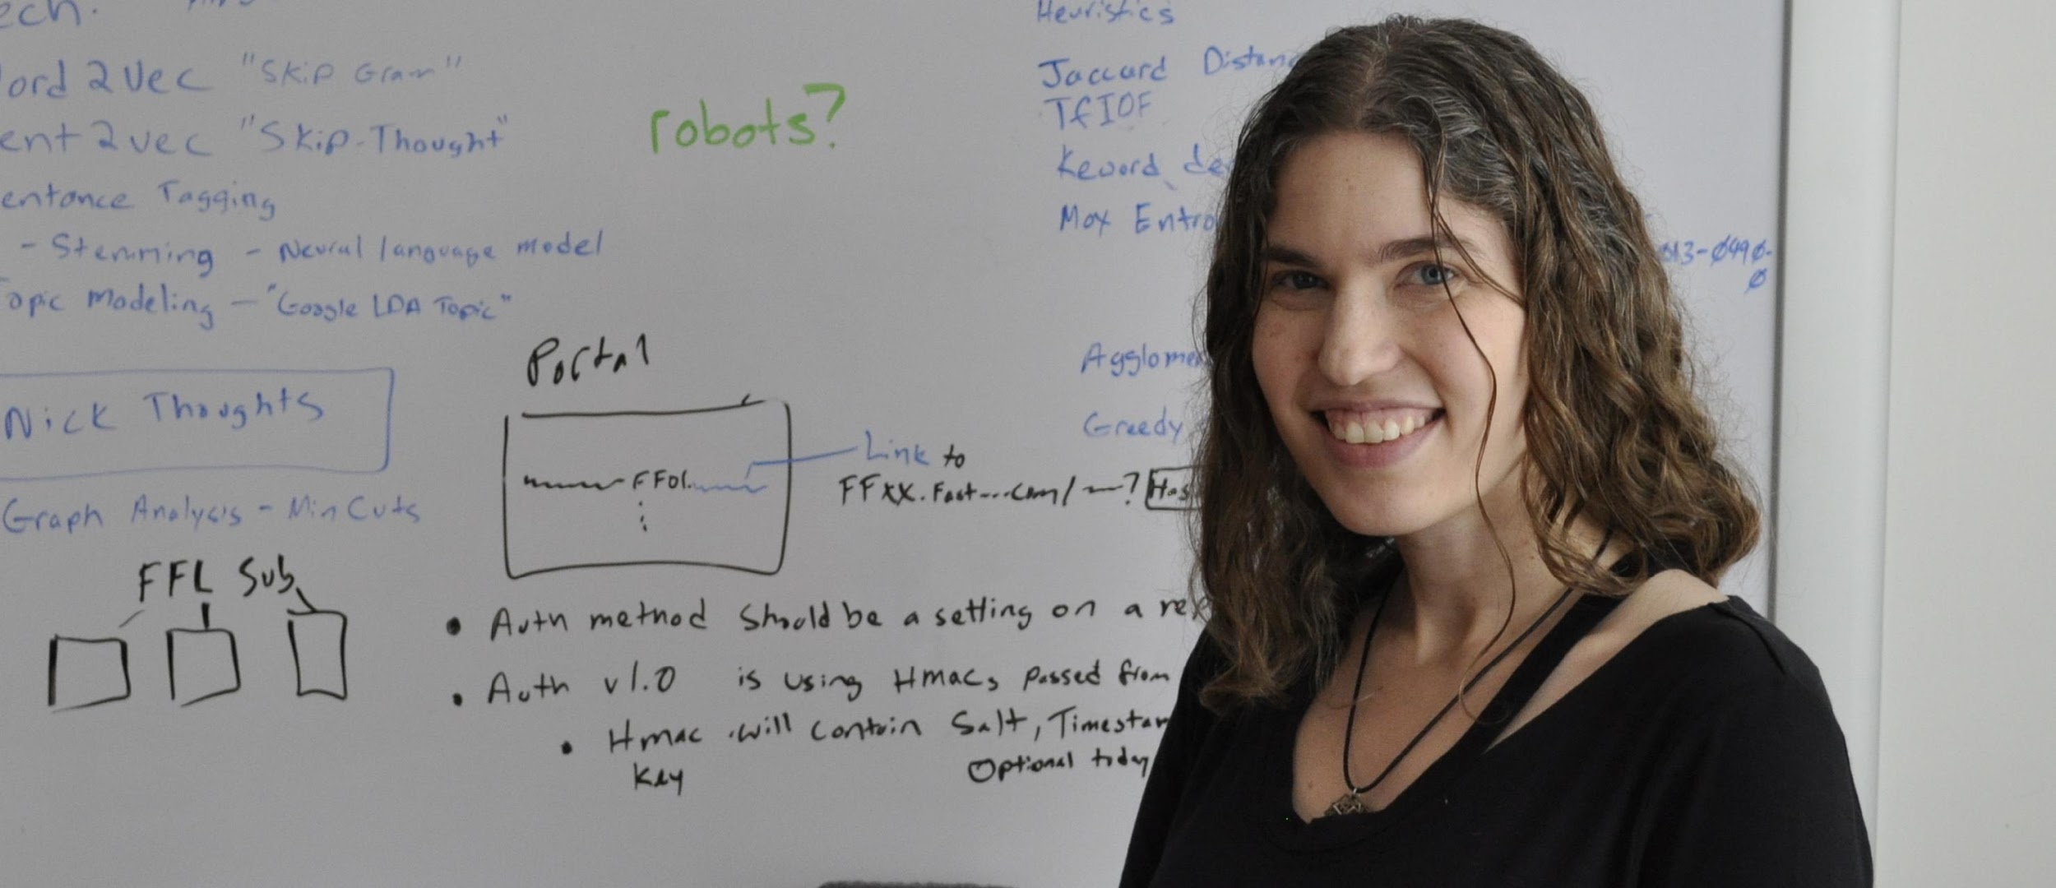
Hilary Mason
American DS
Founder – Fast Forward Labs
Works at Cloudera
Awards
Mason received the TechFellows Engineering Leadership award in 2012.
She was also on the Fortune 40 under 40.
Crain's New York 40 under Forty list.
Top 100 most creative people in business by Fast Company.
Source: https://en.wikipedia.org/wiki/Hilary_Mason_(data_scientist)

Slide 4
Team
Guided by: Sathya Veera Reddy Dendi
N.V V Ram Pandu
J.Mohana Naresh
Kolla Ravi Teja
K.Sai Vamsi
Padmanabha Suvvala

Slide 5
Problem statement
Predicting the price of Horticulture in Andhra Pradesh to increase farmer income.(Doubling of Farmer Income – In par with Govt. of India)
For Example – Mango
Why mango ?

Slide 6
Related work
Population
Rural
Urban
Majority – in Rural
Rural Income:
Land capital gain:
Migration to Urban
Rural population – 58%, Farmers, Labour, & Allied service providers

Slide 7
In 1951, India had 98 million people working on farming.
In 2014, we have 262 million people working in the farms.
That is an *increase* of near 3 times since independence.
But, Can we produce lands?

Slide 8
We are country of Farming But, we are No-where in exports of Nuts & Dry Fruits, Millets (Dr. Khadar Vali)
How can we increase Farmers income, may double?
As Govt. of India
How?

Slide 9
Where do farmers fail?
Seed/ Plant selection – 15%
Water – Rain water, Bore well recharge, Farm ponds, MARR, Mulch (Weed), Drip Irrigation(Fertilizer)
Weather – Playhouses, Shade-net - 10%
Labour – Same time, Farm Automation
Electricity -Solar Pump-sets
Marketing & Supply Chain
Export: Groundnuts, Mango, Fish & Prawns

Slide 10
Nutritional Value of Mango
Andhra Pradesh has emerged as 2nd largest fruit producing state in the country.
Average productivity of mango is 10 ton per ha in AP compared to national average of 7.2 ton per ha.
Kenya is the leading country in world with a productivity of 48.8 ton per ha

Slide 11
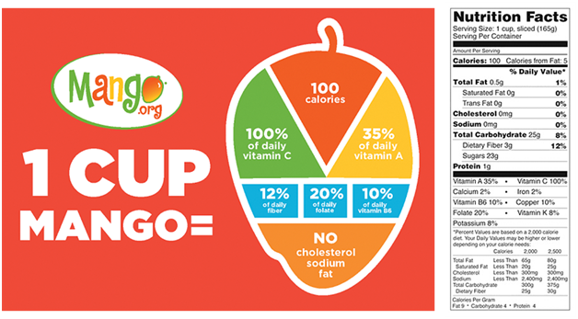

Slide 12
Andhra Pradesh has emerged as 2nd largest fruit producing state in the country.
Average productivity of mango is 10 ton per ha in AP compared to national average of 7.2 ton per ha.
Kenya is the leading country in world with a productivity of 48.8 ton per ha

Slide 13
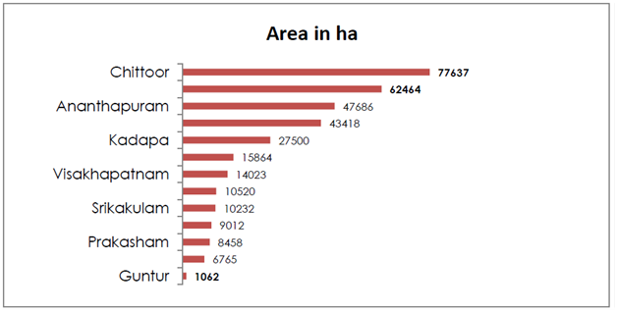
Area wise distribution of mango in Andhra Pradesh

Slide 14
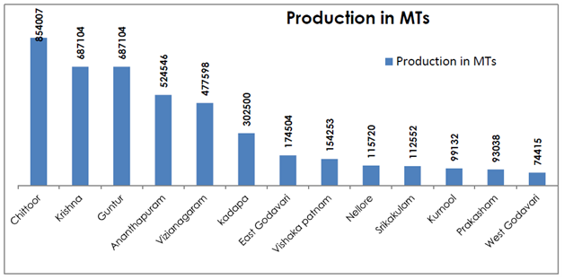
Production of mango in Andhra Pradesh
Source: Value chain analysis of mango in Chittoor district, Andhra Pradesh 2017-2018

Slide 15
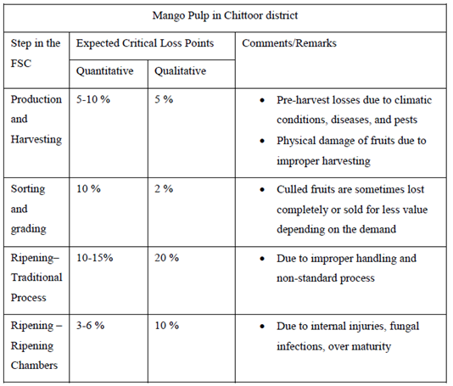
Preliminary screening of food losses in the selected food supply chain (FSC)
Source: Value chain analysis of mango in Chittoor district, Andhra Pradesh (2017-2018)

Slide 16
Applications
Packaging: Domestic & International
Pulp Processing
Storage
Ripening Chambers
Logistic
Ripening Chambers

Slide 17
Datasets
Where did the dataset come from ?
Different features from different resources (web) .
We manually created the dataset.

Slide 18
Datasets
Weather - Humidity - www.worldweatheronline.com
Weather - Temperatures - Statistical Abstract of Andhra Pradesh(PDF’s)
Weather - Rainfall - www.knoema.com
Price - https://agmarknet.gov.in

Slide 19
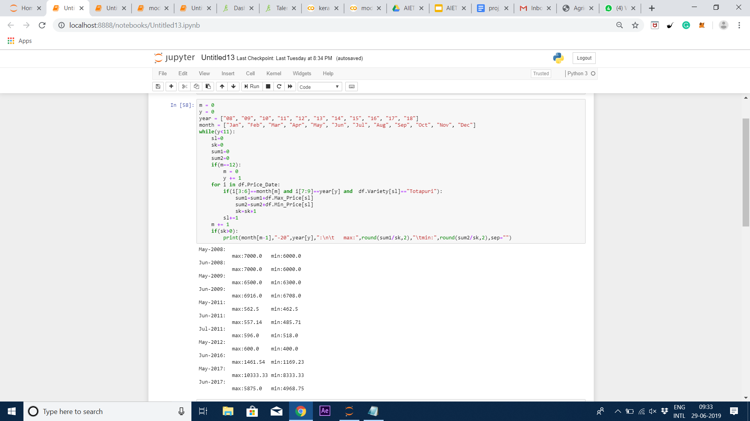

Slide 20
Pre-processing of Dataset
The important part to get accurate results .
As we know that mango is a seasonal crop. We don’t find values of price in non producing months.
Question is : What to replace those empty cells with ?

Slide 21
Pre-Processing of Dataset
With mean or median or 0’s ?
Not actually, this will result less accuracy.
Deleting them?
Yes, the accurate one.

Slide 22
Methods and model
We trained our dataset on three models:
Multiple linear regression
SVM using RBF kernel
Neural networks using keras

Slide 23
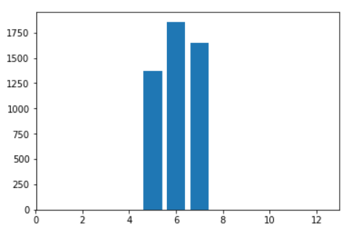
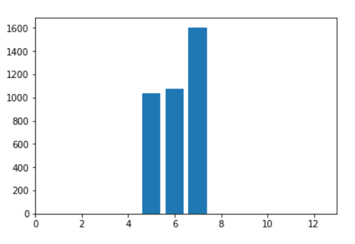
Results on regression - 2016
2016 actual
2016 predicted

Slide 24
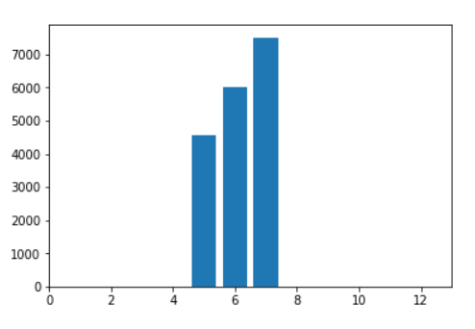
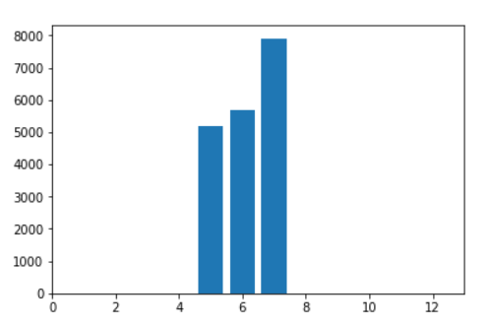
Results of regression - 2017
2017 actual
2017 predicted

Slide 25
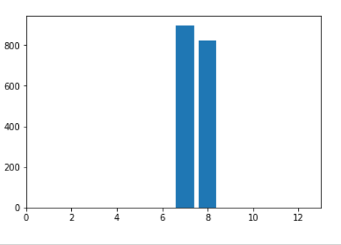
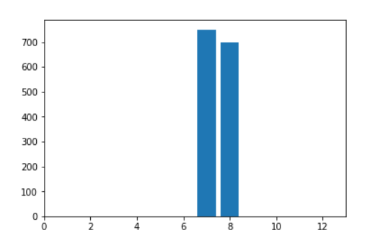
Results of regression - 2018
2018 actual
2018 predicted

Slide 26
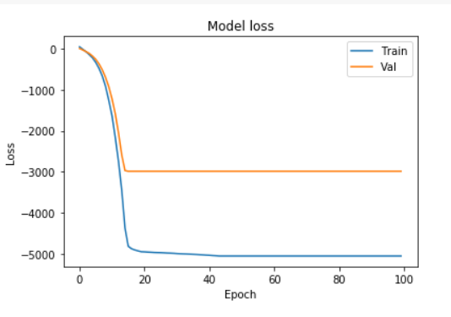
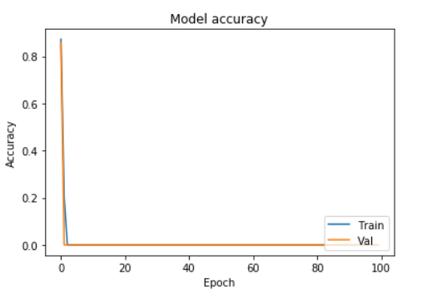
Accuracy and loss measure using keras

Slide 27
Future work
Collecting data from with Govt. of India
Extending to other crops such as Onion, Tomato
Making Output data in real-time deploying online
Present Project is connecting Dot to my upcoming Project Under Operations under Govt. Of India.

Slide 28
Conclusion
The predictions obtained through Linear regression, SVM, and NN are in the trend.
We achieved better accuracy with Linear regression .
We had compared the trend between predicted and actual using keras.

Slide 29
Q & A
Any Questions we are free to answer.

Slide 30
Thank you!

