Slide 1
ENTITY FRAMEWORK CORE
08.05.2019
Entity Framework Core
Ramón Tomás
Software Engineer

Slide 2

Ramón Tomás
Software Engineer
Full-stack developer
Expert in .NET & Cloud solutions
https://www.linkedin.com/in/rtomasc/
rtomas@plainconcepts.com
@ramon_tomas84 (twitter)

Slide 3
Introduction
Features

Slide 4
1. Introduction

Slide 5
Introduction
Entity Framework Core (EF Core) is a Lightweight, extensible, and cross-platform version of the Entity Framework
Run on .NET Core or .NET Framework
Shipped in Nuget package
Subset of EF with new features
EF Core provides an object-relational mapper ORM avoiding the need of dealing with the underlying database schema.

Slide 6
2. Features

Slide 7
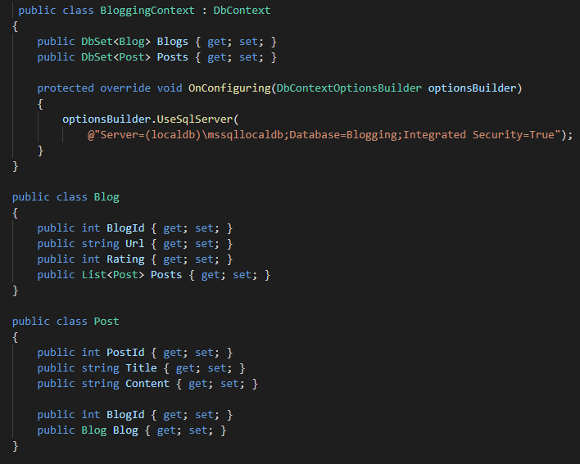
Model
Data access is performed using a model. A model is made up of entity classes and a context object that represents a session with the database.
A model can be generated from an existing database, hand coded or by using migrations
DbContext represents the session and provides an API to communicate with the database.
DbSet represents the entity mapped to the database table. It is the access point to entity database operations

Slide 8
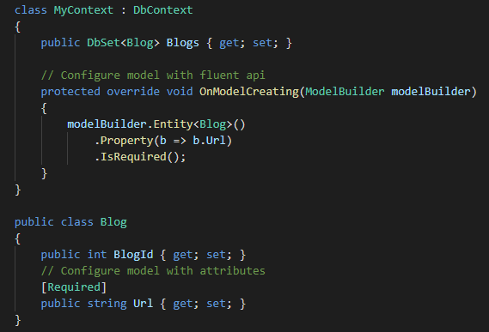
Model Configuration
EF, by default, uses a set of conventions to build a model
Allows to extend or override the model configuration by using fluent api or attributes

Slide 9
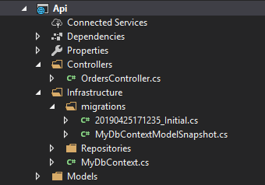
Managing Schemas
Migrations or Scaffolding options.
The migrations feature provides a way to incrementally update the database schema to keep it in sync with the application's data model.
Migrations includes command-line tools and APIs that help managing schemas: create, update, remove, revert,..

Slide 10
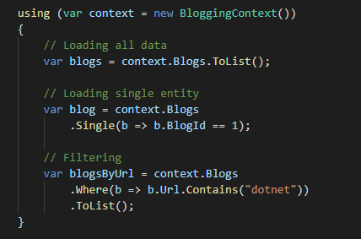
Querying Data
Uses Language Integrated Query (LINQ) to query data.
LINQ allows you to write strongly typed queries based on your EF model context.
LINQ methods take Lambda Expressions (delegates)

Slide 11
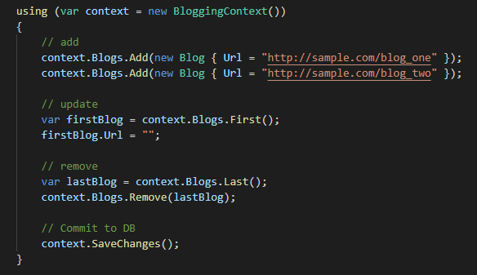
Saving Data
Each EF context has a ChangeTracker that is responsible of keeping track of entity changes.
These changes are stored and only committed to DB after executing SaveChanges.
SaveChanges manages the transaction.

Slide 12
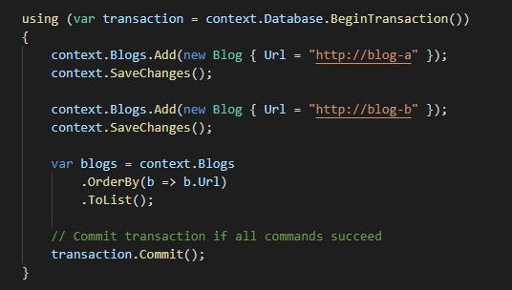
Transactions
By default all changes in a call to SaveChanges are applied in a transaction.
Allows to control transactions
Allows cross-context transactions
Not all providers support it

Slide 13
Providers
EF Core can use different databases by using including these database providers
SQL Server
SQLite
In-Memory
EF Core can also use third party database providers
SQL Server
SQLite
PostgreSQL
MySQL
Oracle (Preview) …

Slide 14
Features
Built-in conventions
Fluent API
Data annotations
Hi/Lo algorithm
Field mapping
Shadow properties
Own Entity Types
Spatial Data GIS

Slide 15
¡Thank you!
www.plainconcepts.com
@plainconcepts

