Slide 1
NET CORE
21.10.2018
Net Core features
Ramón Tomás
Software Engineer

Slide 2

Ramón Tomás
Software Engineer
Full-stack developer
Expert in .NET & Cloud solutions
https://www.linkedin.com/in/rtomasc/
rtomas@plainconcepts.com
@ramon_tomas84 (twitter)

Slide 3
.Net Overview
Tooling
ASP.Net Core features
Future of .Net
#MicroservicesEvent

Slide 4
1. .Net Overview

Slide 5
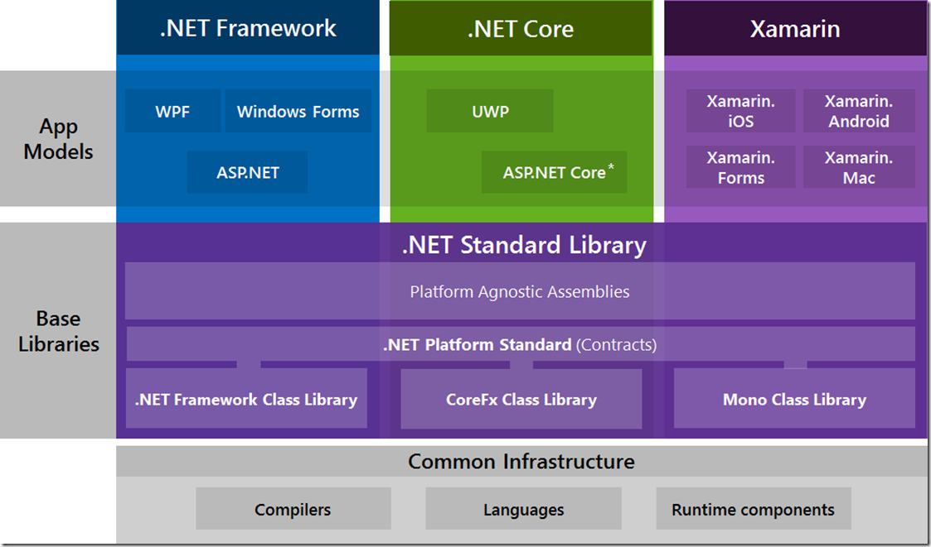
.Net Architecture

Slide 6

.Net Core Features
Cross platform development and deployment
Performance
Open source
Modular framework distributed as NuGet packages
Lightweight
Side-by-side runtime frameworks

Slide 7
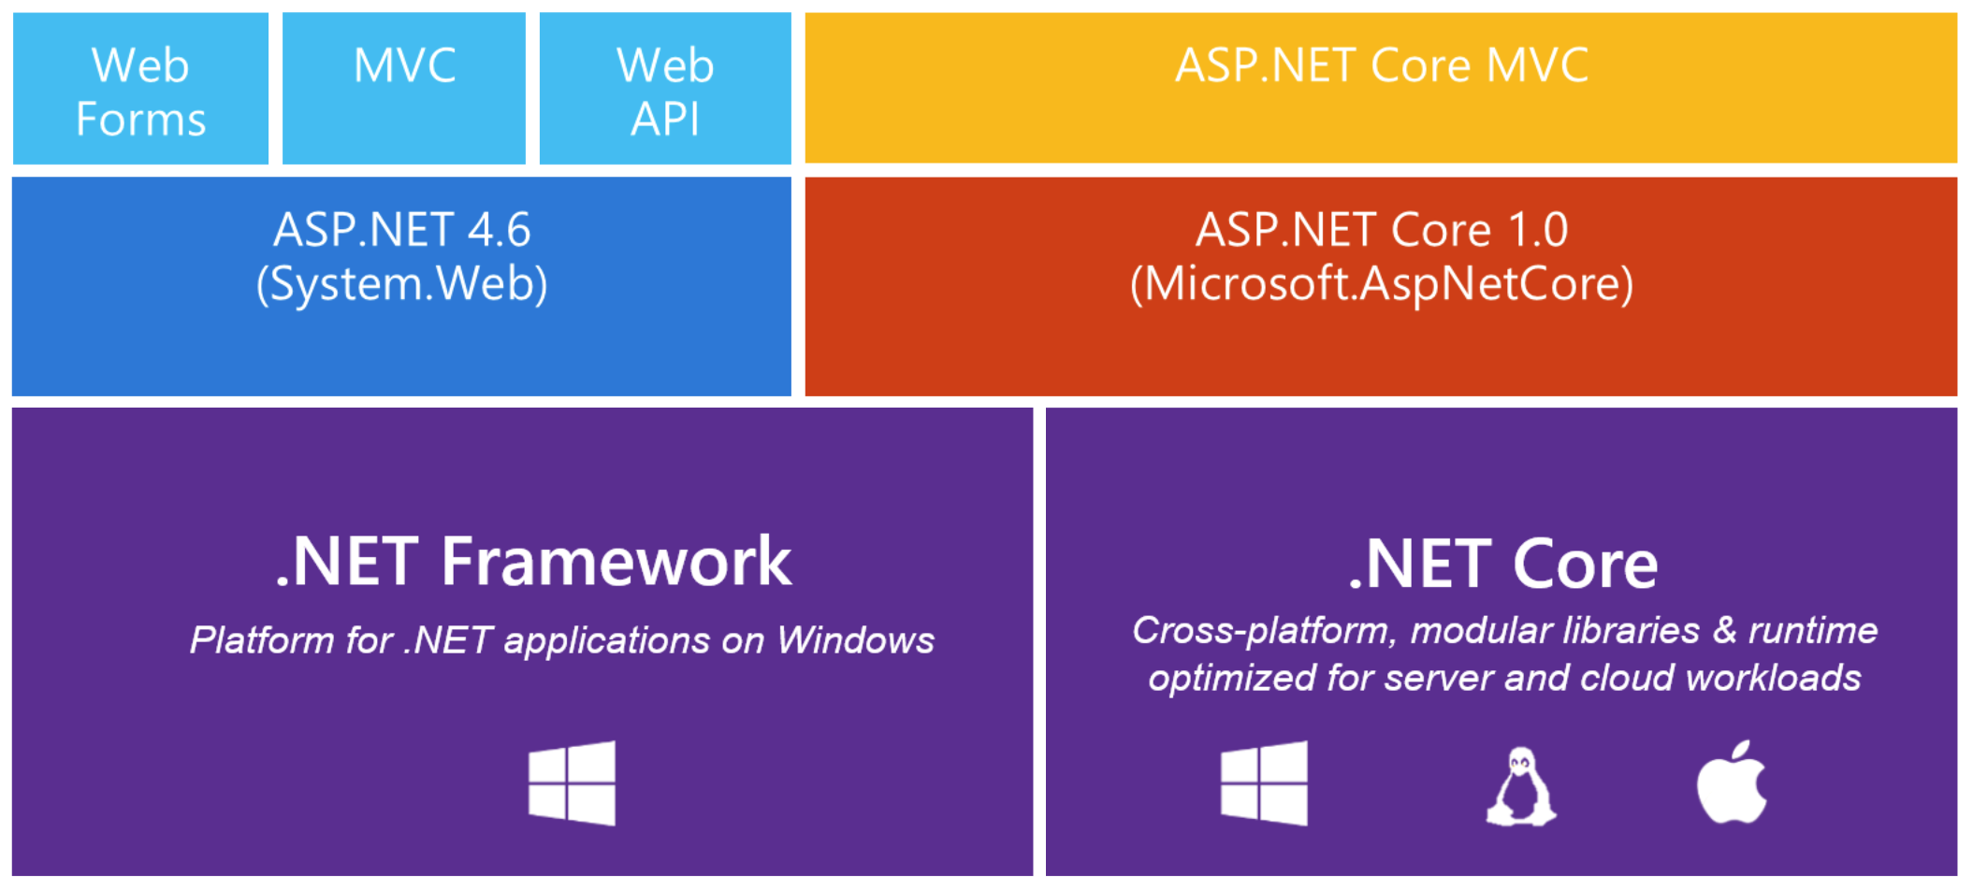
Asp.Net Core

Slide 8
2. Tooling

Slide 9
Tooling
Visual studio 2017+
Visual studio for MAC
Visual studio code
Command Line Interface CLI

Slide 10
3. Middlewares

Slide 11
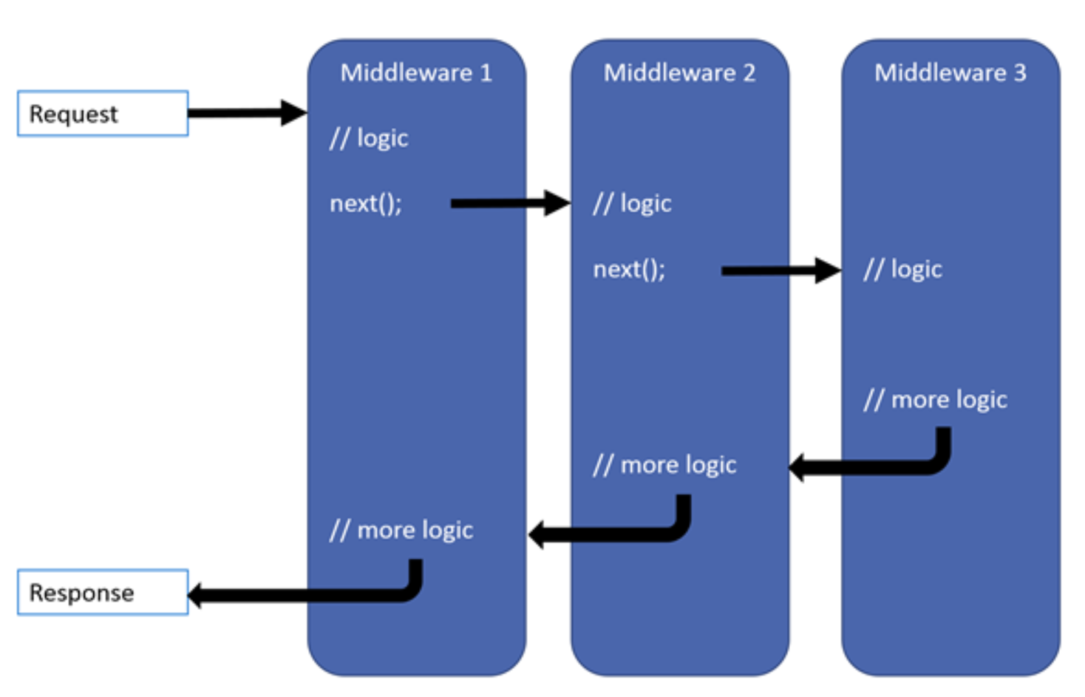
Asp.net Core Middlewares
Software assembled into an app pipeline to handle requests and responses
Request delegates can implement the following types: Use, Run and Map.

Slide 12
4. Dependency Injection

Slide 13
Asp.net Core DI
Built-in dependency injector
Lifecycle: Singleton, Scoped and Transient.
Possibility to integrate third-party DIs

Slide 14
5. Logging

Slide 15
Asp.net Core Logging
ASP.NET Core comes with a built-in logging API
Built-in logging providers (Console, Debug, EventLog, Azure App Service)
Third-party logging providers (Nlog, Serilog, elmah, ...)
Support for other providers

Slide 16
6. Asp.Net Core Configuration

Slide 17
Configuration
key-value pairs established by configuration providers
Configuration builder to apply different configuration providers (Key Vault, json files, Env. Var., command line, …)
Overrides settings based on the order.
Default configuration builder.
Possibility to override the default builder.

Slide 18
1. Future of .Net

Slide 19
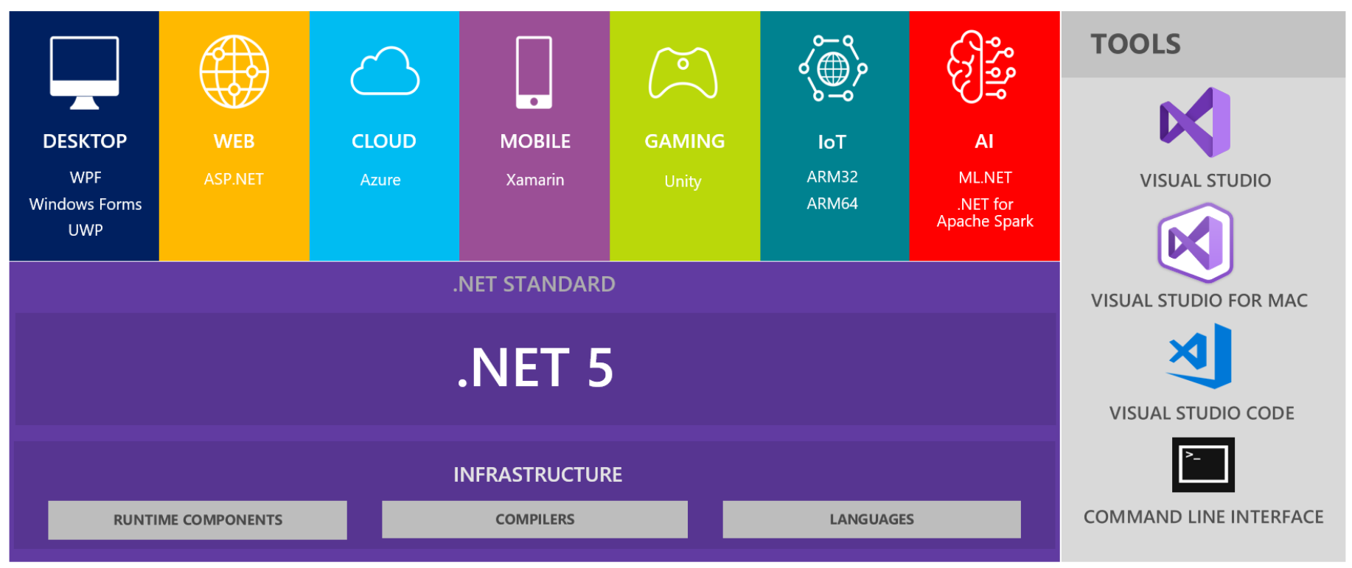
Future of .Net .Net 5
.Net Core next release: .Net 5
Single .NET runtime and framework to rule them all.
After .Net Core v3.0 will not port more features from .Net Framework
.Net Framework 4.8 will be the last major version.
Existing applications that want to take advantage of the new features in .NET should consider moving to .NET Core

Slide 20
¡Thank you!
www.plainconcepts.com
@plainconcepts

