Slide 1
AGENDA
Object-oriented programming
SOLID principles
Design patterns
Entity Framework Core
.Net Core

Slide 2
OBJECT-ORIENTED PROGRAMMING
08.05.2019
Object-oriented programming
Ramón Tomás
Software Engineer

Slide 3

Ramón Tomás
Software Engineer
Full-stack developer
Expert in .NET & Cloud solutions
https://www.linkedin.com/in/rtomasc/
rtomas@plainconcepts.com
@ramon_tomas84 (twitter)

Slide 4
Introduction
OOP Principles

Slide 5
1. Introduction

Slide 6
Introduction
Object-oriented programming OOP is a programming paradigm whereby the solution to a programming problem is modelled as a collection of collaborating objects.
Objects are entities that possesses both state and behavior
OOP is based on the following principles: Encapsulation, Inheritance, Abstraction and Polymorphism

Slide 7
2. OOP Principles

Slide 8
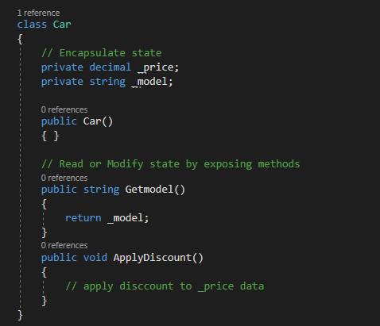
Encapsulation
The implementation and state of the objects are privately held internally.
Other objects do not have access to them.
Provides public methods to read or modify internal state.
Avoids data corruption.

Slide 9
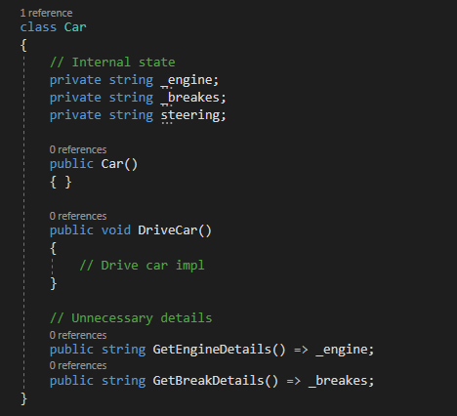
Abstraction
Objects should only expose a high-level mechanism for using it
This mechanism should hide internal implementation details

Slide 10
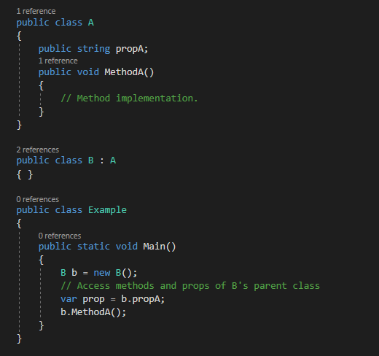
Inheritance
Allows to define child objects (Derived classes) that reuses, extends or modifies the behavior of the parent object (Base class).

Slide 11
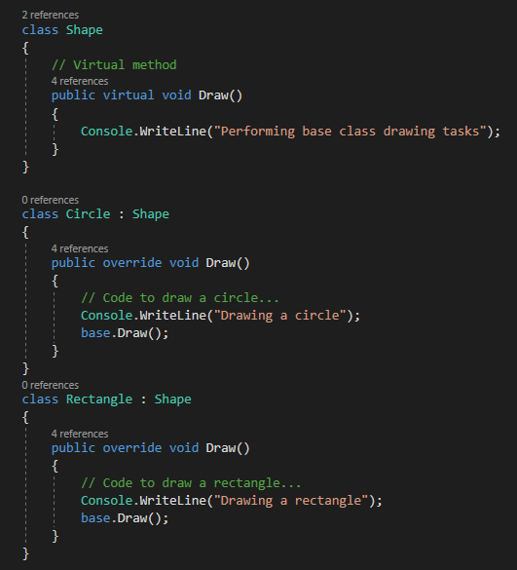
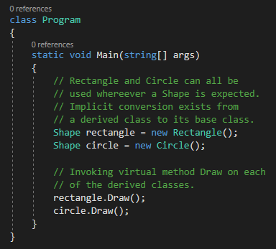
Polymorphism
Polymorphism: Many shapes.
Provides a way to use a subclass exactly like its parent but each subclass might implement its own version.
At runtime, child objects may be treated as a base class objects.
Base classes may define and implement methods that derived classes can override.

Slide 12
3. Composition

Slide 13
Composition
Inheritance can bring maintenance and extendibility issues.
Subclasses become highly dependent on parent classes.
Complexity increases as new requirements appear.
Composition is the principle that classes should achieve polymorphic behavior by using functionality instances rather than inheritance.
Composition can be achieved by applying different Design patterns.

Slide 14
4. Generics

Slide 15
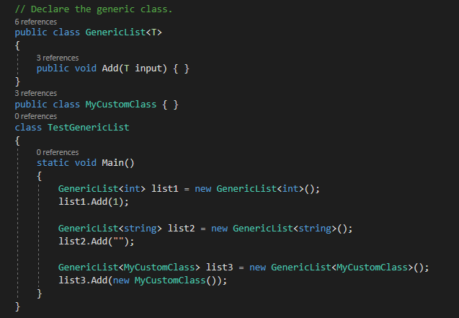
Generics
Concept of type parameters.
Classes and methods can defer the type’s specification until they are declared or instantiated.
Maximize code reuse and type safety.

Slide 16
¡Thank you!
www.plainconcepts.com
@plainconcepts

