Slide 1
gRPC
12.09.2019
gRPC Introduction
Ramón Tomás
Software Engineer

Slide 2
HTTP/2
gRPC
Tooling
#MicroservicesEvent

Slide 3
1. HTTP/2

Slide 4
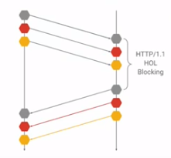
HTTP/1 Limitation
Limited parallelism. New TCP connection on each HTTP request.
Head of line Blocking HOL
HTTP Headers. Uncompressed plain text headers on every request.
Based on text protocols

Slide 5
HTTP/2
Released in 2015. Extend the semantics of HTTP/1.1
High-level compatibility with HTTP/1.1
Supported by most of the web browers
Compression of request headers
Binary protocol
HTTP/2 Server push
Request multiplexing over a single TCP connection

Slide 6
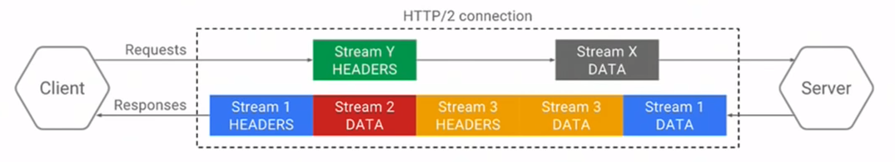
Request/Response multiplexing
Single TCP Connection
Parallel request/responses without blocking
Payload/Headers chunked into multiple frames
Client and Server maintain an indexed list of headers

Slide 7
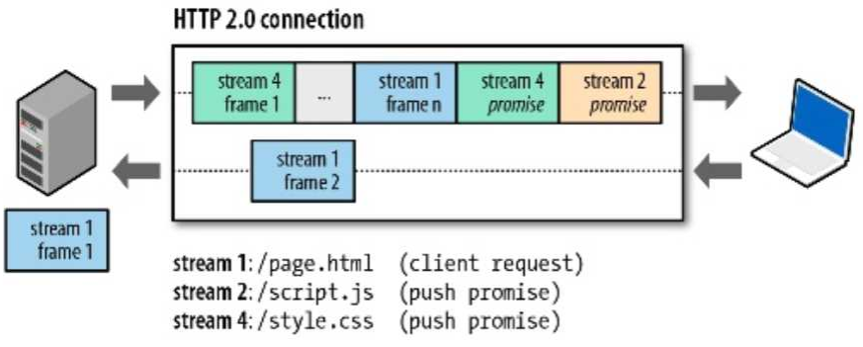
HTTP/2 Server Push
Single Connection
Reduced round trips
Avoid Request/Response pattern
Push promise mechanism

Slide 8
2. gRPC

Slide 9
Introduction
Open source high performance RPC framework.
Originally developed at Google (SPDY).
Built on top of HTTP/2 network protocol.
Multi-language support.
Protocol Buffers as the Interface Definition Language (IDL) to describe the API
Efficiency in serialization with Protocol Buffers and connectivity with HTTP/2
Connection options: Unary, server-side streaming, client-side streaming, bi-directional streaming.

Slide 10
gRPC Use Cases
Microservices
APIs
Mobile Clients
Web Clients (Web gRPC library or Reverse Proxy HTTP-gRPC transcoders)

Slide 11

Some early adopters

Slide 12
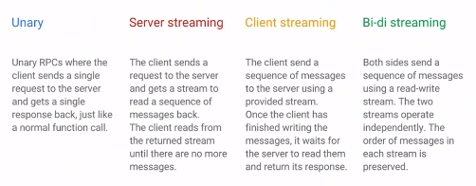
Connection Options

Slide 13
Protocol Buffer (Protobuf)
Automated and efficient mechanism to serialize structured data.
Ideal for message communication or storing data.
Data structures and services defined in a proto definition file (.proto)
Resilient to definition updates.
Possibility to generate stubs classes in different languages.

Slide 14
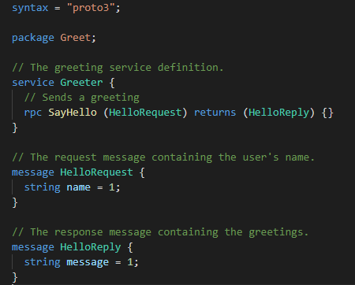
Proto Definition File (.proto)

Slide 15
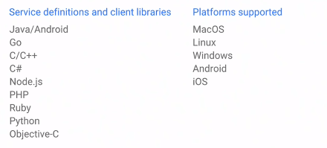
Multi-Language Support

Slide 16
3. Tooling

Slide 17
Tooling
ProtoC
Multi-language tool to compile .proto definition files.
Generate stub classes

Slide 18
C# Tooling
Grpc.Tools
Google.Protobuf
Grpc.Net.Client

Slide 19
¡Thank you!
www.plainconcepts.com
@plainconcepts

