Slide 1
TrueRefactor
Isaac Griffith
Stephani Schielke

Slide 2
The Problem
Legacy Software Systems
Generational Gap in Design “Best Practices”
Minimal Experience in older languages
Time constraints to add new features
Proposed Solution:
Automated Refactoring
Using Genetic Algorithms

Slide 3
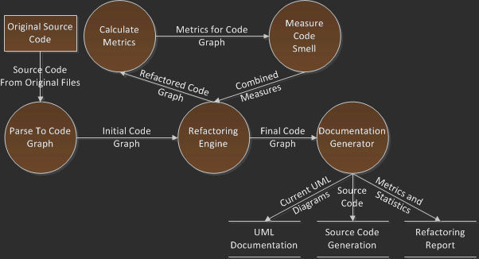

General Process
Portions We are
Currently Working
on
Previous Work Done

Slide 4
Metrics, Code Smells, and Analysis
Behavioral
Aspect
Metrics
Define
Select
Application
Code Smell
Application
Understand-ability
Reuseability
Maintain-ability
Lack of Cohesion between Methods
Coupling Between Objects
Weighted Methods per Class
Possible Metrics

Slide 5
Metrics, Code Smells, and Analysis
Metrics
Define
Select
Application
Code Smell
Application
Understand-ability
Reuseability
Maintain-ability
Lack of Cohesion between Methods
Coupling Between Objects
Weighted Methods per Class

Slide 6




Metrics, Code Smells, and Analysis
Metrics
Define
Select
Application
Code Smell
Application
Move Method
Collapse
Hierarchy
Extract Method
Extract Class
LCOM
CBO
WMC
$$fitness=$$
$lcom$ +
$$cbo+$$
$$wmc$$

Slide 7

Metrics, Code Smells, and Analysis
Metrics
Define
Select
Application
Code Smell
Application
Move Field
Pull up Field
Push down Method
Extract Class
CodeSmell
$$convergence=\sum{{codesmell}_{i}}$$

Slide 8
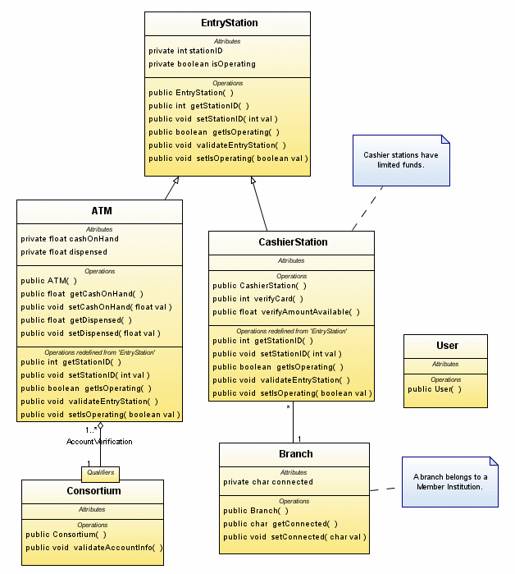
UML Output
Each Node represents:
Some portion of code
UML Entity
Using EMF Library
Each Edge represents
Some association between elements
Best Individual

Slide 9
Operational Verification
System Verification
Design experiments using injected faults
Compare Generated UML with original code/UML
Implementation verification via Integration and Regression testing using NMI Build and Test Laboratory.
Metrics Verification
JUnit Tests for implementation verification
Reporting
CodeSmell Verification
JUnit Tests for implementation verification
Reporting

Slide 10
Expected Results
Accurate Refactoring
Increased:
Understandability
Reusability
Maintainability
Foundation for future tools
Notes:
Accurate Refactoring
Increased:
Understandability
Reusability
Maintainability
Foundation for future Tools

