Slide 1

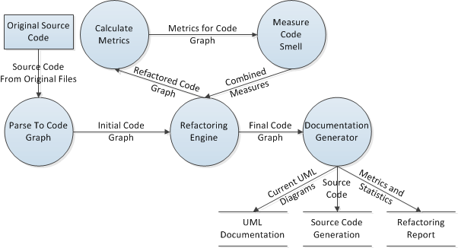
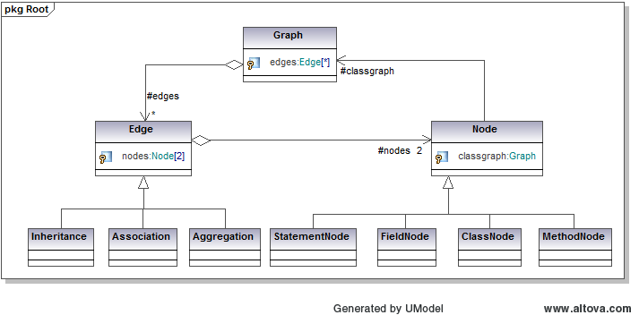
Automated Refactoring of Legacy Software Systems to Current Best Practices
Isaac Griffifth
isaacgriffith@gmail.com
Stephani Scheilke
stephani.scheilke@gmail.com
Objective: To restructure software in order to increase the understandability, reusability, and maintainability as a means to quantify the rationality of a program. In effect,
unveiling the potentially lost subjective knowledge and processes embedded into the original code by the Software Engineers.
1. Introduction
4. Basic Process
This work presents an attempt to provide empirical approach to:
Analysis of metrics that indirectly measure the behavior concepts of maintainability, reusability, and understandability of software projects.
Software Engineering issues dealing with automated refactoring the understandability of software by multiple engineers
2. Refactoring
Refactoring is provided by manipulating entities within a graph structure representing the content of an entire source code base of an application
These operations implement a defined technique which modifies the structure of the software without changing its overall function.
The refactoring operations used are:
Figure 4. Basic Process Data Flow Diagram
Figure 3. Example Resultant UML Documentation
Move Method
Move Field
Pull Up Method
Pull Up Field
Collapse Hierarchy
Push Down Field
Push Down Method
Move Class
5. Results
6. Mathematical Implications
Provides the quantification of the behavior of program execution in the form of metrics, which provide a tool to analyze the necessary qualities of software to ensure that it complies with current best practices
Quantification of the notion of Code Smells providing an overall measure of the effect of refactoring on source code across a project.
Class A
Move from A to B
Class B
Class A
Class B
M1
M2
M1
M2
M1
M2
M1
M2
M3
Figure 1. Move Method Refactoring Technique
Code Smells: Provide a set of heuristics by which we can measure the effectiveness of refactoring over an entire software project’s source code base.
Combining the Quantified Heuristics of Code Smells with the metrics below we can adequately refactor a system and verify it meets current best practices.
7. Philosophical Implications
Introduces an example of a new paradigm in Computer Science
Produces an example of Dark Programing
Provides empirical evidence towards a more defined understanding of program darkness
3. Metrics and Measures
8. Conclusions
Maintainability
Measures the amount of cohesion, coupling, and complexity of software components
Metric: Coupling Between Objects, Cyclomatic Complexity and Lack of Cohesion in Classes
Reusability
Measure of the cohesion components of the software
Metric: Coupling between Objects and Lack of Cohesion in Classes
Understandability
Measures the complexity of each component of the software
Metric: Cyclomatic Complexity

