Slide 1
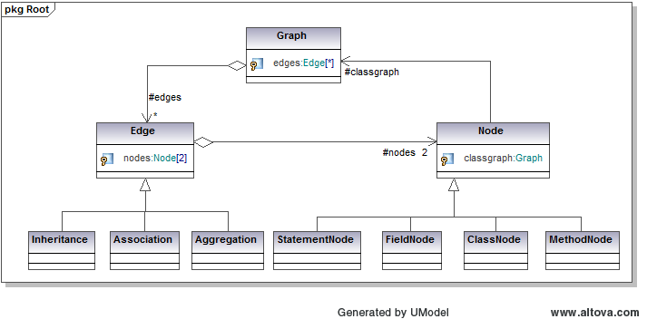
Dark Programming and The Quantification of Rationality and Understanding in Software
Isaac Griffith, Stephani Schielke, and Scott Wahl
Objective: To restructure software in order to increase the understandability, reusability, and maintainability as a means to quantify the rationality of a program. In effect,
unveiling the potentially lost subjective knowledge and processes embedded into the original code of the software
1 Introduction
Methodology Continued
Results Continued
This work presents an attempt to provide empirical answers to:
Philosophy of Computer Science questions regarding
Rationality of so-called Dark Programming
The connection between subjectivity and objectivity in the program design process and its link to rationality and understanding
Mathematical issues involved with
Analysis of metrics to measure these qualities over the scope of large projects
Definition of graph manipulations representing refactoring techniques
Software Engineering issues dealing with automated refactoring the understandability of software by multiple engineers
Metrics and Measures
Resultant UML Documentation
Program
Darkness
Program
Rationality
Subjectivity –Objectivity
Connection
Maintainability
Reusability
Understandability
Coupling
Between
Classes
Lack of Cohesion in Methods
Weighted
Methods
Per Class
Cyclomatic
Complexity
3 Results
2 Methodology
4 Analysis
Evolutionary Algorithm
Randomly apply refactoring to generate different code graphs
Refactoring
Uses graph manipulations to modify source code graph
Move Method (Field)
Pull-Up Method (Field)
Mathematical
Computational
Philosophical
Class A
Move from A to B
Class B
Class A
Class B
M1
M2
M1
M2
M1
M2
M1
M2
M3
5 Conclusions
Class A
Class A
M1
M2
M1
M2
M3
Class B
Class B
M1
M2
M1
M2

