Slide 1
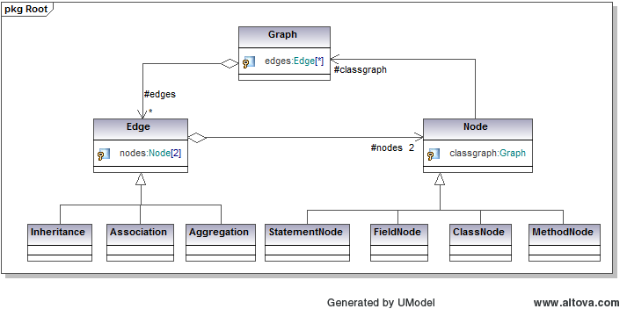
Dark Programming and The Quantification of Rationality and Understanding in Software
Isaac Griffith, Stephani Schielke, and Scott Wahl
Objective: To restructure software in order to increase the understandability, reusability, and maintainability as a means to quantify the rationality of a program. In effect,
unveiling the potentially lost subjective knowledge and processes embedded into the original code by the Software Engineers.
1. Introduction
Methodology Continued
Results Continued
Document Generation
Resultant UML Documentation
3. Results
2. Methodology
4. Analysis
Metrics and Measures
Refactoring
Move Method (Field)
Pull-Up Method (Field)
Mathematical
Computational
Philosophical
Class A
Move from A to B
Class B
Class A
Class B
M1
M2
M1
M2
M1
M2
M1
M2
M3
5. Conclusions
Class A
Class A
M1
M2
M1
M2
M3
Class B
Class B
M1
M2
M1
M2
Notes:
1

