Slide 1

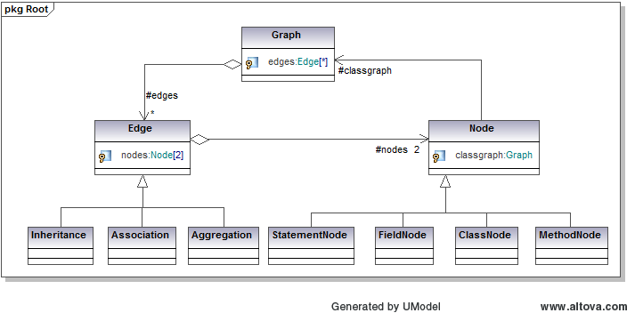

Dark Programming and The Quantifying of Rationality and Understanding in Software
Isaac Griffifth
isaacgriffith@gmail.com
Stephani Scheilke
stephani.scheilke@gmail.com
Objective: To restructure software in order to increase the understandability, reusability, and maintainability as a means to quantify the rationality of a program. In effect,
unveiling the potentially lost subjective knowledge and processes embedded into the original code by the Software Engineers.
1. Introduction
4. Basic Process
This work presents an attempt to provide empirical answers to:
Rationality of emergent programs
The link between rationality and understanding of programs
Analysis of metrics to measure these qualities over the scope of large projects
Software Engineering issues dealing with automated refactoring the understandability of software by multiple engineers
Modify
Code
Graph
Calculate
Metrics
Refactor
Evolutionary
Algorithm
Refactoring
Operations
2. Refactoring
UML
Refactoring is provided by manipulating entities within a graph structure representing the content of an entire source code base of an application
These operations implement a defined technique which modifies the structure of the software without changing its overall function.
The refactoring operations used are:
Generate Documentation
Reports
Figure 3. Example Resultant UML Documentation
Figure 2. The Basic Process
Source Code
6. Mathematical Implications
5. Results
Move Method
Move Field
Pull Up Method
Pull Up Field
Collapse Hierarchy
Push Down Field
Push Down Method
Move Class
Class A
Move from A to B
Class B
Class A
Class B
M1
M2
M1
M2
M1
M2
M1
M2
M3
7. Philosophical Implications
Figure 1. Example Refactoring Graph Operation
3. Metrics and Measures
Program Rationality
Program Darkness
Maintainability
Measures the amount of cohesion, coupling, and complexity of software components
Metric:
8. Conclusions
Reusability
Measure of the cohesion components of the software
Metric:
Understandability
Measures the complexity of each component of the software
Metric:

