Slide 1


5 TALKING ROBOTS
Machine Learning Project
Ramona Ferrari
S4944096
Robotics Engineering - UNIGE

Slide 2
Introduction
Apply concepts of Machine Learning
Classification Problem
Real problem in Robotics Field

Slide 3
Index
1. PROBLEM STATEMENT
2. DATASET
3. PREPROCESSING OF DATA
4. MODELS
5. CONCLUSIONS

Slide 4
1. Problem statement
5 robots:
ID: 0, 1, 2, 3, 4
Communication:
10 positive numbers
Recognition:
Which robot is talking only knowing the spoken numbers?
Why?
Social robot applications

Slide 5

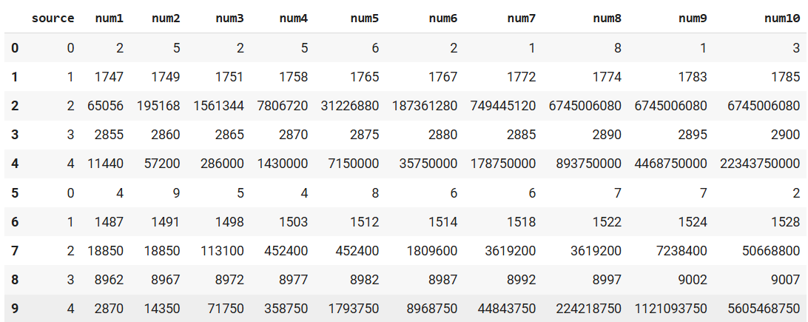
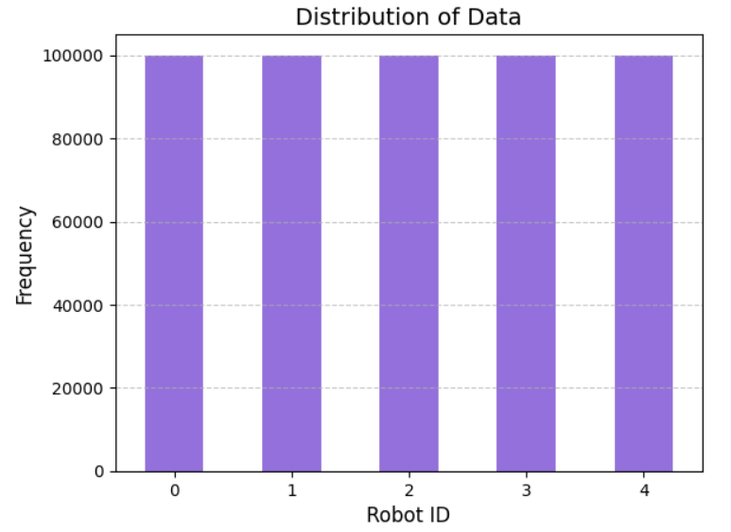
2. Dataset
Data are taken from : Classification of Robots from their conversation
500000
11

Slide 6



3. Preprocessing of data
Check on null or missing values
Use 5000 samples
Divide X vector and Y target
Normalize the data
Shuffle data
Division in training and testing set

Slide 7
4. Models
1. LINEAR SVC
2. SVC WITH RBF KERNEL
3. KNN

Slide 8
GRIDSEARCH
It is a scikit-learn tool
Search over model parameters
Testing all the combinations

Slide 9
LINEAR SVC
Linear Support Vector Classifier:
Supervised algorithm
Find the optimal hyperplane in N-dimensional space
Maximise the bounds between classes
Linear kernel
Some parameters: penalty, loss, C, multi_class

Slide 10
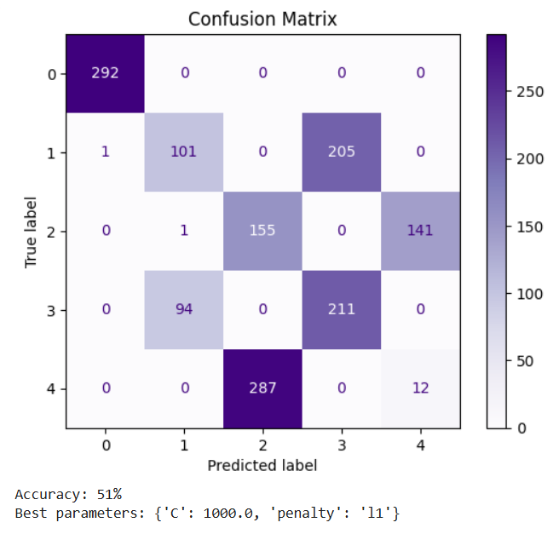
Parameters: C : np.logspace(-4,3,10) penalty: [‘l1’,’l2’]
LINEAR SVC

Slide 11

Support Vector Classifier with RBF kernel:
Supervised algorithm
Some parameters: C, kernel, gamma, decision_function_shape
Non-linear kernel: radial basis function
Hyperplane + maximise bounds
SVC WITH RBF KERNEL
Radial Basis Function Kernel using Euclidean Distance:
$$K\left(x_{i},x \right)={e^{−λ\left\|x_{i}−x\right\|}}^{2}$$

Slide 12
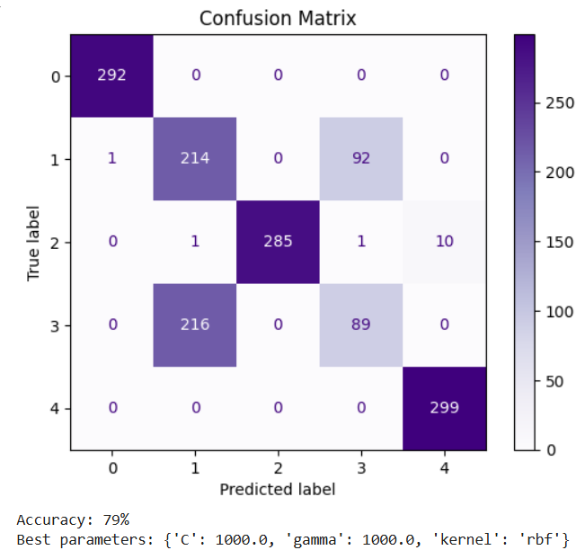
Parameters: C: np.logspace(-4,3,10) kernel: [‘rbf’] gamma: np.logspace(-4,3,10)
SVC WITH RBF KERNEL

Slide 13
K-NEAREST NEIGHBORS
K nearest neighbor:
Supervised algorithm
Some parameters: k, p, metric
Lazy learner
No training phase

Slide 14
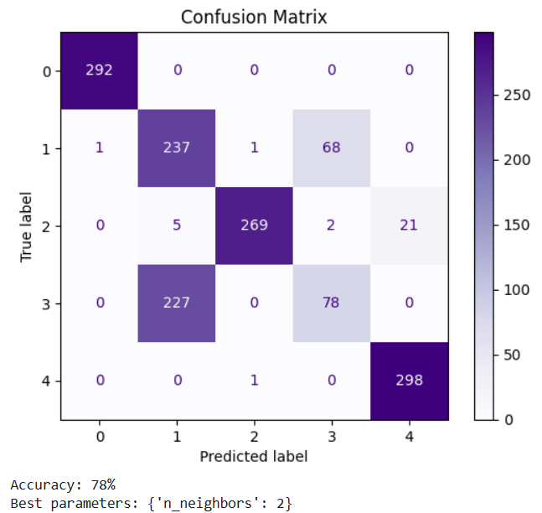
K-NEAREST NEIGHBORS
Parameters: n_neighbors: [1,2,4,8,16,32]

Slide 15
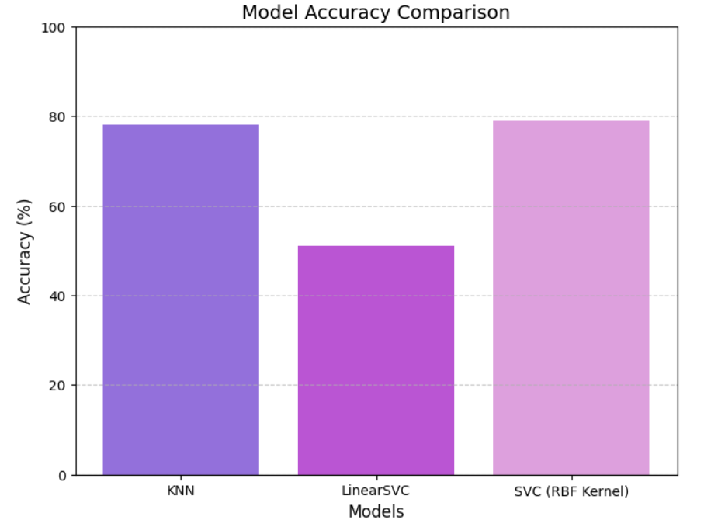
5. Conclusions
Best performance: SVC with RBF Kernel
Actually, there is no big difference between KNN and SVC with RBF kernel.
Recommended choice: KNN.

Slide 16
References:
Dataset
Code
Scaler
Linear SVC
SVC
KNN
GridSearch

Slide 17
THANK YOU FOR LISTENING!
Ramona Ferrari
S4944096
Robotics Engineering - UNIGE

