Slide 1

ENERGY HARVESTING with piezoelectric transducers
Valentina Condorelli, Annika Delucchi,
Ramona Ferrari, Daniele Rialdi, Alvin Isac Prem Sunder
Notes:
Ra

Slide 2
INDEX
PROJECT AIM
PROBLEM BREAKDOWN
EXPERIMENTAL RESULTS
FUTURE IMPROVEMENTS
Notes:
Ra

Slide 3
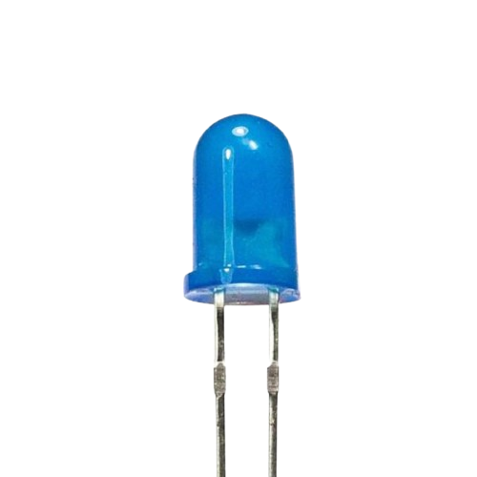
PROJECT AIM
Turn on a light emitter (LED)
How?
Building an ad hoc
CIRCUIT
Bonding a vibrating mechanical system with a PIEZOELECTRIC PATCH
Notes:
Ra

Slide 4
PROBLEM BREAKDOWN
DERIVE
Eigenfrequency
Coupling
Damping modal parameters
Notes:
Ra

Slide 5
PROBLEM BREAKDOWN
DERIVE
Eigenfrequency
Coupling
Damping modal parameters
DESIGN
Electric circuit for switching on the LED
Notes:
Ra

Slide 6
PROBLEM BREAKDOWN
DERIVE
Eigenfrequency
Coupling
Damping modal parameters
DESIGN
Electric circuit for switching on the LED
TEST
Ensure that the goal is achieved
Notes:
Ra

Slide 7
STEP 0
Piezo theory
Notes:
Ra

Slide 8
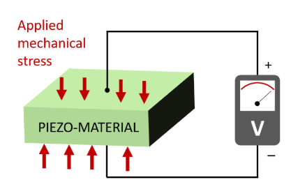
THEORY ON PIEZO ELECTRIC MATERIAL.
SMART MATERIAL → SMART SYSTEM
Material: Piezo electric
Stressed → generation of voltage
Pros:
Effective,
Simple,
Low cost.
Notes:
Ra

Slide 9
THEORY ON VIBRATIONS AND RESONANCE
We exploit vibrations, particularly the resonance, to maximise the piezo's use.
RESONANCE
dynamic amplification of motion
VIBRATION
Motion of particles caused by a wave.
Notes:
Ra

Slide 10
STEP 1
Eigenfrequency, coupling and damping modal parameters
Notes:
Annika

Slide 11
ASSUMPTIONS
MATERIAL PROPERTIES
ELECTRICAL CHARACTERISTICS
Homogeneous material
Resistive load
Reduction of the load
Reduction of the mechanical dumping (motion)
Lower output voltage
Mechanical and electrical properties uniformly distributed
Notes:
Annika
Homogeneous material = mechanical and electrical properties uniformly distributed

Slide 12
ASSUMPTIONS
MATERIAL PROPERTIES
ELECTRICAL CHARACTERISTICS
Reduction of the load
Reduction of the mechanical damping (motion)
Lower output voltage
Mechanical and electrical properties uniformly distributed
Notes:
Annika
Homogeneous material = mechanical and electrical properties uniformly distributed

Slide 13




GOAL
$$ω_{i}$$
$$k_{i}$$
$$R_{i}$$
Write the TF
$$\frac{\overline{V}}{F}=f(ω_{i}, k_{i}, R_{L})$$
Choose the mode with the k highest value
Maximise power
Notes:
Annika
Homogeneous material = mechanical and electrical properties uniformly distributed

Slide 14

TRANSFER FUNCTION
Express the voltage as a function of the external force
$$\frac{\overline{V}}{F}=f(ω_{i}, k_{i}, R_{L})$$
Assumption: the harvester is designed to have the maximum amplitude where the force is applied, i.e. $ω \sim ω_{i}$
We excite the structure at its resonance
Notes:
Annika

Slide 15

TRANSFER FUNCTION
DIFFERENTIAL EQUATION
$$\ddot{q_{i}}+2ξ_{i}ω_{i}\dot{q_{i}}+ω_{i}^{2}q_{i}−ω_{i}k_{i}\overline{V}=F_{i}$$
External force
Acceleration term
Damping term
Elastic restoring force
Electromechanical coupling term
Notes:
Annika

Slide 16

TRANSFER FUNCTION
$\left\{\begin{aligned}\ddot{q_{i}}+2ξ_{i}ω_{i}\dot{q_{i}}+ω_{i}^{2}q_{i}−ω_{i}k_{i}\overline{V}=F_{i} \\ \overline{V} −\overline{Q}+ω_{i}k_{i}q_{i}=0 \end{aligned}\right.$
$$⇓$$
$$\frac{\overline{V}}{F}=−\frac{iτww_{i}k}{ω_{i}^{2}−ω^{2}−2ξ_{i}ω_{i}ω^{2}τ+i\left(2ξ_{i}ω_{i}ω+ω_{i}^{2}ωτ−τω^{3}+ω_{i}^{2}ωk^{2}τ\right)}$$
$$τ=−R_{L}C_{pi}$$
Notes:
Annika

Slide 17

MAXIMISE COUPLING
Capability of transforming the applied mechanical into electrical energy
The values can be up to$k_{i}=0.3$
Steps:
Identify the coupling for different modes
Choose the highest value of the coupling, to get the mode we should work at
Notes:
Annika
Ideally, a good value for k_max is 0.3

Slide 18
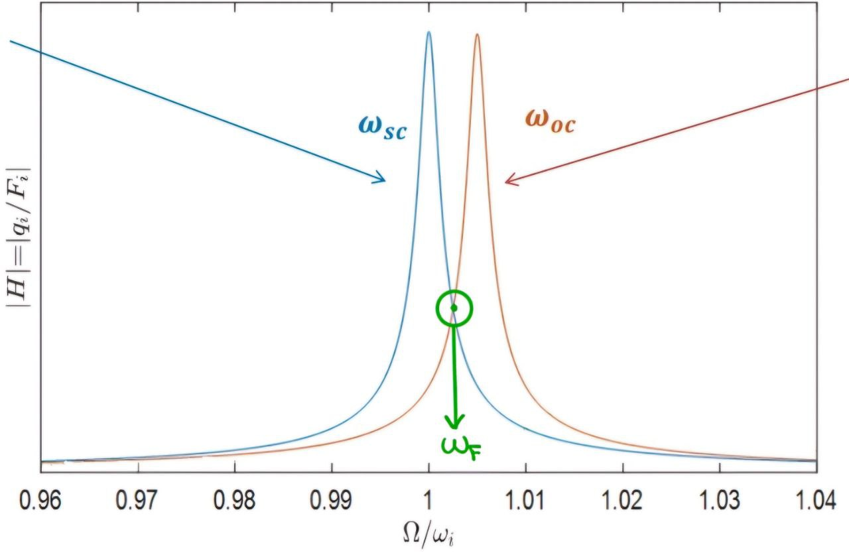

MAXIMISE COUPLING
Find the excitation frequency of the first mode both in open circuit and short circuit.
$$k_{i}= \sqrt{\frac{ω_{oc}^{2} −ω_{sc}^{2}}{ω_{i}^{2}}}$$
Notes:
Annika
Ideally, a good value for k_max is 0.3

Slide 19



OPTIMAL RESISTANCE AND POWER
Maximise the power choosing conveniently the resistance
$$P=\frac{{\overline{V}}^{2}}{F^{2}R_{i}}$$
$Re(P)$ stored energy
$Im\left(P\right)$ reactive power
In the end we want to find
$$max⁡(Re\left(P\left(ω_{i}, k_{i}\right)\right))$$
Notes:
Annika
Reactuve power flows back and forth in the structure
We leave k_i and w_i parametric in the code. Or we can fix wi and leave ki the only parametric value

Slide 20
STEP 2
Electric circuit for switching on the LED
Notes:
dan

Slide 21
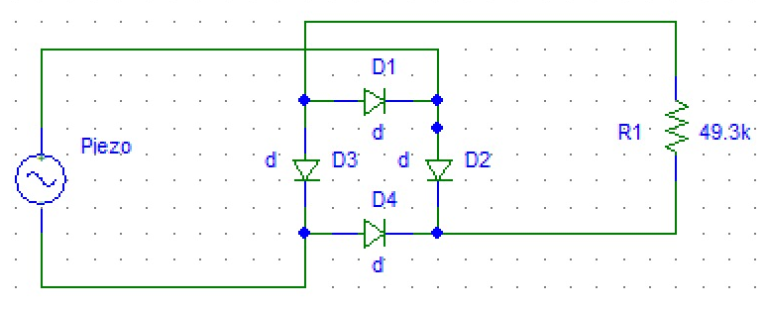
ELECTRIC CIRCUIT FOR SWITCHING ON THE LED
In the circuit we have 3 main components:
the voltage source that is the piezoelectric material;
a rectifier done with 4 silicon diodes;
a 49.3 kΩ resistance.
Notes:
Dan

Slide 22
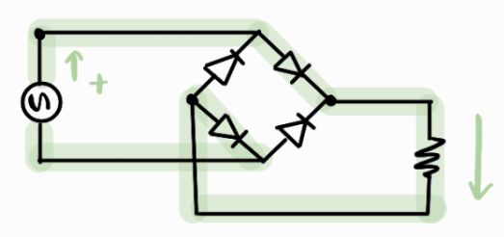
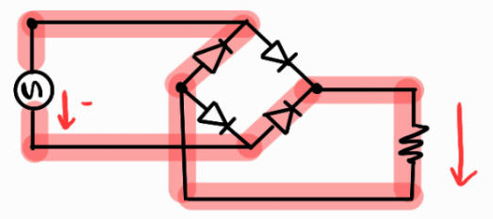
RECTIFICATION
Get always a positive voltage from sinusoidal source.
Independently from how the current flows, we always get a positive output.
Notes:
Dan

Slide 23
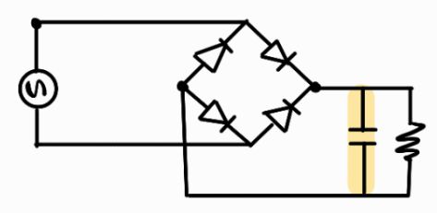
OSCILLATORY SMOOTHING
We could have also added a capacitance to our circuit.
Capacitance stores energy and reduces the oscillatory behaviour of the voltage.
Notes:
Dan

Slide 24
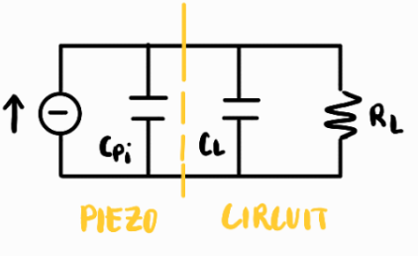

CAPACITANCE ISSUE
To compute the coupling:
$$k=\frac{χi}{w_{i}\sqrt{C_{pi}}}$$
We have to consider that coupling is reduced by adding a capacitance.
Notes:
Dan

Slide 25
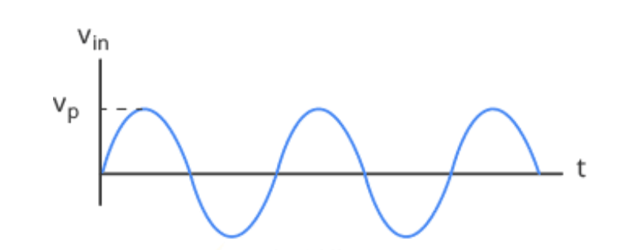
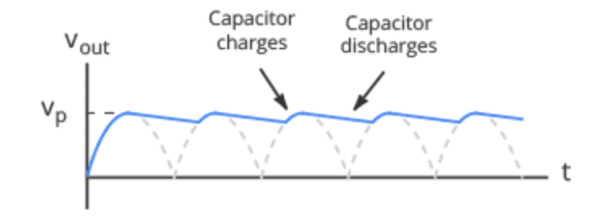
CIRCUIT BEHAVIOR
Voltage behaviour before the rectifier.
Voltage behaviour after the rectifier (dashed line) and the capacitor (blue line).
Notes:
Dan

Slide 26
CIRCUIT BEHAVIOR
At first we supposed to introduce a small capacitance to retrieve a constant output.
However, we did not used it. The output voltage is the dashed line of the rectifier voltage profile.
Notes:
Dan

Slide 27
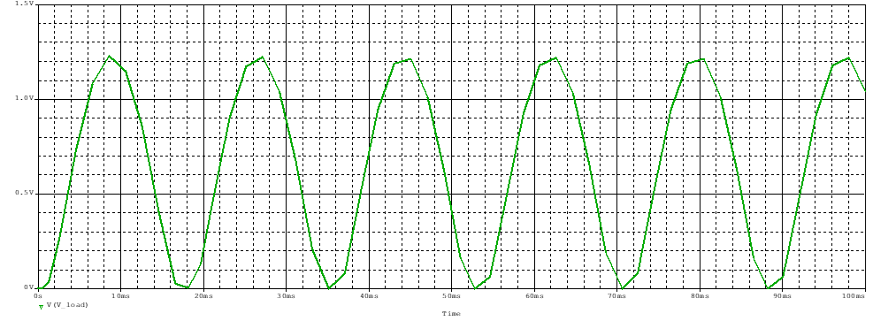
CIRCUIT TEST
We have tested the rectifier behaviour on Pspice with a 2 Volt sinusoidal input. It is clear by the image that the signal is now a positive only wave.
Notes:
Dan
For Schottky diodes, this value would be lower (0.2−0.4). This is what we had in the simulator
We use silicon diodes.

Slide 28

RECTIFIER LOSSES
We can consider 2 equations:
In (1) we can see what we can expect ideally by the rectifier, but this is not for practical implementations;
In (2) we can see the voltage drop for 2 diodes.
We can take into account (2), so we expect to have 1.4 V drop given only by the rectifier.
$$V=0.637 V_{MAX} (1)$$
$$V_{D_{drop}}=0.7 V$$
$$V_{D_{drop}}=2V_{D_{drop}}=1.4 V (2)$$
Notes:
Dan
2/pi = $0.637$

Slide 29
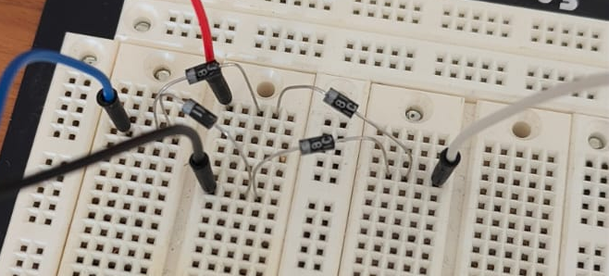
REAL CIRCUIT
DIODE BRIDGE
This is the circuit we realize on the breadboard.
This was the easiest way to create experimentally our circuit and changing configurations fast.
Notes:
Dan fino qua

Slide 30
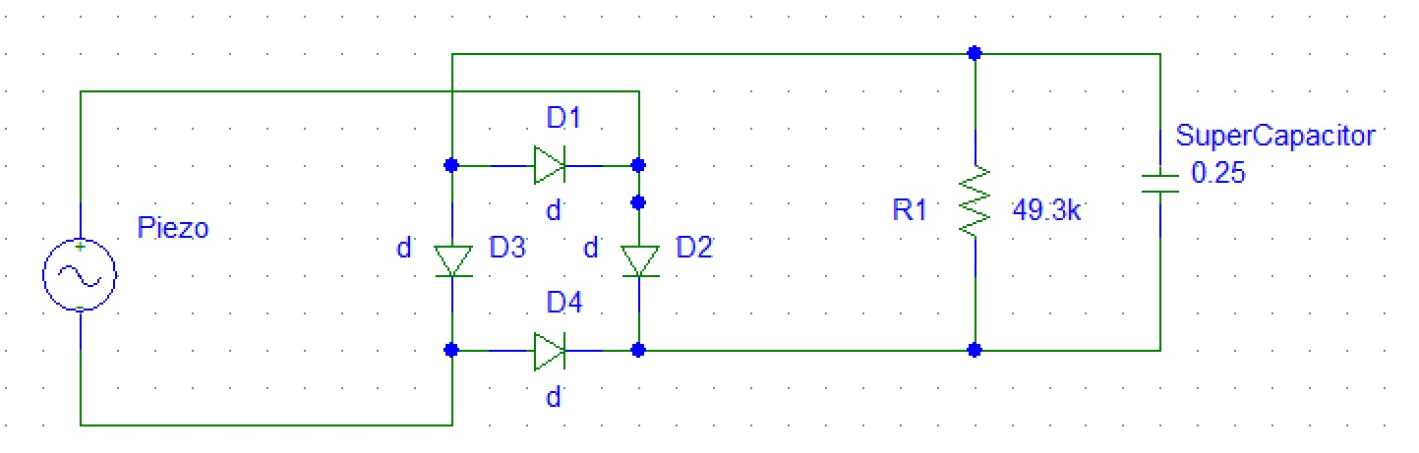
CIRCUIT WITH SUPER CAPACITOR
For the additional goal, we added a supercapacitor of 0.25F, to store the energy from the piezo.
Notes:
Dan

Slide 31
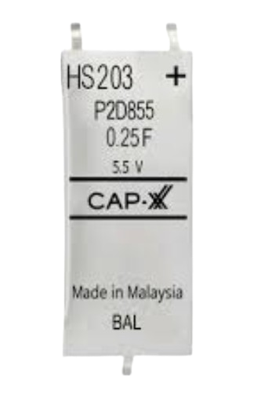
SUPERCAPACITOR vs BATTERY
We decided in favour of the supercapacitor because of three main factors:
High power density;
Fast charging/discharging;
Long lifecycle.
Notes:
Dan

Slide 32
STEP 3
Ensure that the goal is achieved
Notes:
Vale

Slide 33
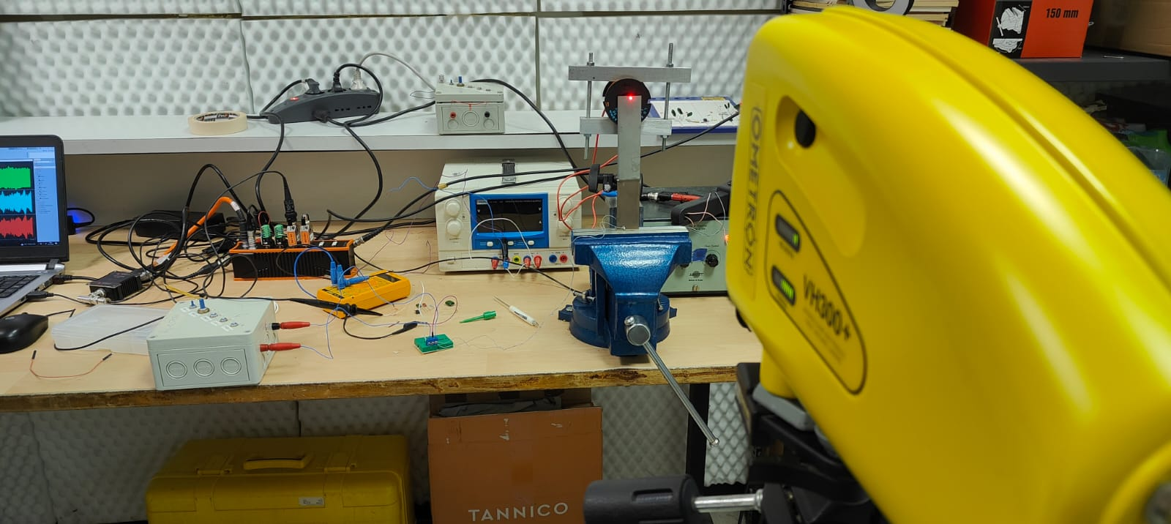
EXPERIMENTAL SETTING
Notes:
Vale

Slide 34
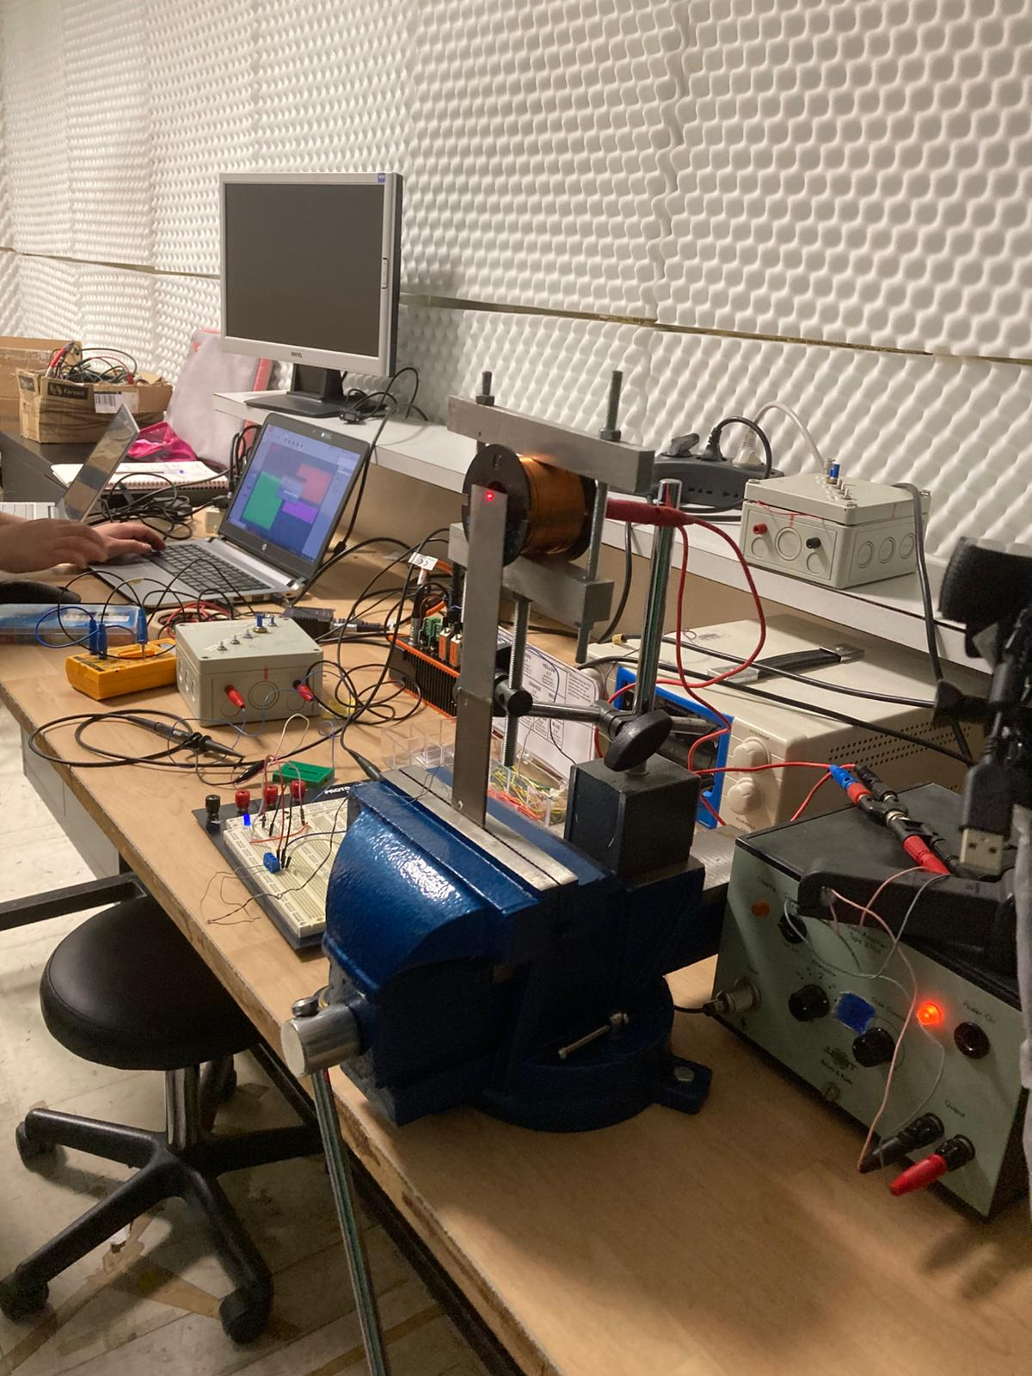
EXPERIMENTAL SETTING
PIEZO PATCH
DEWESOFT
BOARD
LASER
GAIN
CLAMP
POTENTIOMETER
Notes:
Vale

Slide 35
EXPERIMENTAL SETTING
DEWESOFT
Software used to acquire data from the piezo, such as the FRF and the modes, while running the necessary experiments.
Notes:
Vale

Slide 36
EXPERIMENTAL SETTING
POTENTIOMETER
Tunable resistance, used as the load for our circuit.
Notes:
Vale

Slide 37
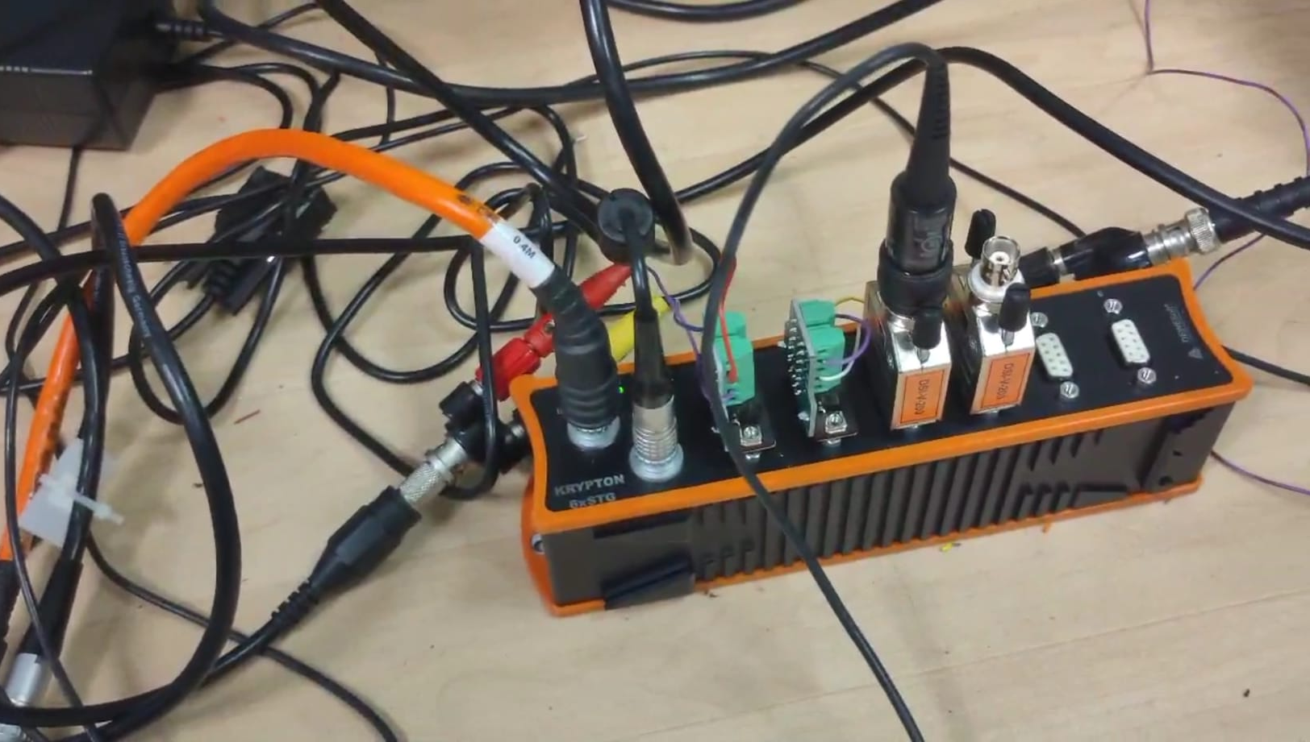
EXPERIMENTAL SETTING
BOARD
Platform used to collect all the
inputs that needed to be measured
by the Dewesoft software.
Notes:
Vale

Slide 38
EXPERIMENTAL SETTING
LASER
System used to capture the oscillations of the piezo without contact.
It points at the extreme part of the piezo
It is centered on the principal symmetry axis
It requires focus tuning
Notes:
Vale
On the principal symmetry axis only the bending motion is recorded
Perché focus tuning è richiesto da sapere

Slide 39
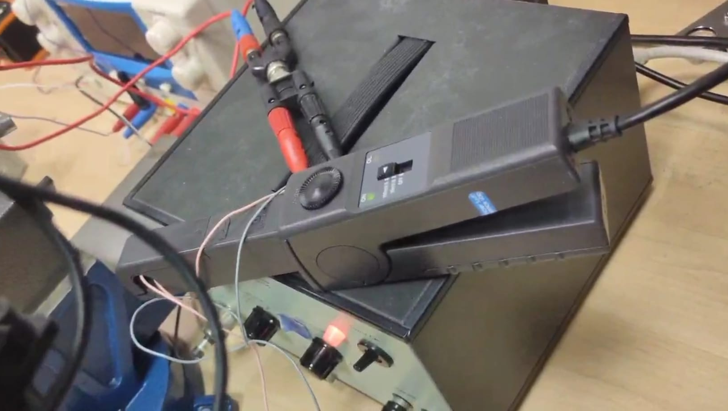
EXPERIMENTAL SETTING
CLAMP
Tool used to sense the current, by means of a coil inside it, and convert it into a readable electrical signal, with the desired sensitivity.
Notes:
Vale
C’era un discorso da fare sul voltaggio che andava diviso /2.. Boh! E chi se lo ricorda…

Slide 40
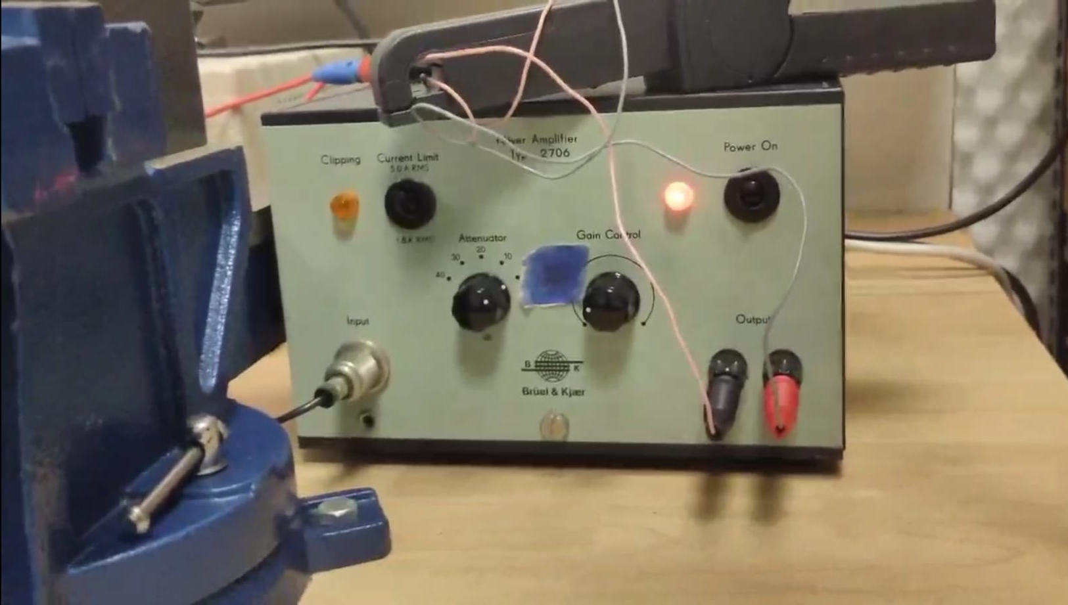
EXPERIMENTAL SETTING
GAIN
Tool used to modulate the intensity of the piezo oscillations.
Notes:
Vale
C’era un discorso da fare sul voltaggio che andava diviso /2.. Boh!

Slide 41
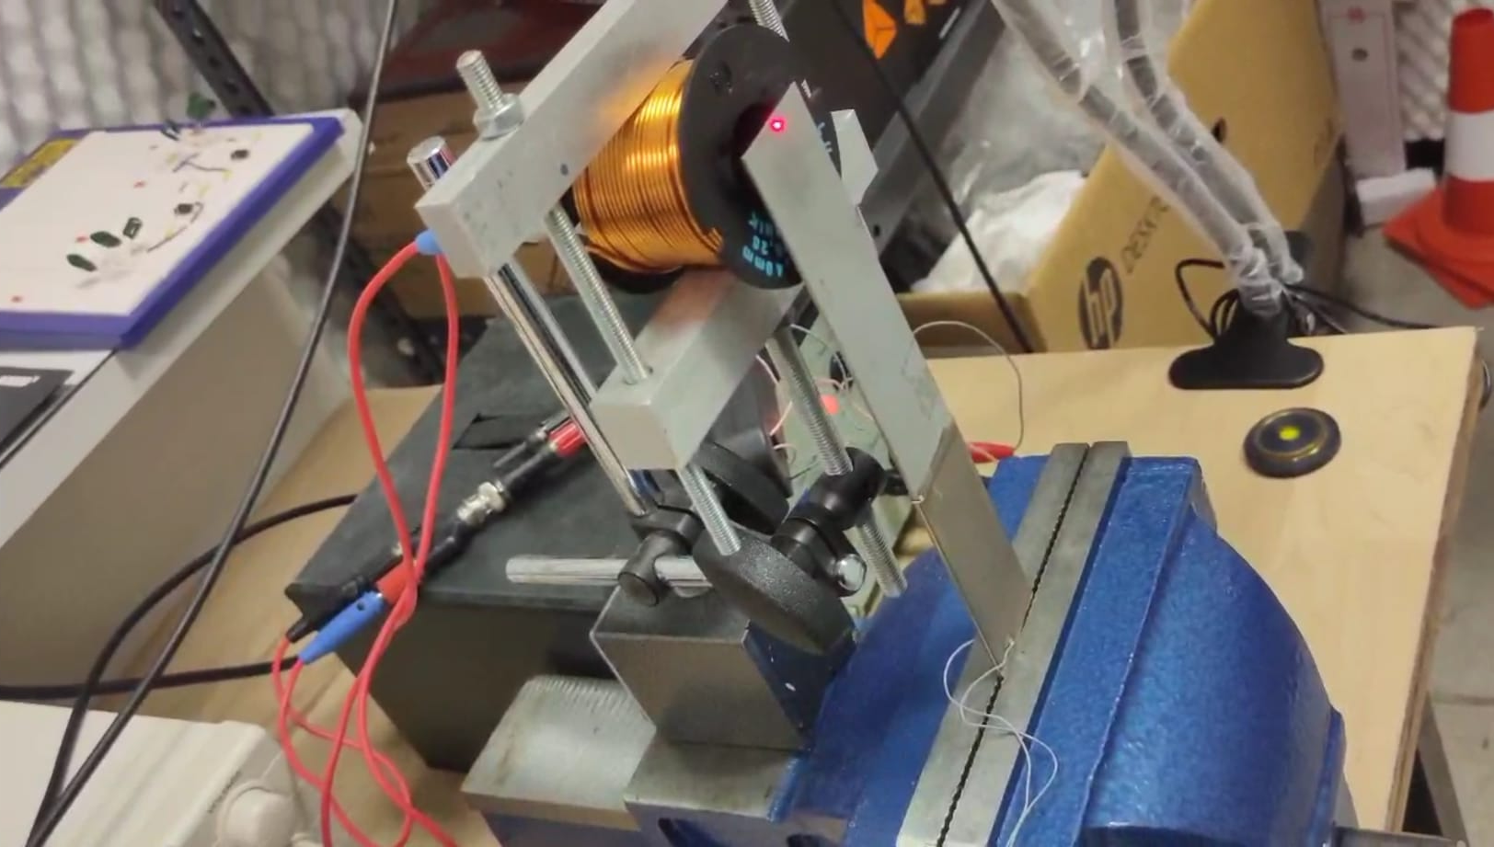
EXPERIMENTAL SETTING
PIEZOELECTRIC TRANSDUCERS
Two piezoelectric patches bonded on a vibratic mechanical system, which is excited by external forces.
Notes:
Vale

Slide 42
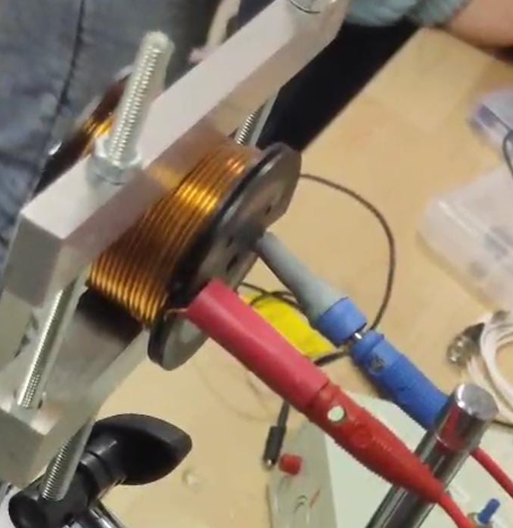
EXPERIMENTAL SETTING
COIL
System deployed to excite the vibrating mechanical structure without direct contact
Notes:
Vale

Slide 43
EXPERIMENTAL SETTING
EXCITATION METHOD
A magnet is placed on the piezo, centered on its principal symmetry axis
The magnet is manually moved at center of the coil
AC signal passes through the coil
Notes:
Vale

Slide 44
EXPERIMENTAL SETTING
For Ampere law, an alternating magnetic field is generated in the coil
The magnet is periodically attracted and rejected by the magnetic field
The mechanical system oscillates and the piezo patches deform, thus generating and electric charge
Notes:
Vale
The cantilever generates vibration through magnetic coupling between the magnets at its free end and an alternating magnetic field adjacent to the power line. This mechanism ensures minimal frequency fluctuation and provides a stable power output for the nearby wireless sensor nodes.
vale fino a qua

Slide 45
FRF AND MODES
As said before, we want to evaluate our FRF in both short and open circuit to retrieve the frequency of the first mode.
This way we can choose the optimal load accordingly
The modes are the natural frequencies of the system. We concentrate on the first one, as it is the fastest and the strongest one.
Notes:
Alvin
I modi sono le natural frequencies del sistema (utile per la risonanza)

Slide 46
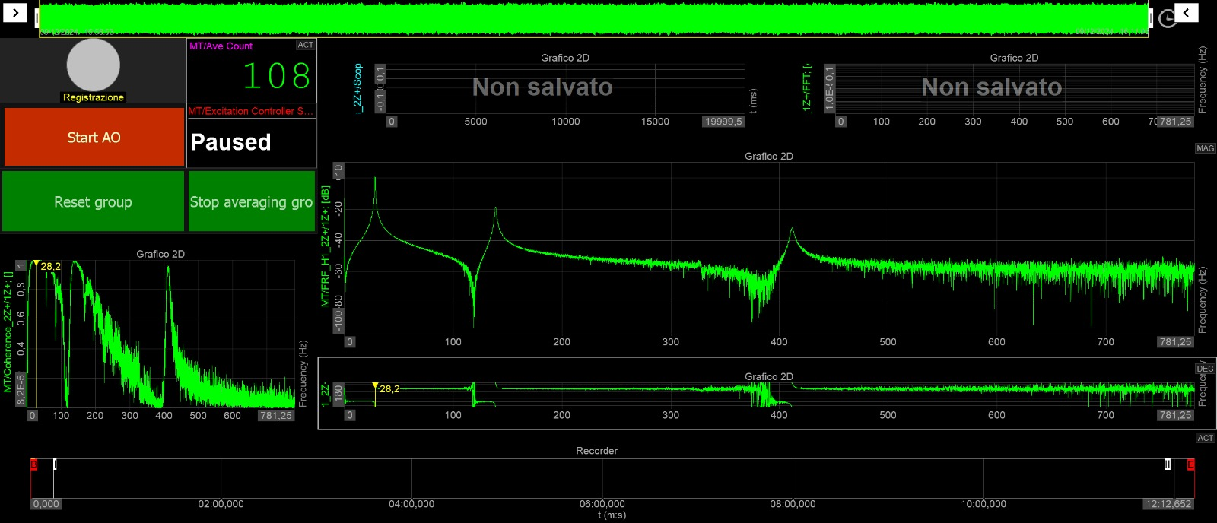
FRF AND MODES
SHORT CIRCUIT: the first mode has an excitation frequency of 28.163 Hz,
which is rounded to 28.2 Hz in the graph by the software, and a damping ratio of 0.0066.
Notes:
Alvin

Slide 47
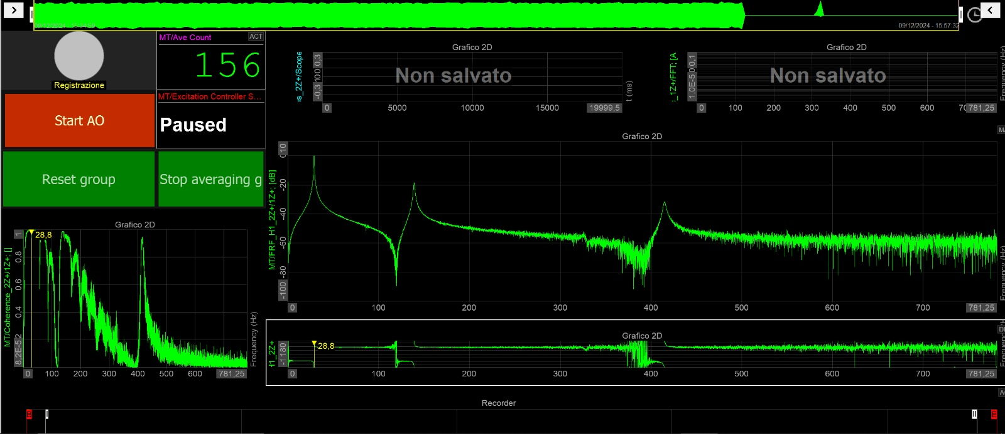
FRF AND MODES
OPEN CIRCUIT: the first mode has an excitation frequency of 28.765 Hz,
which is rounded to 28.8 Hz in the graph by the software, and a damping ratio of 0.0056.
Notes:
Alvin

Slide 48
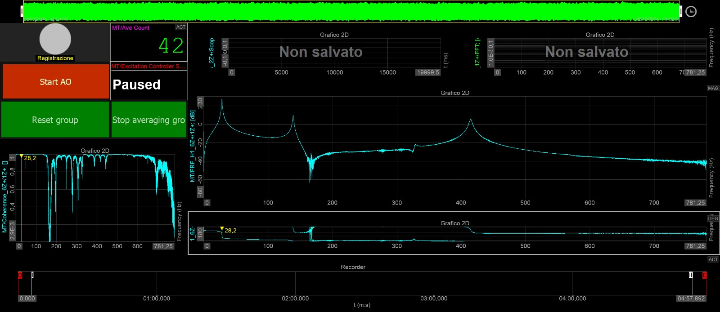
FRF AND MODES
RESISTIVE LOAD: as shown in the circuit, we put a resistor of 49.3kΩ as
the optimal load for our circuit. The excitation frequency was set to 28.23Hz.
Notes:
Alvin

Slide 49

EXPERIMENTAL PARAMETERS
 | $$ω_{1}$$ | $$R_{L_{1}}$$ | $$k_{1}$$
OPEN CIRCUIT | 28.786 Hz | $$∞$$ | /
SHORT CIRCUIT | 28.163 Hz | $$\sim 0$$ | /
OPTIMAL LOAD | 28.23 Hz | 49.3 kΩ | 0.2115
Notes:
Alvin
We consider only the first mode, as it is the one for which we have more power (it is the strongest one)
We are not interested in the copuling for open and short circuit

Slide 50

EXPERIMENTS RESULT
The LED is successfully charged with the energy harvested by the piezo!
The LED blinks as we do not have either a battery or a capacitor where the energy is stored. Thus, the light changes according to the sinusoidal input.
Notes:
Alvin

Slide 51
EXPERIMENTS RESULT
We chose a blue LED with the following characteristics
3.4 V voltage drop
20/30 mA to turn on the LED
But other colours have lower voltage drop, requiring less voltage
Notes:
Alvin

Slide 52
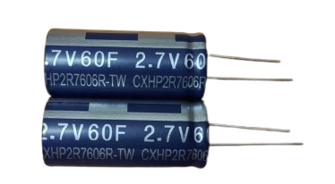
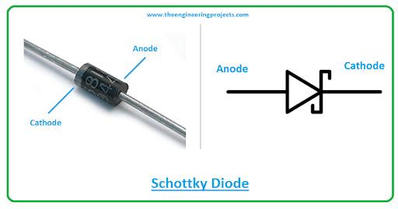
FUTURE IMPROVEMENTS
It is possible to add a bigger supercapacitor to store more energy.
It requires an inductor, to adjust the resonant frequency to match the natural frequency of the vibrations.
It is also possible to use Schottky diodes for a reduced drop of voltage.
Notes:
Alvin
It is important for impedance matching and resonant frequency tuning, which maximizes the energy harvested
By adding an inductor in series or parallel with the piezoelectric transducer, you can adjust the resonant frequency of the circuit to match the natural frequency of the mechanical vibrations. This is important for impedance matching and resonant frequency tuning, which maximizes the energy harvested

Slide 53
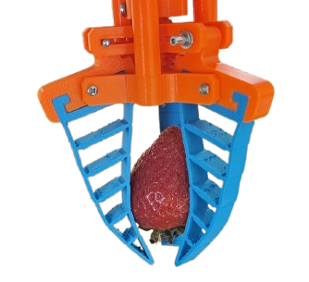
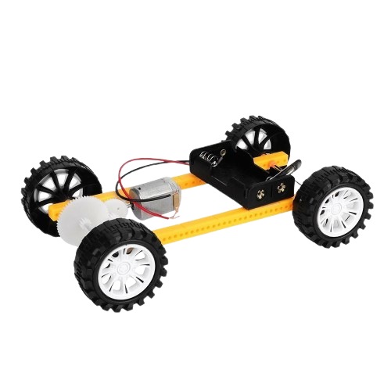
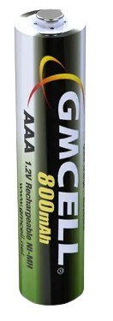
FUTURE IMPROVEMENTS
Once the energy is correctly stored, we can use it to power several objects
We can also add a battery to store energy, by adding capacitances to charge the battery
Notes:
Alvin

Slide 54
BIBLIOGRAPHY
Course slides
https://www.slideshare.net/slideshow/biot-savart-law-amp-amperes-law/70405242
https://etechsparks.com/full-wave-and-half-wave-rectifier-with-filter/
https://ietresearch.onlinelibrary.wiley.com/doi/full/10.1049/iet-cds.2018.5069
https://www.autodesk.com/products/fusion-360/blog/schottky-diodes/
Software:
PSPICE software
Matlab software
DewesoftX software

Slide 55
THANK YOU FOR
THE ATTENTION!

