Slide 1
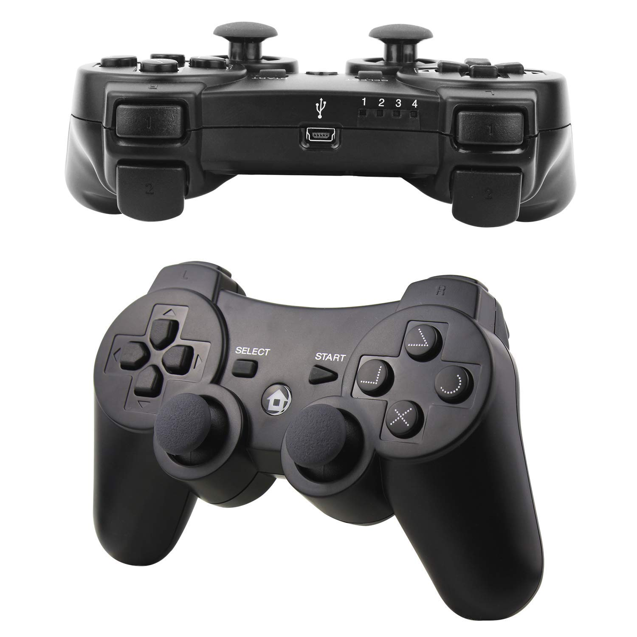

Slide 2
DRIVER
Retract hook, lift robot –
Left Front Button
Deploy hook – Right front button
Right Pivot – Right front trigger
Pivot left - Left front trigger
Limelight driving - Tringle
Deploy hook - Circle
Intake Arm up – X
Right Joystick 2 Turn
Left Joystick 1 Speed

Slide 3
OPERATOR
Intake / Lower arm –
Left Front Button
Shooter– Right front button
Transfer to shooter –
Right front trigger
Transfer stuck - Left front trigger
Control Panel 3 turns - Tringle
Climb motor- Circle
Left Joystick button
Push down for low
target
Control Panel Color Match - Square
Intake Arm up – X
Climb motor - Left Joystick 1

Slide 4
Button 4
Button 5
Button 6
Button 7
Button 0
Button 1
Button 3
Left Joystick 0
Right Joystick 2
Button 2
Left Joystick 1
Right Joystick 4

Slide 5
DRIVER
Retract hook, lift robot –
Left Front Button
Deploy hook – Right front button
Right Pivot – Right front trigger
Pivot left - Left front trigger
Limelight driving - Tringle
Deploy hook - Circle
Intake Arm up – X
Right Joystick 2 Turn
Left Joystick 1 Speed

Slide 6
OPERATOR
Intake / Lower arm –
Left Front Button
Shooter– Right front button
Transfer to shooter –
Right front trigger
Transfer stuck - Left front trigger
Control Panel 3 turns - Tringle
Climb motor- Circle
Left Joystick button
Push down for low
target
Control Panel Color Match - Square
Intake Arm up – X
Climb motor - Left Joystick 1

