Slide 1
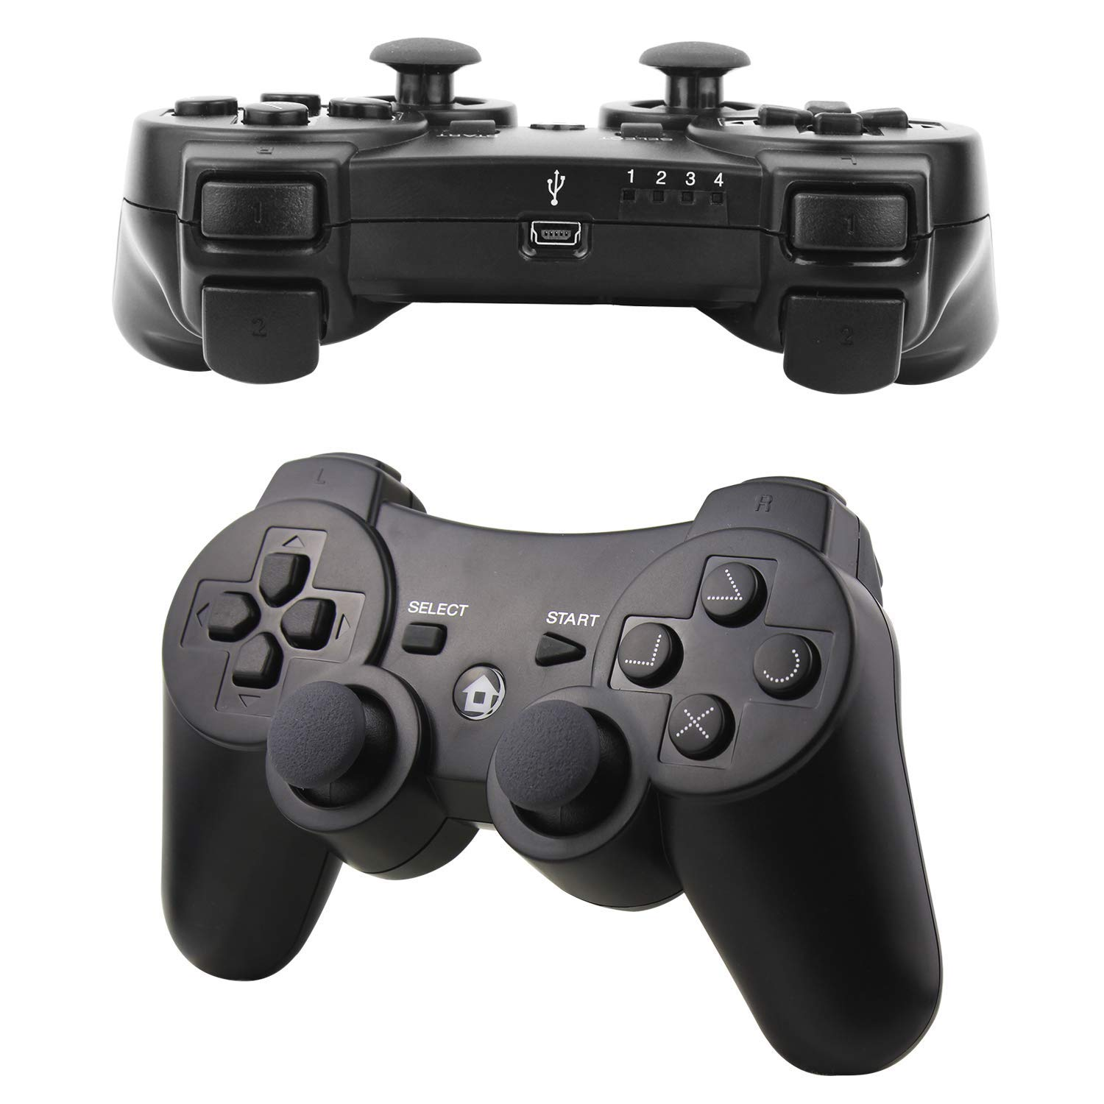

Slide 2
DRIVING OPERATOR
Button 5 Climb Front Push Down
Button 4 Climb Front Push Up
Button 7 Right Pivot
Button 6 Left Pivot
Button 0 Quick Turn
Button 1 Hatch Mover Extend
Button 2 Hatch Mover Retract
Right Joystick 2 Turn
Left Joystick 1 Speed

Slide 3
GAME OPERATOR
Button 4 Cargo Hold
Button 5 Hatch Hold
Button 6 Cargo Release
Button 7 Hatch Release
Button 0 Level Up
Button 1 Climb Back Push Up
Button 3 Climb Back Push Down
Button 2 Level Down
Left Joystick 1
Elevator
Right Joystick 4
Extension

Slide 4
Button 4
Button 5
Button 6
Button 7
Button 0
Button 1
Button 3
Left Joystick 0
Right Joystick 2
Button 2
Left Joystick 1
Right Joystick 4

Slide 5
Button 4
Button 5
Button 6
Button 7
Button 0
Button 1
Button 3
Left Joystick 0
Right Joystick 2
Button 2
Left Joystick 1
Right Joystick 4

