Slide 1
Learning what airlines actually prefer
Every flight-plan revision records a choice the airline made — this
is what those choices reveal
EUROCONTROL Innovation Hub · Maastricht Upper Area Control Centre

Slide 2
The goal: proposals airlines will actually accept
01 A cheaper route is not enough — If the airline would not have chosen it, the proposal is ignored
02 The system must learn preference — Not just minimise fuel or time, but predict which route this airline would accept
03 Preference is learned, not assumed — From what airlines have actually chosen before, not from a cost formula
An ignored proposal channel is a channel that eventually gets switched off.

Slide 3
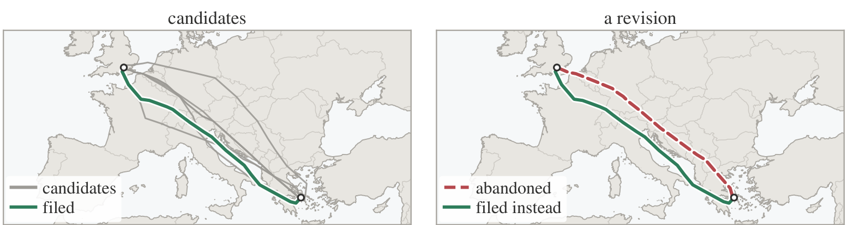
Pairs, not sets
Earlier work compared the filed route to a SET of generated alternatives. This work compares PAIRS from real revisions instead.

Slide 4
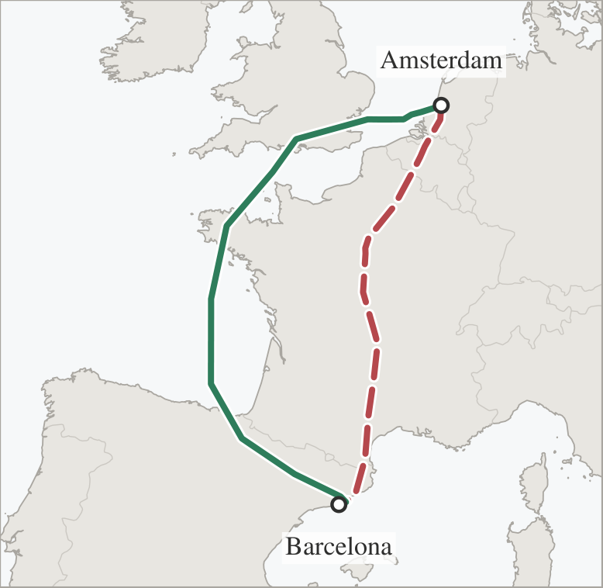
Every revision is a trade
Amsterdam → Barcelona: 39 extra minutes and 1.4 tonnes of fuel to avoid 102 minutes of network delay.

Slide 5
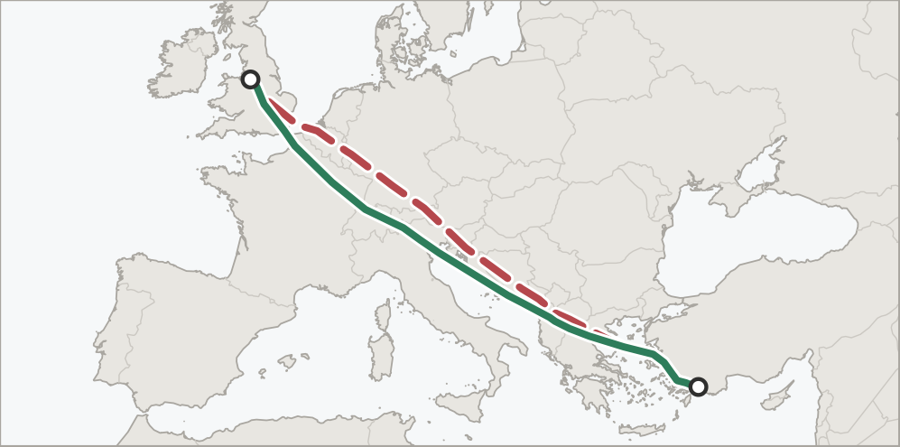
Not every revision is about delay
No regulation involved — the operator identified a cheaper route and filed it directly.

Slide 6
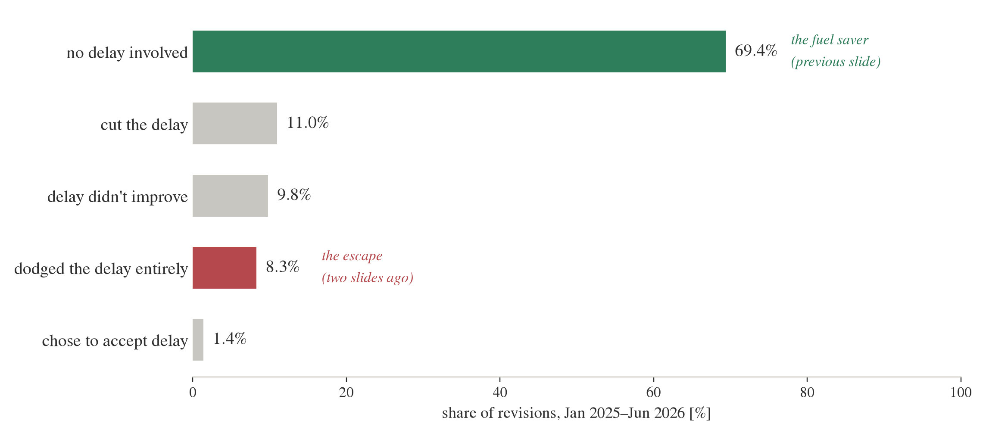
What the archive records
Most route changes are routine — not the dramatic cases just shown.

Slide 7
How a cost rule is tested
01 Take a held-out pair — Two real routes from one revision, never used to train anything
02 Apply the rule — For example, “prefer less fuel” — the rule always picks one of the two routes
03 Compare to what happened — Did the rule's pick match the route the airline actually filed?
04 Accuracy = share correct — Across all such pairs, “prefer less fuel” is right only 44.9% of the time
The same test, repeated for every rule in the next chart — only one beats a coin flip.

Slide 8
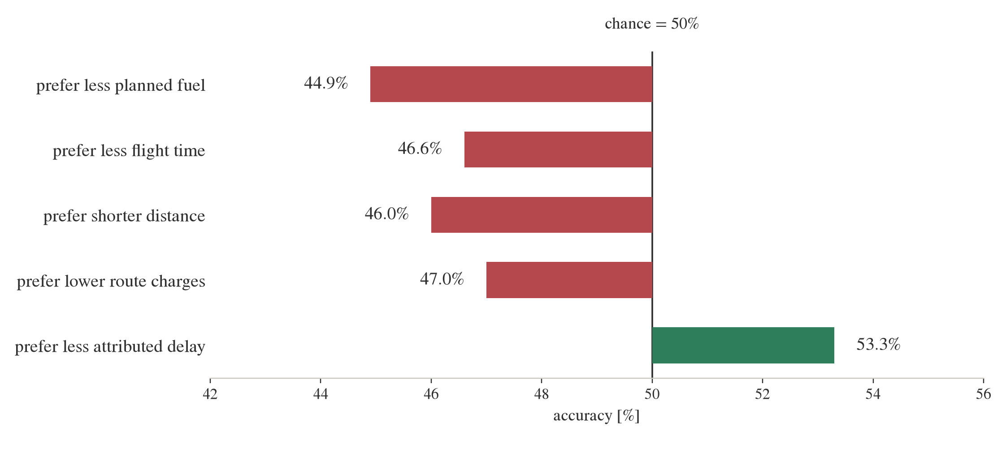
Cost rules score below chance
Simple cost rules all underperform a coin flip. Only “avoid delay” helps.

Slide 9
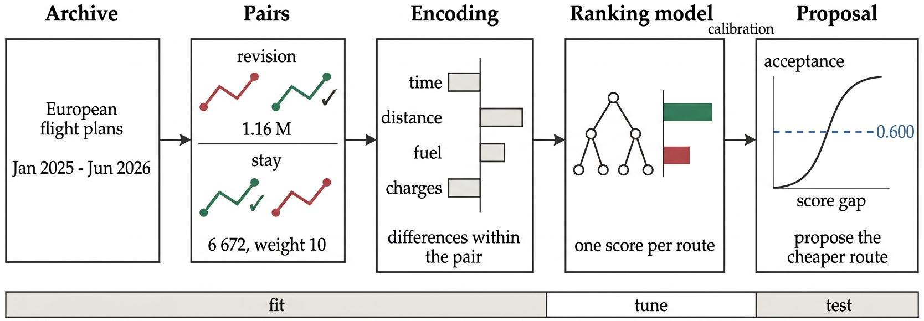
How it works, start to finish
Revisions and stay pairs both become training examples. The model learns the pattern and estimates its own confidence.

Slide 10
Two datasets, two questions
Revision pairs — 884,000 pairs
One flight refiles: it files route A, then switches to route B before departure. The pair is (A, B) — which did the airline pick?
Stay pairs — 6,672 pairs
Two flights, same day, same route choice. One was hit by a regulation, had a real alternative (its twin's route), and stayed. Pair: (kept, declined).
Both feed one model — stay pairs count 10× each to offset being 132× rarer, then held out to test the fix.

Slide 11
A stay pair, concretely
01 Two flights, same day, same city pair — Same origin, destination, and aircraft type — but different routes
02 One flight was delayed; its twin was not — The twin's route is a real, demonstrated alternative — flown that same day
03 The delayed flight kept its route anyway — Its route is labelled preferred; the twin's route is the declined alternative
04 This happened despite the cost — Across all 6,672 such pairs: median peak delay 31 minutes, and 47.5% kept the pricier route in fuel
Real evidence that operators value stability itself — exactly what an over-eager model would violate.

Slide 12
How the bias test works
01 Find two similar flights, same day — Same origin, destination, aircraft type — one delayed, one not
02 The delayed flight had a reason to move — Its twin's route was a real, demonstrated alternative — and it stayed anyway
03 Label “stayed” as the preferred route — Delay features are hidden, so route geometry alone must decide
04 Score it without seeing delay — Before this fix, the answer was 45.7% — worse than chance
This is the regulation-blind test behind the next chart — the fix raises this to 57.3%.

Slide 13
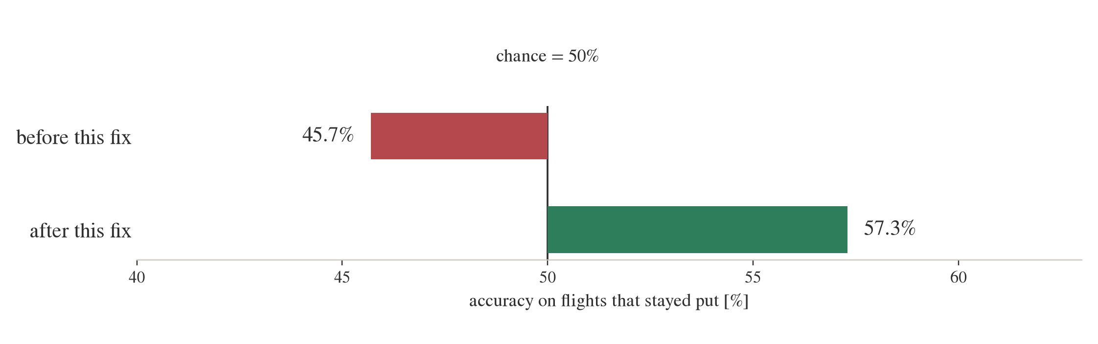
Correcting a bias toward change
With regulation clues hidden, route-only accuracy on stay pairs: 45.7% before correction, 57.3% after.

Slide 14
Why the model sees differences, not totals
01 Routes in different pairs vary hugely in scale — A short regional hop and a long intercontinental sector burn very different absolute fuel
02 So each indicator is rebased to its own pair — Subtract the pair's minimum from both routes — the cheaper one becomes 0
03 The model sees only the extra, not the total — 0 kg and 300 kg, not 2,000 kg and 2,300 kg — the gap that actually drove the choice
Skip this step, and the next chart shows exactly what it costs.

Slide 15
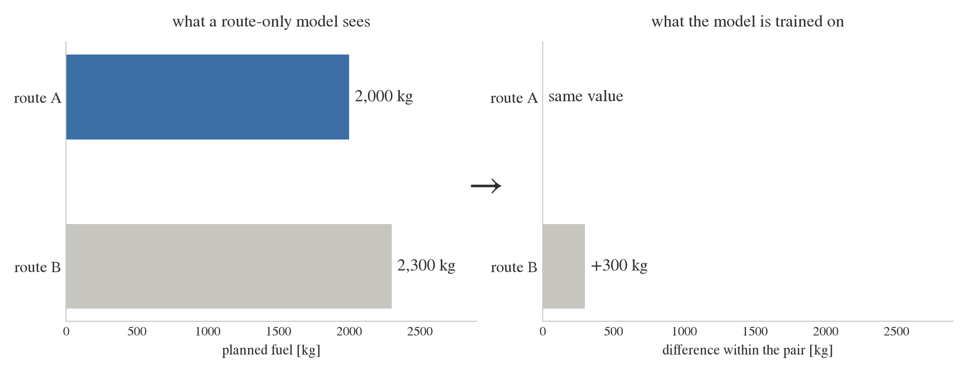
The one choice that changes everything
2,000 kg alone is meaningless; the 300 kg gap is everything. Drop it: accuracy falls to chance (60.6% → 50.8%).

Slide 16
How accuracy and confidence are measured
01 Score both routes in a held-out pair — Never used in training, tuning, or calibration
02 Correct = higher score matches the choice — Accuracy is this, averaged across all pairs: 68.3% overall
03 The score gap is a confidence signal — A bigger gap between the two scores means a more confident call
04 Coverage = share of cases answered — Answering only the surest fifth raises accuracy to 95%
The same measure drives both charts that follow.

Slide 17
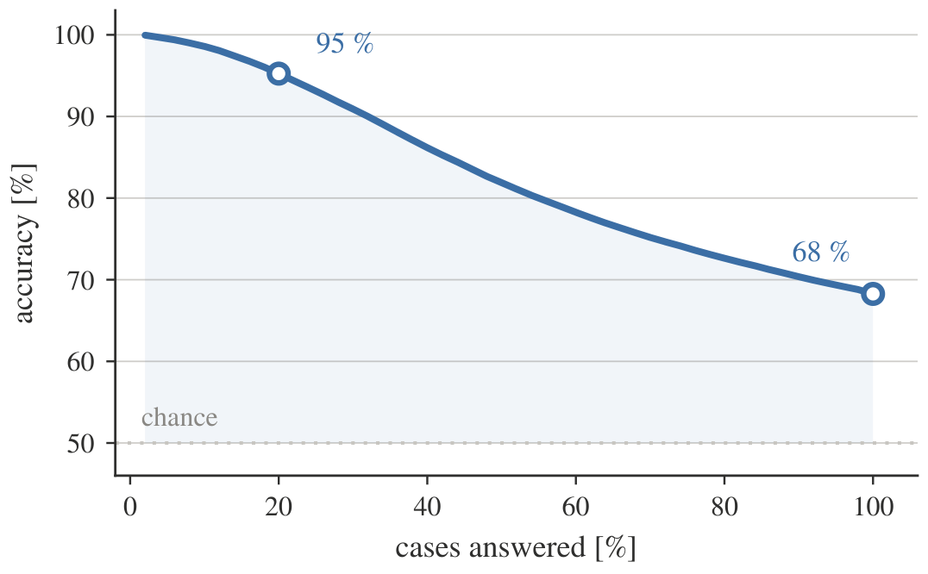
The headline, and the curve behind it
68.3% accuracy across all cases; 95% on the most confident fifth.

Slide 18
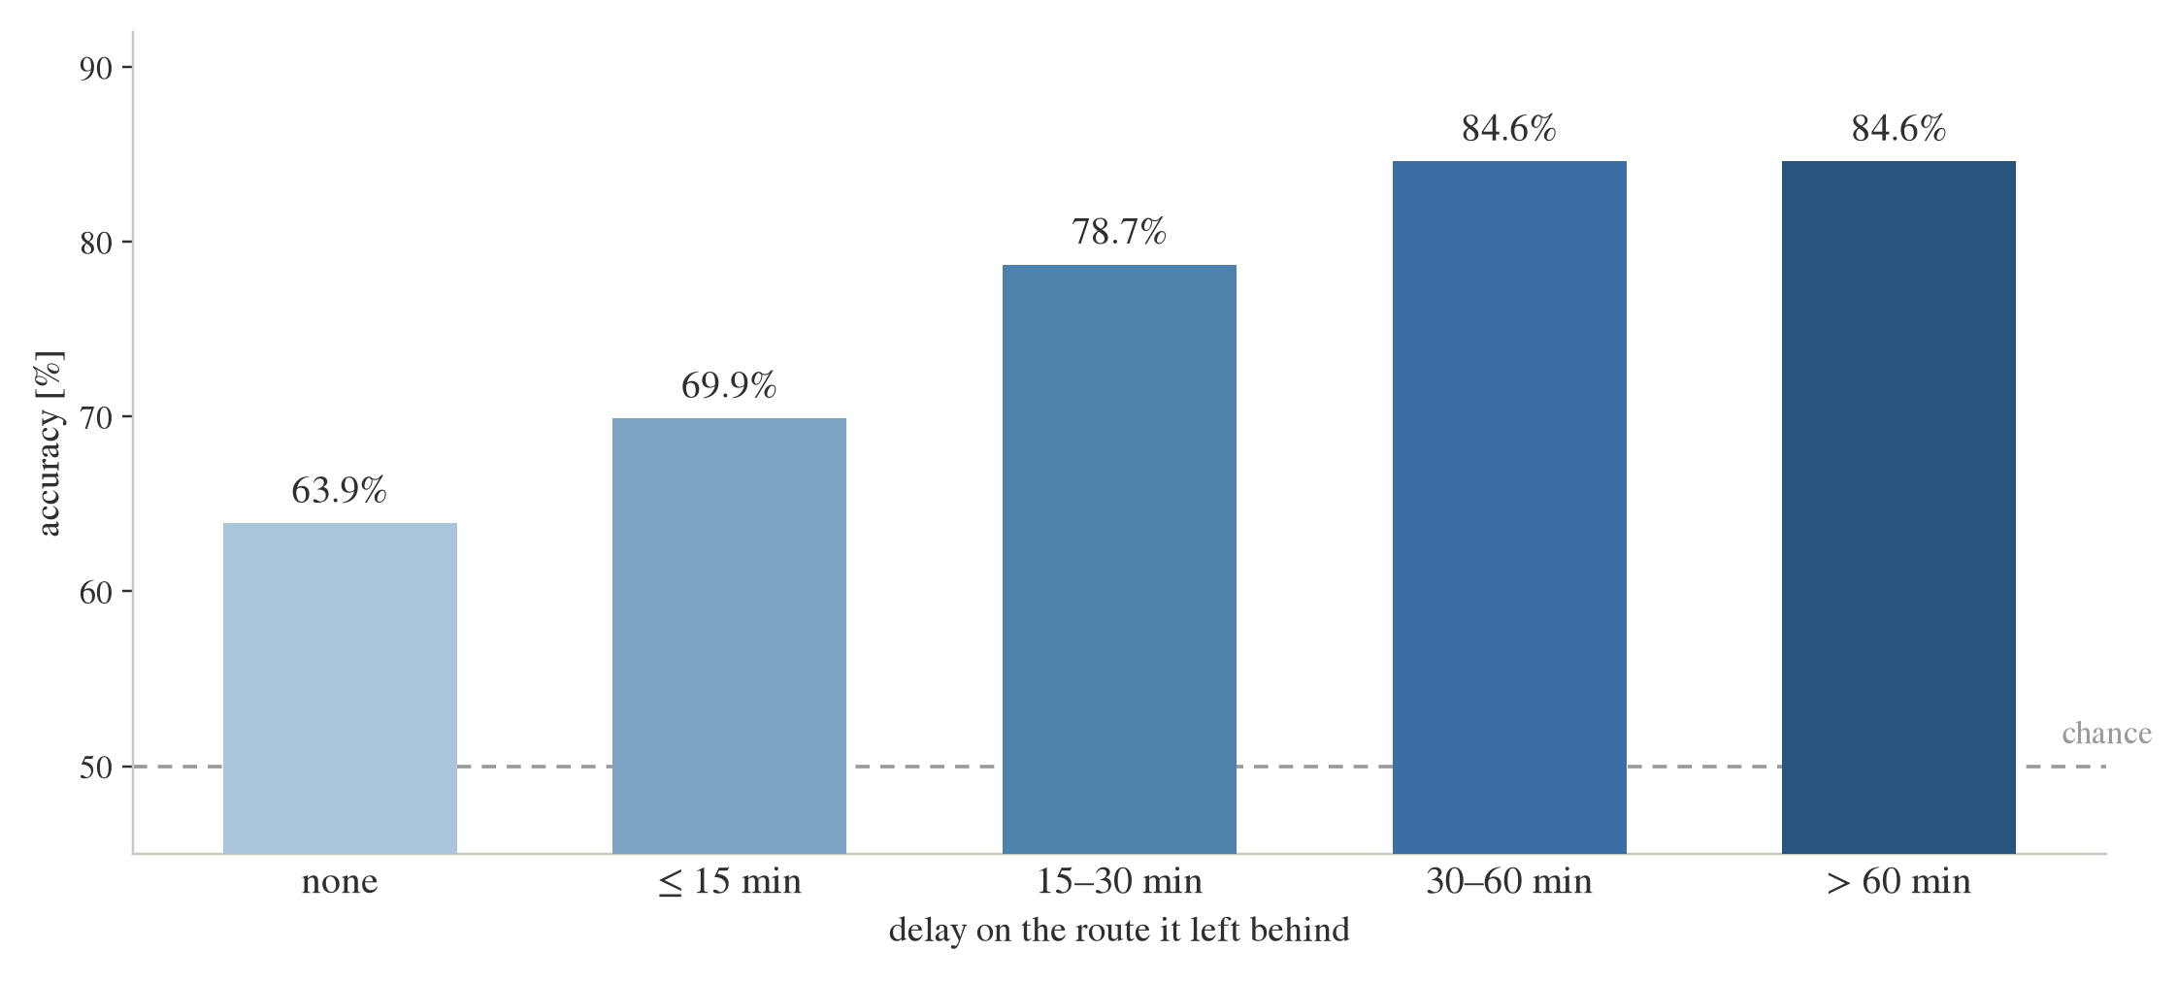
Where the accuracy lives
Accuracy rises with the delay being avoided — the larger the
incentive, the clearer the decision.

Slide 19
How feature importance is measured
01 Treat each input as a player in a game — Route, fuel, delay, distance, and every other feature
02 The payout is the model's score — For one specific route, on one specific decision
03 Add features one at a time, in random order — Measure how much the score moves each time one joins
04 Average that movement over the quarter — Each feature's fair share of the credit — route structure earns the most
This ranks what moves the score, not what an operator consciously weighs.

Slide 20
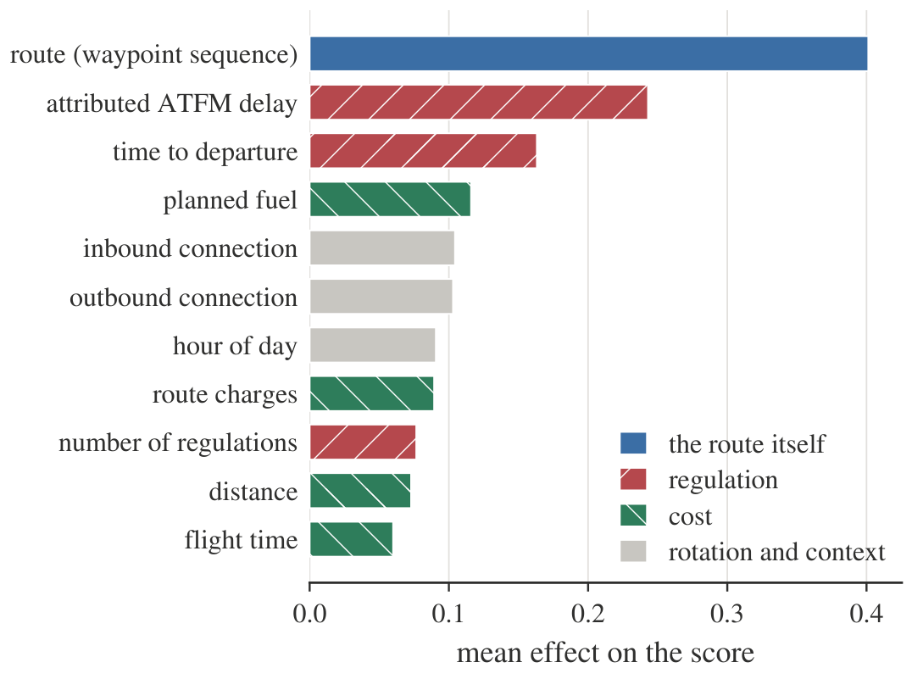
What drives the model’s decisions
Route structure carries more weight than any single cost
indicator — fuel, time, or distance.

Slide 21
How a score becomes a proposal
01 The model scores each candidate route — The alternative comes out +3.6 ahead — just the model's own number, not yet a percentage
02 History says how sure to be — Among past cases with a lead about this big, the airline picked the model's suggestion 8 times out of 10
03 Only propose if that clears the bar — The policy requires at least 6 of 10; 8 of 10 clears it, and it only counts as confirmed once the airline's later filing agrees
This is the policy behind every fuel figure in this talk.

Slide 22
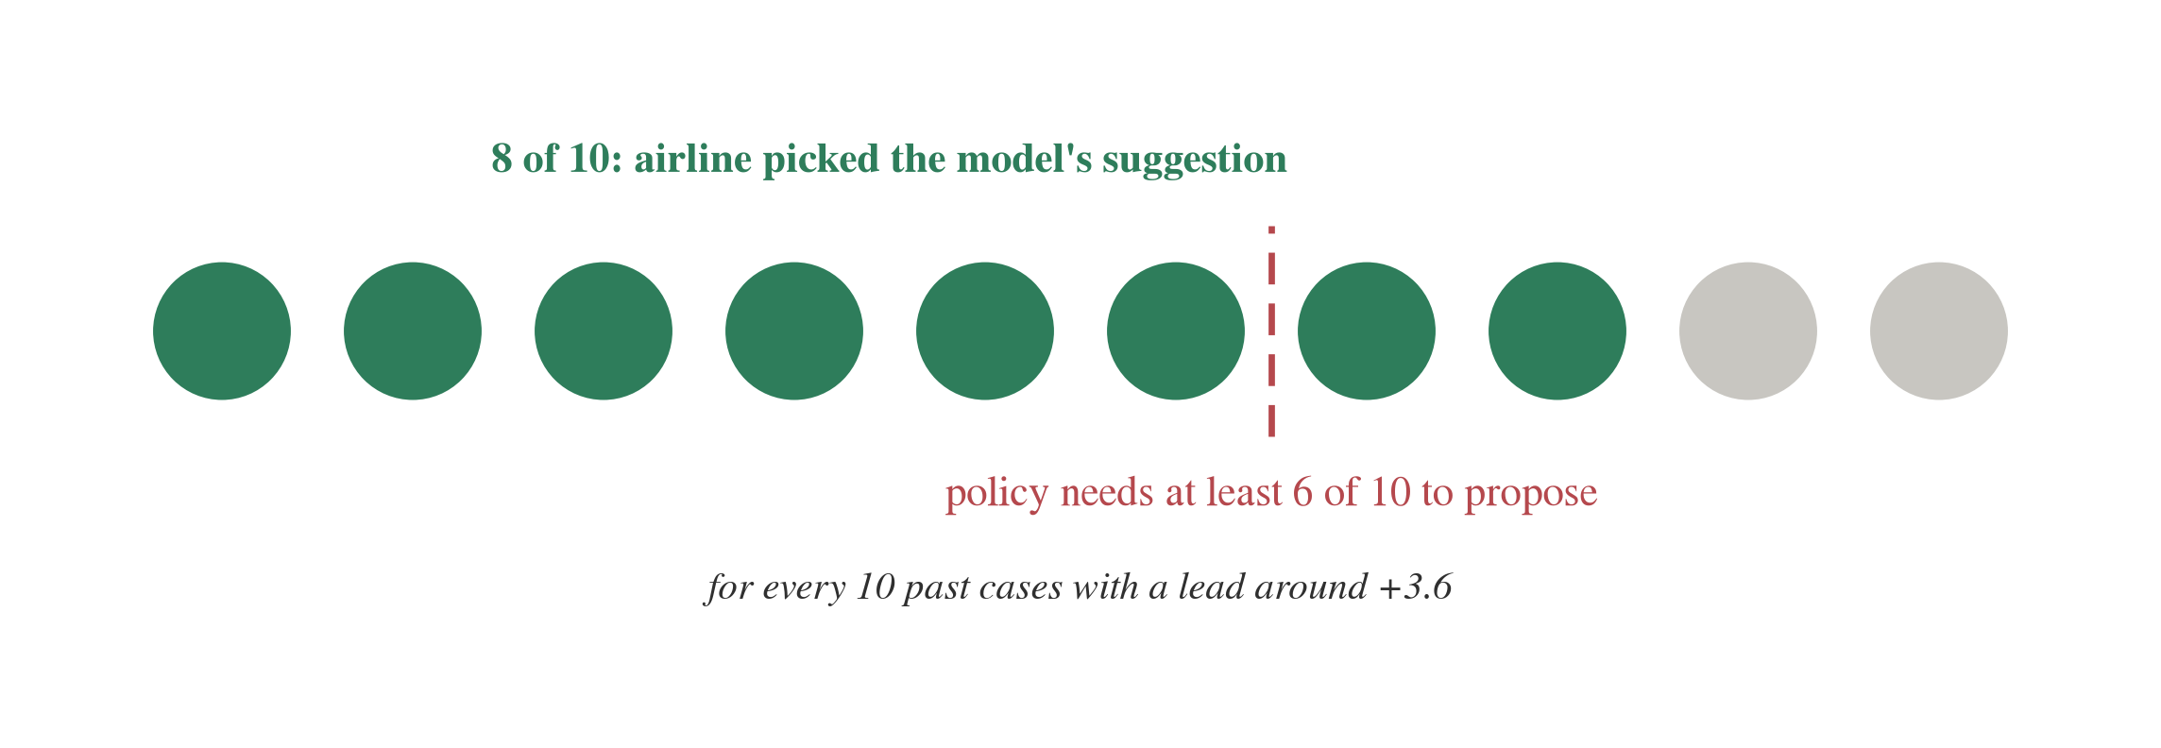
The count behind that probability
That's the whole mechanism — real past cases, counted, compared against the bar the policy requires.

Slide 23
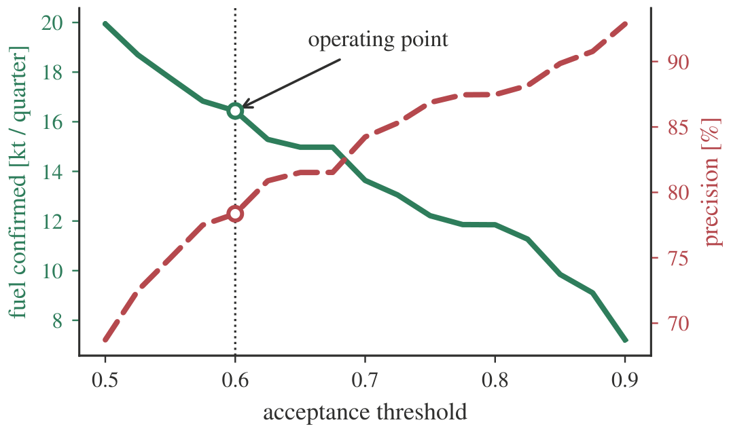
From a score to a decision
More confidence required means fewer suggestions but better precision. At this threshold: 16.4 kt fuel a quarter, ~200 kt CO₂/yr.

Slide 24
A proposal, concretely
01 Two candidate routes — Same airline, aircraft, and departure time — no delay involved
02 Comparison — One route burns 2,016 kg less fuel — roughly a fifth of trip fuel
03 Confidence check — This case clears the threshold set for an 80%-precision channel
04 Outcome — The airline's later filing matched the suggested route exactly
One case from the test period, followed start to finish.

Slide 25
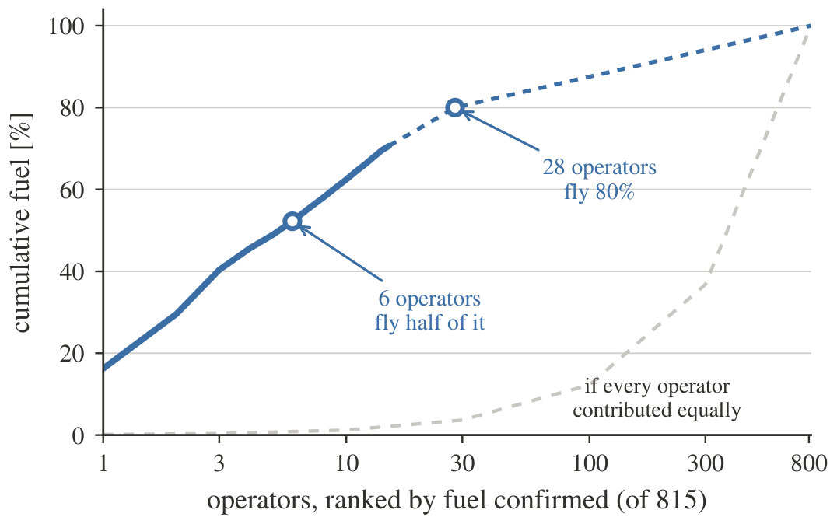
Where the value sits
Six of 815 airlines account for half of the confirmed fuel;
28 account for four-fifths.

Slide 26
How the ageing test works
01 Shift the whole design back one year — Train through October 2025 instead of February 2026
02 Freeze everything at the cutoff — Same threshold, same calibration — no peeking at 2026 data
03 Score month by month, unmodified — January through June 2026, one month at a time
04 Compare to the fresh model on the same months — Isolates pure ageing — precision barely moves, as the next chart shows
The result: precision holds at 77-79% even six months out.

Slide 27
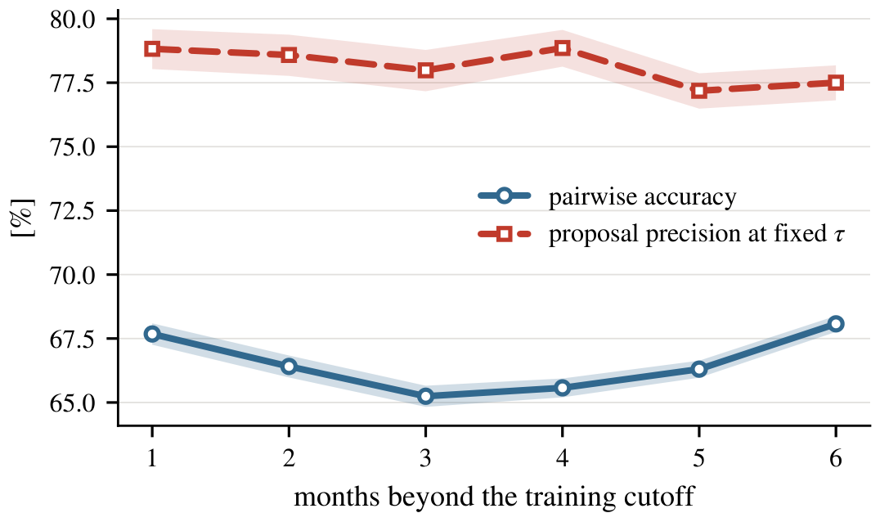
How fast does the model age?
Precision holds steady (77-79%) six months on; it simply proposes less. Retraining recovers the 1-3 points that drift costs.

Slide 28
Open questions and limitations
The model learns from what airlines did, not what they would say they prefer
Only flights that changed are observed; those that stayed are not
Every fuel figure is planned fuel, not fuel actually burned
Cases where a better route was never proposed are invisible to this data
A suggestion is only as reliable as the traffic picture it is computed against

Slide 29
Deployed and serving
01 Registered and version-controlled — MLflow Model Registry, Unity Catalog, on MUAC's Databricks workspace
02 Live REST endpoint — Scores real candidate route sets on request; scales to zero when idle
03 Ready for the next step — A live shadow-mode trial is what would confirm real-world acceptance
The scoring system is live today — the next step is a trial in front of real dispatchers.

Slide 30
Where the full analysis is documented
SESAR Innovation Days 2026
Transportation Research
Part C
Presented
Conference-length version
In preparation
Full results and limitations

Slide 31
Questions?
EUROCONTROL Innovation Hub · Maastricht Upper Area Control Centre

