Slide 1

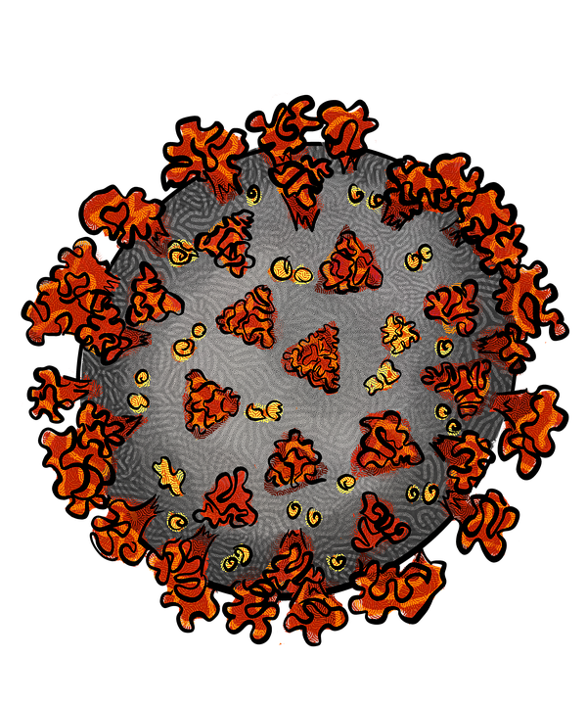
A
COVID-19 CASES
C
STACKING FRAMEWORK
Raw data of each Brazilian state
Split
Training set
Test set
System Inputs and Outputs
Base-learners Layer-0
RF
CUBIST
RIDGE
SVR
B
GENERAL APPROACHES
ARIMA
Base-learners Predictions
Meta-learner Layer-1
GP
System Inputs
RIDGE
Stacking
Meta-learner Prediction
CUBIST
SVR
Performance metrics
MAE
sMAPE
IP
RF

