Slide 1

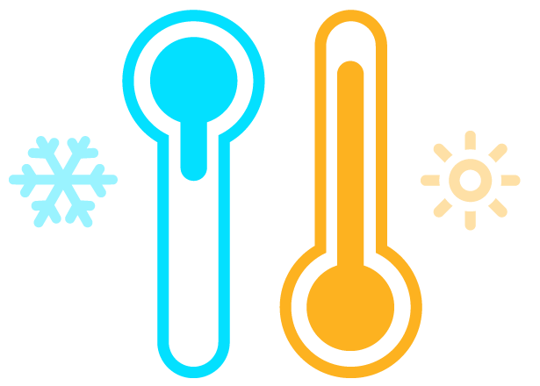
1
Climatic variables
2
General approaches
KNN
SVR
BRNN
QRF
CUBIST
VMD
3
Hybrid Model Flowchart
IMF predictions
IMF₁, IMF₂, IMF₃, IMF₄, and IMF₅
BRNN
VMD-BRNN VMD-CUBIST
VMD-KNN
VMD-QRF
VMD-SVR
Climatic variables
CUBIST
IP
COVID-19 cases
KNN
Raw data of Brazil / USA states
∑
VMD
sMAPE
QRF
SVR
RRMSE
Decomposition phase
Training and Integration phase
Performance Metrics

