Slide 1
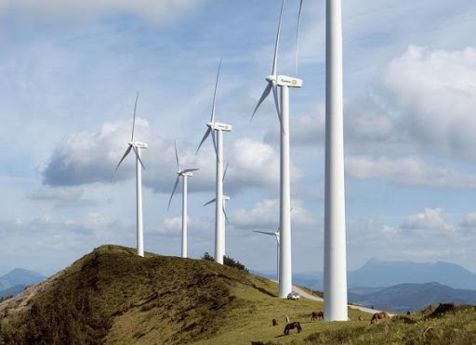

1
General approaches
2
Wind energy forecasting
VMD
BRNN
CUBIST
SVR
3
Hybrid Model Flowchart
Exogenous inputs
IMF predictions
VMD-BRNN VMD-CUBIST
VMD-SVR
IMF₁, IMF₂, IMF₃, IMF₄, and IMF₅
BRNN
IP
Wind power generation
Wind turbine data
∑
VMD
CUBIST
sMAPE
SVR
RRMSE
Decomposition phase
Training and Integration phase
Performance Metrics

