Slide 1
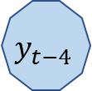
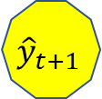
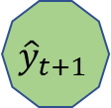
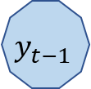
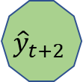

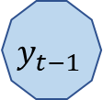

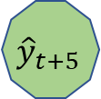
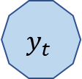
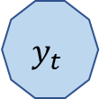
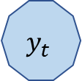
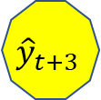
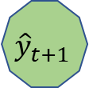
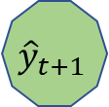
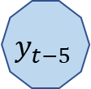
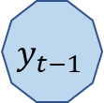
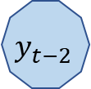
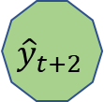



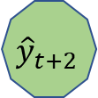

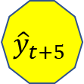

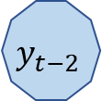

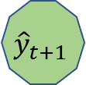

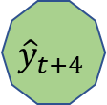

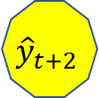
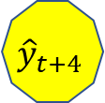



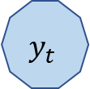



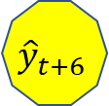
$$y_{t−5}$$
$$y_{t−4}$$
$$y_{t−3}$$
$$y_{t−2}$$
$$y_{t−1}$$
$$y_{t}$$
Time series .................
$$y_{t−4}$$
$$y_{t−3}$$
$$y_{t−2}$$
$$y_{t−1}$$
$$y_{t}$$
$${\hat{y}}_{t+1}$$
Forecasting 1-step-ahead ........
$$y_{t−3}$$
$$y_{t−2}$$
$$y_{t−1}$$
$$y_{t}$$
$${\hat{y}}_{t+1}$$
$${\hat{y}}_{t+2}$$
Forecasting 2-steps-ahead ...................
$$y_{t−2}$$
$$y_{t−1}$$
$$y_{t}$$
$${\hat{y}}_{t+1}$$
$${\hat{y}}_{t+2}$$
$${\hat{y}}_{t+3}$$
$$y_{t−1}$$
$$y_{t}$$
$${\hat{y}}_{t+1}$$
$${\hat{y}}_{t+2}$$
$${\hat{y}}_{t+3}$$
$${\hat{y}}_{t+4}$$
...
$$y_{t}$$
$${\hat{y}}_{t+1}$$
$${\hat{y}}_{t+2}$$
$${\hat{y}}_{t+3}$$
$${\hat{y}}_{t+4}$$
$${\hat{y}}_{t+5}$$
$${\hat{y}}_{t+1}$$
$${\hat{y}}_{t+2}$$
$${\hat{y}}_{t+3}$$
$${\hat{y}}_{t+4}$$
$${\hat{y}}_{t+5}$$
$${\hat{y}}_{t+6}$$
Forecasting 6-steps-ahead .................................................................

